Slide 1
Restaurant Franchisee Management System
Team members:
Mukund Ladani (202003039)
Kashyap Halavadia (202003040)

Slide 2
Functional Requirements
There is a network of franchisee restaurants and company-owned (self - owned) restaurants across the Gujarat. We need to store all the relevant details of each of this restaurant branches.
Each branch has several employees working in it , each employee will have EID,Name, address, etc details , you also need to keep track whether an employee is working in a franchisee-owned branch or company-owned.
We also need to store all the details of the franchisee companies like their CIN no,address and their contact details , which branches they are controlling ,etc.
Also we need to keep record that from which suppliers each of the branch is taking raw materials and at which rate .
Link to Lab2

Slide 3
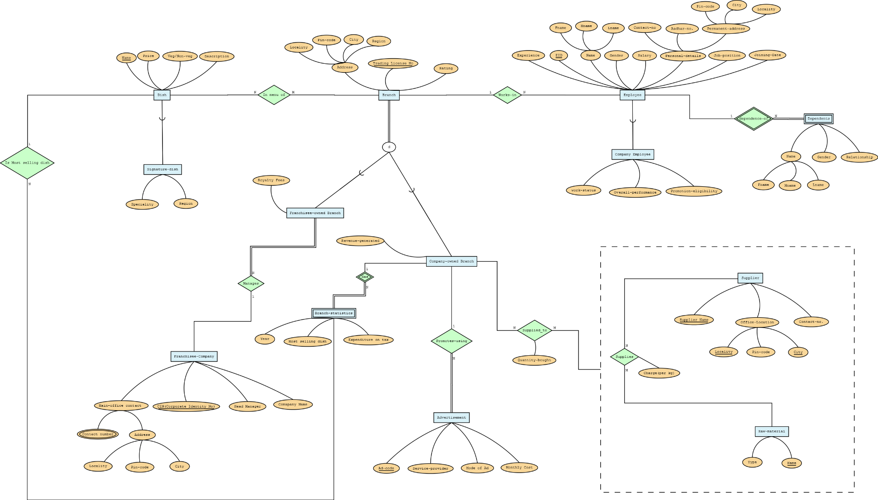
HAMBURGER....
ER Model
Link to Lab3

Slide 4
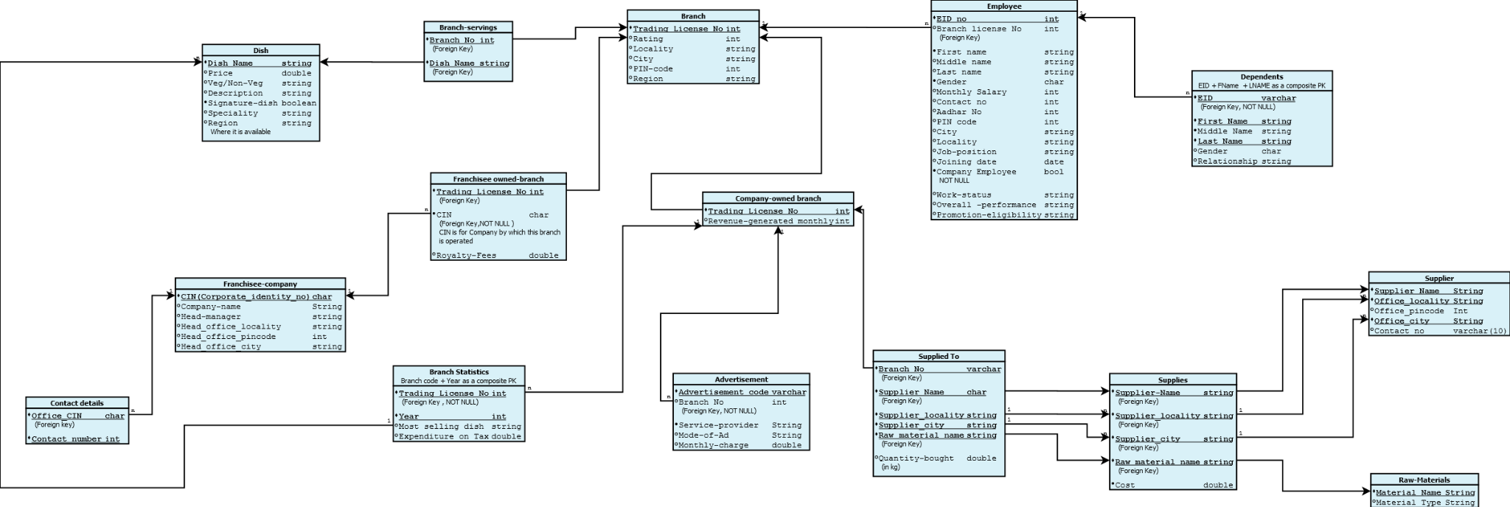
Relational Model
Link to Lab4

Slide 5
SQL DDL
create table branch(
Trading_license_no decimal(6,0) check(Trading_license_no>99999 and
Trading_license_no<1000000) primary key,
Rating int check(Rating>0 and Rating<=5),
Locality varchar(15) not null,
PIN_code decimal(6,0) check(PIN_code>99999 and PIN_code<1000000)
not null,
City varchar(20) not null,
Region varchar(12) not null
);
create table contact_details (
office_cin char(21) references franchiseecompany(cin) on update cascade on
delete cascade,
contact_no decimal(10,0) check(contact_no>999999999 and
contact_no<10000000000),
primary key(office_cin,contact_no)
);
Link to Lab5

Slide 6
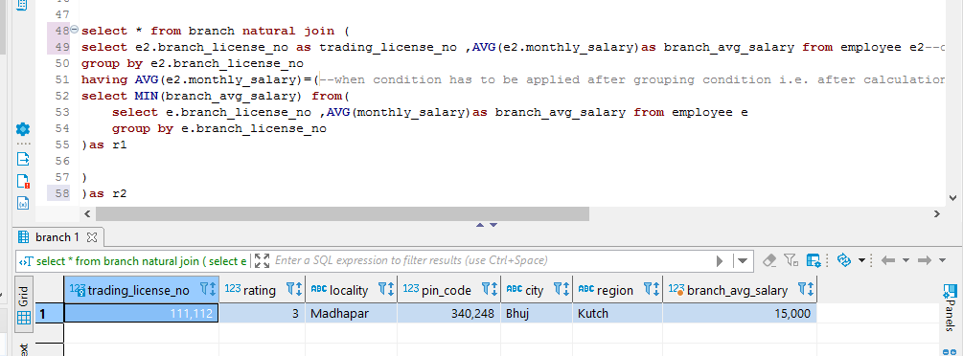
HAMBURGER....
SQl Queries
List the branch details of the branch which has the lowest average salary for its employees.
select * from branch natural join (
select e2.branch_license_no as trading_license_no ,AVG(e2.monthly_salary)as branch_avg_salary
from employee e2
group by e2.branch_license_no
having AVG(e2.monthly_salary) =
(
select MIN(branch_avg_salary) from
(
select e.branch_license_no ,AVG(monthly_salary)as branch_avg_salary from employee e
group by e.branch_license_no
)as r1
)
)as r2
Link to Lab10(Query_No3)

Slide 7
HAMBURGER....
SQl Queries
2) List all the suppliers which supply all the raw materials.
select r3.supplier_name,r3.supplier_office_locality,r3.supplier_office_city,contact_no
from supplier s3 join (--instead of join we could also have done IN(nested query)
select supplier_name,supplier_office_locality,supplier_office_city
from supplies as s
except(--for using except the column names should be same in both the relations
select supplier_name,supplier_office_locality,supplier_office_city from (
select s2.supplier_name,s2.supplier_office_locality,s2.supplier_office_city,rm.material_name
from supplies as s2 cross join raw_material rm
except--during set operations the attribute name will be of relation r1
select supplier_name,supplier_office_locality,supplier_office_city,raw_material_name
from supplies
) as r2
)
)as r3 on(s3.supplier_name=r3.supplier_name and s3.office_locality=r3.supplier_office_locality and s3.office_city=r3.supplier_office_city )
Link to Lab10(Query_No6)

Slide 8
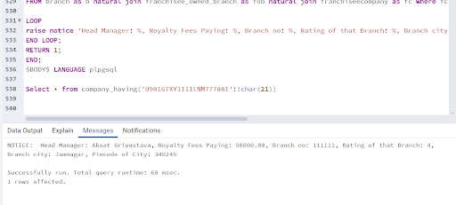
Stored Procedure
Create a procedure for getting the details of the franchisee company whose cin number is passed as an argument in the stored procedure.
CREATE or REPLACE FUNCTION company_having(ccin char(21)) RETURNS integer AS $BODY$
DECLARE
r record;
BEGIN
FOR r IN SELECT head_manager,royalty_fees,b.trading_license_no,rating,city,pin_code FROM branch as b natural join franchisee_owned_branch as fob natural join franchiseecompany as fc where fc.cin=ccin
LOOP r
aise notice 'Head Manager: %, Royalty Fees Paying: %, Branch no: %, Rating of that Branch: %, Branch city: %, Pincode of City: %', r.head_manager,r.royalty_fees,r.trading_license_no,r.rating,r.city,r.pin_code;
END LOOP;
RETURN 1;
END;
$BODY$ LANGUAGE plpgsql
Link to Lab11( Procedure_No1 )

Slide 9
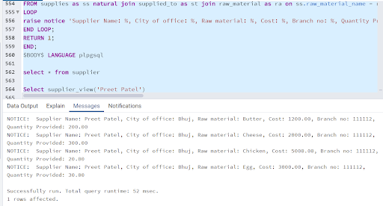
Stored Procedure
Create a procedure for getting the details of the supplier, supplying which raw-materials at which cost and amount to which branch whose name is passed as an argument in the stored procedure.
CREATE or REPLACE FUNCTION supplier_view(name varchar(20))
RETURNS integer AS $BODY$
DECLARE
r record;
BEGIN
FOR r IN SELECT ss.supplier_name,sr.office_city,ss.raw_material_name,ss.cost,st.branch_no,st.quantity_bought
FROM supplies as ss natural join supplied_to as st join raw_material as ra on ss.raw_material_name = ra.material_name join supplier as sr on (ss.supplier_name = sr.supplier_name and ss.supplier_office_locality = sr.office_locality and ss.supplier_office_city=sr.office_city ) where sr.supplier_name='Preet Patel'
LOOP
raise notice 'Supplier Name: %, City of office: %, Raw material: %, Cost: %, Branch no: %, Quantity Provided: %', r.supplier_name,r.office_city,r.raw_material_name,r.cost,r.branch_no,r.quantity_bought;
END LOOP;
RETURN 1;
END;
$BODY$ LANGUAGE plpgsql
Link to Lab11( Procedure_No5 )

Slide 10
Triggers
For ensuring that the two subtypes i.e.(company-owned branch and franchisee-owned branch) of the branch relation are following disjoint total -participation IS-A relationship constraint, we need to have a trigger on the franchisee-owned branch and company-owned branch table to ensure while insertion of a branch in any of these tables(company-owned branch and franchisee-owned branch) , that branch is present in only one one of these tables i.e. insertion will not be allowed in franchisee-owned branch if that branch is already present in the company-owned branch table.
Link to Lab11(Trigger_No1)

Slide 11
Triggers
In the advertisement table , the ad_code is of specific format , it is a 5 letter alpha-numeric number whose first two letters should be alphabets denoting mode of ads and the last three letters will be integers. So we need to check before a tuple is inserted in the advertisement table that if it is valid or not .Insertion will be allowed only if it is valid.This can be implemented using triggers.
Link to Lab11(Trigger_No5)

Slide 12
Triggers
Create a special procedure so that each of the views of the individual branch menu becomes updatable. So that if one branch wants to add a particular dish in the menu from its own then that dish_name is automatically inserted in the dish (if not already present )relation and the dish_name and branch_no gets inserted in the branch_serving relation.
Link to Lab11(Trigger_No2)

Slide 13
JAVA CODE (JDBC API)
void updEmployeeSalary(Connection c)
{
PreparedStatement stmt = null;
String sql = "UPDATE restaurantfranchisee.employee SET monthly_salary = ? WHERE eid = ?";//'?' are parameters in the sql statement
try
{
stmt = c.prepareStatement(sql);
stmt.setBigDecimal(1, new BigDecimal(22000));//new BigDecimal()
stmt.setBigDecimal(2, new BigDecimal(1000000004));
int affectedRows = stmt.executeUpdate();
stmt.close();
System.out.println("Table Updated successfully: Rows Updated: " + affectedRows);
}
catch (Exception e)
{
e.printStackTrace();
System.err.println(e.getClass().getName()+": "+e.getMessage());
System.exit(0);
}
}
Link to JDBC_API_Code

Slide 14
Concluding Remarks
We have tried to implement all the features taught in the course in this project.
Especially in implementing triggers , queries and stored procedures we have kept in mind the business specific requirements of the restaurant franchisee management system.
Also there are some improvements that we can make in this project like adding some more tables and attributes like for recording expenditure and revenue of each of the branch for every year.
We learnt how a basic model of a database is designed from the very scratch by this project.
We also tried to implement some of the application specific constraints.

Slide 15
THANKYOU

