Slide 1
Plant Species Identification Using MobileNetV2 Transfer Learning
Student Name : N. Mukunda Rao
Roll Number : 160124771051
Class And Section : AIDS - 1 , Semester 5

Slide 2




Introduction
Agricultural &
Educational Impact
Limitations of Manual ID
Manual identification needs experts and can be slow or inconsistent.
Plant identification supports crop management, research, and learning.
Role of Deep Learning
Project Approach
Neural networks learn visual features to automate species classification.
Use MobileNetV2 transfer learning to build a compact, accurate classifier.

Slide 3
Problem Statement
  Manual identification is time-consuming.
  Requires expert knowledge.
  Similar plants are difficult to distinguish.
  Lighting and backgrounds affect identification.
  Manual identification can cause errors.
  Need for a fast and user-friendly tool.
  Deep learning can automatically classify plants.
  Provides species prediction with confidence score.

Slide 4
DATASET
Dataset Overview
14 Plant Classes
  Mango
  Melon
  Orange
  Paddy
  Papaya
  Pineapple
  Watermelon
  Source: Plant Species Image Dataset
  Total Images: 9,800
  Number of Classes: 14
  Images per Class: 700
  Image Input Size: 224 × 224 pixels
  Aloe Vera
  Banana
  Coconut
  Corn
  Cucumber
  Ginger
  Guava
Dataset Preparation
  Images divided into training and validation sets
  Training Images: 7,840
  Validation Images: 1,960
  Data augmentation applied during training: Random Flip, Random Rotation, and Random Zoom

Slide 5

Objectives
1
Build classifier
Develop a deep-learning model for plant species recognition.
2
14-class classification
Distinguish among 14 plant species from images.
3
MobileNetV2 transfer
Leverage pretrained MobileNetV2 (ImageNet) to improve performance.
4
Prediction confidence
Provide confidence scores alongside class predictions.
5
Web integration
Deploy the trained model in a React + Flask web application.

Slide 6
WORKFLOW
1.Input
2.Preprocessing
3. Data Augmentation
upload plant image
Resize to 224×224
Random Flip, Rotation and Zoom
4.MoblieNetV2
5.classification
6.prediction
7.Output
pretrained MoblieNetV2
Dense layer, Dropout and SoftMax
Classify into 1 of 14 plant species
Plant Species + Confidence score

Slide 7
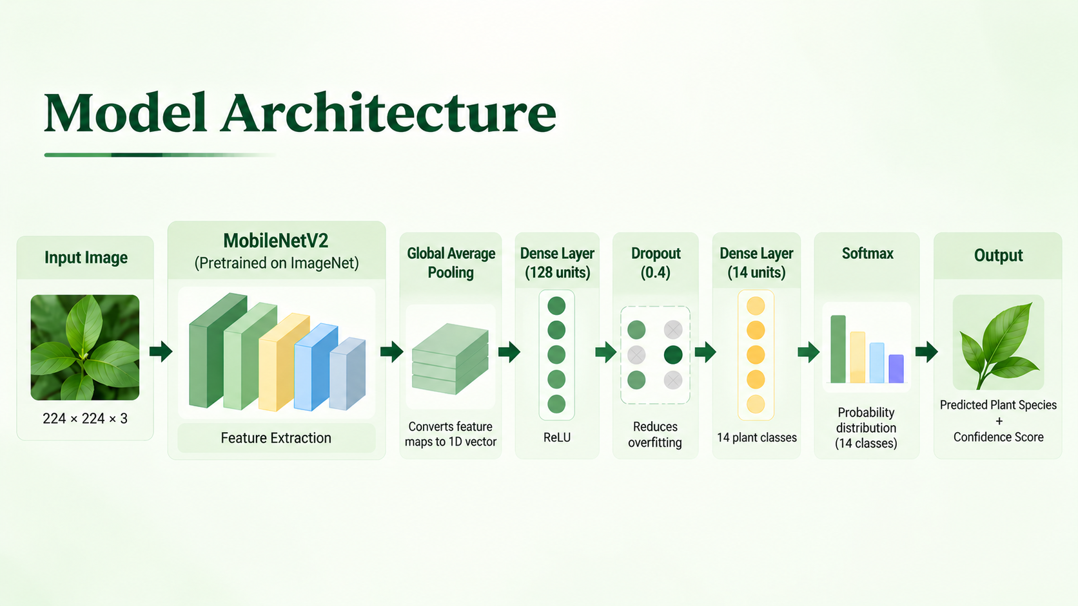

Slide 8
Tech Stack
Category | Technology
Language | Python, JavaScript
Deep Learning | TensorFlow, Keras, MobileNetV2
Image Processing | Pillow, NumPy
Frontend | React.js, HTML, CSS, JavaScript
Backend | Flask
Model | MobileNetV2 Transfer Learning
Deployment | Render

Slide 9
Limitations & Future Work
Limitations
Future Work
  Limited to 14 species
  Depends on dataset quality
  Sensitive to image quality
  Similar species may be confused
  Background can affect prediction
  Add more plant species
  Increase dataset size
  Improve model accuracy
  Add unknown-species detection
  Develop a mobile app

Slide 10


Results & Conclusion
Key Results
  14 plant species classified from images.
  Dataset: 9,800 images (700 per class).
  Best validation accuracy: 85.61%.
  Final validation accuracy: 85.15%.
Conclusion
Transfer learning with MobileNetV2 provides an effective, practical approach for plant species identification suitable for a simple web-based demo.

Slide 11
THANK YOU

