Slide 1

Case Study :
Supermarket Sales Data Analysis and Customer Insights Using R
Student Name: N. Mukunda Rao
Roll No : 160124771051
Course : Artificial Intelligence
and Data Science

Slide 2

Introduction
Supermarkets generate large volumes of transaction data containing information about customers, products, sales, payments, and ratings. Analyzing this data can help understand purchasing patterns and supermarket performance.
R will be used for data cleaning, analysis, visualization, and extracting useful insights.

Slide 3
Problem Statement
  Analyze supermarket sales and customer transaction data.
  Identify important sales and purchasing patterns.
  Compare performance across products, branches, and customers.
  Understand customer preferences and buying behavior.
  Use R to analyze the data and generate meaningful insights.

Slide 4
Objectives
01
02
Analyze overall supermarket sales
and revenue patterns.
Understand customer purchasing behavior based on customer type and gender.
03
04
Identify patterns across product lines, branches, cities, payment methods, and time.
Create meaningful visualizations and derive useful customer and business insights using R.

Slide 5
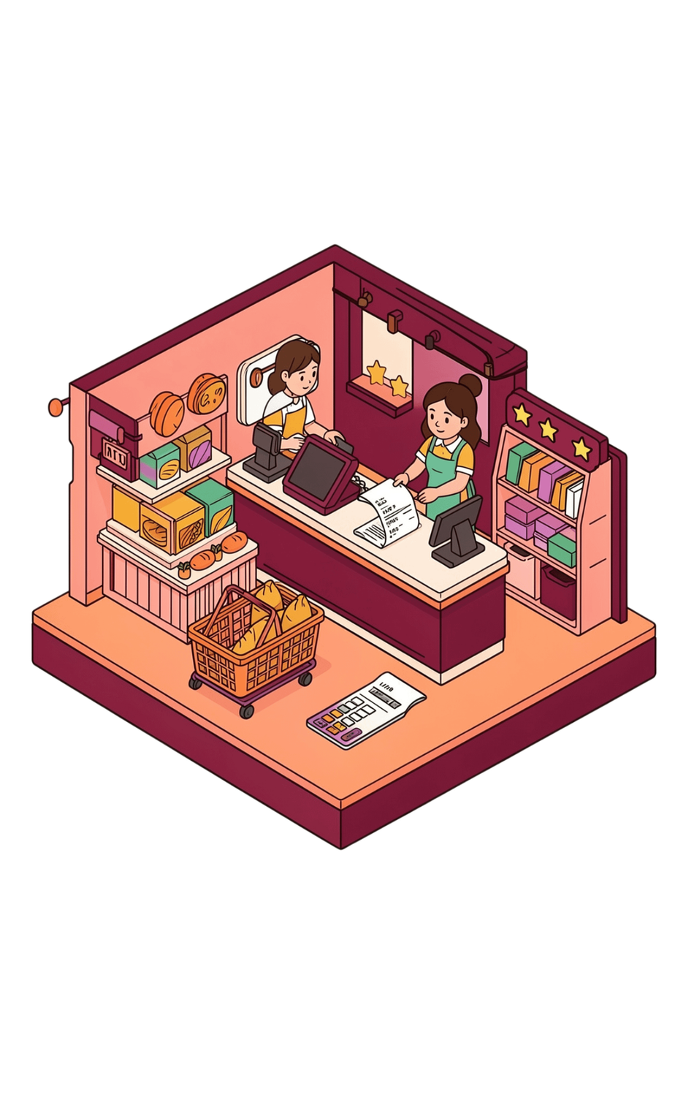

Dataset Description
Dataset: Supermarket Sales Dataset
Records: 1,000
Variables: 17
Type: Transaction-level supermarket sales data
Important variables
Branch · City · Customer Type · Gender · Product Line · Unit Price · Quantity · Tax · Total · Date · Time · Payment · COGS · Gross Income · Rating

Slide 6
Customer information
Product information
Why This Dataset?
Sales and revenue information
Branch and city information
The dataset contains multiple dimensions of supermarket transactions, including:
Therefore, it is suitable for studying both sales performance and customer insights.
Payment information
Date and time
Customer ratings

Slide 7

Proposed Methodology
  Data Collection
  Data Import into R
  Data Cleaning & Preprocessing
  Exploratory Data Analysis
  Statistical Analysis
  Data Visualization
  Customer & Sales Insights
  Prediction/Modeling
  Conclusion

Slide 8
Data Preparation
  Import dataset into R
  Check dataset structure
  Check missing values
  Check duplicate records
  Check incorrect/inconsistent values
  Convert variables to appropriate data types
  Handle date and time variables
  Prepare clean data for analysis

Slide 9
POSSIBLE MODELS FOR SALES & CUSTOMER ANALYSIS
Machine learning methods that can extend the analysis in R
01
02
03
LINEAR REGRESSION
DECISION TREE
K-MEANS CLUSTERING
Predict sales revenue using relevant transaction variables.
Explore which factors may influence sales outcomes.
Group customers with similar purchasing patterns.
Prediction
Interpretation
Segmentation
Note: These are proposed models; the current case study PPT does not report trained models or prediction results.

Slide 10






Planned Visualizations & Insights
Product-line sales → Bar Chart
Branch comparison → Bar Chart
Customer type comparison
→ Donut/Bar Chart
Gender analysis
→ Bar Chart
Sales over time
→ Line Chart
Quantity distribution → Histogram
Rating analysis
→ Box Plot
Payment method
→ Bar/Donut Chart

Slide 11
THANK YOU

