Slide 1




NEXT GEN EMPLOYABILITY PROGRAM
Creating a future-ready workforce
Team Members
College Name :Annai Mira College of Engineering and Technology
Student Name :MUKUNDHAN P
Student ID :au513521104029

Slide 2

CAPSTONE PROJECT SHOWCASE
Project Title
Building Bus Reservation System using Python and Django
Abstract | Problem Statement | Project Overview | Proposed Solution | Technology Used | Modelling & Results | Conclusion

Slide 3
Abstract
• Purpose : The project aims to develop a web-based platform that allows users to easily search for available bus routes, select seats, and make reservations online, providing a convenient and efficient way to plan and book bus travel.
• Features: The system will include features such as user authentication, bus management (including routes, schedules, and availability), a reservation system with seat selection and also cancelling the booked buses.
• Technology Stack: Built using Python and the Django web framework, the project utilizes Django’s built-in authentication system for user management , and integration with third-party payment gateways for secure transactions.
• Objective: By creating an intuitive and user-friendly interface, the project aims to streamline the bus reservation process , enhancing the overall experience for both passengers and bus operators while providing a robust and scalable solution for managing bus reservations online.
Source :

Slide 4
Problem Statement
• Inefficient Booking Process: Currently, there is a lack of efficient and user-friendly platforms for booking bus tickets online. Existing systems may suffer from complicated interfaces , limited availability information, or lack of integration with payment gateways, leading to frustration and inconvenience for users.
• Manual Management for Bus Operators: Bus operator soften rely on manual processes for managing routes, schedules, and reservations, leading to inefficiencies, errors, and difficulties in maintaining up-to-date information. There is a need for a centralized, automated system that enables bus operators to efficiently manage their services and improve overall operations.
• Lack of Real-Time Updates : Users may face challenges in obtaining real-time updates on bus availability, schedules, and reservations, resulting in uncertainty and inconvenience when planning their travel. A solution is required to provide accurate and timely information to users , enhancing their experience and facilitating smoother travel planning.
Source :

Slide 5
Project Overview
Booking Buses MadeEasy:We'recreatinga website where you can easily find and book bus tickets online. No more standing in long lines or struggling with confusing websites. Just a few clicks ,and you're all setforv your journey!
• Hassle-Free Travel Planning : vOur platform will let you check bus routes, pick your seats, and pay securely online. Say goodbye to last-minute worries about finding a seat or missing out on your preferred bus – we've got you covered!
• Convenient for Bus Operators Too: Bus operators will have an easy time managing their services with our system. They can update schedules, track bookings, and keep everything running smoothly ,making travel hassle-free foreveryone involved.
Source :

Slide 6
Proposed Solution
Our Project provides the solution to the problems in Bus Ticket Booking in a simplified and efficient way . Our web sitet contains the following features that will make the Bus Booking process very easier
• User-Friendly Interface: Develop a clean and intuitive user interface for the website, allowing users to easily search for bus routes, view available schedules , and select seats based on their preferences .The interface should be responsive and accessible across different devices.
• Comprehensive Bus Database: Create a comprehensive database to store information about buses,routes, schedules,seat availability, and pricing.This database will serve as the backbone of the system, enabling efficient retrieval and management of data.
• User Authentication and Profiles: Implement a user authentication system to allow users to create accounts, log in securely, and manage their profiles. Users should be able to view their booking history, update personal information,and manage preferences.
.
Source :

Slide 7
Bus Management Dashboard : Provide bus operators with a dedicated dashboard to manage their services. This dashboard will allow operators to add new buses, update routes and schedules , manage seat availability, and track bookings in real-time.
• Dynamic Seat Selection : Implement a dynamic seat selection feature that allows users to view and select available seats on the bus. Users should be able to see which seats are already booked and choose their preferred seating arrangement.
• Real-Time Availability Updates: Ensure that seat availability information is updated in real-time to provide users with accurate and up-to-date information. This will prevent overbooking and reduce the likelihood of conflicts during the reservation process.
• Secure Payment Integration: Integrate a secure payment gateway to facilitate online transactions for bus reservations . Users should be able to pay using various payment methods, such as credit/debit cards, mobile wallets, or net banking, with confidence in the security of their personal and financial information.
Source :

Slide 8


Technology Used
Front-end
Back-end
Source :

Slide 9
Modelling & Results
MODELLING: • Database Modeling:Utilize Django's ORMto design and implement
the database schema for the project. Define models for buses, routes, schedules, reservations, users, and any other relevant entities . Establish appropriate relationships between these models (such as one-to-man yor many-to-many) to accurately represent the data structure.
• User Interaction Modeling : Model the user interaction flow through wireframes or mock ups to visualize the user interface design. Consider the user journey from searching for bus routes to making a reservation and receiving confirmation. Iterate on the designs based on usability testing and feedback to optimize the user experience.
RESULTS: • User satisfaction on using our website .
• Easier way of booking the tickets in the easier and in the efficient way
Source :

Slide 10
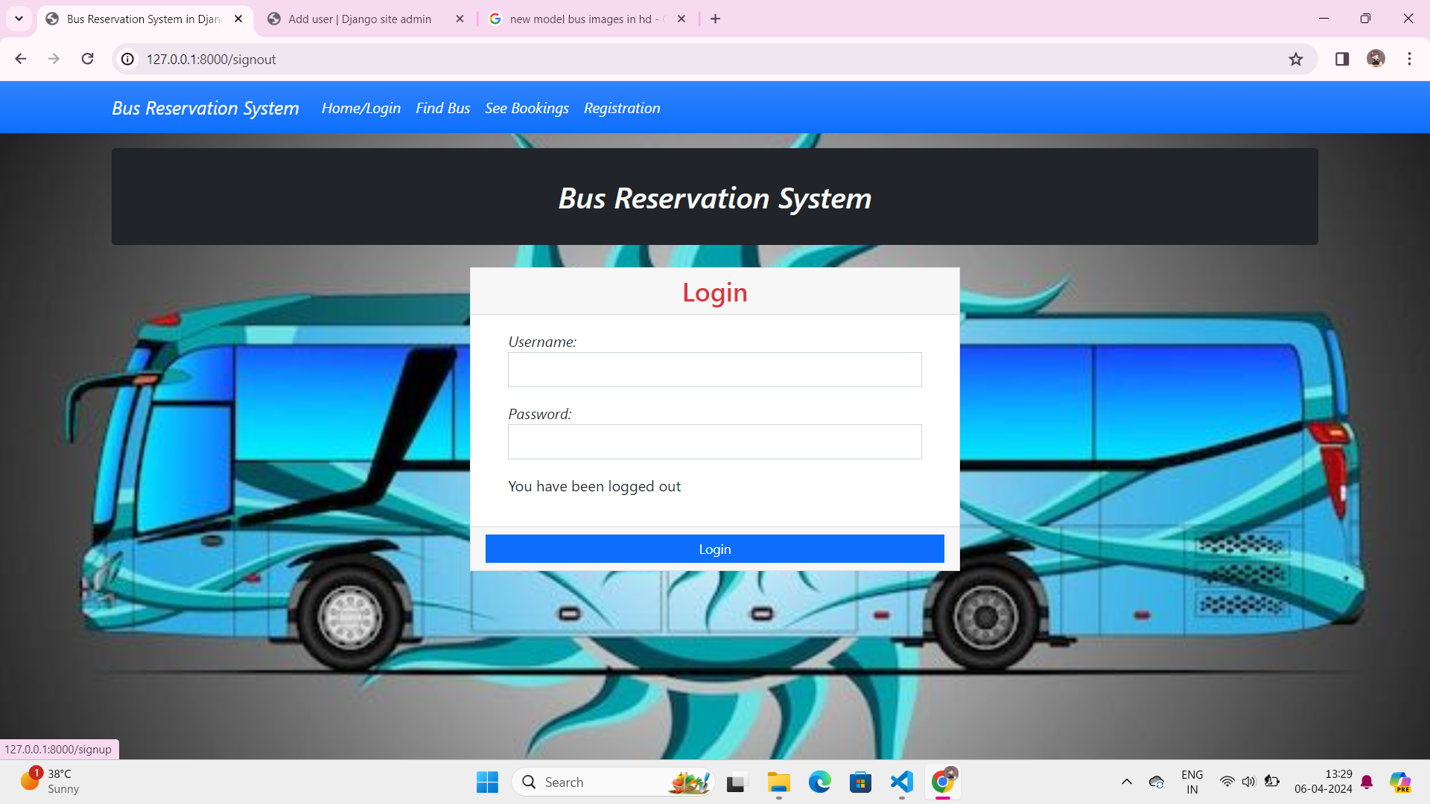
Homepage
The Home page consistsof a friendly interface and easiernavigation to all the pages like Find Bus , See Bookingsand Registrationpages .
● It provideseasy access so that all peoplecan use the website without any issues

Slide 11
About-Us-Page
• Provide a brief over view of the company's history, including its founding date, key milest ones,and the vision that drives its operations. Communicate the company's mission statement and core values, outlining its commitment to providing convenient, reliable, and affordable bus travel solutions to customers.
• Introduce the team behind the online bus reservation platform, including key members such as founders , developers , designers , and customer supportre presentatives . Share brief bios or profiles of team members, highlighting their expertise, passion for innovation, and dedication to delivering exceptional service to users.
• Showcase customer testimonials and success stories to demonstrate the positive impact of the platformon users' travel experiences. Highlight real-life examples of satisfied customers who have benefited from the convenience, ease of use, and reliability of the online bus reservation service. Include quotes, photos,or videos to add authenticity and credibility to the testimonials.

Slide 12
Service-Page
The About Us page contains the following informations
• Provide a brief overviewof the company'shistory, including its founding date, key milestones,and the vision that drives its operations. Communicate the company's mission statement and core values, outlining its commitment to providing convenient, reliable, and affordable bus travel solutions to customers.
• Introduce the team behind the online bus reservation platform, including key members such as founders,developers,designers,and customersupportrepresentatives.Share brief bios or profilesof team members, highlighting their expertise, passion for innovation, and dedication to delivering exceptionalserviceto users.
• Showcase customer testimonials and success stories to demonstrate the positive impact of the platformon users' travel experiences.Highlight real-life examplesof satisfiedcustomerswho have benefited from the convenience, ease of use, and reliability of the online bus reservation service. Includequotes, photos,or videos to add authenticity and credibility to the testimonials.

Slide 13
Departments-Page
The departments page contains the following informations
• Operational Departments Overview:Providean overview of the operational departments within the organization, such as the booking department,customer service department, and technical support department. Explain the role and responsibilities of each department in ensuring the smooth operation of the online bus reservation platform.
• Team Members and Roles:Highlight the team membersassociatedwith each department, along with their respectiveroles and areas of expertise.This could include department heads, managers, supervisors, and staff members responsible for executing day-to-day tasks and providing support to customersand stakeholders.
• Collaboration and Communication Channels:Describe how differentde partments collaborate and communicate with each other to achieve common goals and deliver exceptional service to customers. Highlight the communicationc hannels used, such as team meetings,project manage menttools, and internal messaging platforms ,to facilitate seamless coordination and information sharing acrossde partments.

Slide 14
Blog-Page
• MobileApp Development:Consider developing a mobile app version of the online bus reservation platformto cater to users who prefer to booktickets and manage reservations on their smartphones or tablets. The app could offer additional features suchas push notifications for bookingupdates,GPS tracking of buses in real-time, and seamless integration with mobile payment options for enhanced convenience and accessibility.
• Advanced Analytics and Personalization: Implement advanced analytics and machine learning algorithms to analyze user behavior, preferences, and booking patterns. Use this data to personalize the user experience by offering targeted recommendations , customized promotions,and tailored travel suggestions basedon individual preferences and past booking history. This could help increase user engagement,loyalty, and conversionrates on the platform.

Slide 15
Future Enhancements:
• MobileAppDevelopment:Consider developinga mobileapp version of the online bus reservation platformto cater to users who preferto book tickets and manage reservations on their smartphones or tablets. The app could offer additional features such as push notifications for booking updates,GPS tracking of buses in real-time, and seamless integration with mobile payment options for enhanced convenience and accessibility
. • Advanced Analytics and Personalization: Implement advanced analytics and machine learning algorithms to analyze user behavior, preferences, and booking patterns. Use this data to personalize the user experience by offering targeted recommendations , customized promotions,and tailored travel suggestions basedon individual preferences and past booking history. This could help increase user engagement,loyalty, and conversi on rates on the platform

Slide 16
Conclusion
Achievements and Milestones : Reflectonthe achievements and milestones reached throughout the project development lifecycle. Highlight key accomplishments, such as the success full implementation of core features, integration with payment gateways, and deployment to a production environment.
• User Feedback and Impact: Discuss the feedback received from users during beta testing or post-launch surveys . Summarize the overall user experience and satisfaction with the platform, including any areas for improvement identifiedc by users . Additionally, analyze the impact of the project on facilitating convenient and efficient bus travel booking for users
Source :

Slide 17
Thank You!
Notes:
Thank You !!

