Slide 1
OpenAiMul.c
Bailey Tucker 24744334
Two n-limb integers in. 2n-limb product out.
Same contract as GMP mpn_mul_n.
About 4 minutes.

Slide 2
The paper, and this file
Preprint: 23 September 2026.
Tape bound: kappa = 2^(-182).
That machine uses schoolbook past a cutoff we cannot store.
log2(n) would have to pass 2^(2^75).
The timed function is a 16-bit digit convolution.

Slide 3
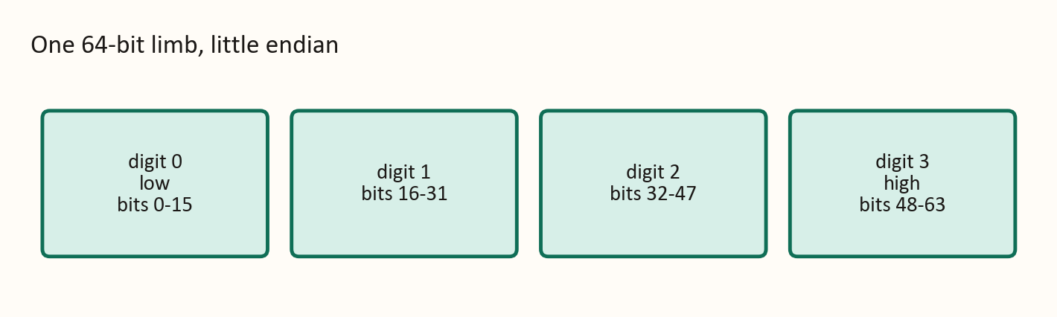
One limb, four digits
Low digit is bits 0 to 15. Carry later moves in base 2^16.

Slide 4
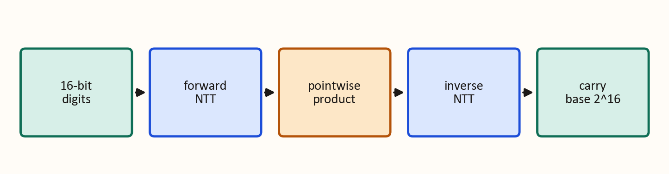
What one call does
Length of the transform is at least twice the digit count.

Slide 5
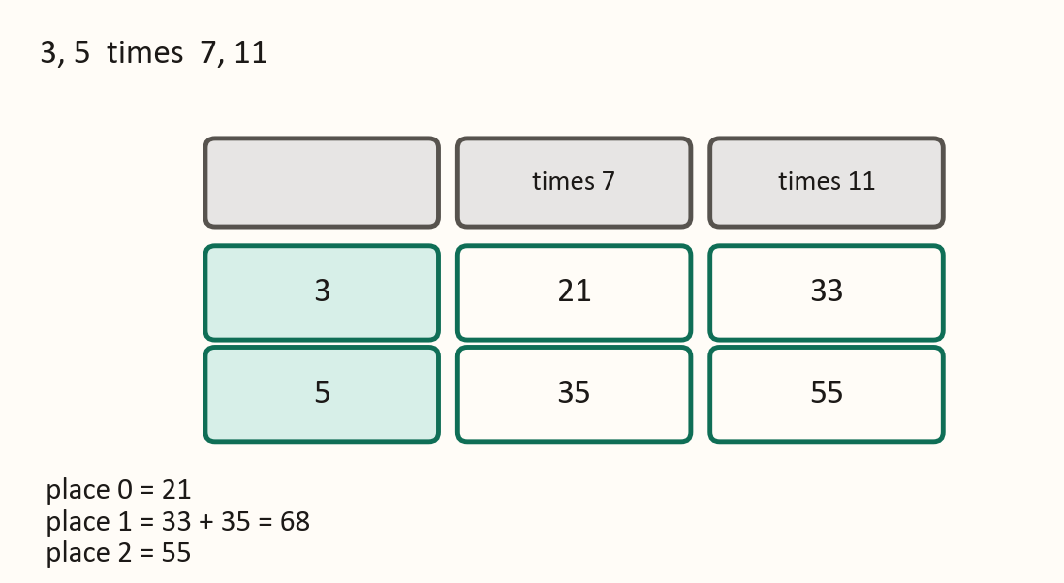
A product you can check by hand
21 + 68 x 2^16 + 55 x 2^32. No carry in this example.

Slide 6
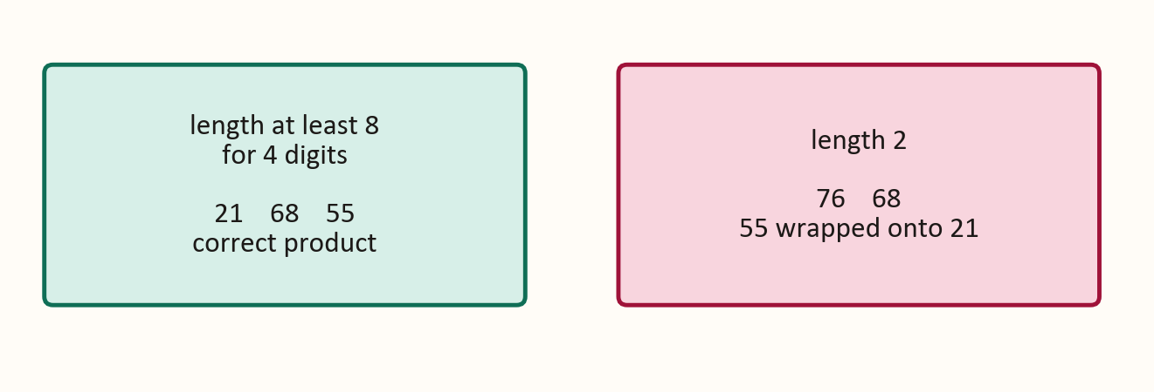
Length 2 writes a different integer
76 is 21 + 55. The carry cannot move the 55 back.

Slide 7
The invariant
After the inverse transform, bucket k holds the digit products for shift k.
Nothing from a higher shift has wrapped in.
The sum is smaller than the modulus, so it has not wrapped modulo P.
The inverse step also divides by the length.
Without that scale, every coefficient is too big by the length.

Slide 8
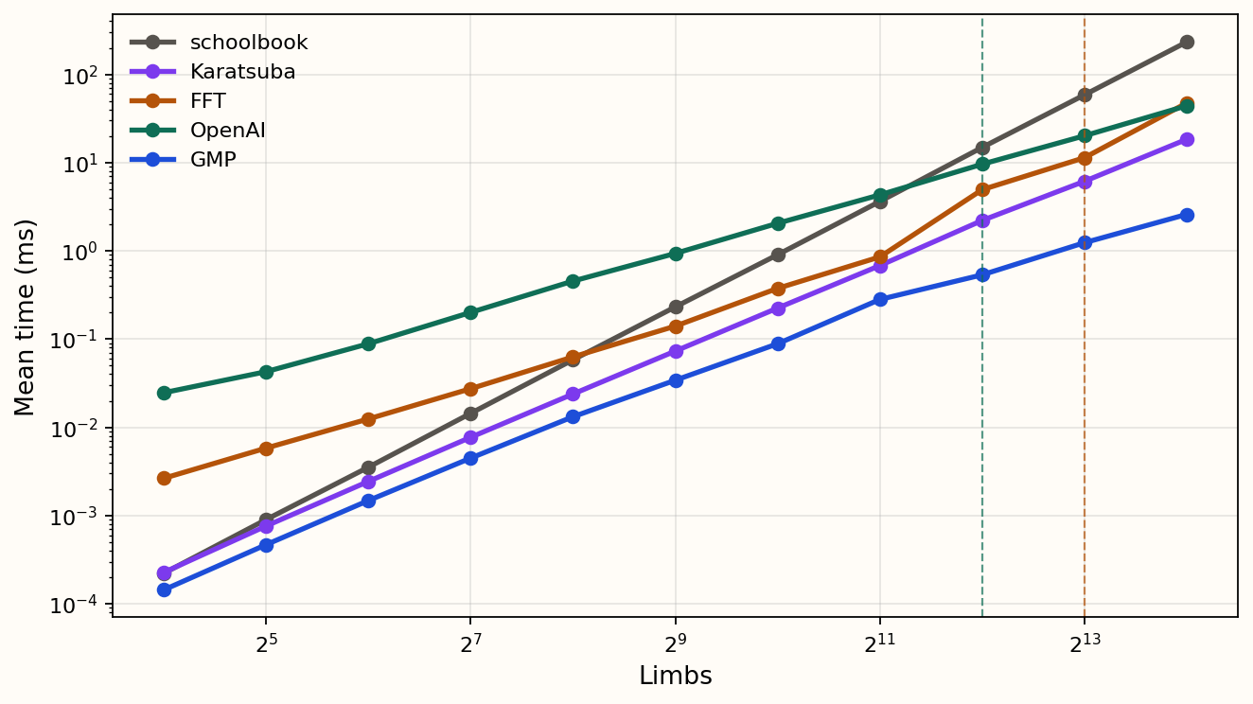
Harness times, through 16,384 limbs
Same run, after Karatsuba was merged. Dashed lines mark 4,096 and 8,192 limbs.

Slide 9
Where mine is faster
GMP is fastest on every row. At 16,384 limbs it is about 17 times faster than mine.
Karatsuba is faster than mine at every size in this table.
I pass schoolbook at 4,096 limbs: 9.6 ms against 14.9 ms.
I am still behind schoolbook at 2,048 limbs: 4.3 ms against 3.6 ms.
I am still behind the FFT at 8,192 limbs: 20.1 ms against 11.4 ms.
At 16,384 limbs I edge the FFT: 44.1 ms against 47.5 ms. Karatsuba is 18.4 ms. GMP is 2.6 ms.

Slide 10
Why the FFT falls behind, and what is next
Above 2,048 limbs the FFT uses 8-bit digits, so its transform is longer.
Mine stays on 16-bit digits. On this run I only edge it at 16,384 limbs.
Karatsuba is faster than both of those at that size.
Next: build the twiddle powers in setup, outside the timer.
A larger n on this file will not catch GMP.

