Slide 1
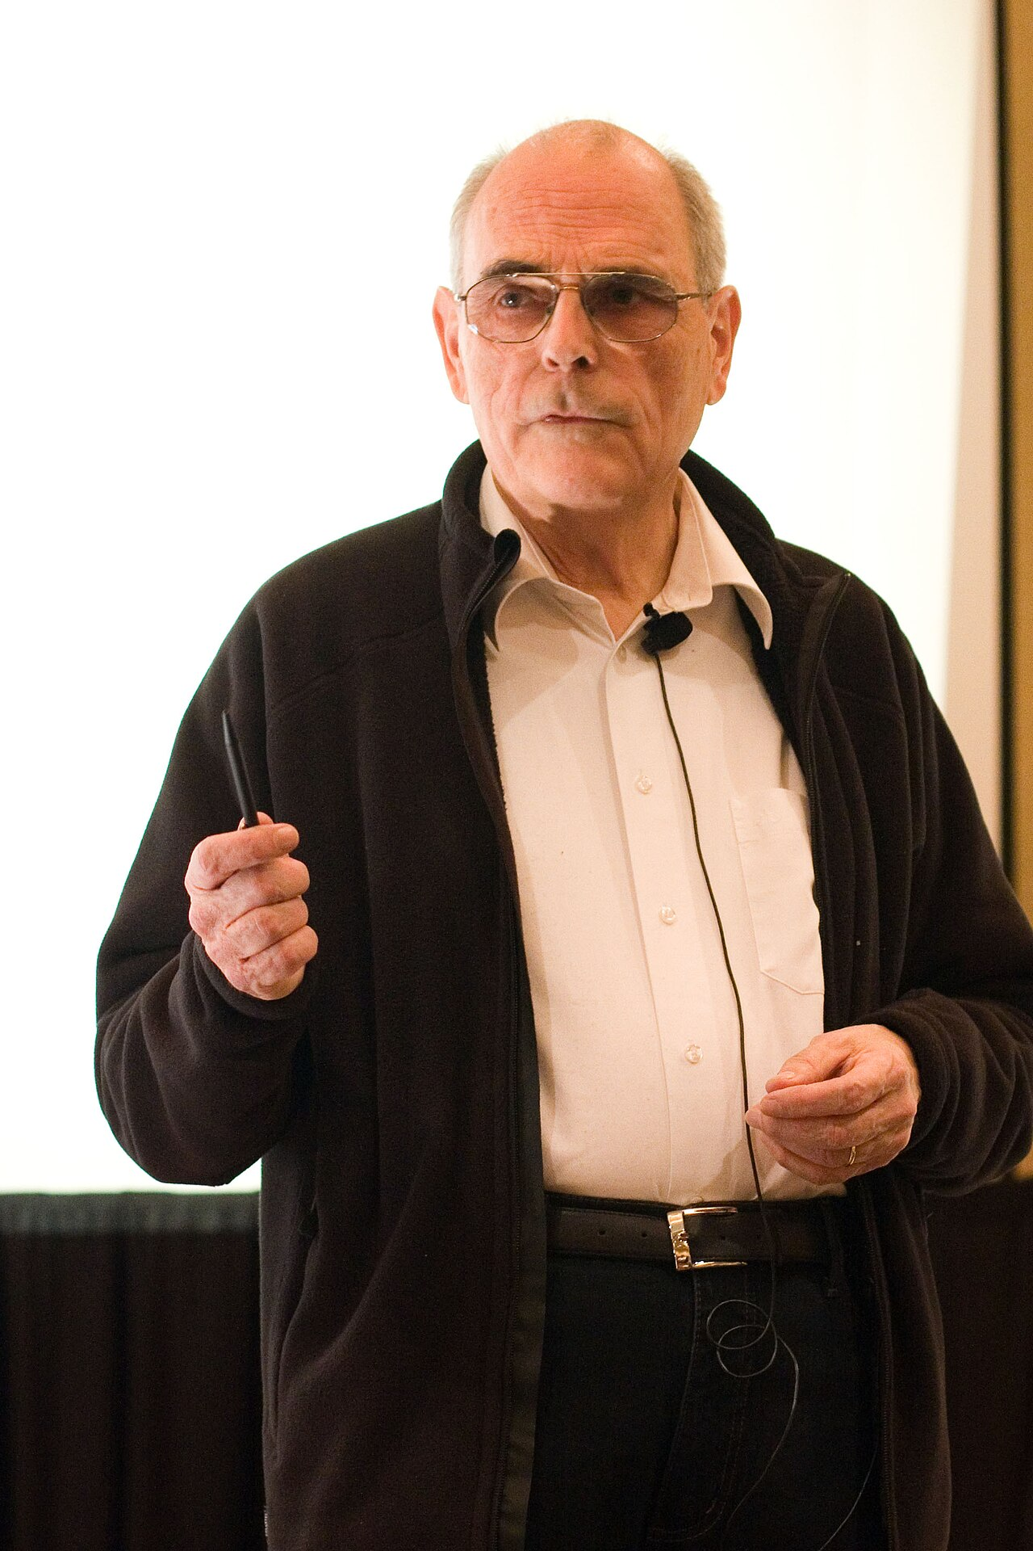
Strassen's Algorithm
- Fast matrix multiplication
- Volker Strassen, 1969
- "Gaussian elimination is not optimal"
Volker Strassen
Notes:
IMAGE: Photo of Volker Strassen at his Knuth Prize lecture (David Eppstein, CC BY-SA 3.0, Wikimedia Commons: File:Strassen_Knuth_Prize_lecture.jpg).
Open with the hook: everyone assumed you needed n³ multiplications until 1969.

Slide 2
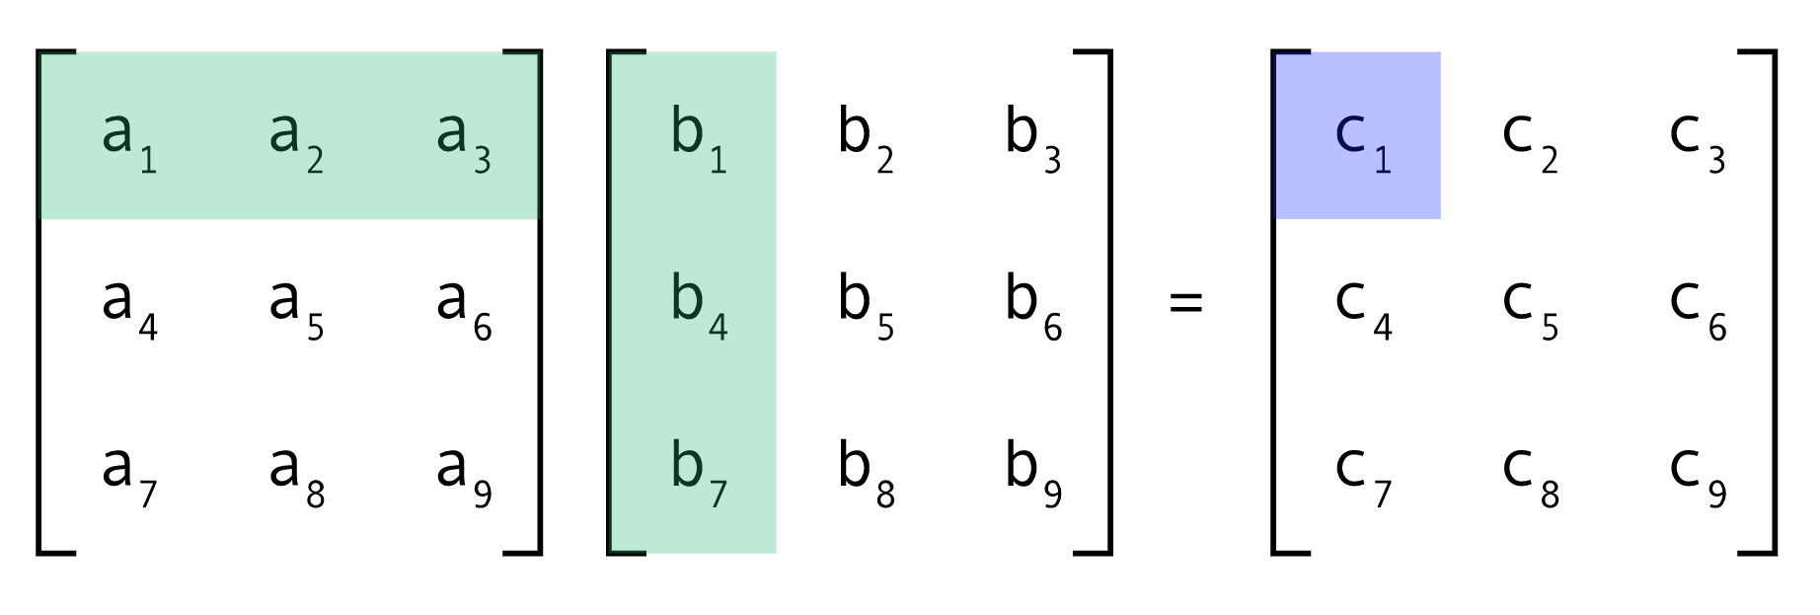
The problem
C[i][j] = sum(A[i][k] · B[k][j])
n² entries in C, each needs n multiplications -> n³ multiplications
Used everywhere: neural networks, graphics, solving linear systems, graph algorithms
n | Classical n³ multiplications
2 | 8
10 | 1,000
100 | 1,000,000
1,024 | 1,073,741,824
Notes:
IMAGE: left, native table showing the n³ triple-loop count; right, text on where matrix multiplication is used (graphics, ML, solving linear systems, graph algorithms).
Say: C[i,j] = sum over k of A[i,k]*B[k,j]. n² outputs, each is n multiplies -> n³.

Slide 3
Divide and conquer
A11
A12
B11
B12
C11
C12
=
x
A21
A22
B21
B22
C21
C22
C₁₁ = A₁₁B₁₁ + A₁₂B₂₁
C₁₂ = A₁₁B₁₂ + A₁₂B₂₂
C₂₁ = A₂₁B₁₁ + A₂₂B₂₁
C₂₂ = A₂₁B₁₂ + A₂₂B₂₂
8 smaller multiplications -> still n³
Additions are cheap (n² work)
Each block is (n/2 x n/2)
Naive recursion: 8 block products
T(n) = 8T(n/2) + Theta(n²) = Theta(n³)
Notes:
IMAGE: native shapes - three 2x2 block grids (A, B, C) drawn in PowerPoint with the blocks colour-coded: A11 blue, A12 orange, A21 green, A22 purple (same for B and C).
Split each matrix into four n/2 x n/2 blocks. The obvious recursion needs 8 block multiplications -> T(n)=8T(n/2)+O(n^2) = O(n^3). No gain.

Slide 4
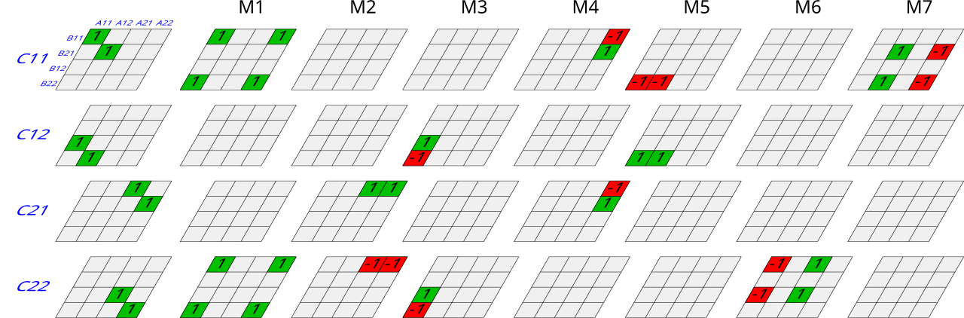
Seven products instead of Eight
M₁ = (A₁₁ + A₂₂)(B₁₁ + B₂₂)
M₂ = (A₂₁ + A₂₂) B₁₁
M₃ = A₁₁ (B₁₂ − B₂₂)
M₄ = A₂₂ (B₂₁ − B₁₁)
M₅ = (A₁₁ + A₁₂) B₂₂
M₆ = (A₂₁ − A₁₁)(B₁₁ + B₁₂)
M₇ = (A₁₂ − A₂₂)(B₂₁ + B₂₂)
C₁₁ = M₁ + M₄ − M₅ + M₇ C₁₂ = M₃ + M₅ C₂₁ = M₂ + M₄ C₂₂ = M₁ − M₂ + M₃ + M₆
Notes:
IMAGE: Strassen_algorithm.svg (Cyp, CC BY-SA 3.0, Wikimedia Commons). Left column = the 8 products of the naive method, columns M1..M7 = Strassen's seven; summing the coloured columns reproduces the left column.
Read the seven products, then the four recombinations. Cue the manim animation to show WHY the combos cancel.

Slide 5
Why the complexity is n^log₂7
T(n) = 7 x T(n/2) + Theta(n²)
Master theorem: a = 7, b = 2, n^log₂7 approx. = n^2.807 > n²
Level k | Subproblems 7ᵏ | Block size n/2ᵏ | Extra work per recurse
0 | 1 | n | n²
1 | 7 | n/2 | 7/4 x n²
2 | 49 | n/4 | (7/4)² x n²
log₂ n | 7^log₂n = n^log₂7 | 1 | (7/4)^log₂n x n² = n^log₂7
Notes:
IMAGE: native table of the recursion tree level by level (no external image).
Level k has 7^k subproblems each of size n/2^k. Multiplication work only appears at the leaves: 7^(log2 n) = n^(log2 7). Addition work per level is 7^k (n/2^k)² = n² (7/4)^k, a growing geometric series dominated by the last level, so additions never change the exponent.

Slide 6
Classical vs Strassen
n | Classical | Strassen 7^log₂n | Ratio
16 | 4096 | 2401 | 1.7x
256 | 16777216 | 5764801 | 2.9x
1024 | 1073741824 | 282475249 | 3.8x
8192 | 5.5 x 10¹¹ | 9.7 x 10¹⁰ | 5.7x
Recurrence only counts multiplications at full depth. Real implementations stop early (see the code) and switch to classical multiplication below a threshold.
Segment 5 - Complexity
Notes:
IMAGE: native comparison table. Computed values: n³ vs 7^log2(n) for n powers of two. Emphasise the gap grows without bound but only pays off once n is large enough to amortise the extra additions.

Slide 7
Constraints and practical limits
WHEN IT APPLIES
- Needs subtraction: any ring (ints, reals, mod p) NOT for boolean
- Squares of size 2ᵏ otherwise pad with zeros
- Exact over integers; rounding error only matters with floats
PRACTICAL LIMITS
- 18 extra block additions per level: slower for small n
- Extra memory: temporaries, padding up to 4x elements
- Cache and vectorised BLAS favour classical code
- Break-even: roughly n = 500-1000+
- (Huang et al. 2016 saw 20% gains at n=512)
Notes:
IMAGE: two-column text slide (valid vs limits); no external image.
Validity: needs a ring (subtraction). Fails for Boolean and min-plus semirings. Square power-of-two by padding. Exact for integers; floats lose some stability.

Slide 8
Extra research: numerical stability
 | Classical | Strassen
Error bound | Componentwise | Normwise only
Badly scaled rows/cols | Handled well | Can lose accuracy
Growth with depth | None | Constant grows with recursion levels
Theory (Demmel et al. 2007) | Stable | Stable in the normwise sense
Mitigations: stop recursing early and scale rows/columns before multiplying
Notes:
IMAGE: native table of error-bound comparison.
Classical multiplication has a componentwise error bound; Strassen's is only normwise (Higham; Webb Miller 1975). Demmel, Dumitriu, Holtz and Kleinberg proved that fast matrix multiplication algorithms are 'stable' in a normwise sense, so the loss is a worse constant, not a catastrophe.

Slide 9
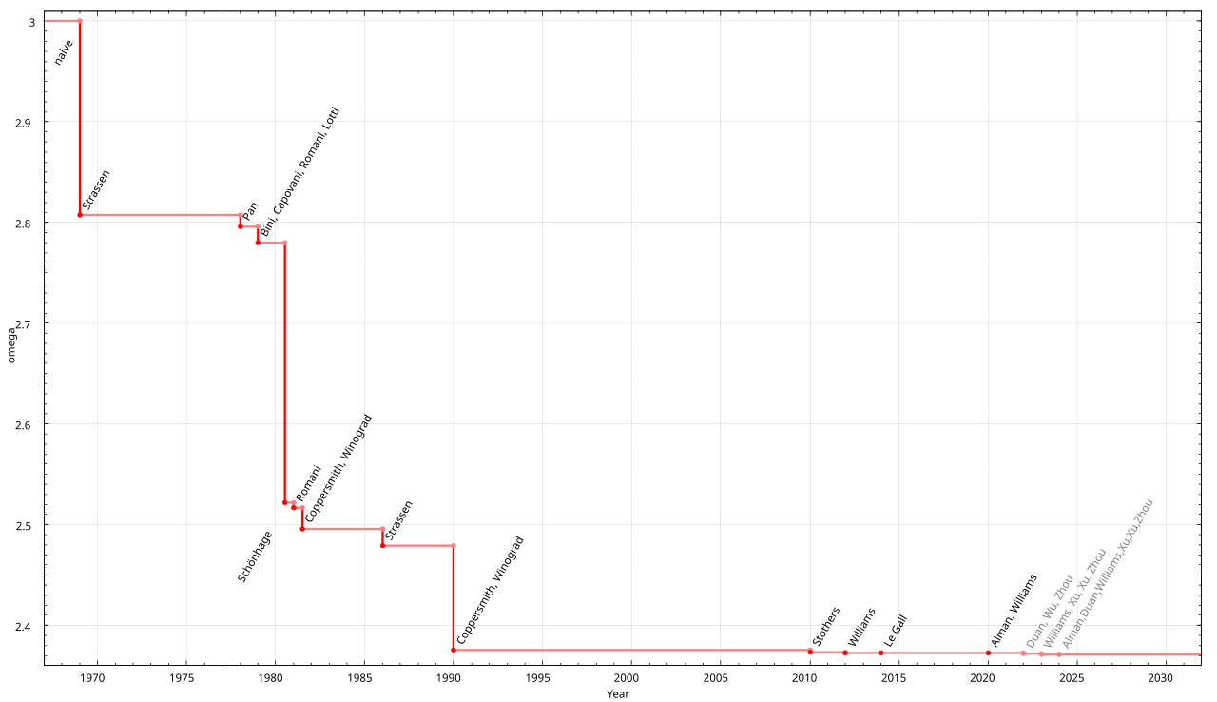
Extra research: is 7 optimal? What came next
• Hopcroft & Kerr (1971), Winograd (1971): 7 is optimal for 2x2
• Winograd's variant: 15 additions instead of 18
• AlphaTensor (DeepMind, 2022): 47 multiplications for 4x4 over GF(2) vs 49
• Best known exponent today: omega < 2.371339 (Alman et al., 2024)
• Those algorithms are never used in practice
Exponent omega over time
Notes:
IMAGE: MatrixMultComplexity_svg.svg (Jochen Burghardt, CC BY-SA 4.0, Wikimedia Commons) - the improvement of the exponent omega over time from 3 down to ~2.37.
Hopcroft & Kerr 1971 and Winograd 1971: 7 multiplications is optimal for 2x2. AlphaTensor (Fawzi et al., Nature 2022) found 47 multiplications for 4x4 over GF(2), beating 49 = 7x7 from Strassen applied twice. Alman et al. 2024: omega < 2.371339.

Slide 10
References
Alman, J., Duan, R., Williams, V. V., Xu, Y., Xu, Z., & Zhou, R. (2024). More asymmetry yields faster matrix multiplication. arXiv. https://arxiv.org/abs/2404.16349
ByteQuest. (n.d.). Strassen algorithm visually explained [Video]. YouTube. https://www.youtube.com/watch?v=2IgZuVGwEb0
Demmel, J., Dumitriu, I., Holtz, O., & Kleinberg, R. (2007). Fast matrix multiplication is stable. Numerische Mathematik, 106, 199–224. https://doi.org/10.1007/s00211-007-0061-6
Fawzi, A., Balog, M., Huang, A., Hubert, T., Romera-Paredes, B., Barekatain, M., Novikov, A., Ruiz, F. J. R., Schrittwieser, J., Swirszcz, G., Silver, D., Hassabis, D., & Kohli, P. (2022). Discovering faster matrix multiplication algorithms with reinforcement learning. Nature, 610, 47–53. https://doi.org/10.1038/s41586-022-05172-4
GeeksforGeeks. (2025). Strassen’s matrix multiplication. https://www.geeksforgeeks.org/dsa/strassens-matrix-multiplication/
Sagar Choudhary. (n.d.). Strassen’s matrix multiplication | Faster matrix multiplication explained with example [Video]. YouTube. https://www.youtube.com/watch?v=cGmfchtOJi4
Strassen, V. (1969). Gaussian elimination is not optimal. Numerische Mathematik, 13(4), 354–356. https://doi.org/10.1007/BF02165411
Wikipedia contributors. (n.d.). Computational complexity of matrix multiplication. In Wikipedia. Retrieved October 14, 2026, from https://en.wikipedia.org/wiki/Computationalcomplexityofmatrixmultiplication
Wikipedia contributors. (n.d.). Strassen algorithm. In Wikipedia. Retrieved October 14, 2026, from https://en.wikipedia.org/wiki/Strassen_algorithm
Notes:
IMAGE: none, text only. Keep on screen for the final seconds.

