Slide 1

LOCATION ANALYSIS
Finding the right spot to open up a franchise

Slide 2
Business Problem
A business in the sports supplements industry wishes to expand.
The task at hand is to find the right location to open a supplement store in Manhattan, NYC. This is crucial to the success of the supplement store franchise looking to expand.
Many sports enthusiasts and gym goers from various ethnicities reside in New York. With a population north of 8 million, this is a prime city for business.
The right location to open up a supplement store would be one where sports enthusiasts and gym goers are more likely to be found AND no supplement shops are found in close vicinity.

Slide 3
Data Requirements
Details about the neighborhoods in Manhattan can be found on this → https://geo.nyu.edu/catalog/nyu_2451_34572 json file found on the web.
All the neighborhoods can be found on the json file and placed onto a Dataframe.
We’ll analyse the venues in the neighborhood using Foursquare’s API.
The API returns all the venues along with the venue category
Venues in each neighborhood that are frequented by sports enthusiasts and gym goers will be taken into account
Existing supplement shops will also be taken into account

Slide 4
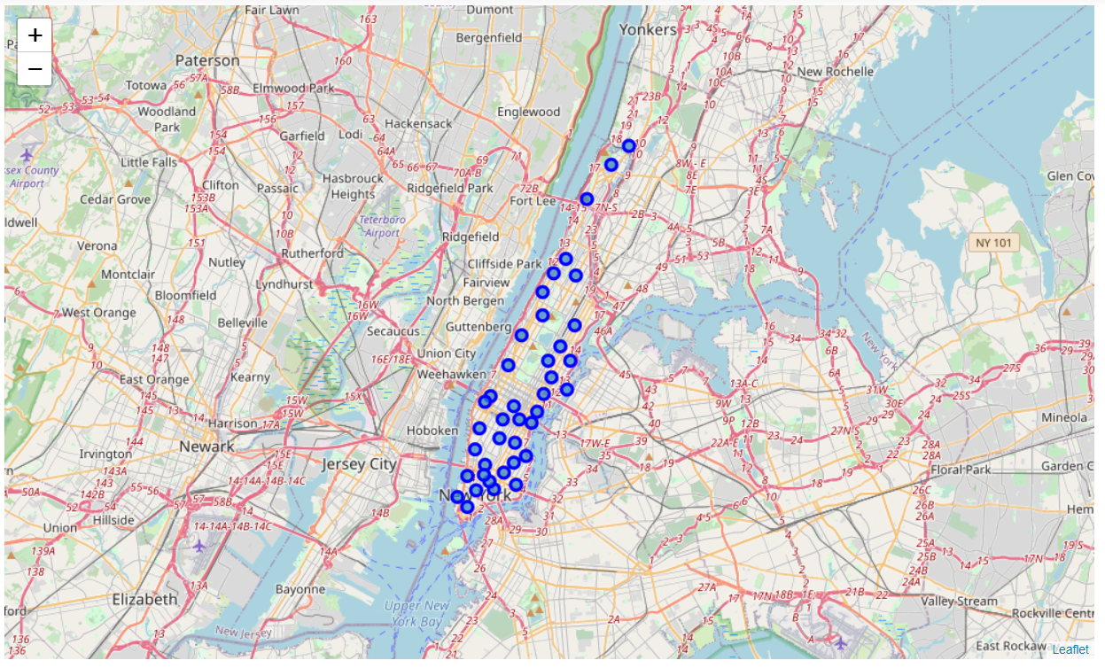

Slide 5
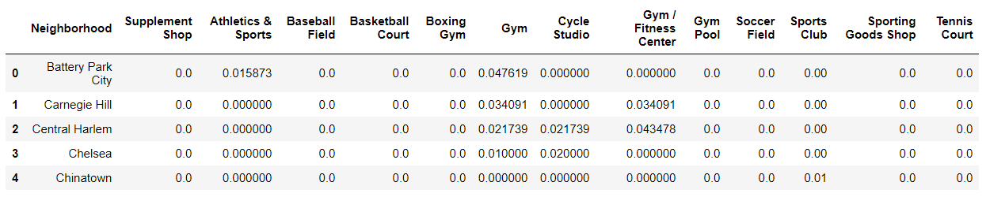
Selecting Venue Categories
We’ll be working with the following venue categories:
Athletics & Sports Venues
Baseball Fields
Basketball Courts
Boxing Gyms,
Climbing Gym
Cycle Studios
Gyms, Gym/Fitness Centres, Gym Pools
Soccer Fields
Sports clubs, Sporting Goods Shops
Tennis courts
Supplement Shops

Slide 6
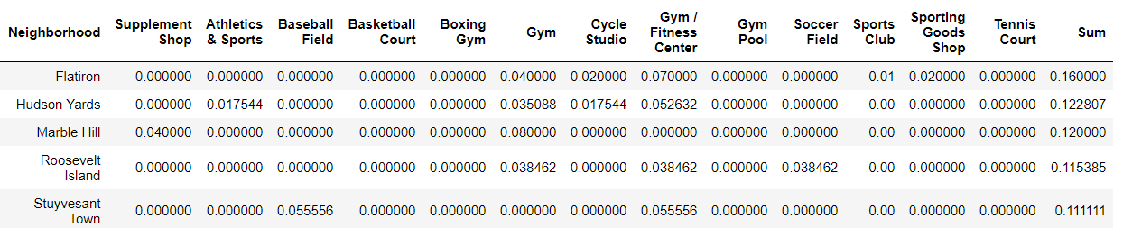
Methodology
We'll analyse each neighborhood and take a mean of all sports facilities to quantify the concentration of each sports facility in each neighborhood.
We have ignored all stadiums and other facilities which are used infrequently throughout the year and are reserved for tournaments.
Further, we'll sum all column mean values to get a value on the total sports facility concentration in each neighborhood. This step will exclude supplement shops.

Slide 7
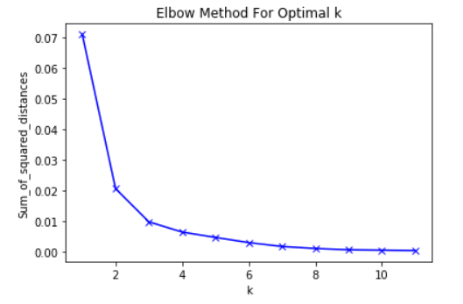
KMeans Clustering
We'll use the KMeans Machine Learning alogorithm to cluster neighborhoods based on the sports facilites and supplement shops present. The elbow method will be deployed to calculate the optimal k value.
The optimal value for k is 3

Slide 8
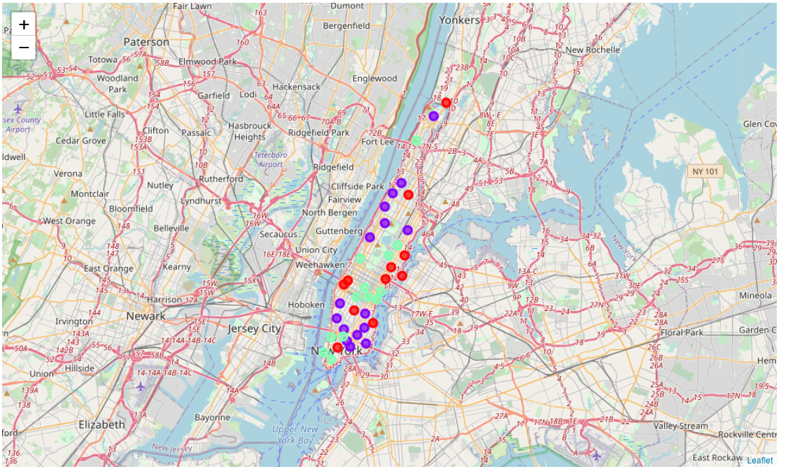
Let’s overlay all clusters on the map

Slide 9
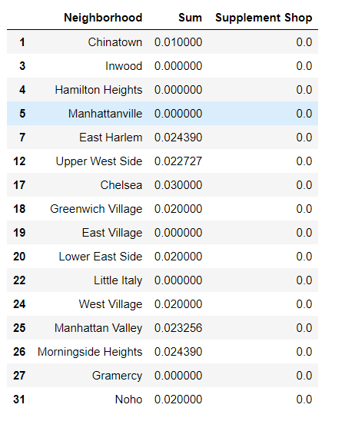
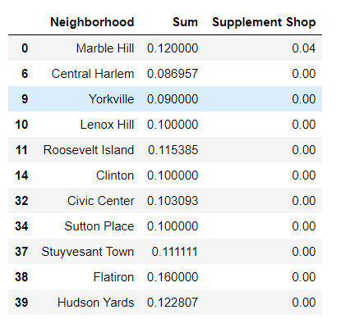
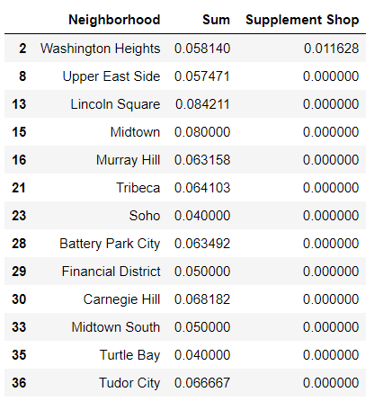
Results
Cluster 1
Cluster 0
Cluster 2

Slide 10
Conclusion
Analysing each cluster reveals that clusters 0 and 2 have a significant portion of sports facilities and closer inspection reveals that cluster 0 has a siginificant chunk of sports facilities.
Meanwhile, cluster 1 has to be avoided like the plague as it has very few sports facilities; therefore, it's in the best interest of stakeholders to avoid cluster 1 and focus on cluster 0.
Final decision has to be taken by stakeholders to determine which of the locations described above are ideal depending on the vicinity of the surroundings itself.

