Slide 2
Overview

Slide 3
Project summary

Slide 4
Data Understanding
Initial variables
Tip Prediction for customer
Generosity of customer for driver
Payment Type
Dummy Variables
Machine Learning Algorithm
Tip Prediction
Dummy Variables
Machine Learning Algorithm
Generous
Not Generous
Vendor ID
Total Amount
Trip Distance
Surcharge

Slide 5
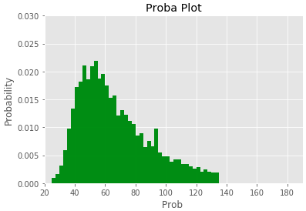
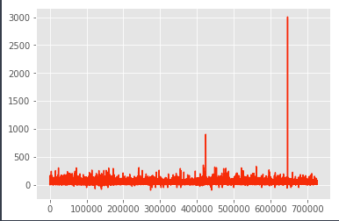
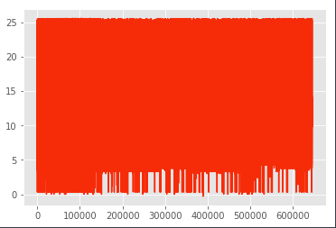
Data Quality Check - Outliers
For the variable Total Amount
 | With Outliers | Without Outliers
Mean | 15,1 | 11,5
Median | 11,15 | 10,3
Range | 3106.65 | 26
Standard Deviation | 13 | 4,8
Variance | 173 | 23
Outliers Visualization
Probability plot after removing outliers:

Slide 6
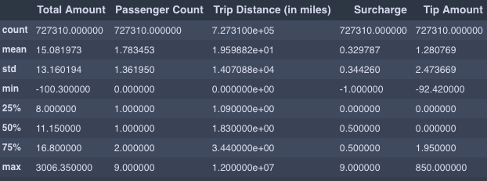
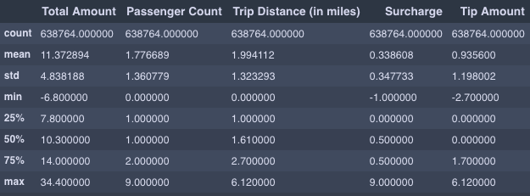
Data Quality Check - Outliers
For all the dataset
From 727310 observations to 638724 ➔ around 10 % of outliers
Removing outliers significantly decreases the range, the SD and so the variance
Other mathematical properties don’t change much
WITH OUTLIERS
WITHOUT OUTLIERS

Slide 7
Dummy Variables
The Discrete variables are transformed into Dummy Variables to make the analysis
Dummy variables are very usefull when…
Payment Type
Initial Factors | Dummy
CSH (= Cash) | 0
CRD (= Card) | 1

Slide 8
PCA

Slide 9
Multiple Regression
Be precise, use the statmod regression

Slide 10
KNN

Slide 11
Analysis
With/without outliers
With without dummy
Which algo to answer the problematic

Slide 12
Conclusion

