Slide 1


Classification
1.MNIST
Mukunthan Ragavan

Slide 2
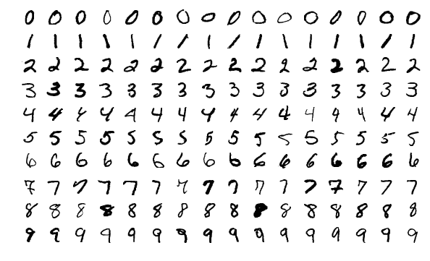
MNIST
MNIST database (Modified National Institute of Standards and Technology database) is a large database of handwritten digits that is commonly used for training various image processing systems.

Slide 3
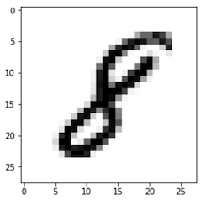
Gray scale Image
Pixel = Picture x Element.
28*28 pixels and each pixel will one byte
(8 bits) which can represent 256 (0-255) values.
0 – White to 255-Black

Slide 4
Coding starts…..

Slide 5
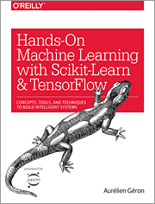
Hands-on Machine Learning with Scikit-Learn, Keras, and TensorFlow Concepts, Tools, and Techniques to Build Intelligent Systems
Reference
Aurélien Géron!

Slide 6
Thanks All
Have a nice day!

