Slide 1


Classification
3. Confusion
Matrix
Mukunthan Ragavan

Slide 2
Confusion Matrix
A confusion matrix is a summary of prediction results on a classification problem. The number of correct and incorrect predictions are summarized with count values and broken down by each class.
Reference: https://www.geeksforgeeks.org/confusion-matrix-machine-learning/

Slide 3
Coding starts…..

Slide 4
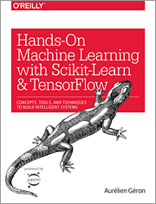
Hands-on Machine Learning with Scikit-Learn, Keras, and TensorFlow Concepts, Tools, and Techniques to Build Intelligent Systems
Reference
Aurélien Géron!

Slide 5
Thanks All
Have a nice day!

