Slide 1


Classification
3. Precision &
Recall
Theory, Formulas & Reverse Engineering
Mukunthan Ragavan

Slide 2
Agenda
Precision-Recall - Theory
Precision-Recall – Formulas with interpretation
Precision-Recall – Understanding

Slide 3
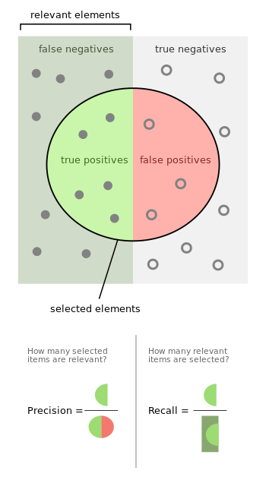
Precision-Recall - Theory
When a search engine returns 30 pages only 20 of
which were relevant while failing to return 40 additional
relevant pages, its precision is 20/30 = 2/3
while its recall is 20/60 = 1/3. So, in this case,
precision is "how useful the search results are",
and recall is "how complete the results are".
Precision is the probability that a (randomly selected)
retrieved document is relevant.
Recall is the probability that a (randomly selected)
relevant document is retrieved in a search.
Reference: https://en.wikipedia.org/wiki/Precision_and_recall

Slide 4
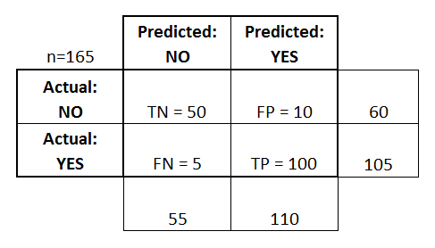
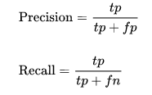
Precision-Recall – Formulas with interpretation
Precision= 91%
Recall=95%

Slide 5
Precision-Recall - Understanding
A system with high recall but low precision returns many results,
but most of its predicted labels are incorrect when compared to the training labels.
A system with high precision but low recall is just the opposite,
returning very few results, but most of its predicted labels are correct when
compared to the training labels.
An ideal system with high precision and high recall will return many results,
with all results labeled correctly.
Reference:
https://scikit-learn.org/stable/auto_examples/model_selection/plot_precision_recall.html

Slide 6
Coding starts…..

Slide 7
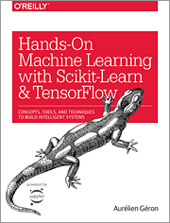
Hands-on Machine Learning with Scikit-Learn, Keras, and TensorFlow Concepts, Tools, and Techniques to Build Intelligent Systems
Reference
Aurélien Géron!

Slide 8
Thanks All
Have a nice day!

