Slide 1


Classification
5. F1 Score
Harmonic mean
Mukunthan Ragavan

Slide 2
Agenda
F1 score – Combined metric of Recall and Precision
Harmonic mean and why not Arithmetic mean

Slide 3
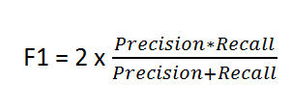
F1 Score
In statistical analysis of binary classification, the F₁ score (also F-score or F-measure) is a measure of a test's accuracy.
F1 is an overall measure of a model’s accuracy that combines precision and recall.

Slide 4
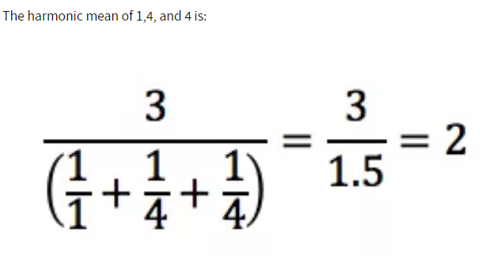
What is Harmonic Mean?
Harmonic mean can be expressed as the reciprocal of the arithmetic mean of the reciprocals of the given set of observations.
Refer: https://en.wikipedia.org/wiki/Harmonic_mean

Slide 5
Why is Harmonic Mean?
Let us consider, r=0 and p= 90
Arithmetic mean gives F1 as 45 whereas harmonic mean gives F1 as 0.
Arithmetic hides extreme worst cases in Recall or Precision whereas harmonic mean reflects low mean considering both Recall and Precision.
In simple words, F1 should be high only if both r and p are high.

Slide 6
Coding starts…..

Slide 7
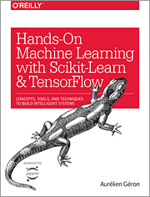
Hands-on Machine Learning with Scikit-Learn, Keras, and TensorFlow Concepts, Tools, and Techniques to Build Intelligent Systems
Reference
Aurélien Géron!

Slide 8
Thanks All
Have a nice day!

