Slide 1


Classification
6. ROC Curve
Sensitivity & Specificity
Mukunthan Ragavan

Slide 2
Agenda
Sensitivity and Specificity overview
Trade off between Sensitivity and Specificity
ROC Curve and AUC

Slide 3
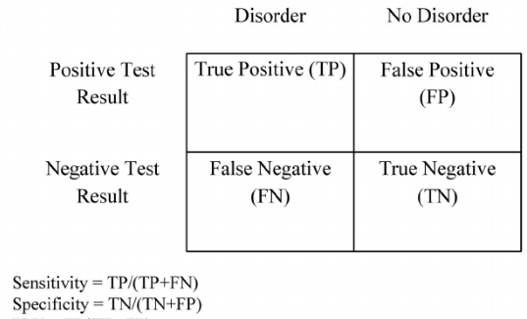
Sensitivity and Specificity overview
Sensitivity: Proportion of true positive (diseased) with a positive test result.
Specificity: Proportion of true negative (non-diseased) with a negative test result.

Slide 4
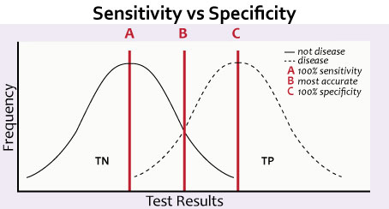
Trade off between Sensitivity and Specificity
FP FN
Sensitivity⬆ Specificity⬇ and Sensitivity⬇, Specificity⬆

Slide 5
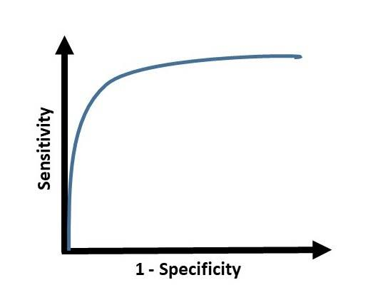
ROC Curve
An ROC curve (receiver operating characteristic curve) is a graph showing the performance of a classification model at all classification thresholds. This curve plots two parameters:
True Positive Rate (Sensitivity)
False Positive Rate (1-Specificity)

Slide 6
ROC Curve (Why 1-Specificity)
With a very low threshold, everything will be detected but you'll have no specificity. With a very high threshold, you'll have perfect specificity but never classify anything as positive.
You could plot specificity on the X-axis and just reverse the direction so it goes from 1 to 0 instead of 0 to 1.
It's more intuitive with 1-specificity, which is the rate of false positives among all cases that should be negative (false positive + true negative). As you move along the ROC curve, you get more true positive but also more false positive.
Reference: https://www.researchgate.net/post/Why_does_the_ROC_curve_plot_for_sensitivity_by_1-specificity

Slide 7
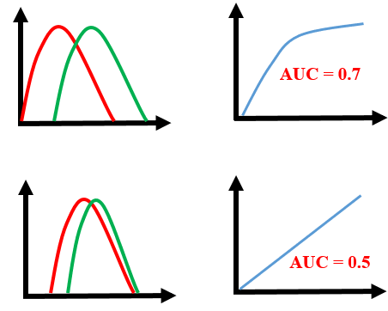
AUC
With a ROC curve, you're trying to find
a good model that optimizes the trade off
between the False Positive Rate (FPR)
and True Positive Rate (TPR).
What counts here is how much area is under the curve. The ideal curve in the left image fills in 100%, which means that you're going to be able to distinguish between negative results and positive results 100% of the time (which is almost impossible in real life).
The further you go to the right, the worse the detection. The ROC curve to the far right does a worse job than chance, mixing up the negatives and positives.

Slide 8
Coding starts…..

Slide 9
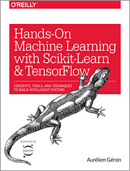
Hands-on Machine Learning with Scikit-Learn, Keras, and TensorFlow Concepts, Tools, and Techniques to Build Intelligent Systems
Reference
Aurélien Géron!

Slide 10
Thanks All
Have a nice day!

