Slide 1


Classification
7. Multiclass Classification
One vs. All
Mukunthan Ragavan

Slide 2
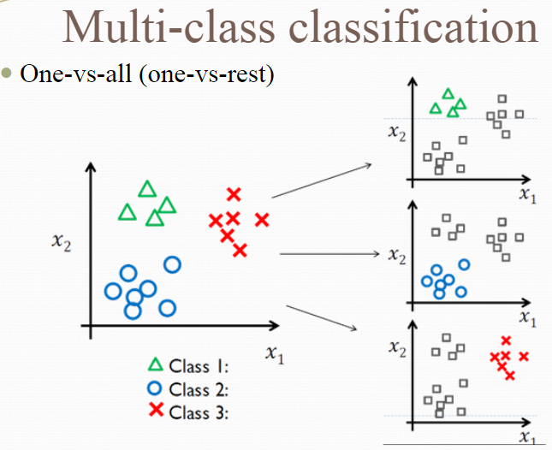
Multiclass Classification
Multiclass or multinomial
classification is the problem
of classifying instances into
one of three or more classes.
(Classifying instances into one
of two classes is called
binary classification.)
https://en.wikipedia.org/wiki/Multiclass_classification#One-vs.-rest

Slide 3
Coding starts…..

Slide 4

Hands-on Machine Learning with Scikit-Learn, Keras, and TensorFlow Concepts, Tools, and Techniques to Build Intelligent Systems
Reference
Aurélien Géron!

Slide 5
Thanks All
Have a nice day!

