Slide 1

Qualitative behaviour of ecological models
Vincent Jansen
vincent.jansen@rhul.ac.uk

Slide 2
Introduction
Population dynamics describe change over time
Aim of population and community ecology is to understand the processes underlying patterns of change
Mathematical models help us to link process to pattern
I hope this course will help in understanding the qualitative behaviour of mathematical models

Slide 3
Introduction
Most models that are of interest in biology are non-linear dynamical systems
Mathematical analysis tools are sharpest for linear systems, and for real models often only possible to a limited extent
Therefore many researchers do not get beyond looking at simulation studies for a limited set of parameters. This gives a very myopic perspectice
How can you understand and interpret the dynamical behaviour of a model in wider and more a systematic way?

Slide 4
2022-23 1-1 Single species models, stability, metapopulations: Exponential growth
Vincent Jansen
vincent.jansen@rhul.ac.uk

Slide 5
Outline
1-1 Exponential Growth
1-2 Logistic growth, stability
1-3 Metapopulations

Slide 6
2023-24 1-1 Exponential Growth
Vincent Jansen
vincent.jansen@rhul.ac.uk

Slide 7
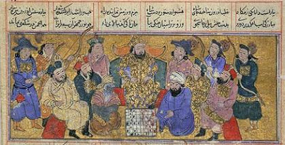
Exponential Growth
The simplest model for growth is to assume that the net per capita growth is density independent
The idea goes back many centuries
The courtier and the Persian king
Notes:
According to legend, a courtier presented the Persian king with a beautiful, hand-made chessboard. The king asked what he would like in return for his gift and the courtier surprised the king by asking for one grain of rice on the first square, two grains on the second, four grains on the third etc. The king readily agreed and asked for the rice to be brought. All went well at first, but the requirement for 2 n − 1 grains on the nth square demanded over a million grains on the 21st square, more than a million million (aka trillion) on the 41st and there simply was not enough rice in the whole world for the final squares.

Slide 8


Slide 9
Exponential Growth
This gives the sequence: 1,2,4,8,16,32,64,128,256,512, etc.
or 2⁰, 2¹, 2², 2³, 2⁴ etc
The courtier would get 18446744073709551615 grains of rice, that is about 5 x 10¹¹ metric tons, more than 500 times the current yearly global rice production!

Slide 10
grains
squares

Slide 11
Log₂[grains]
squares

Slide 12
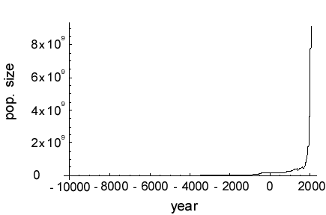
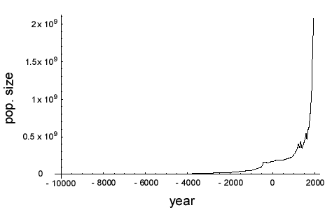
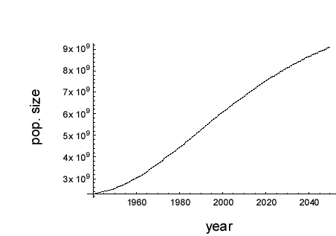
The growth of the human population

Slide 13
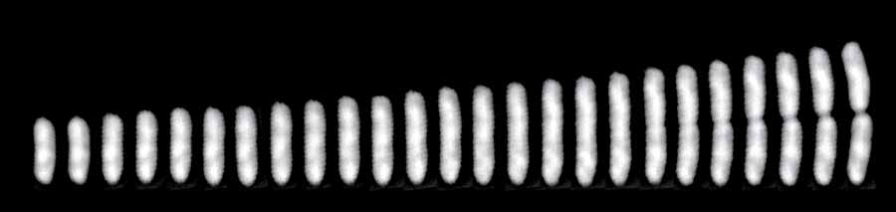
Bacterial population growth
A single E. coli cell dividing
Bacteria multiply by dividing in 2
So you get 1,2,4,8,16,32 etc bacteria
This is a geometric series (all terms powers of 2)
Notes:
http://ucsdnews.ucsd.edu/pressrelease/study_sheds_light_on_what_causes_cells_to_divide

Slide 14
Bacterial Growth
Absorbancy
Escherichia coli grown on minimal salts and complex medium
Time (mins)
Absorbancy
Time (mins)
http://biology.clc.uc.edu/fankhauser/labs/microbiology/growth_curve/growth_curve.htm

Slide 15
Humans vs Bacteria
Humans
Bacteria
Absorbancy
Time (mins)
Time (mins)

Slide 16
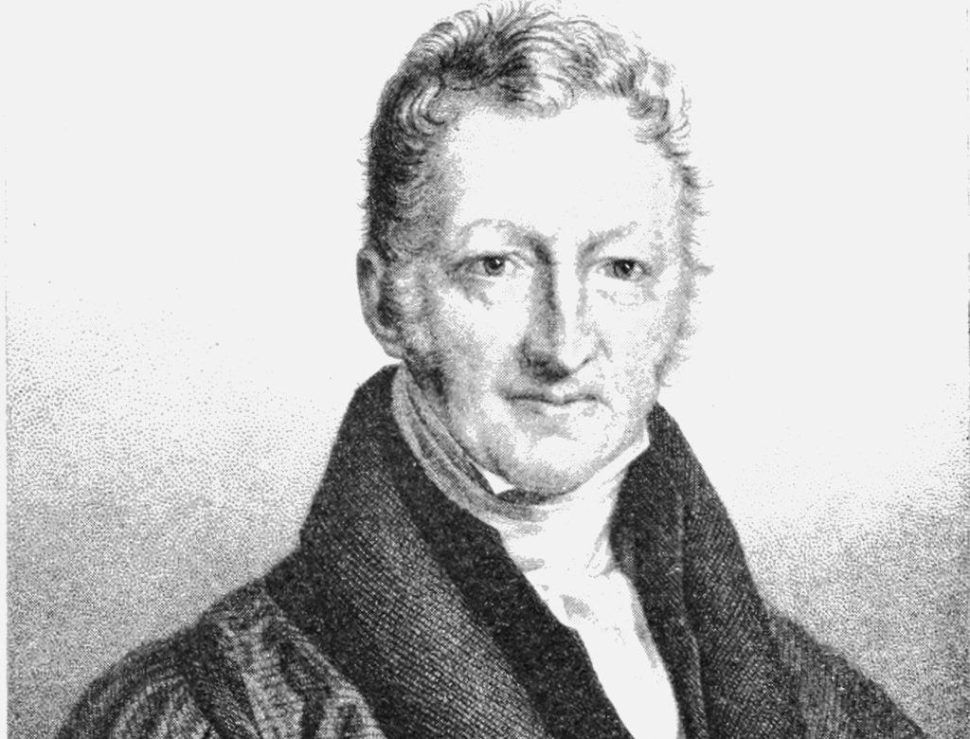

Slide 17
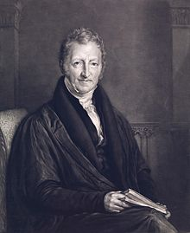
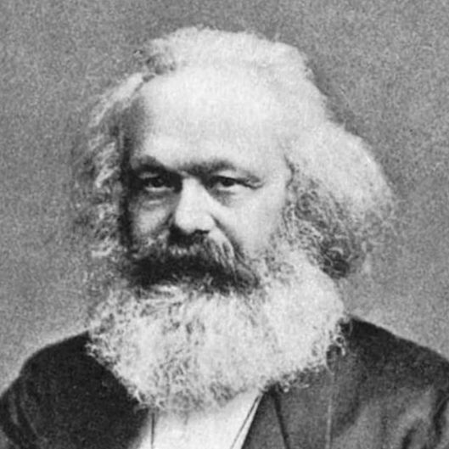
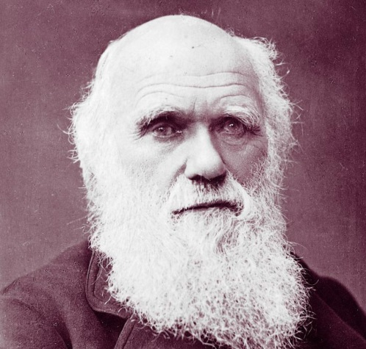
Humans vs Bacteria:
The end is nigh!
Malthus wrote an essay (1789) in which he claims that the human population grows geometrically
It became a very influential text
The reverend Thomas Malthus
Revolution!
Marx
Evolution!
Darwin

Slide 18
Do human and bacterial populations grow in the same way?
Obviously the time scale is different
But are the growth curves the same or different?
To find out we will build a simple model for exponential (geometric) growth, and see if Malthus was right.
Exponential!
The reverend Thomas Malthus

Slide 19
Exponential Population Growth
The size of the population at time point t is N_{t}
If we assume births and death rates are proportional to the size of the population:
Births = b N_{t}
Deaths = d N_{t}
This amounts to assuming that the probability of a person giving birth (or dying) is independent of population size.
b: per capita birth rate
d: per capita death rate

Slide 20
Exponential Growth (discrete time)
With a constant per capita birth and death rate we find a growth process similar to the accumulation of interest:
N_{t+1}-N_{t} =bN_{t}-dN_{t}=rN_{t} (r=b-d, is the net per capita growth rate)
or
N_{t+1}=(1+b-d) N_{t}=(1+r)N_{t}
General solution:
N_{t}=N₀(1+r)^{t}

Slide 21
Exponential growth (discrete time)
A simple prediction:
If growth is exponential then the logarithm of the population size increases linearly
where a=ln(N₀) and b=ln(1+r) .

Slide 22
Exponential Growth

Slide 23
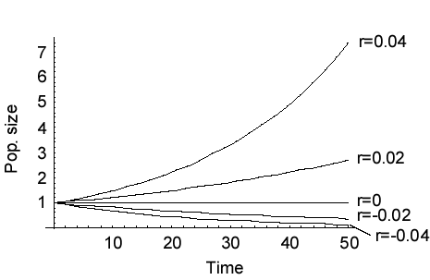
Exponential growth
The net growth rate r=b-d

Slide 24
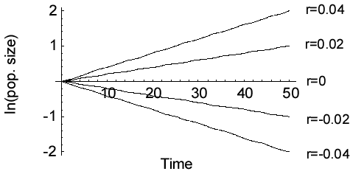
Exponential growth

Slide 25
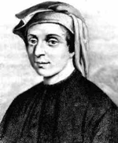
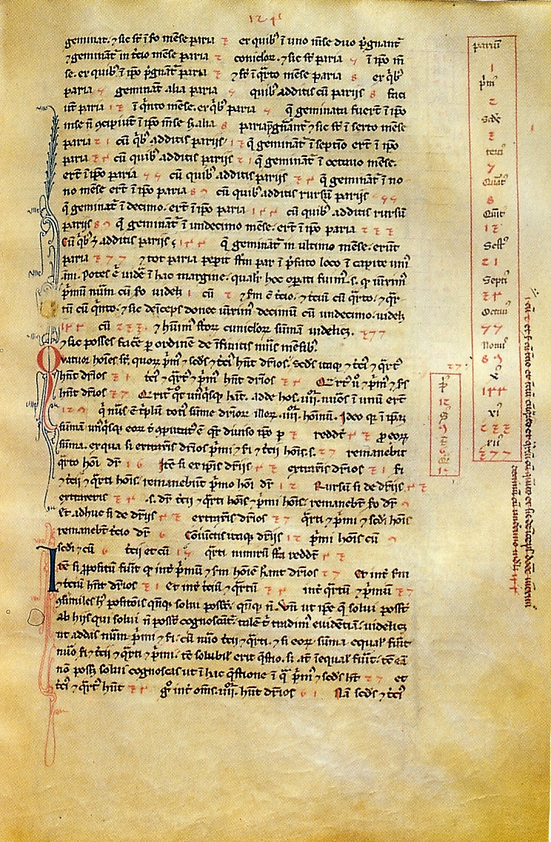
The Fibonacci sequence
Leonardo of Pisa (Fibonacci)
(c. 1170 – c. 1250)
Page from the Liber Abaci, with the Fibonacci sequence
Suppose a newly-born pair of rabbits, one male, one female, are put in a field. Rabbits are able to mate at the age of one month so that at the end of its second month a female can produce another pair of rabbits. Suppose that our rabbits never die and that the female always produces one new pair (one male, one female) every month from the second month on. How many pairs will there be in one year ?

Slide 26
The Fibonacci sequence
Leonardo of Pisa (Fibonacci)
(c. 1170 – c. 1250)
Suppose a newly-born pair of rabbits, one male, one female, are put in a field. Rabbits are able to mate at the age of one month so that at the end of its second month a female can produce another pair of rabbits. Suppose that our rabbits never die and that the female always produces one new pair (one male, one female) every month from the second month on. How many pairs will there be in one year ?

Slide 27
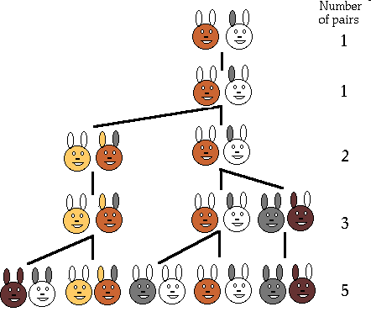
1,1,2,3,5,8,13,21,34,55,89,144

Slide 28
Fibonacci’s rabbits
ln[nr of rabbits]
time

Slide 29
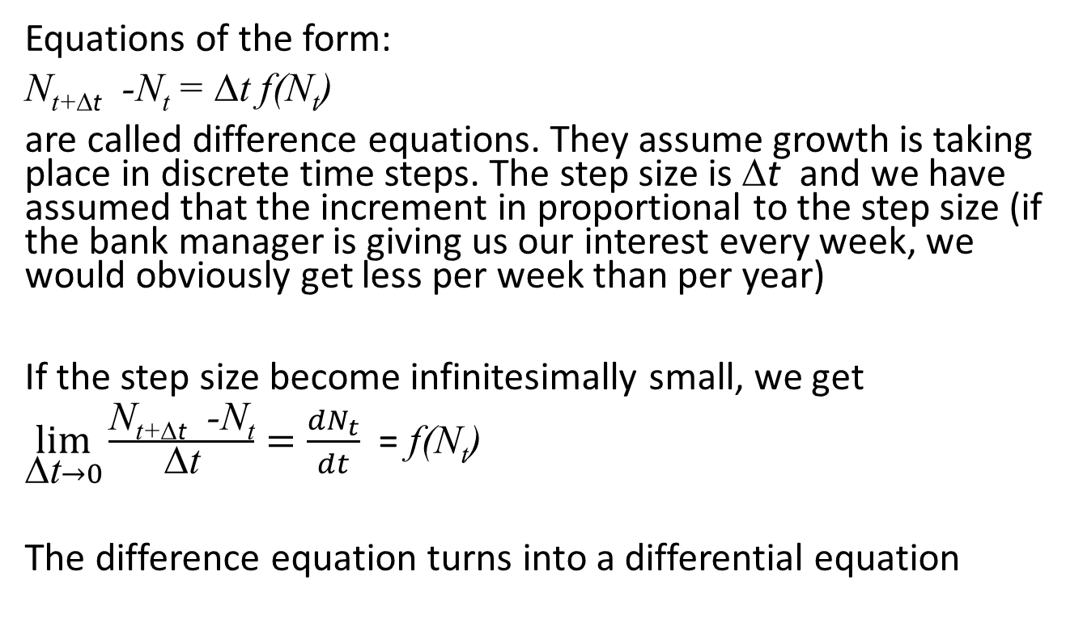
Exponential Growth (discrete time)
Equations of the form:
N_{t+Δt} -N_{t} = Δt f(N_{t})
are called difference equations. They assume growth is taking place in discrete time steps. The step size is Δt and we have assumed that the increment in proportional to the step size (if the bank manager is giving us our interest every week, we would obviously get less per week than per year)
If the step size become infinitesimally small, we get
$\lim_{\text{D}\text{t}→0}{\frac{\text{N}\text{t}\text{+}\text{D}\text{t} \text{−}\text{Nt}}{\text{D}\text{t}}}=\frac{dN_{t}}{dt}$ = f(N_{t})
The difference equation turns into a differential equation

Slide 30
Exponential growth (continuous time)
If we assume constant per capita birth and death rates:
Which can be rewritten as
where r=b-d is the per capita growth rate .
This is the exponential growth model for overlapping generations
b N – d N = (b - d) N
r N

Slide 31
Exponential growth in continuous time
r N
Previous examples were in discrete time
The differential equation
Can be solved to give:
Where N(0) is the population size at time t=0 and e is a constant (the base of the natural logarithm) with value ≈2.718

Slide 32
Exponential growth
The net growth rate r=b-d

Slide 33
Exponential growth

Slide 34
Humans vs Bacteria analysed
So let’s see, do humans or bacterial populations show exponential (=geometric growth)?

Slide 35
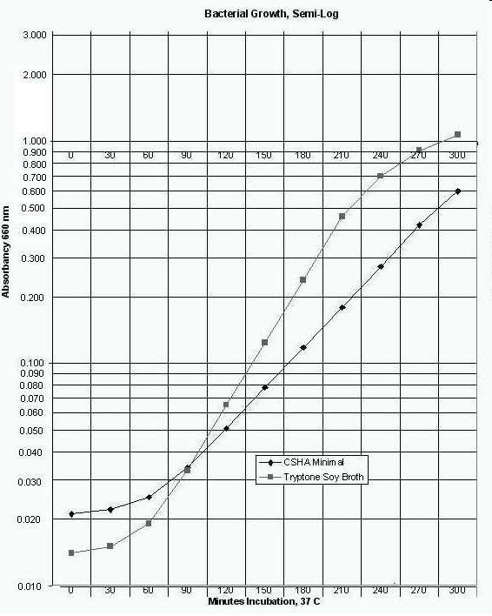
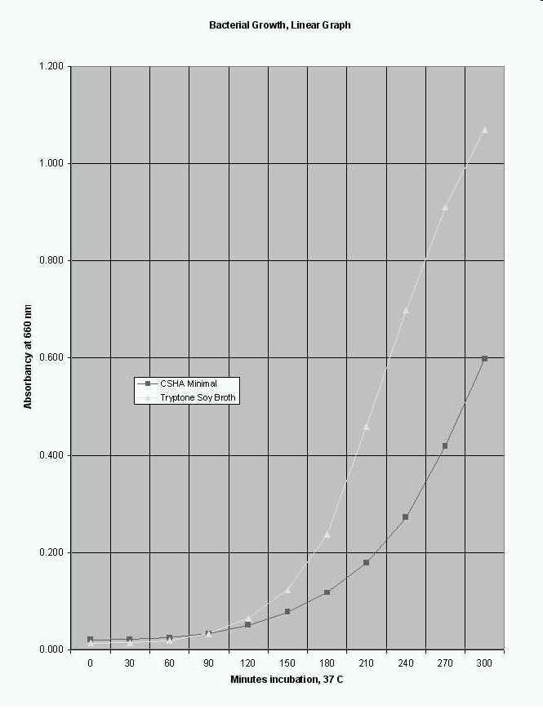
Example: Bacterial Growth
Escherichia coli grown on minimal salts vs complex media
http://biology.clc.uc.edu/fankhauser/labs/microbiology/growth_curve/growth_curve.htm

Slide 36
Human Population Growth

Slide 37
Growth Rate
We can use the exponential model to calculate per capita growth rates
If we measure the population at times 0 and T the model predicts:
Solving for r we find

Slide 38

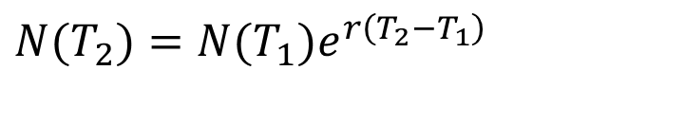
Growth Rate
We can use the exponential model to calculate per capita growth rates
If we measure the population at times T₁ and T₂ the model predicts:
Solving for r we find
$$N(T_{2})=N(T_{1})e^{r\left(T_{2}−T_{1}\right)}$$
$$r=\frac{1}{T_{2}−T_{1}}\ln{\frac{N(T_{2})}{N(T_{1})}}$$

Slide 39
Are growth rates constant for bacteria?
Simple medium
Complex medium
Growth rate
Time (mins)
Time (mins)

Slide 40
Are human population growth rates constant?

Slide 41
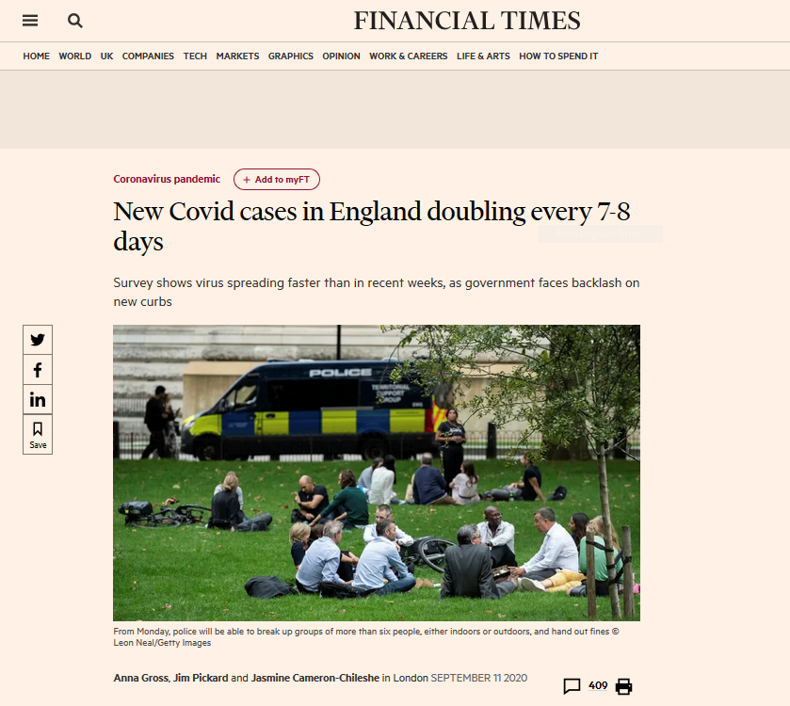

Slide 42
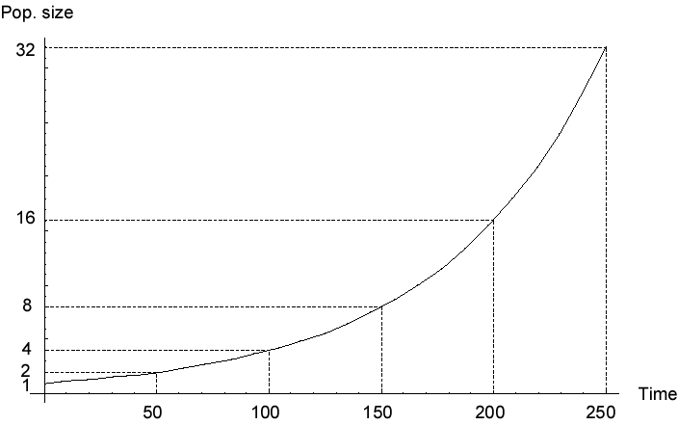
Doubling Time
In the exponential growth model the population sizes double in a given amount of time.
This is called the doubling time

Slide 43
Doubling Time
The difference in growth rate is illustrated by the doubling time (ln 2)/r
Therefore, if you know the doubling time, you know the growth rate
Doubling time is more intuitive

Slide 44
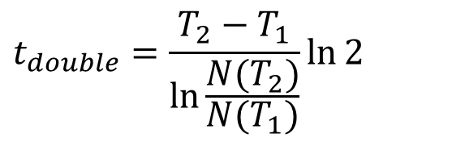
Doubling Time
To calculate the doubling time we solve:
Solving for t_{double} we find:
Applied to two time points:
$$t_{double}=\frac{T_{2}−T_{1}}{\ln{\frac{N(T_{2})}{N(T_{1})}}}\ln{2}$$

Slide 45
Doubling Time
Let’s try that.
The human population size 5000BC was estimated at 5 million, at 1AD it was estimated at 170 million
The human population size 1650AD was estimated at 545 million, at 1850AD it was estimated at 1200 million
How do the doubling times compare over these periods?

Slide 46
Doubling Time
For the human population doubling time was, over the last 12000 years, approx. 900 years
From 1950 until now it was approx. 35 years
Notes:
0.000705131 983 0.00394646 176

Slide 47
Density Dependence
For the exponential model we assumed the per capita growth rate is independent of the population size
Let’s see if that is correct

Slide 48
Are growth rates constant for bacteria?
Simple medium
Complex medium
Growth rate
Absorbancy (density)
Absorbancy (density)

Slide 49
Density Dependence in the Human population

Slide 50

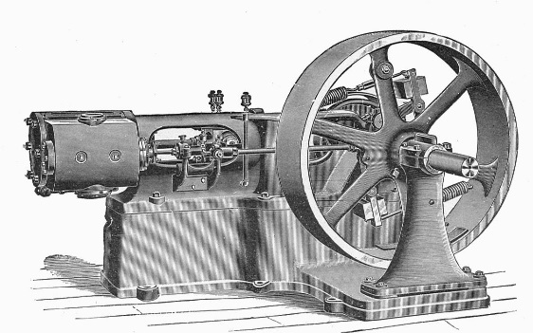
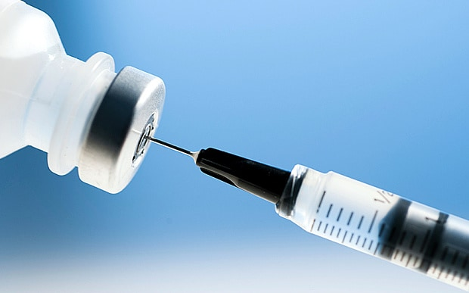
Density Dependence in the Human population
For big populations the growth rate declines with size
But initially the growth rate increased with sizes: the bigger the population got the better we did.
This is where Malthus went wrong: humans are not like bacteria, and we have not ran out of resources yet

Slide 51
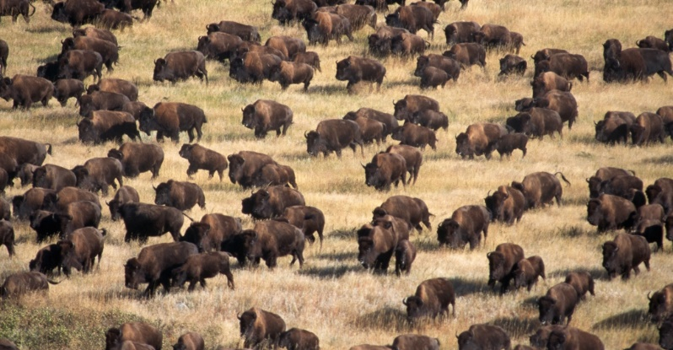
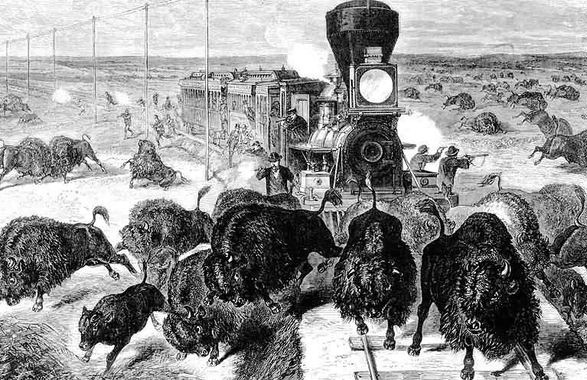
Growth of the Bison population
The American Plains bison (Bison bison) was nearly hunted to extinction in the 19th century. In the early 20th century attempts at saving the bison started.

Slide 52
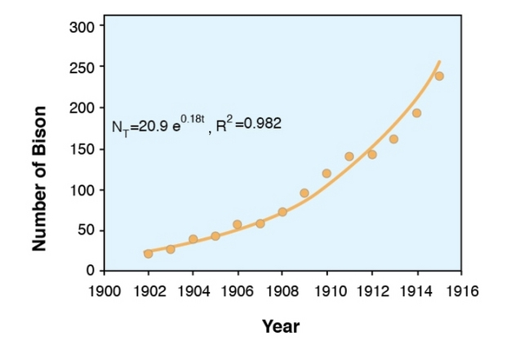
Growth of the Bison population
The rescued herds started small, but with plentiful resources and few predators, they grew quickly. In northern Yellowstone National Park the herd grew from 21 bison in 1902 to 250 in 1915. This is a textbook example of exponential growth

Slide 53
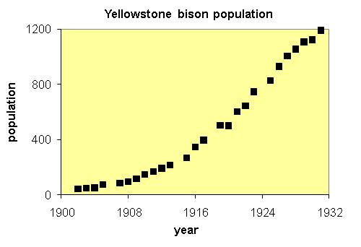
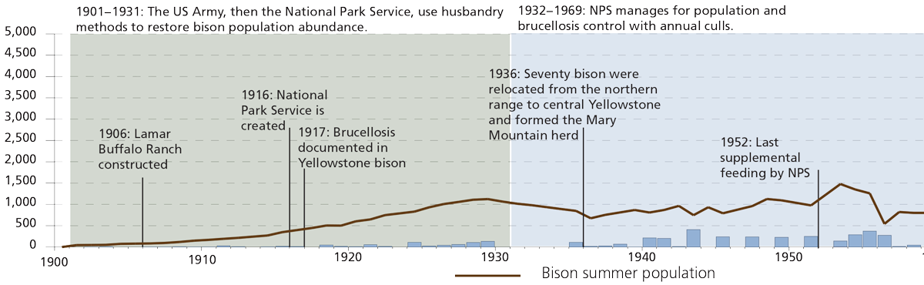
Growth of the Bison population
But it didn’t go on forever. The herd kept growing, albeit slower than exponential after the population got bigger

Slide 54
Learning outcomes
Understand the continuous and the discrete time exponential growth model and appreciate the assumptions it is based on

