Slide 1

2023-24 1-2 Single species models, stability, metapopulations Logistic growth, stability
Vincent Jansen
vincent.jansen@rhul.ac.uk

Slide 2
Outline
1-1 Exponential Growth
1-2 Logistic growth, stability
1-3 Metapopulations

Slide 3
Bacterial Growth
Absorbancy
Escherichia coli grown on minimal salts and complex medium
Time (mins)
Absorbancy
Time (mins)
http://biology.clc.uc.edu/fankhauser/labs/microbiology/growth_curve/growth_curve.htm

Slide 4
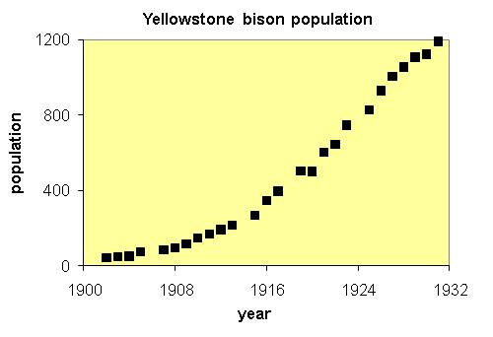
Growth of the Bison population

Slide 5
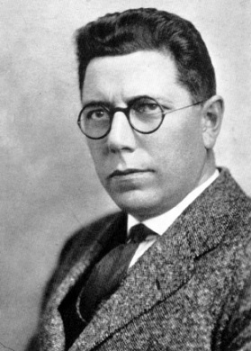
Growth curve of yeast
Raymond Pearl (1879-1940)
From R. Pearl (1927) Q. Rev. Biol. 2 532-548 using data from Carlson (1913) Biochem. Zeitschr. 57, 313-334
Notes:
Pearl: In 1926, his book, Alcohol and Longevity,^{[7]} demonstrated that drinking alcohol in moderation is associated with greater longevity than either abstaining or drinking heavily. In 1938, his data and work demonstrated the negative health effects of smoking tobacco.

Slide 6
Growth rate of yeast vs density
Per capita growth rate
Population density

Slide 7
Logistic Growth
The per capita growth rate depends on the population size
To study the effects of a density dependent growth rate let’s assume the growth rate decreases linearly with the population size

Slide 8
Logistic Growth
The per capita growth rate depends on the population size
To study the effects of a density dependent growth rate let’s assume the growth rate decreases linearly with the population size
rk
-rk

Slide 9
Logistic Growth
The per capita growth rate is a function of N, in this case we use r(k-N)
The population growth can be described as:
The parameter k is the carrying capacity
This is the logistic growth model
Note: slightly different parametrisation from other texts

Slide 10
Logistic Growth
Solutions converge to the carrying capacity, k, if r>0.
This is an equilibrium of the model

Slide 11
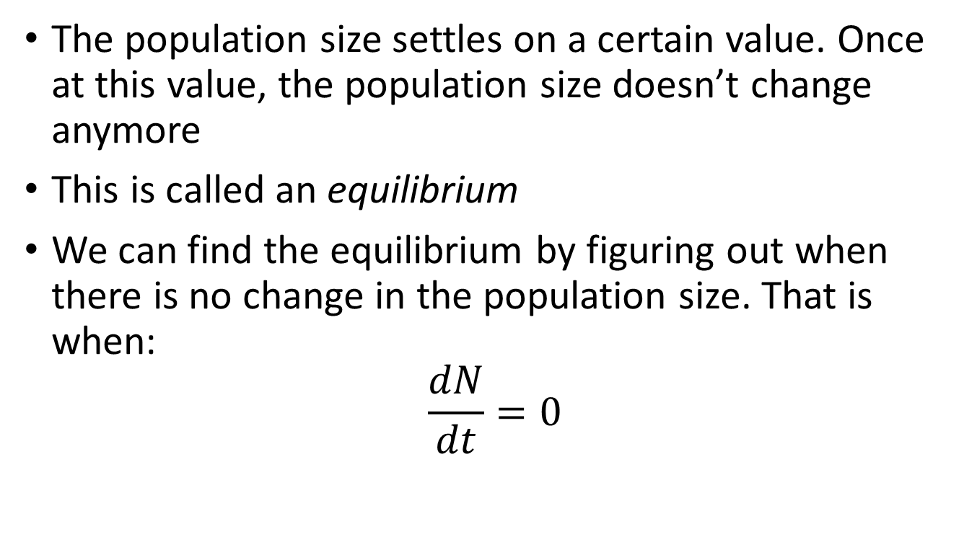
Equilibria
The population size settles on a certain value. Once at this value, the population size doesn’t change anymore
This is called an equilibrium
We can find the equilibrium by figuring out when there is no change in the population size. That is when:
$$\frac{dN}{dt}=0$$

Slide 12

Calculation of the equilibria
To find the equilibria we solve $\frac{dN}{dt}=0$:
To give
or

Slide 13
Logistic Growth
Solutions converge to the carrying capacity, k, if r>0.
This is an equilibrium of the model

Slide 14
Calculation of the equilibria
It appears we have two equilibria
The population size away from one, and moves towards the other.
The equilibrium that the population size moves away from is called unstable, the one it moves towards is called stable
and

Slide 15
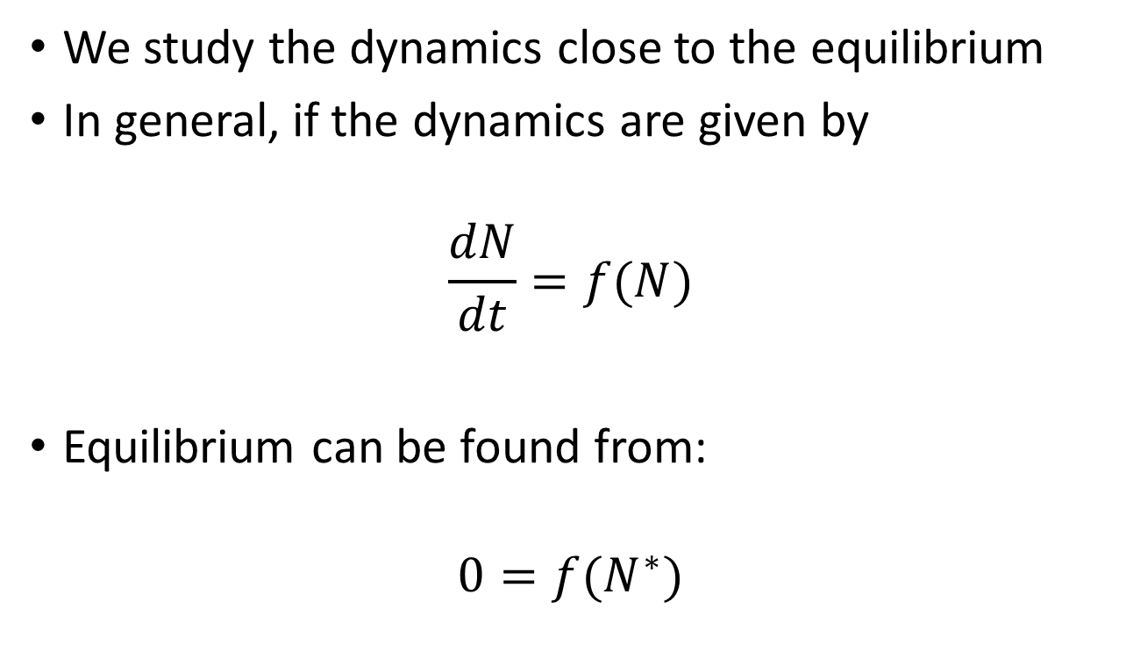
Stability of the equilibria
We study the dynamics close to the equilibrium
In general, if the dynamics are given by
$$\frac{dN}{dt}=f(N)$$
Equilibrium can be found from:
$$0=f(N^{∗})$$

Slide 16
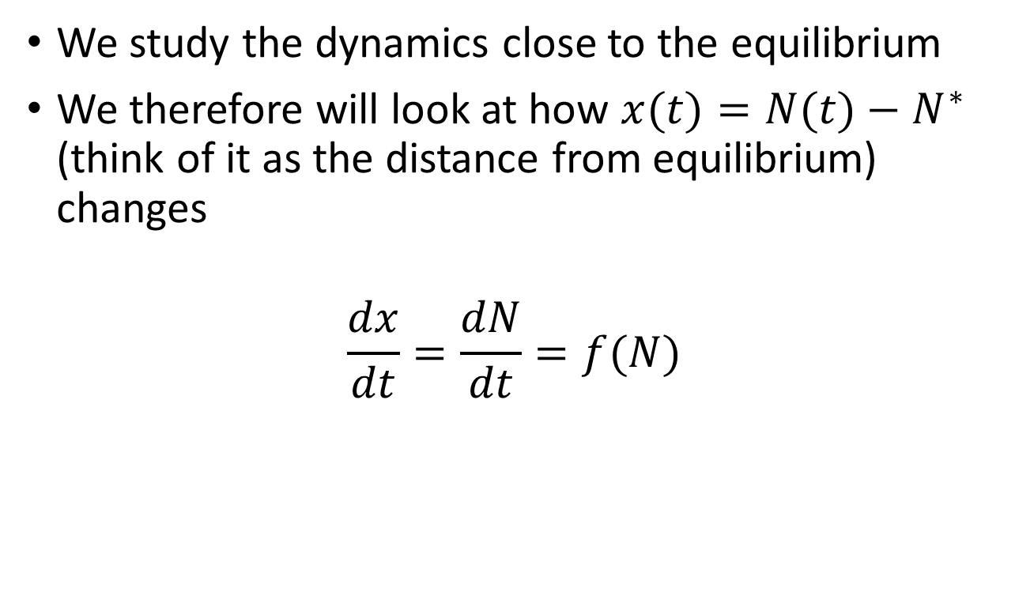
Stability of the equilibria
We study the dynamics close to the equilibrium
We therefore will look at how $x(t)=N(t)−N^{∗}$ (think of it as the distance from equilibrium) changes
$$\frac{dx}{dt}=\frac{dN}{dt}=f(N)$$

Slide 17
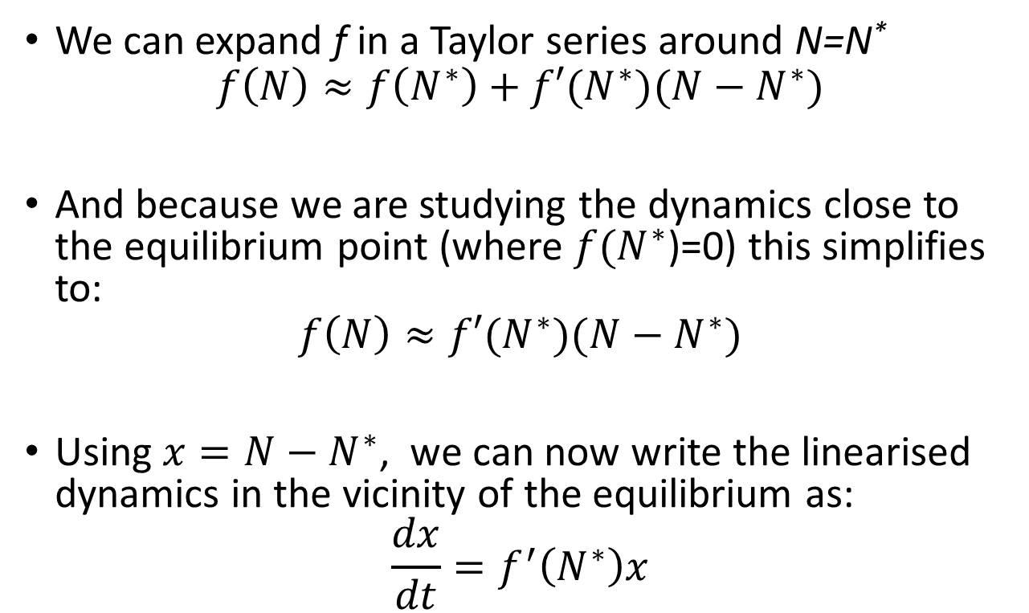
Stability of the equilibria
We can expand f in a Taylor series around N=N*
$$f\left(N\right)≈f\left(N^{∗}\right)+f′(N^{∗})(N−N^{∗})$$
And because we are studying the dynamics close to the equilibrium point (where $f(N^{∗}$)=0) this simplifies to:
$$f\left(N\right)≈f′(N^{∗})(N−N^{∗})$$
Using $x=N−N^{∗}$, we can now write the linearised dynamics in the vicinity of the equilibrium as:
$$\frac{dx}{dt}=f^{′}\left(N^{∗}\right)x$$

Slide 18

Stability of the equilibria
f(N)$=r\left(k−N\right)N$

Slide 19
Stability of the equilibria
For the logistic model this gives us as the linearised dynamics close to equilibrium:

Slide 20
Stability of
The dynamics close to equilibrium are approximately:
With solution
The rate rk is called the eigenvalue
The equilibrium is stable if the eigenvalue negative, i.e. if rk<0
and unstable if the eigenvalue is positive, i.e. rk>0

Slide 21
Stability of
Eigenvalue

Slide 22
Stability of
The dynamics close to equilibrium are approximately:
The eigenvalue is now -rk
The equilibrium is stable if -rk<0
and unstable if -rk>0

Slide 23
Stability of
Eigenvalue

Slide 24
Bifurcation diagram
A transcritical bifurcation

Slide 25
Try this yourself in Practical 1: Make bifurcation diagram for the continuous logistic equation.

Slide 26
Learning outcomes
Understand the logistic growth model and appreciate the assumptions it is based on
Be able to determine local stability in models for one species
Be able to interpret a simple bifurcation diagram
Appreciate how to understand the qualitative outcomes of the model and how they depend on the parameters.

