Slide 1

2023-24 2-2 Interspecific competition between two species Equilibria and Stability of the L-V Model
Vincent Jansen
vincent.jansen@rhul.ac.uk

Slide 2
Outline
2-1 The Lotka-Volterra Interaction Model
2-2 Equilibria and Stability
2-3 Apparent Competition

Slide 3
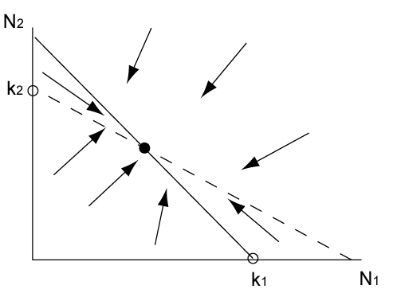
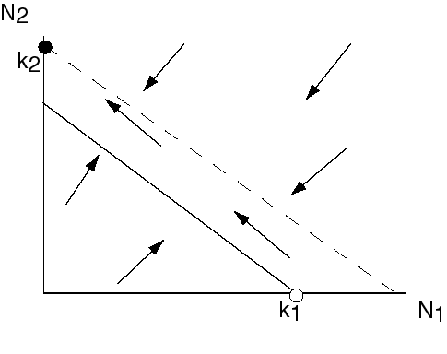
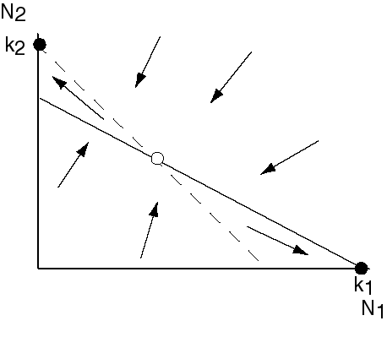
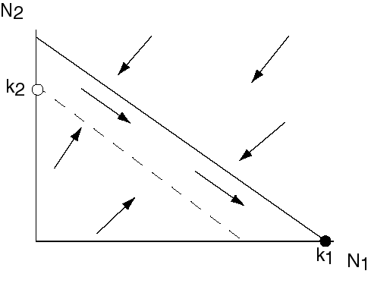
The outcomes of competition
Species 1 excludes 2
Species 2 excludes 1
Coexistence
Alternative stable states

Slide 4
Lotka-Volterra interaction model
Describes how the densities of two competing species change simultaneously
It is a system of 2 differential equations:

Slide 5

Equilibria and stability
The L-V competition model can have 4 different equilibria
We can find these by solving:
Which gives

Slide 6
Equilibria and stability
3 equilibria are:
The 4th one you can find by solving:
Which gives

Slide 7
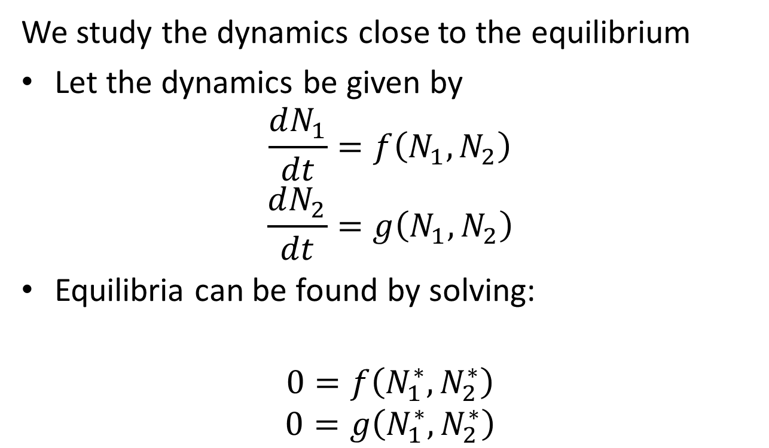

Local stability analysis (in general for 2D system)
We study the dynamics close to the equilibrium
Let the dynamics be given by
$$\frac{dN_{1}}{dt}=f\left(N_{1},N_{2}\right)$$
$$\frac{dN_{2}}{dt}=g\left(N_{1},N_{2}\right)$$
Equilibria can be found by solving:
$$0=f\left(N_{1}^{∗},N_{2}^{∗}\right)$$
$$0=g\left(N_{1}^{∗},N_{2}^{∗}\right)$$
$$(N_{1}^{∗},N_{2}^{∗})$$

Slide 8
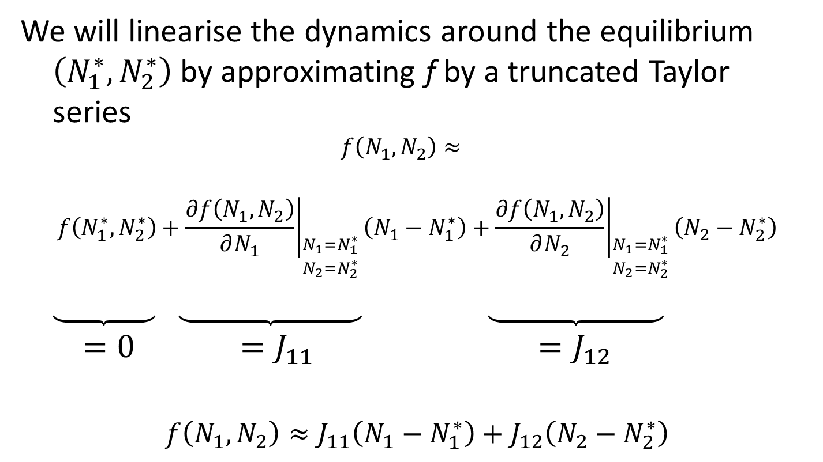
Linearised dynamics
We will linearise the dynamics around the equilibrium $\left(N_{1}^{∗},N_{2}^{∗}\right)$ by approximating f by a truncated Taylor series
$$f\left(N_{1},N_{2}\right)≈$$
$$f\left(N_{1}^{∗},N_{2}^{∗}\right)+{\left.\frac{∂f\left(N_{1},N_{2}\right)}{∂N_{1}}\right|}_{\begin{aligned}N_{1}=N_{1}^{∗} \\ N_{2}=N_{2}^{∗}\end{aligned}}\left(N_{1}−N_{1}^{∗}\right)+{\left.\frac{∂f\left(N_{1},N_{2}\right)}{∂N_{2}}\right|}_{\begin{aligned}N_{1}=N_{1}^{∗} \\ N_{2}=N_{2}^{∗}\end{aligned}}\left(N_{2}−N_{2}^{∗}\right)$$
$$=0 =J_{11} =J_{12}$$
$$f\left(N_{1},N_{2}\right)≈J_{11}\left(N_{1}−N_{1}^{∗}\right)+J_{12}\left(N_{2}−N_{2}^{∗}\right)$$

Slide 9
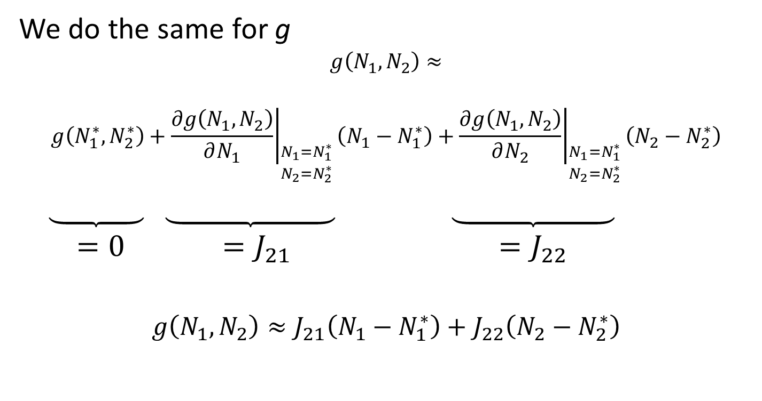
Linearised dynamics
We do the same for g
$$g\left(N_{1},N_{2}\right)≈$$
$$g\left(N_{1}^{∗},N_{2}^{∗}\right)+{\left.\frac{∂g\left(N_{1},N_{2}\right)}{∂N_{1}}\right|}_{\begin{aligned}N_{1}=N_{1}^{∗} \\ N_{2}=N_{2}^{∗}\end{aligned}}\left(N_{1}−N_{1}^{∗}\right)+{\left.\frac{∂g\left(N_{1},N_{2}\right)}{∂N_{2}}\right|}_{\begin{aligned}N_{1}=N_{1}^{∗} \\ N_{2}=N_{2}^{∗}\end{aligned}}\left(N_{2}−N_{2}^{∗}\right)$$
$$=0 =J_{21} =J_{22}$$
$$g\left(N_{1},N_{2}\right)≈J_{21}\left(N_{1}−N_{1}^{∗}\right)+J_{22}\left(N_{2}−N_{2}^{∗}\right)$$

Slide 10
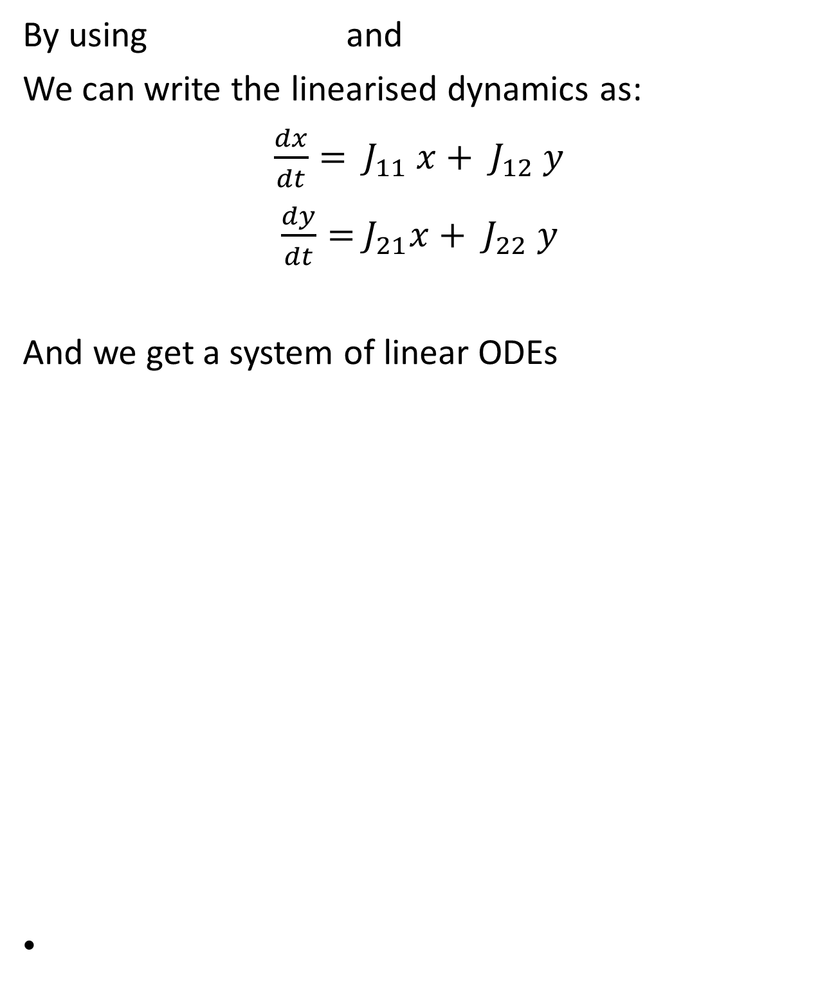
Linearised dynamics
By using and
We can write the linearised dynamics as:
$\frac{dx}{dt}=$ ${ J}_{11} x+{ J}_{12} y$
$\frac{dy}{dt}=$ $J_{21}x+{ J}_{22} y$
And we get a system of linear ODEs

Slide 11
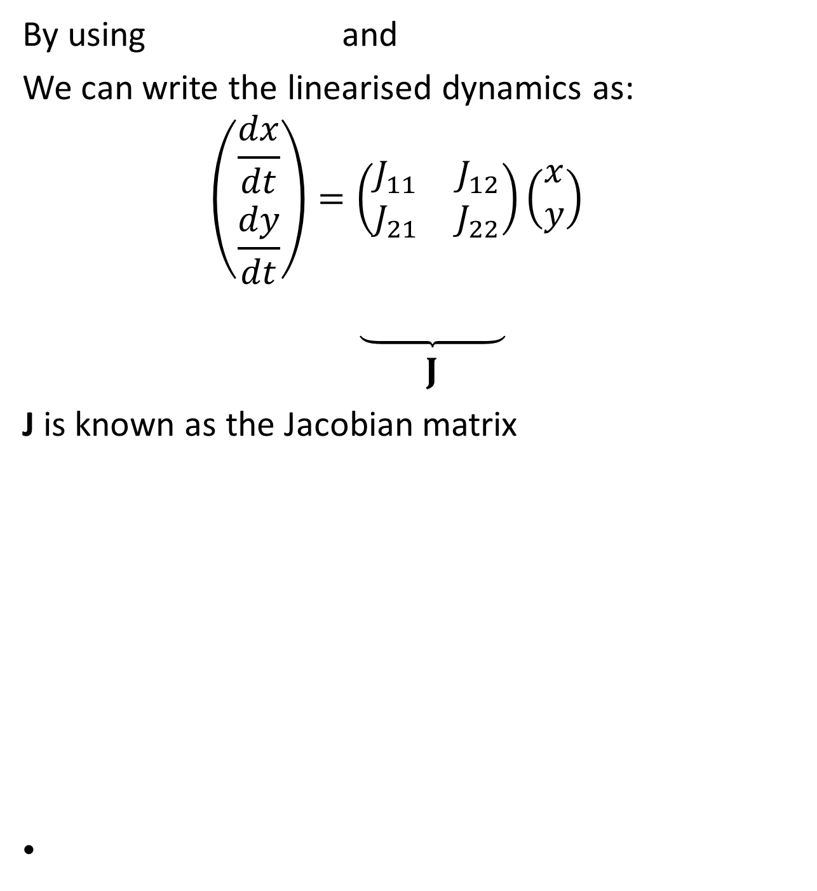
Linearised dynamics
By using and
We can write the linearised dynamics as:
$$\left(\begin{matrix}\frac{dx}{dt} \\ \frac{dy}{dt}\end{matrix}\right)=\left(\begin{matrix}J_{11} & J_{12} \\ J_{21} & J_{22}\end{matrix}\right)\left(\begin{matrix}x \\ y\end{matrix}\right)$$
$$J$$
J is known as the Jacobian matrix

Slide 12
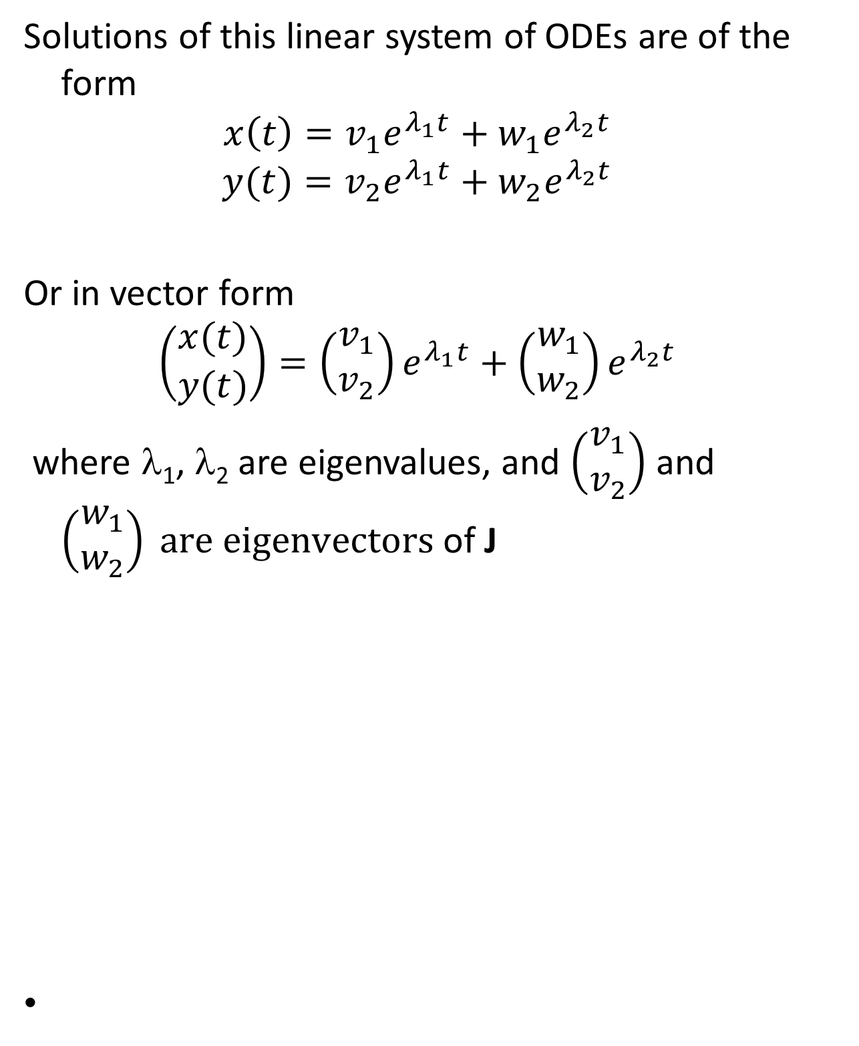
Linearised dynamics
Solutions of this linear system of ODEs are of the form
$$x\left(t\right)=v_{1}e^{λ_{1}t}+w_{1}e^{λ_{2}t}$$
$$y(t)=v_{2}e^{λ_{1}t}+{w_{2}e}^{λ_{2}t}$$
Or in vector form
$$\left(\begin{matrix}x(t) \\ y(t)\end{matrix}\right)=\left(\begin{matrix}v_{1} \\ v_{2}\end{matrix}\right)e^{λ_{1}t}+\left(\begin{matrix}w_{1} \\ w_{2}\end{matrix}\right)e^{λ_{2}t}$$
where λ₁, λ₂ are eigenvalues, and $\left(\begin{matrix}v_{1} \\ v_{2}\end{matrix}\right)$ and $\left(\begin{matrix}w_{1} \\ w_{2}\end{matrix}\right) are eigenvectors$of J

Slide 13
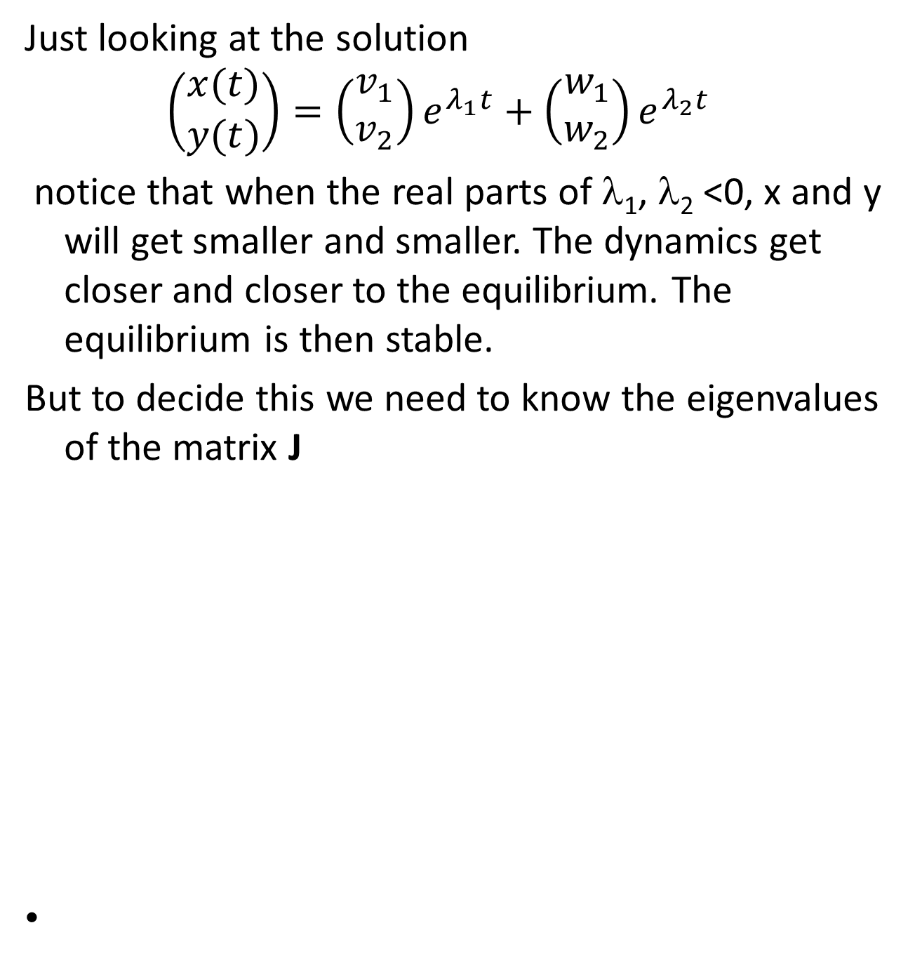
Linearised dynamics
Just looking at the solution
$$\left(\begin{matrix}x(t) \\ y(t)\end{matrix}\right)=\left(\begin{matrix}v_{1} \\ v_{2}\end{matrix}\right)e^{λ_{1}t}+\left(\begin{matrix}w_{1} \\ w_{2}\end{matrix}\right)e^{λ_{2}t}$$
notice that when the real parts of λ₁, λ₂ <0, x and y will get smaller and smaller. The dynamics get closer and closer to the equilibrium. The equilibrium is then stable.
But to decide this we need to know the eigenvalues of the matrix J

Slide 14
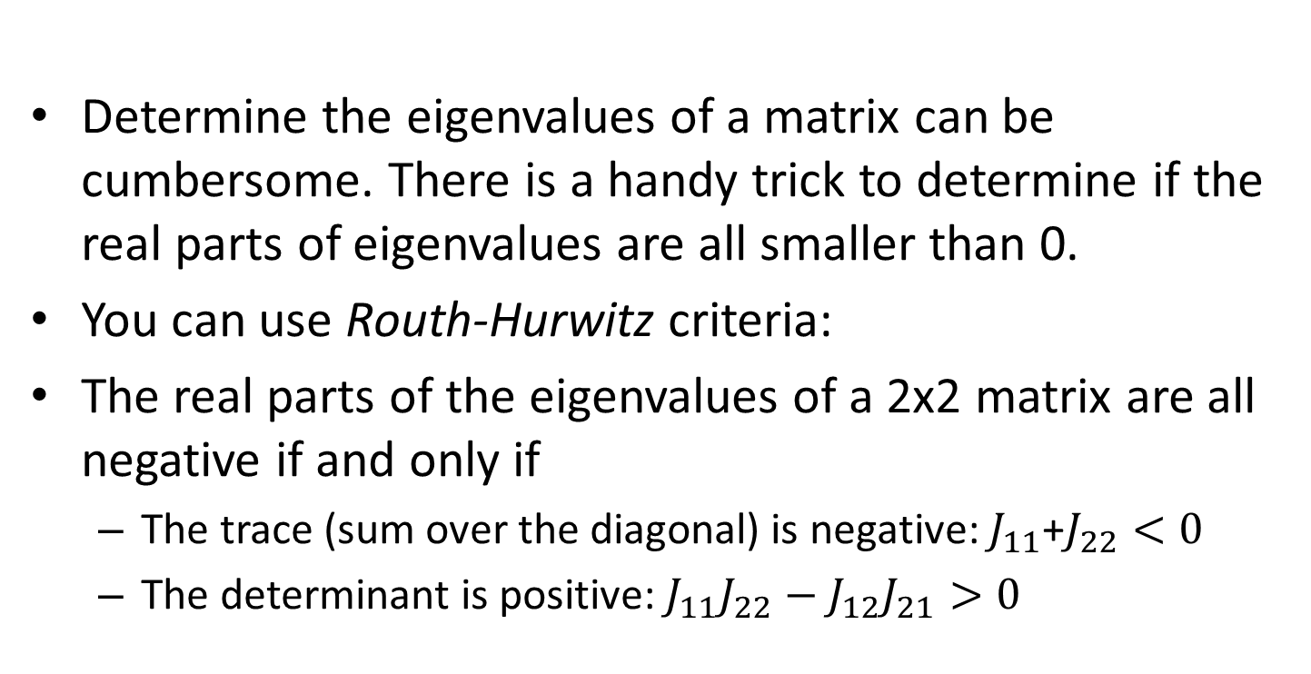
Do I really need to find the eigenvalues?
Determine the eigenvalues of a matrix can be cumbersome. There is a handy trick to determine if the real parts of eigenvalues are all smaller than 0.
You can use Routh-Hurwitz criteria:
The real parts of the eigenvalues of a 2x2 matrix are all negative if and only if
The trace (sum over the diagonal) is negative: $J_{11}$+$J_{22}<0$
The determinant is positive: $J_{11}J_{22}−J_{12}J_{21}>0$

Slide 15
On the blackboard, show RH criteria for 2x2

Slide 16
Equilibria and stability
Now we will apply this to the Lotka-Volterra interaction model

Slide 17
Equilibria and stability
Using vector notation

Slide 18
Equilibria and stability
Let and
The dynamics close to an equilibrium are approximately:
Next we will look at the 4 equilibria and study their stability

Slide 19
Stability of
The dynamics close to equilibrium are approximately:

Slide 20
Stability of
The Jacobian matrix is
One eigenvalue is -r₁k₁ (same as the logistic model), the other one is r₂k₂ (1-βk₁/k₂)
If r₂k₂>0 and 1-βk₁/k₂<0 y moves towards y=0 and
if r₂k₂>0 and 1-βk₁/k₂>0 y moves away from y=0 (equilibrium unstable)
This allows the interpretation that if 1/β>k₁/k₂ then N₂ can invade in

Slide 21
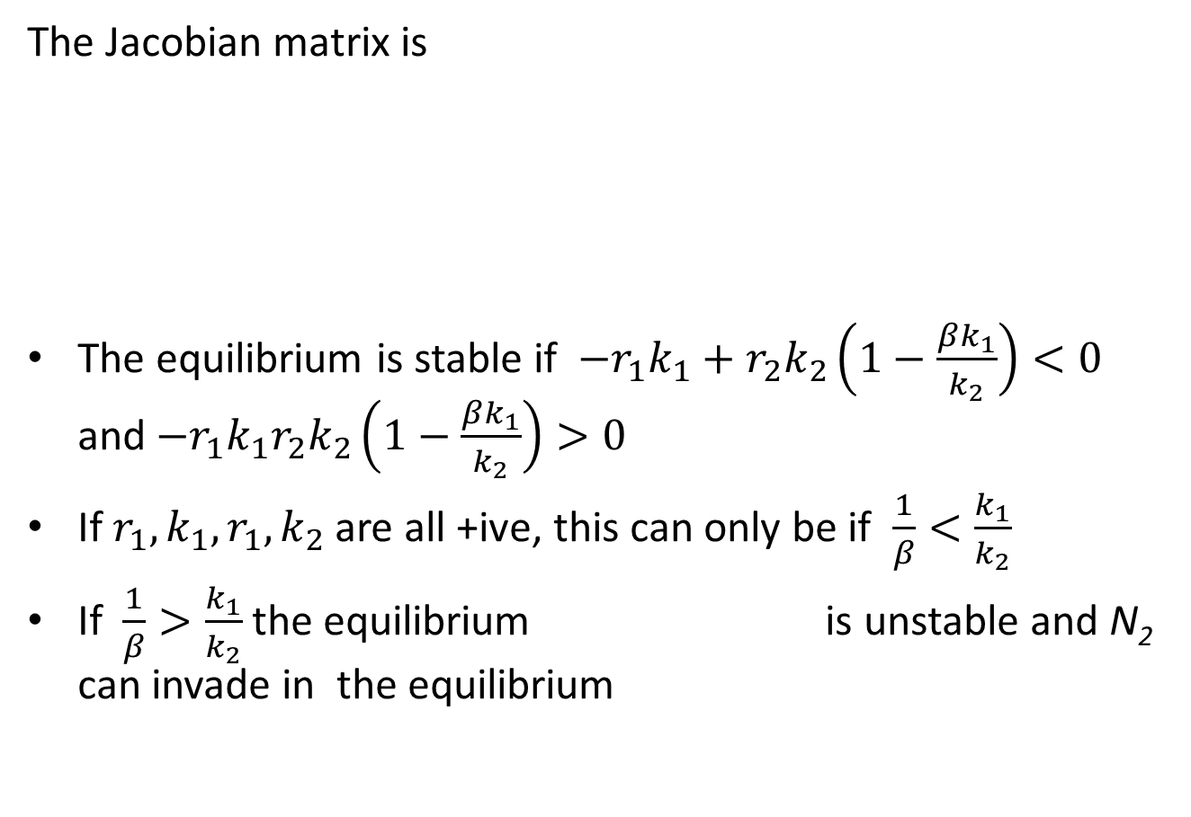
Stability of
The Jacobian matrix is
The equilibrium is stable if $−r_{1}k_{1}+r_{2}k_{2}\left(1−\frac{βk_{1}}{k_{2}}\right)<0$ and$−r_{1}k_{1}r_{2}k_{2}\left(1−\frac{βk_{1}}{k_{2}}\right)>0$
If $r_{1},k_{1},r_{1},k_{2}$ are all +ive, this can only be if $\frac{1}{β}<\frac{k_{1}}{k_{2}}$
If $\frac{1}{β}>\frac{k_{1}}{k_{2}}$ the equilibrium is unstable and N₂ can invade in the equilibrium

Slide 22
Stability of
The dynamics close to equilibrium are approximately:

Slide 23
Stability of
The dynamics close to equilibrium are approximately:

Slide 24
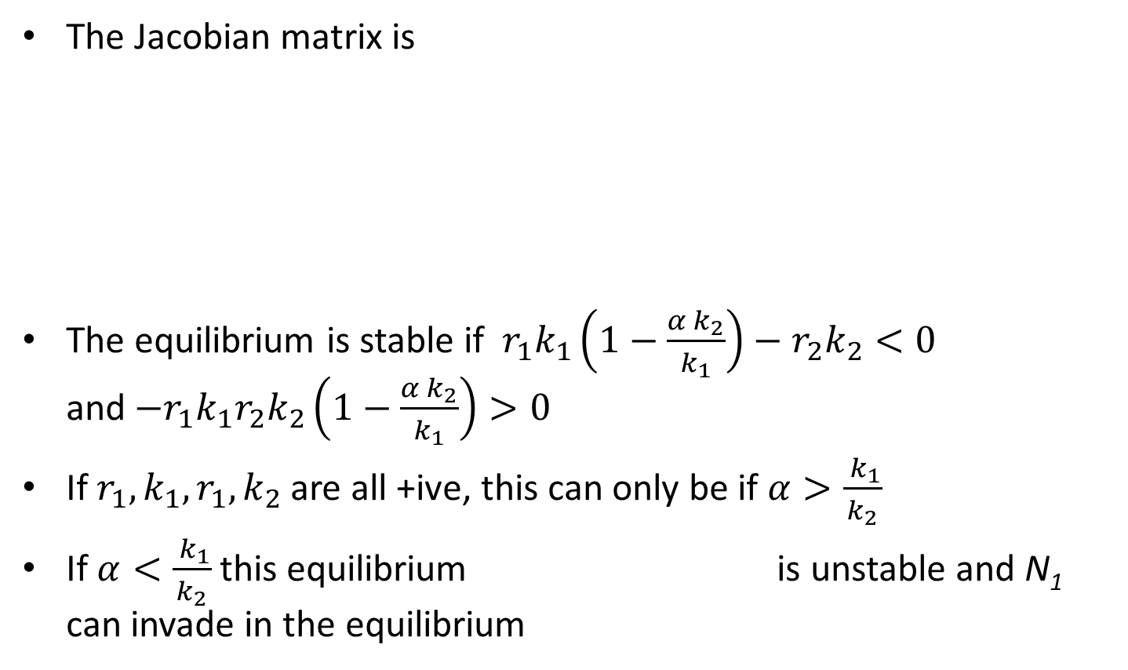
Stability of
The Jacobian matrix is
The equilibrium is stable if $r_{1}k_{1}\left(1−\frac{α k_{2}}{k_{1}}\right)−r_{2}k_{2}<0$ and$−r_{1}k_{1}r_{2}k_{2}\left(1−\frac{α k_{2}}{k_{1}}\right)>0$
If $r_{1},k_{1},r_{1},k_{2}$ are all +ive, this can only be if $α>\frac{ k_{1}}{k_{2}}$
If $α<\frac{ k_{1}}{k_{2}}$this equilibrium is unstable and N₁ can invade in the equilibrium

Slide 25
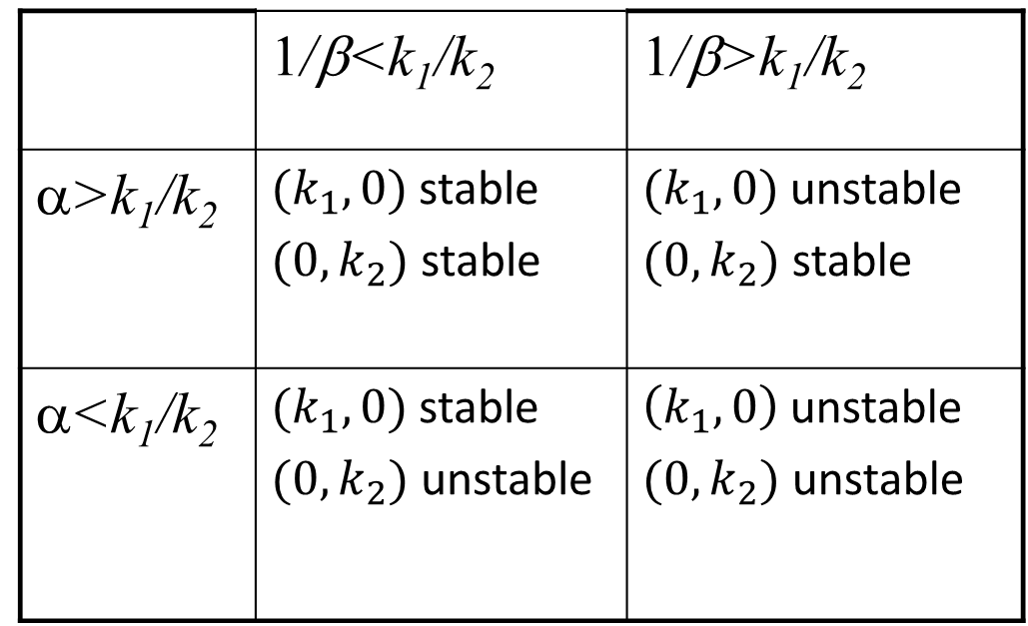
Formal criteria
The following inequalities predict the outcome of competition (if all rs and ks +ive)
 | 1/β<k₁/k₂ | 1/β>k₁/k₂
α>k₁/k₂ | $(k_{1},0)$ stable $(0,k_{2})$ stable | $(k_{1},0)$ unstable $(0,k_{2})$ stable
α<k₁/k₂ | $(k_{1},0)$ stable $(0,k_{2})$ unstable | $\left(k_{1},0\right)$ unstable $(0,k_{2})$ unstable

Slide 26
Formal criteria
The following inequalities predict the outcome of competition (if all rs and ks +ive)
 | 1/β<k₁/k₂ | 1/β>k₁/k₂
α>k₁/k₂ | Neither can invade | N₁ no invasion, N₂ invades
α<k₁/k₂ | N₁ invades, N₂ doesnot | Both invade

Slide 27
Formal criteria to predict the outcome of the LV model
The following inequalities predict the outcome of competition (if all rs and ks +ive)
 | 1/β<k₁/k₂ | 1/β>k₁/k₂
α>k₁/k₂ | Alternative stable states | Species 2 excludes 1
α<k₁/k₂ | Species 1 excludes 2 | Coexistence

Slide 28
But how about the stability of the 4th equilibrium?
Equilibrium is given by
The dynamics close to equilibrium are approximately:
And from this we can calculate the eigenvalues and eigenvectors

Slide 29
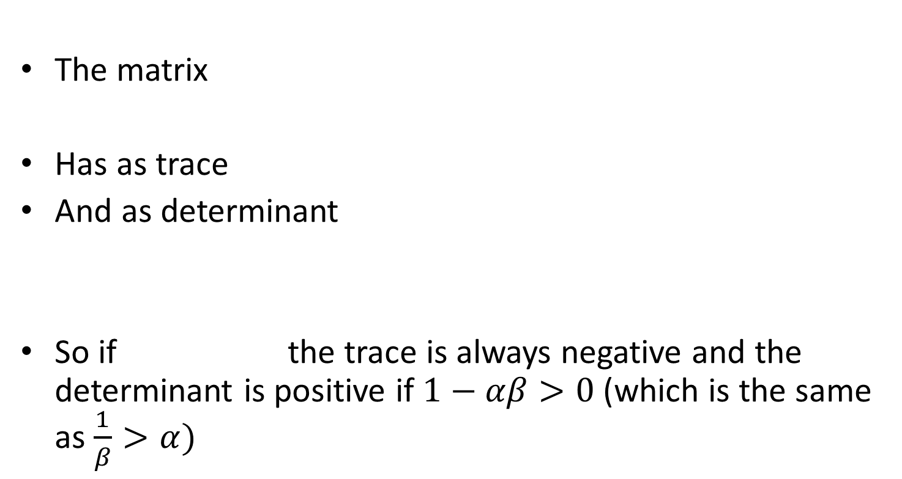
But how about the stability of the 4th equilibrium?
The matrix
Has as trace
And as determinant
So if the trace is always negative and the determinant is positive if $1−αβ>0$(which is the same as $\frac{1}{β}>α)$

Slide 30
Formal criteria
The following inequalities predict the outcome of competition (if all rs and ks +ive)
 | 1/β<k₁/k₂ | 1/β>k₁/k₂
α>k₁/k₂ | Neither can invade Eq. 4 unstable | N₁ no invasion, N₂ invades Eq. 4 not +ive
α<k₁/k₂ | N₁ invades, N₂ no invasion Eq. 4 not +ive | Both invade Eq. 4 stable

Slide 31
Formal criteria to predict the outcome of the LV model
The following inequalities predict the outcome of competition (if all rs and ks +ive)
 | 1/β<k₁/k₂ | 1/β>k₁/k₂
α>k₁/k₂ | Alternative stable states | Species 2 excludes 1
α<k₁/k₂ | Species 1 excludes 2 | Coexistence

Slide 32
Classification as bifurcations
α
k₁/k₂
k₁/k₂
1/β

Slide 33
Graphical method
to establish the outcome of competition
Mark the position of the carrying capacities on the appropriate axes
Draw the isoclines
If the isoclines do not intersect, the competition will lead to the equilibrium associated with the topmost isocline
If the isoclines do intersect, draw a straight line between the carrying capacities. If the intersection of the isoclines is positioned above this line the two species will coexist.
If the intersection of the isoclines is positioned below this line two alternative stable states (the carrying capacities) exist

Slide 34
Do Practical 2: Make a 1 parameter bifurcation diagram of the Lotka-Volterra competition model

Slide 35
What do the eigenvalues and eigenvectors mean?
In the phase plane, eigenvectors are linear approaches over which you can move away from, or towards, an equilibrium (close to the equilibrium)
The eigenvalues are the speed with which you move towards, or away from the equilibrium over these eigenvectors
In the vicinity of the equilibrium the directions are the weighted vector sums of the eigenvectors

Slide 36
What do the eigenvalues and eigenvectors mean?
Eigenvectors for the unstable equilibrium

Slide 37
What do the eigenvalues and eigenvectors mean?
If one of the eigenvalues is positive, the equilibrium is unstable, you will move away from it
If some eigenvalues are positive whilst others are negative, the point is a saddle: you can move towards it from certain directions, but move away from it once you get closer
The eigenvalues are the speed with which you move towards, or away from the equilibrium over these eigenvectors

Slide 38
Competitive exclusion principle
For coexistence we require 1/β>k₁/k₂ and α<k₁/k₂ (hence 1/β>α )
In words this means:
for coexistence we require that
the interspecific competition should be weaker than the intraspecific competition.

Slide 39
Competitive exclusion principle
If 1/β=α the dd parts of the eqns can be rewritten as
K1-(N1+aN2)
And
K2-(N1+aN2)/a
N1+aN2 is the part of the resource that is locked up in the pops.
TO explain: say
R=R0-N1-aN2
Let dN1/dt=r1 N1(C1+R)= r1 N1 (C1+R0-N1-aN2)
And dN2/dt=r2 N2 (C2+R)= r2 a N2 (C2/a+ R0/a-N1/a-N2)
doesn’t seem to clarify much
For coexistence we require α>1/β
If two species use resources in exactly the same way α=1/β (isoclines are parallel)
If α ≈ 1/β the two species are very similar in their resource use (isoclines almost parallel)
In that case there is only a narrow range of carrying capacities for which coexistence is possible
If α = 1/β the two species are the same in their resource use (isoclines parallel), no coexistence is possible

Slide 40
Learning outcomes
Understand the concept of local stability means in a model with 2 species
Being able to predict the outcome of competition in the L-V interaction model

