Slide 1

2023-24 2-3 Interspecific competition between two species Apparent Competition
Vincent Jansen
vincent.jansen@rhul.ac.uk

Slide 2
Outline
2-1 The Lotka-Volterra Interaction Model
2-2 Equilibria and Stability
2-3 Apparent Competition

Slide 3
Lotka-Volterra interaction model
Describes how the densities of two competing species change simultaneously
It is a system of 2 differential equations:

Slide 4
Limitations of the L-V model
The model assumes constant competition coefficients. It might well be that the effects of competition depend in some complicated way on the densities.
It is quite possible that the populations are structured so that this description is not correct (e.g. age structure, spatial structure, etc. ). (You would then need more than 2 equations to describe this)

Slide 5
Limitations of the L-V model
All effects of competition are assumed to be immediate. No delays are taken into account
The model only considers competition and no effects of any other parts of the ecosystem are taken into account (e.g. depletion of resources, shared predators or pathogens)

Slide 6
Apparent Competition
We have so far implicitly assumed that competition has a direct effect on the other species
This need not always be the case. Indirect effects occur when the effect of species 1 on species 2 is transmitted through a third species

Slide 7

Apparent Competition
The idea goes back to Robert Holt (1977)
This is Bob visiting the Royal Holloway picture gallery

Slide 8
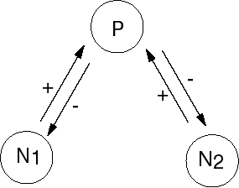
Apparent Competition
A shared predator can mediate an indirect effect between two species, even if there is no direct contact between them
This is called apparent competition

Slide 9
Apparent Competition
a model could read:
and the predator density changes as:

Slide 10
Apparent Competition
We can bring this back to a 2 species model by assuming that the predator responds much faster, and is at quasi-equilibrium
So that the model reads

Slide 11
Apparent Competition
We get the 2 species the L-V model back
It can be shown that for large carrying capacities one species of prey always outcompetes the other.
The species that wins the competition is the one that can withstand the highest predator density

Slide 12


Apparent Competition
Bonsall and Hassell (1997) performed an experiment in which to study apparent competition
The studied 2 species of moths. Each species on its own could support a parasitic wasp which attacks the larvae
Imperial College, Silwood Park

Slide 13
Apparent Competition
Next they let the species compete in an arena in which the moths had no direct interaction, but in which the wasp mediated an indirect interaction

Slide 14
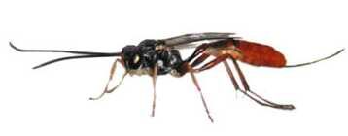
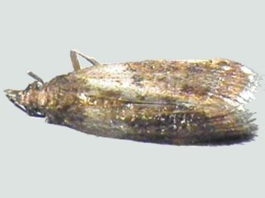
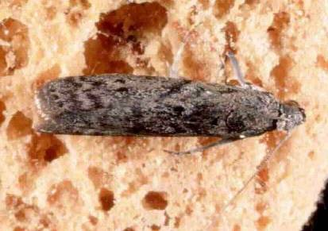
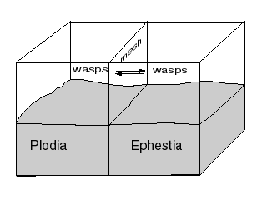
Apparent Competition

Slide 15
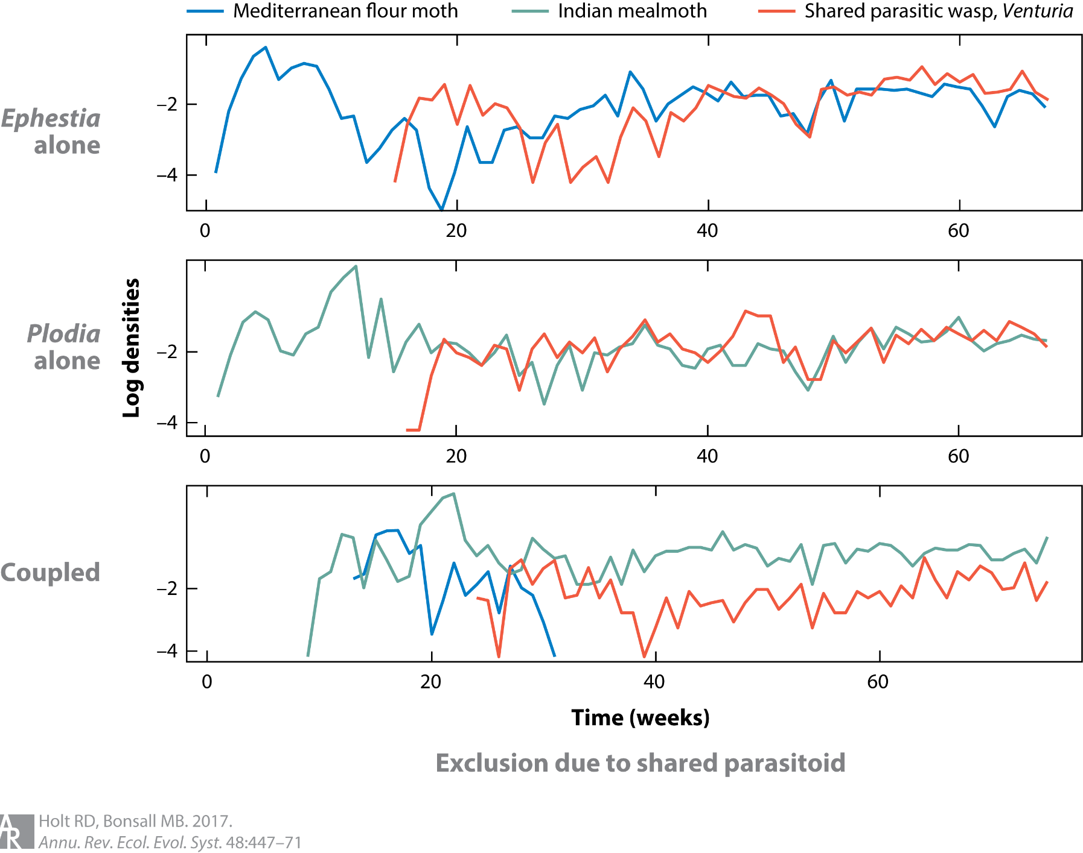

Slide 16
Apparent Competition
They found that one of the moths, Ephestia kuehniella, was repeatedly eliminated in this experiment.
Because Ephestia kuehniella on its own can persist in the presence of the parasitic wasp, this is due to apparent competition

Slide 17
Apparent Competition
This confirmed the theoretical prediction.
It is also illustrates the limitations of the Lotka-Volterra competition model.
It has also been shown that apparent competition occurs in the field: by removing a herbivore species from enclosures in a rainforest Morris et al. (2004) provided experimental evidence for competitive exclusion.

Slide 18
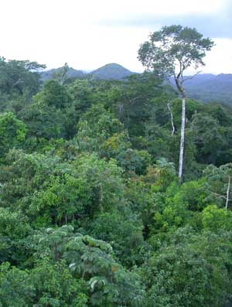
Apparent competition in the rain forest
Rainforest in Belize

Slide 19
Notes:
In the experiment the host plant of Calcomyza (flies) and Pentispa (a beetle) is removed. The effect (in terms of parasitism a, and abundance b) is measured for leaf miners (in red) and Pachyschelus (another beetle)

Slide 20
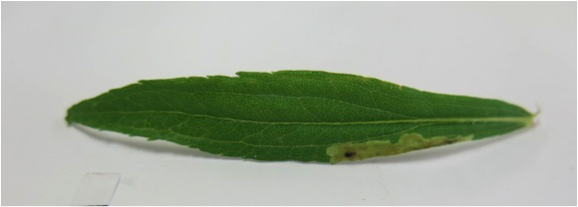
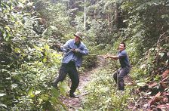
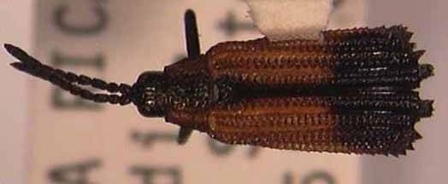
Pachyschelus collaris
Removing the host plant for 8 leaf miner species (Calcomyza) and Pentispa fairmairei

Slide 21

Effect on parasitism
Effect on abundance
Notes:
In the experiment the host plant of Calcomyza (flies) and Pentispa (a beetle) is removed. The effect (in terms of parasitism a, and abundance b) is measured for leaf miners (in red) and Pachyschelus (another beetle)

Slide 22
Learning outcomes
Understand the rationale behind the Lotka-Volterra interaction model
Know the 3 possible outcomes of competition
Understand isoclines and phase plots
Understand the concept of local stability means in a model with 2 species
Have an appreciation of the limitations of the LV model

