Slide 1

2023-24 3-2 Alternative stable states, phase shifts and catastrophic transitions. Chaos and unpredictability Chaos and Unpredictability
Vincent Jansen
vincent.jansen@rhul.ac.uk

Slide 2
Outline
3-1 Phase Shifts and Catastrophic Transitions
3-2 Chaos and unpredictability

Slide 3
Back to the logistic
A Drosophila population kept in the lab. Another logistic growth curve from the work of Pearl. (1927) Q. Rev. Biol. 2 532-548.

Slide 4
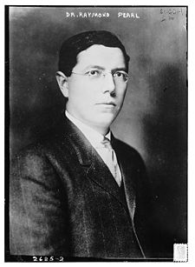
A quote from Pearl (1927)
“Many experiments of this type have been performed. The general result is that the population first grows up to a maximum or asymptotic level, …. A striking result, however, is that both during the growth period and thereafter there are violent oscillations of the populations in size, about its mean position as given by the fitted curve. In fact these waves in the size of the population, produced by oscillations in the birth and death rates, are perhaps the most characteristic feature of population experiments of this particular type. It has not so far been possible to devise any method of holding these populations in a steady state at the level of the asymptote, when there is at all times an abundance of fresh food. The population simply waves up and down about an average size. “

Slide 5
Back to the logistic
Remember, the continuous time logistic model assumes that the density dependence works immediately
For the fruit flies the effect of the density dependence is delayed
What is the effect of such a delay?
Notes:
Density dependence works on the larvae, but the effect is on the nr of eggs laid in the next generation.

Slide 6
Logistic Map
The discrete logistic model (also called logistic map) is given by
with r the maximum per capita growth rate and k the carrying capacity.

Slide 7
Logistic Map
rk
-rk

Slide 8
Logistic Map
For low values of rk the dynamics are very similar to those of the continuous growth model. (Value r=1 used in all the pictures)
_{k=1}
N_{t}
t

Slide 9
Logistic Map
If rk is bigger the dynamics begin to differ from the continuous time model
_{k=2.56}
_{k=2.05}
_{k=1.75}
_{k=2.5}
N_{t}
t

Slide 10
Logistic Map : finding the equilibrium
k

Slide 11
Logistic Map: Stability of the equilibria
We study the dynamics close to the equilibrium
The distance from the equilibrium is
The dynamics close to equilibrium are approximately:
If :
Note that if the multiplier is < −1 or >1 the equilibrium is unstable
Stable if 0<rk<2

Slide 12
Logistic Map: Stability of the equilibrium
N_{t+1}=f(N_{t})
k

Slide 13
Stability of the equilibrium
So what happens if the equilibrium loses stability?
The analysis suggests periodic oscillations. Does this settle into a stable pattern?
We can find the value for the next step from N_{t+1}=f(N_{t})
So after 2 steps we have
Is there an equilibrium that is reached if we look at every second step?

Slide 14
Logistic Map Period 2 cycle
_{k=2.00}
_{k=1.75}
_{k=2.25}

Slide 15
Logistic Map Bifurcation diagram

Slide 16

Logistic Map Bifurcation diagram
The equilibrium becomes unstable.
We can see limit cycles
We see the sequence
Overcompensation->Period 2 cycles
->Period 4 cycles->Period 8 cycles
What next?
After going through the period doubling cascade one finds chaos

Slide 17
Logistic Map Bifurcation diagram

Slide 18
Sensitivity to initial conditions
Density/
population size
Chaotic dynamics are irregular: there is no cyclic repetition of densities, no matter how long a time series you investigate
Chaotic dynamics are sensitive to initial conditions: the butterfly effect
k

Slide 19
Chaos
_{k=2.56}
log(difference red and black plots)
N_{t}
t

Slide 20
Chaos
_{k=2.65}
N_{t}
log(difference red and black plots)
t

Slide 21
Chaos
Why does chaos matter in biology?
It shows that unpredictability can follow even if you know exactly how one generation depends on the next
There are limits to what we can predict, (because we cannot know the present conditions with sufficient precision)

Slide 22
Do Practical 2: Investigate the dependence on initial conditions, and how it affects the predictability of the logistic map.
(This will help visualising when chaos occurs. In the bifurcation diagram you can’t see this)

Slide 23
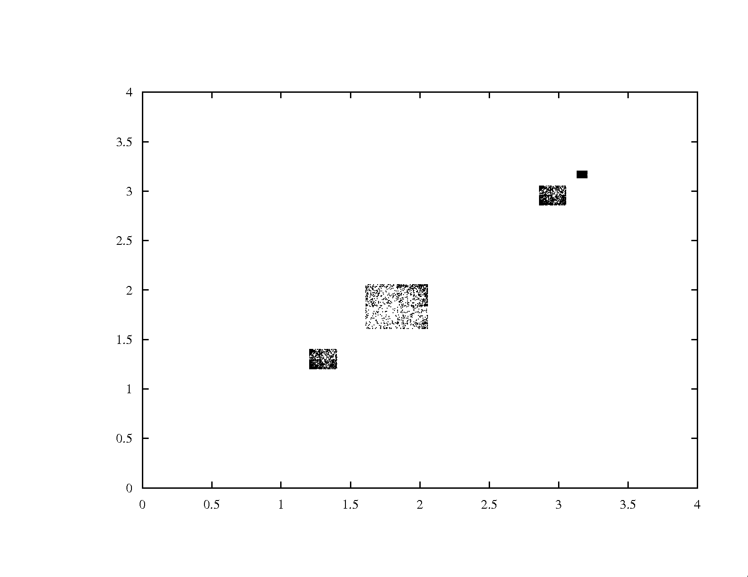
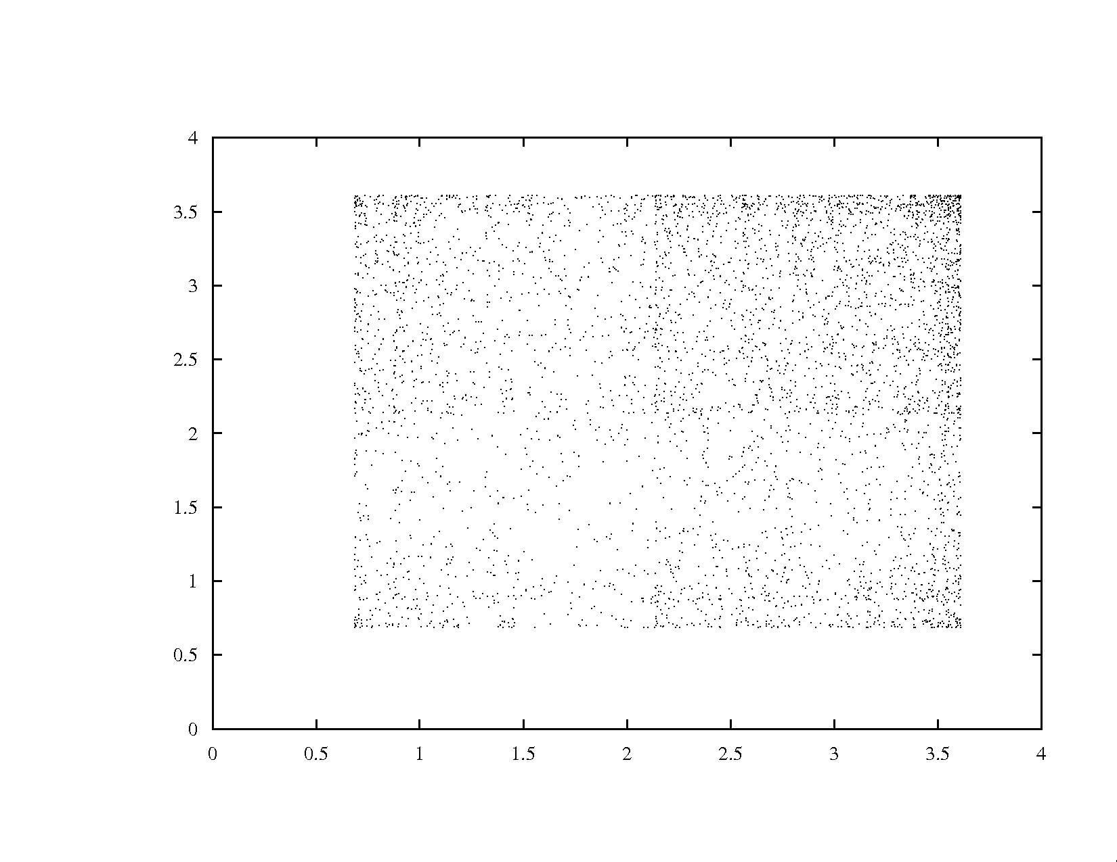
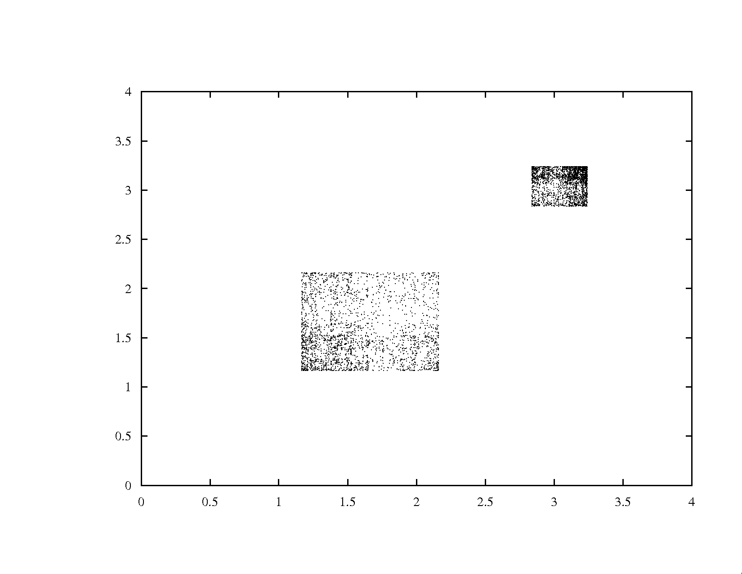
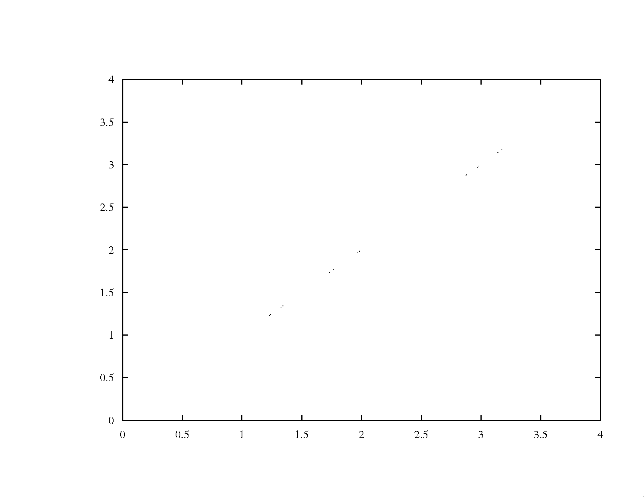
k=2.8
k=2.58
k=2.6
k=2.55
predicted
observed

Slide 24
Chaos
Are population dynamics chaotic?
There is an example of a single species laboratory system of which the dynamics seem chaotic

Slide 25
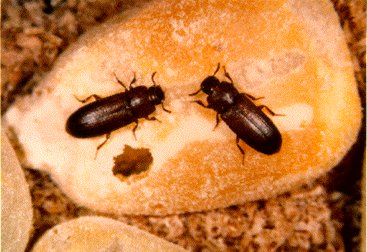
Chaos
Notes:
Results on the flour beetle Tribolium. By manupulating adult mortality rate the dynamics can be changed. The model predicts different types of behaviour for different levels of manipulation. Manipulation starts at week 12.

Slide 26
Chaos
There are some indications that other systems, with more species are chaotic
Beninca et al. isolated a marine ecosystem and kept it in the lab. They found:
Notes:
Conclusion: foodwebs that persist in nature can still be chaotic. Stability is not required for persistence

Slide 27
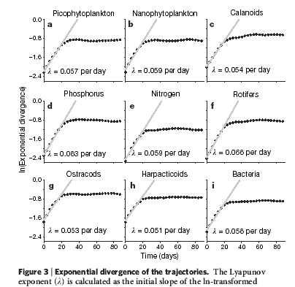
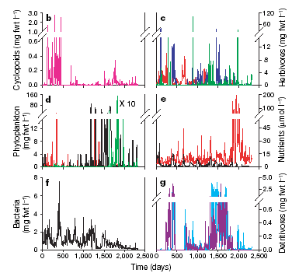
Chaos
Notes:
Conclusion: foodwebs that persist in nature can still be chaotic. Stability is not required for persistence

Slide 28
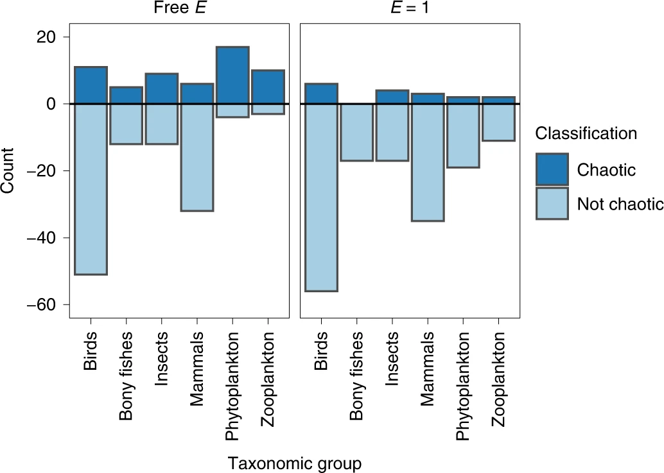
Chaos is not rare in nature
172 times series were screened for chaos (Lyapunov exponent)
v
Chaos is not rare in natural ecosystems, Rogers et al. (2022) Nature Ecology & Evolution volume 6, pages 1105–1111

Slide 29
Learning outcomes
Simple models can have complicated dynamics
Even if you know exactly how things work, it doesn’t mean you can predict them in the long term

