Slide 1

2023-24 4-1 Predator-prey models, limit cycles, Hopf bifurcation The Lotka-Volterra predator-prey model
Vincent Jansen
vincent.jansen@rhul.ac.uk

Slide 2
Outline
4-1 The Lotka-Volterra predator-prey model
4-2 Variations on the predator-prey theme
4-3 Spatial predator-prey interactions

Slide 3
Trophic interactions
Trophic interactions capture all interactions where one species uses another species to feed and reproduce on.
This includes predation, herbivory and parasitism.

Slide 4
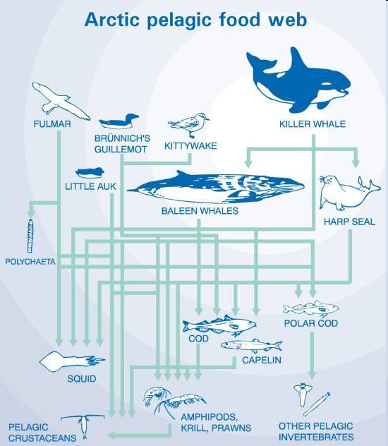
Trophic interactions
Trophic interactions are conspicuous
They are fairly easy to detect and quantify (gut contents)
They are therefore probably over-represented in ecological studies compared to competitive interactions
Food web theory is almost exclusively dedicated to trophic interactions, competition in food webs is rarely measured

Slide 5
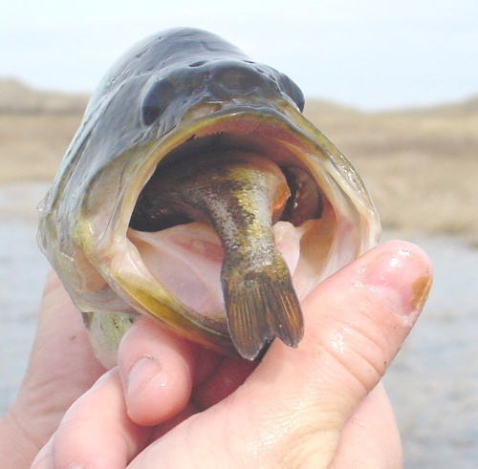
D’Ancona’s observation

Slide 6
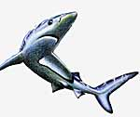
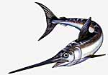
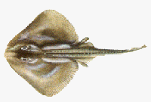
D’Ancona’s observation
Umberto D’Ancona studied data of the Adriatic fisheries
During the first world war (1914-1918) the fishery effort in the Adriatic had been much reduced

Slide 7
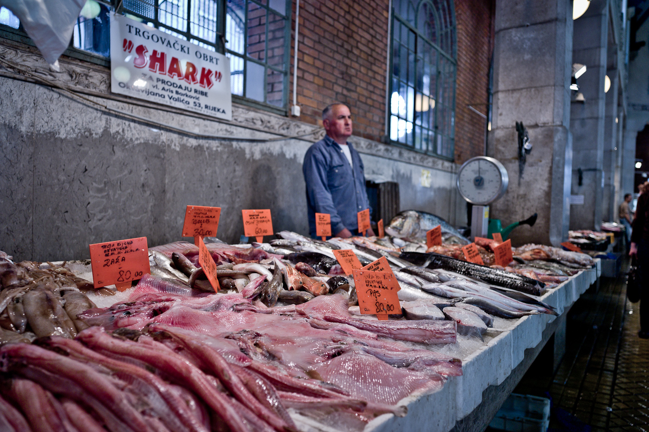
Fiume (Riyeka) fishmarket

Slide 9
D’Ancona’s observation
He noticed that the proportion of predatory fish (sharks, skates, rays etc.) had increased.
Fishermen concentrate on prey fish.
Why the increase?

Slide 10
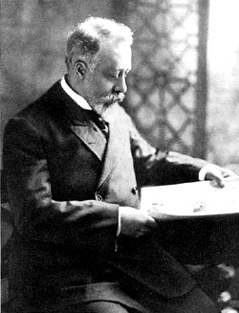
D’Ancona’s observation
This is puzzling as fishermen prefer to catch prey fish.
D’Ancona asked his fiancee’s father, Vito Volterra, how this could be explained.
Vito Volterra was a theoretical
physicist who was developing
an interest in biology.
Vito Volterra
(1860-1940)

Slide 11
Lotka-Volterra predator-prey model
Volterra produced a model (published 1924, Alfred Lotka produced a similar model at about the same time)
The model is similar in structure to the L-V competition model. In the competition model both species suffer from each other’s presence (--) in this model the prey suffers, the predator benefits (-+)

Slide 12
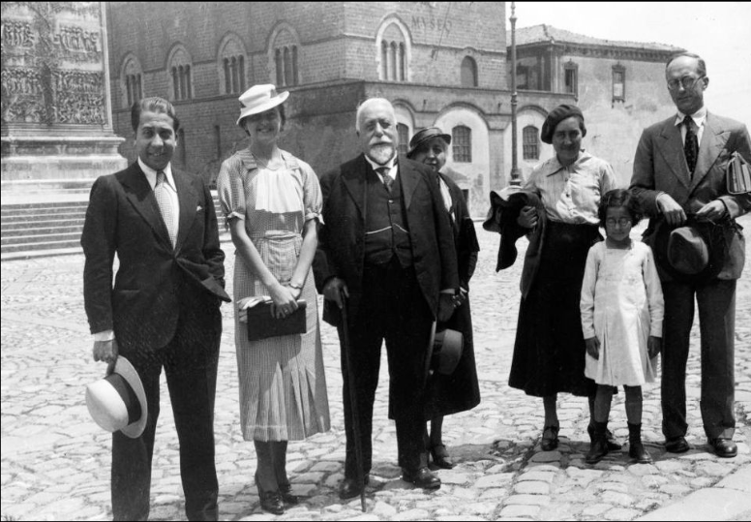
Volterra and family (1930).
L-R: Gustavo & Emilia Volterra, Vito & Virginia Volterra, Luisa D’Ancona, Silvia D’Ancona and Umberto D’Ancona.

Slide 13
Predators and their prey
Volterra assumed:
Without predators the prey population grows unbounded, no density dependence
Without prey the predator population disappears
The number of prey caught only depends on encounter probabilities

Slide 14
Lotka-Volterra predator-prey model
We will use a slightly different notation (following Gotelli)
V: density of the prey (victim) population
P: density of the predator population
In the absence of the predator the prey grows exponentially

Slide 15
Lotka-Volterra predator-prey model
Functional response: the per predator effect of predation on the prey’s growth rate
α is the capture efficiency, assumed to be constant
The functional response is αV
The prey’s growth rate is:

Slide 16
Lotka-Volterra predator-prey model
The per capita prey growth rate is
The per capita prey growth rate is independent of prey density
If the predator density is low, the prey population increases, if it is high it decreases

Slide 17
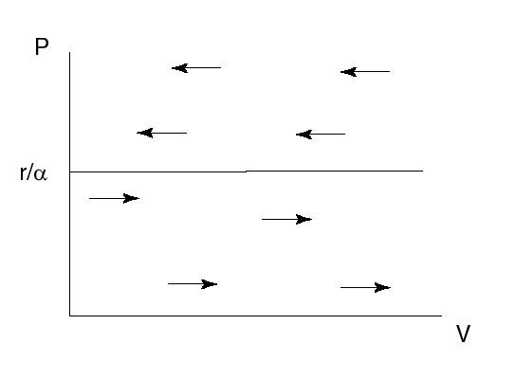
Lotka-Volterra predator-prey model
Prey dynamics if predator density is constant

Slide 18
Lotka-Volterra predator-prey model
In the absence of the prey the predator population will decrease
The predator’s death rate is q
In the absence of prey, the predator population changes as:

Slide 19
Lotka-Volterra predator-prey model
β is the amount of energy gained per unit of time. (If e is the conversion efficiency, β=eα)
The numerical response is βV
The predator’s growth rate is

Slide 20
Lotka-Volterra predator-prey model
The per capita predator growth rate is
The per capita predator growth rate is independent of predator density
If the prey density is low, the predator population decreases, if it is high it increases

Slide 21
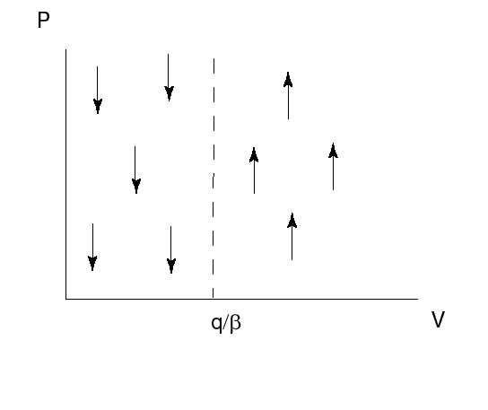
Lotka-Volterra predator-prey model
Predator dynamics if prey density is constant

Slide 22
Lotka-Volterra predator-prey model
The densities of predator and prey change simultaneously
This is described by a system of 2 differential equations:
This model is known as the Lotka-Volterra predator-prey model

Slide 23
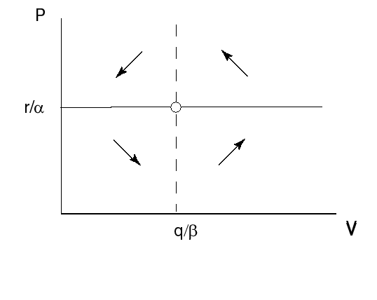
Lotka-Volterra predator-prey model
Combined isoclines

Slide 24
Lotka-Volterra predator-prey model
The prey equilibrium density is given by q/β: only depends on the parameters relating to the predator.
The predator equilibrium density is given by r/α only depends on the parameters relating to the prey.

Slide 25
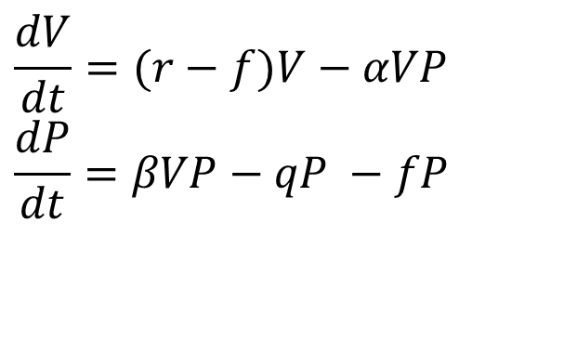
Lotka-Volterra predator-prey model with fishery effort
$$\frac{dV}{dt}=(r−f)V−αVP \\ \frac{dP}{dt}=βVP−qP −fP$$
If we assume that fish is caught with rate f, the model reads:
The prey equilibrium is now V*=(q + f)/β
The predator equilibrium is now P*=(r - f)/α

Slide 26
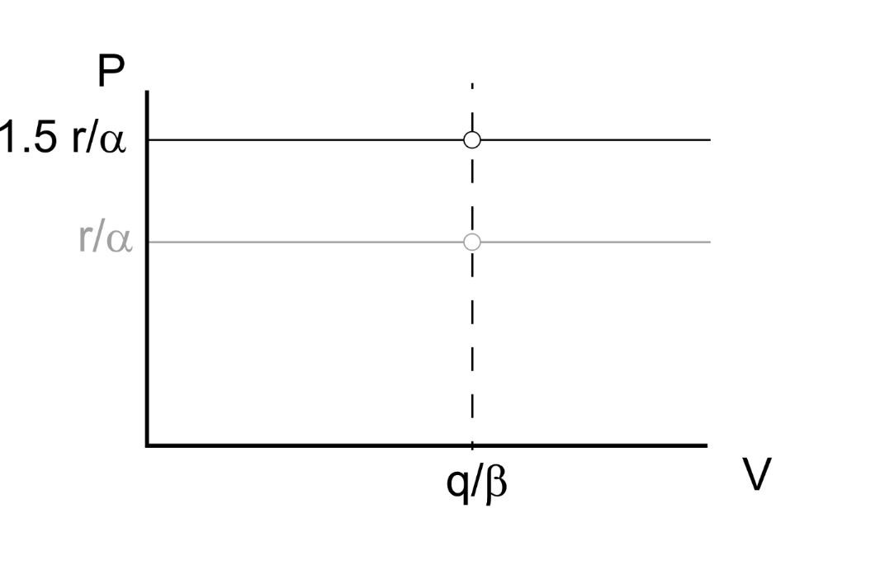
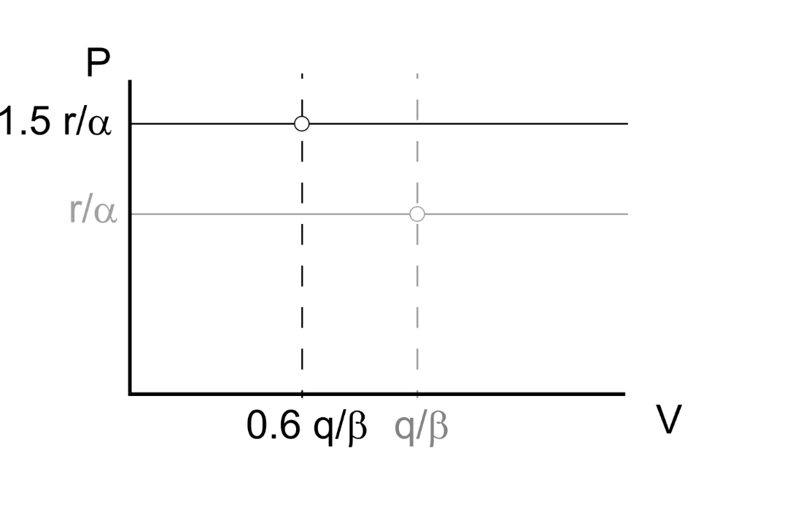
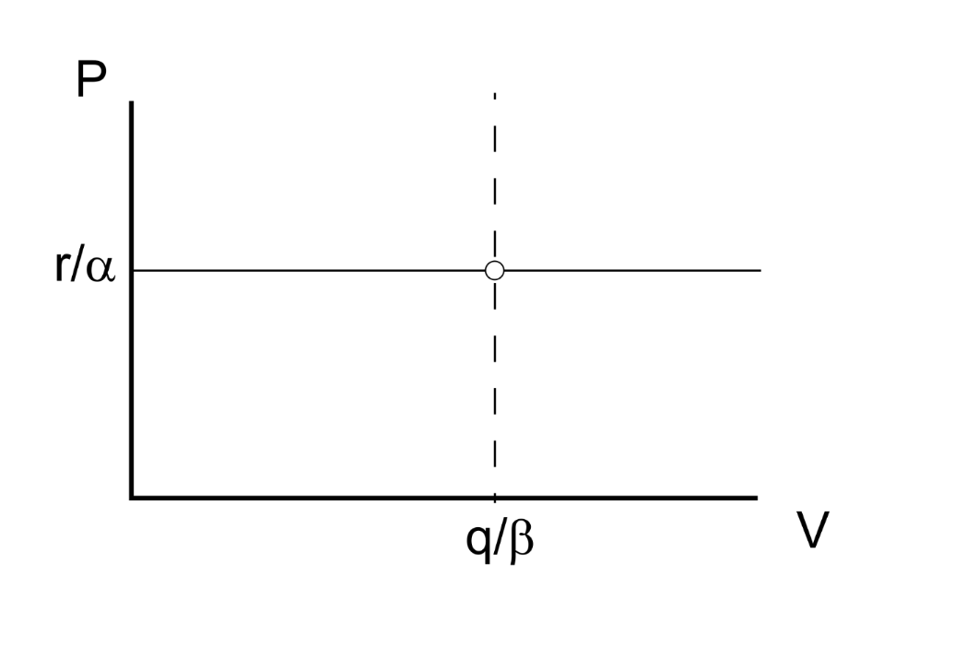
Lotka-Volterra predator-prey model
Say that reduced fishing increases the prey’s growth rate and decreases the predator’s death rate by Δ
Both increase the predator-prey ratio
(r+ Δ)/α
(q- Δ)/β

Slide 27
Lotka-Volterra predator-prey model
A reduced fishing effort (directed at prey and predatory fish) will have two effects: it increases the predator’s equilibrium density and decreases the prey’s equilibrium density
This can explain D’Ancona’s observation why relatively more predator fish was caught after a reduced fishing effort

Slide 29
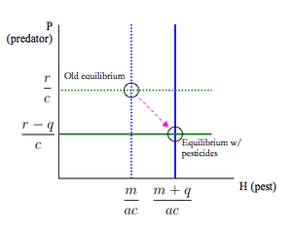
Paradox of the pesticides
The same argument, applied the other way around
Say that applying pesticides decreases prey’s growth rate by 50%
And increases the predator’s death rate by, say, 40%
Resulting in an equilibrium with more pests, and fewer natural enemies
P
r/a
0.6 r/a
q/β
1.4 q/β
V

Slide 30
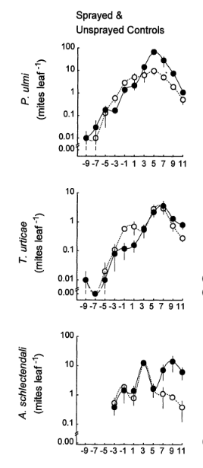
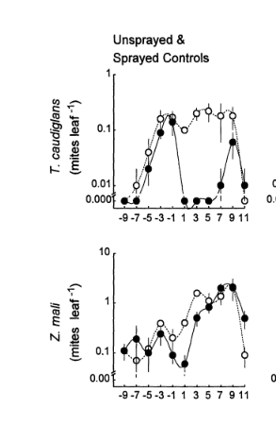


Paradox of the pesticides
Prey and predatory mites in an apple orchard
Phytophagous prey mites
(pests)
Predatory mites
(natural enemies)
The Effects of Refuge Size and Number on Acarine Predator-Prey Dynamics in a Pesticide-Disturbed Apple Orchard
P. J. Lester, H. M. A. Thistlewood, R. Harmsen
Journal of Applied Ecology, Vol. 35, No. 2 (Apr., 1998), pp. 323-331
Notes:
At the time of spraying the phytoseiid predator Typhlodromus caudiglans and the stigmaeid predator Zetzellia mali and Aculus Schlechtendali were present in similar densities. The main phytophagous mites present were the tetranychid mites Panonychus ulmi and Tetranychus urticae. After spraying, Typhlodromus caudiglans was virtually eliminated from sprayed leaves.

Slide 31
Lotka-Volterra predator-prey model, dynamics
Combined isoclines

Slide 32
Lotka-Volterra predator-prey model
The solutions oscillate over time, the amplitude depends on the initial condition much like the motion of a pendulum
Solution over time

Slide 33


Slide 34
Lotka-Volterra predator-prey model
r/α
q/β
Solution as an orbit in a phase plot

Slide 35
Stability
To find the stability we use the distance from the equilibrium x=V-V* and y=P-P* linearise the system, to find

Slide 36
Stability
After substituting the equilibrium values we find that the Jacobian matrix is
Is the equilibrium stable?

Slide 37
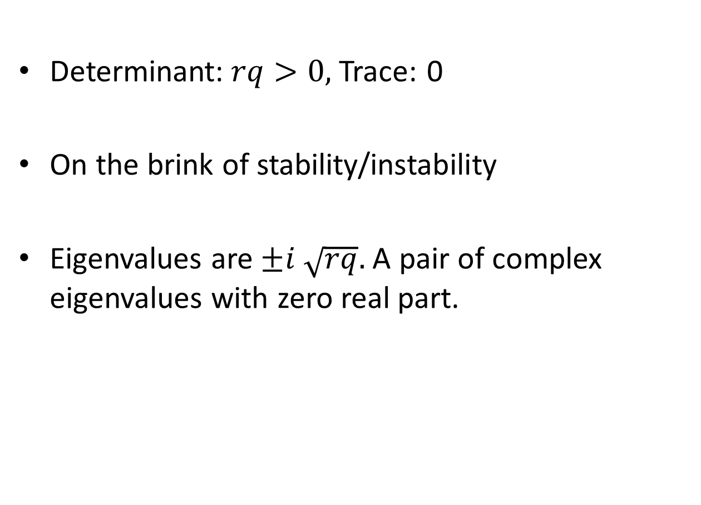
Stability
Determinant:$rq>0,$Trace: 0
On the brink of stability/instability
Eigenvalues are $±i \sqrt{rq}.$ A pair of complex eigenvalues with zero real part.

Slide 38
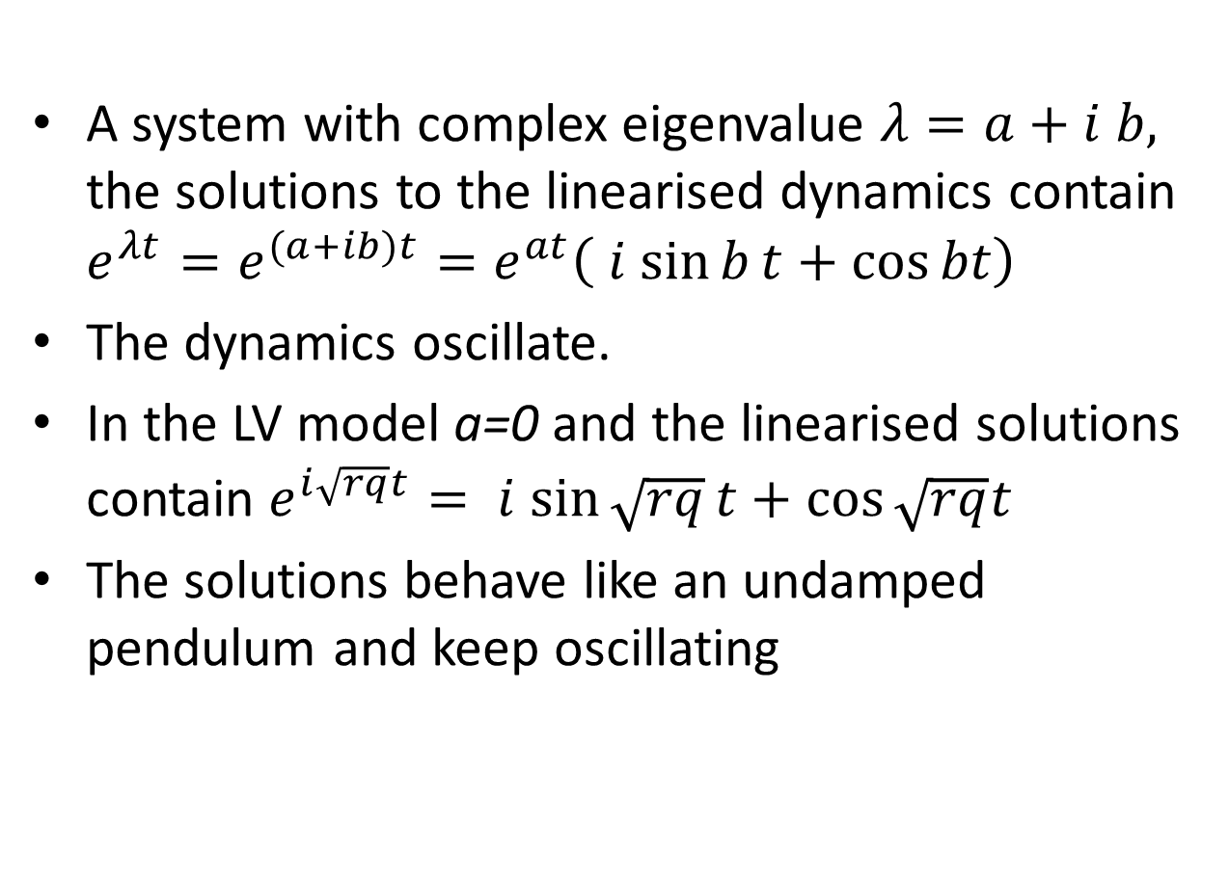
Stability
A system with complex eigenvalue $λ=a+i b,$ the solutions to the linearised dynamics contain $e^{λt}=e^{(a+ib)t}=e^{at}\left(i sin{b}t+\cos{bt}\right)$
The dynamics oscillate.
In the LV model a=0 and the linearised solutions contain $e^{i\sqrt{rq}t}=i sin{\sqrt{rq}}t+\cos{\sqrt{rq}t}$
The solutions behave like an undamped pendulum and keep oscillating

Slide 39
Stability
The model has a constant of motion:
Over one cycle, the value of H is constant.
If the starting point moves away from one cycle, after on revolution you are back to where you started, you remain the same distance from the other cycle
The cycles are therefore all neutrally stable.

Slide 40
Lotka-Volterra predator-prey model
Because the model is on the brink of stability/instability it is very sensitive to a change in the assumptions, slightly changing the assumptions will make (real part of) the eigenvalues +ive or –ive
For this reason it is said that the L-V predator-prey model is not robust

Slide 41
Do Practical 3: (4-1) The Lotka-Volterra predator-prey model

Slide 42
Lotka-Volterra predator-prey model
Assumptions of the model
No delays
No (age, spatial) structure
No prey density dependence
Constant prey capture rate

