Slide 1

2023-24 4-2 Predator-prey models, limit cycles, Hopf bifurcation Variations on the predator-prey theme
Vincent Jansen
vincent.jansen@rhul.ac.uk

Slide 2
Outline
4-1 The Lotka-Volterra predator-prey model
4-2 Variations on the predator-prey theme
4-3 Spatial predator-prey interactions

Slide 3
Lotka-Volterra predator-prey model
Because the model is on the brink of stability/instability it is very sensitive to a change in the assumptions, slightly changing the assumptions will make (real part of) the eigenvalues +ive or -ive
For this reason it is said that the L-V predator-prey model is not robust

Slide 4
Lotka-Volterra predator-prey model
Assumptions of the model
No delays
No prey density dependence
Constant prey capture rate
No (age, spatial) structure

Slide 5
Density dependent prey growth
We can easily add a density dependent prey growth by assuming that the prey will grow according to the logistic model
The prey growth rate is then given by

Slide 6
Density dependent prey growth
The model changes to

Slide 7
Density dependent prey growth
Solutions
Density dependent prey growth acts stabilising
rk/α
V
P
q/β

Slide 8
Do Practical 3:
(4-2) Draw the bifurcation diagram in k for the Lotka-Volterra model with prey density dependence. Use pp3d.ode for this.
(4-2) The relationship between the phase plane and time plots

Slide 9
Density dependent prey growth
Bifurcation diagram in k
V
q/β
k

Slide 10
Density dependent prey growth
Bifurcation diagram in k
V
Prey density
k
P
Predator density
q/β
k

Slide 11
Holling (II) functional response
So far we assumed that the functional response (the per predator effect of predation on the prey’s growth rate) is proportional to the amount of prey
This amounts to saying that the nr of prey eaten will always go up with the number of prey

Slide 12
Holling (II) functional response
Often this is not the case because predators need time to ‘handle’ their prey
Handling includes the time needed for eating and digesting
Even if prey is abundant this will limit the number of prey eaten per predator per unit of time

Slide 13
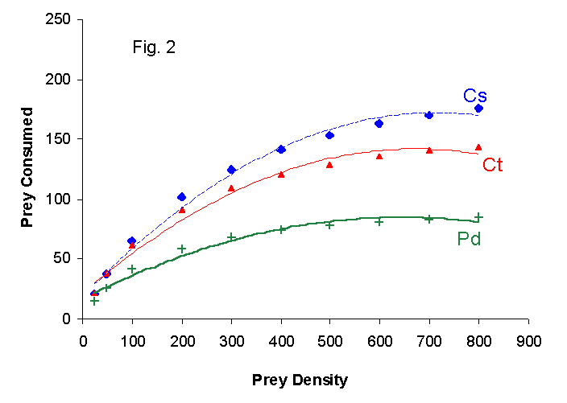
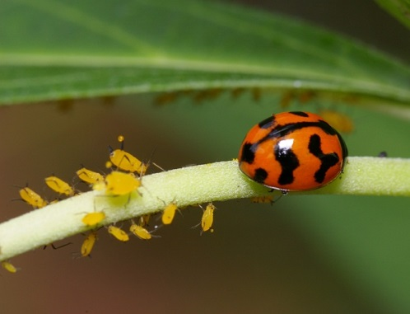
Holling (II) functional response
The number of prey caught depends on the number of prey present
The number of aphids (M. persicae) consumed in 24 hrs by 3 different ladybird species (C. sexmaculatus, C. transversalis and P. dissecta) as a function of aphid density. From Pervez and Omkar, J.Insect Science 5:5 (2005)
Notes:
The handling time for Cs is estimated to be 5.15 minutes.

Slide 14
Holling (II) functional response
The Holling (II) functional response assumes the predator on average has a constant time to handle prey
The functional response then takes the form
The handling time is h
Note that if h=0 this reduces to αV, which is what we had before
Notes:
Derivation: total time budget of predator per prey: h+1/aV

Slide 15
Holling (II) functional response
The number of prey caught depends on the number of prey present
Nr of prey caught per predator
Prey density

Slide 16
Holling (II) functional response
If we include this in the model, solutions look like this
A limit on the number of prey eaten per unit of time acts destabilising

Slide 17
The Rosenzweig-McArthur model
The model with a prey carrying capacity and the type II functional response is known as the Rosenzweig-McArthur model:

Slide 18
Stable limit cycle
If prey density dependence and a Holling type II functional response is combined it can lead to sustained oscillations
These oscillations are independent of the initial conditions
This is called a stable limit cycle

Slide 19
Stable limit cycle

Slide 20
Do Practical 3: (4-2) Investigate the dynamics of the Rosenzweig-McArthur model.

Slide 21
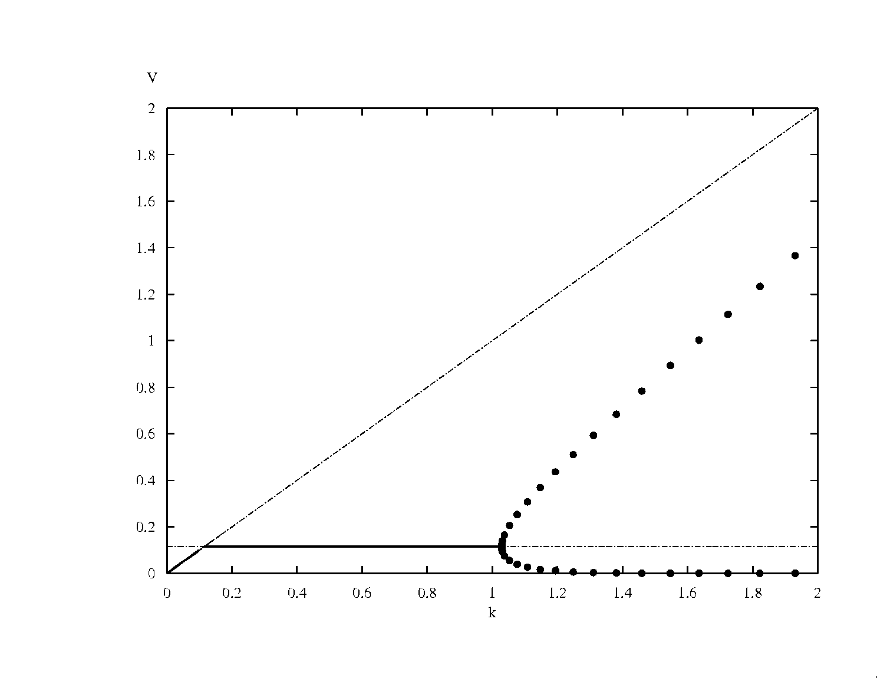
The Hopf bifurcation
V
Prey density
k
In a Hopf bifurcation, the real part of a pair of complex eigenvalues becomes positive. It results in a limit cycle.

Slide 22
The paradox of enrichment
V
Prey density
k
The paradox of enrichment: the better the environment for the prey, the worse they do.

Slide 23
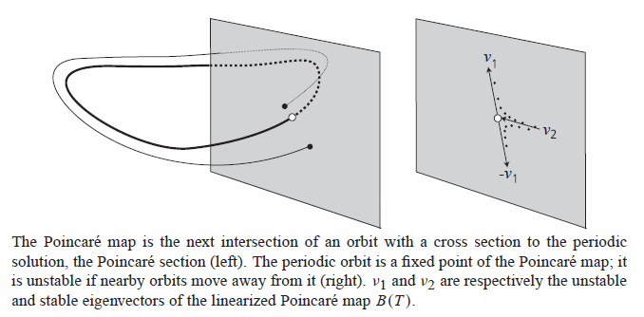
How do they do that?

Slide 24
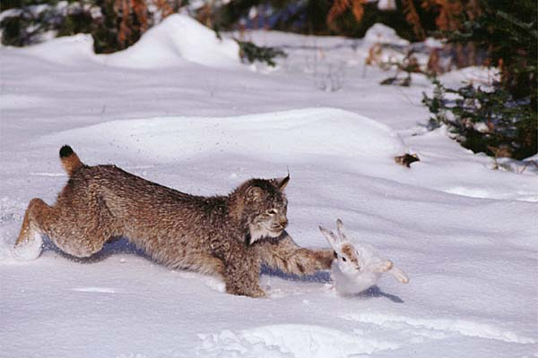
Predators and their prey
Lynx and
Snowshoe hare
Some predator and prey population show this cyclic behaviour

Slide 25

The Hudson’s Bay Company traded in pelts, and kept immaculate records

Slide 26
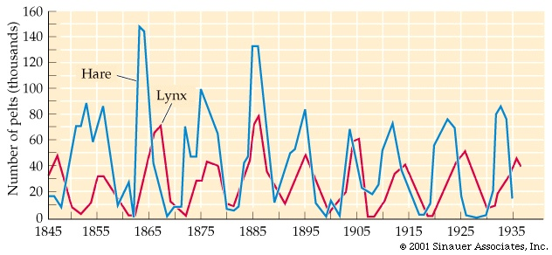
Predators and their prey
Nr of hare and lynx pelts traded through the Hudson’s Bay Company

Slide 27
Experimental demonstration
Mathematical model predicting the dynamics of a rotifer feeding on algae.
Fussman et al. Science (2000).
Notes:
Fussman GF, Ellner SP, Shertzer KW & Hairston NG (2000) Crossing the Hopf Bifurcation in a Live Predator-Prey System, Science, 290. 1358-1360

Slide 28
Experimental demonstration

Slide 29
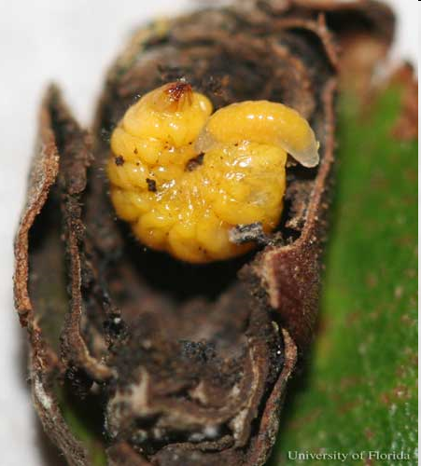
Parasitism
Parasitoids have a free living adult stage, mostly they lay their eggs on or near the host, and consume them
Parasitoid wasps often have non-overlapping generations
This introduces a delay in the interaction between hosts and parasitoid
Notes:
Mature larva of Homoeolabus analis (Illiger), a leaf-rolling weevil, with eulophid external parasitoid larva (probably Paracrias huberi Gumovsky).

Slide 30
Parasitism
Nicholson and Bailey (1935) developed a simple model for host-parasitoid interactions
Hosts are discovered by parasitoids. The more parasitoids there are, the larger the probability to be discovered.

Slide 31
Parasitism
All hosts that are parasitised give rise to one new parasitoid
Nr of new parasitoids: nr of hosts times probability of being parasitised
All hosts that are not parasitised lay λ eggs and give rise to λ new hosts

Slide 32
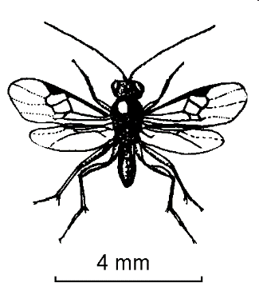



Slide 34
Parasitism
In the Nicholson-Bailey model the probability to be discovered is 1-e^{-aPt}
This assumes random searching and is derived from the Poisson distribution
The number of parasitoids in the next generation is the number of hosts in the previous generation times the probability to be discovered by a parasitoid:
P_{t+1}=H_{t}(1-e^{-aPt})

Slide 35
Parasitism
The number of hosts in the next generation is the number of hosts in the previous that were not discovered
This probability is e^{-aPt}
Each surviving host produces λ offspring
H_{t+1}=λH_{t}e^{-aPt}

Slide 36
Parasitism
The Nicholson Bailey model reads:
P_{t+1}=H_{t}(1-e^{-aPt})
H_{t+1}= λ H_{t}e^{-aPt}

Slide 37
Parasitism
Delays destabilise the host-parasitoid (and predator-prey) interaction
The model can be adapted to produce cyclic dynamics

Slide 38
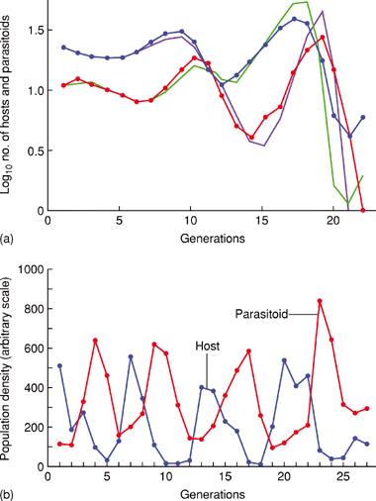
Parasitism
The population dynamics of a parasitoid and host population kept in a lab, compared to the Nicholson-Bailey model
Stable oscillations of parasitoid and host
Notes:
DOI: 10.1038/npg.els.0003164

