Slide 1

2023-24 4-3 Predator-prey models, limit cycles, Hopf bifurcation Spatial predator-prey interactions
Vincent Jansen
vincent.jansen@rhul.ac.uk

Slide 2
Outline
4-1 The Lotka-Volterra predator-prey model
4-2 Variations on the predator-prey theme
4-3 Spatial predator-prey interactions

Slide 3
Spatial interactions
Most predator-prey models are prone to produce cyclic dynamics with large oscillations that suggest that these populations are likely suffer to extinction

Slide 4
Spatial interactions
A number of natural predator-prey systems that show sustained oscillations have been found
Some examples: the hare-lynx cycle, grouse cycles, the cyclic dynamics of rodents in Scandinavia, moose-wolves on Isle Royal, several insect populations, etc.
Most predator and prey populations in the wild do not show such fluctuations
Notes:
Some examples: the hare-lynx cycle, grouse cycles, the cyclic dynamics of rodents in Scandinavia, moose-wolves on Isle Royal, several insect populations, etc.

Slide 5
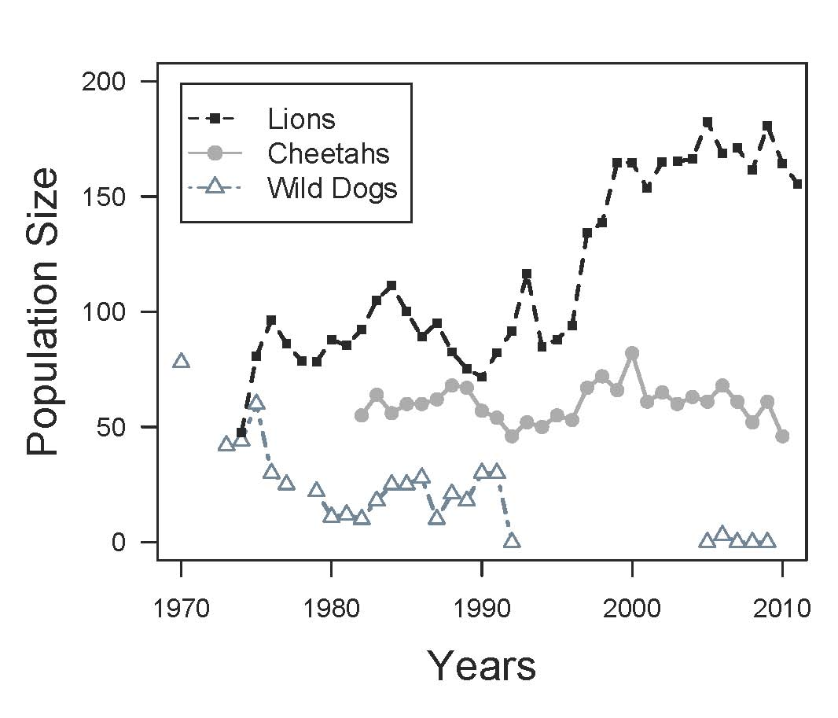
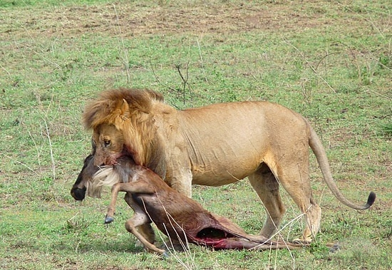
Predators in the Serengeti

Slide 6
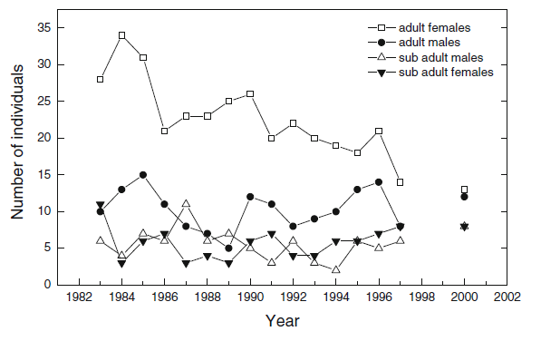
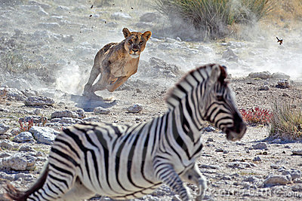
Lions in Etosha (SA)
Trinkel, Naturwissenschaften 2013
Notes:
Fig. 6 The total number of adult females, adult males, subadult males
and subadult females in central Etosha between 1983 and 1997. The
total number of lions and the number of subadults and adults in 2000
were determined by A. Burger, T. Burger and C. DuPlessis
Trinkel Naturwissenschaften (2013) 100:345

Slide 7
Predators and their prey
Although most predator and prey populations in the wild do not show large fluctuations,..
In the lab populations many populations do show strong fluctuations and are difficult to keep alive

Slide 8
Spatial interactions
Why the discrepancy?
Nicholson and Bailey (1934) conjectured, after observing that populations do not persist in their model that populations can locally go extinct, but that other ones will start elsewhere
Can spatial interactions lead to persistence?

Slide 9
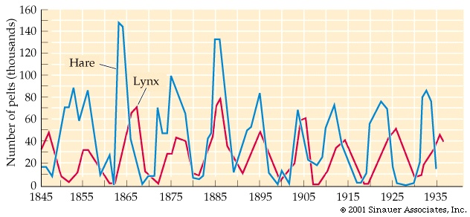
Stable limit cycle
A closer look at the hare-lynx cycle

Slide 10
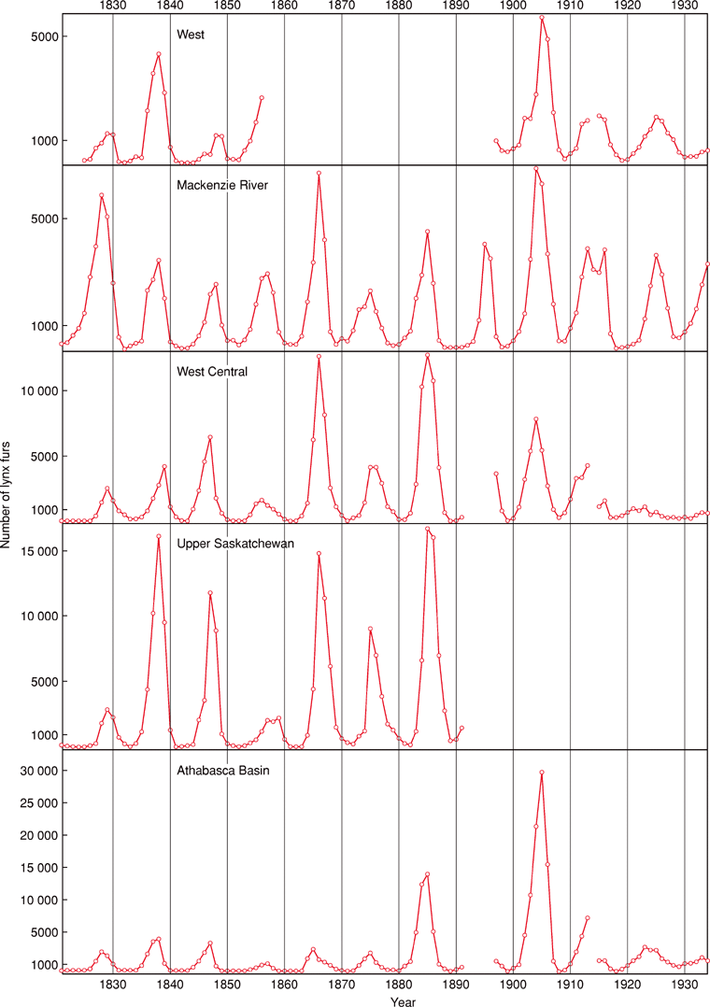
Spatial interactions
Cycles in the number of lynx fur returns of the Hudson's Bay Company, from 1821 to 1934, grouped into five regions. Note the different scales
From: M. Gillman: Population Dynamics: Introduction. DOI: 10.1038/npg.els.0003164. Original source: Elton and M. Nicholson, 1942
Notes:
Figure 9. Cycles in the number of lynx fur returns of the Hudson's Bay Company, from 1821 to 1934, grouped into five regions. Note the different scales (original source Elton and Nicholson, 1942).

Slide 11
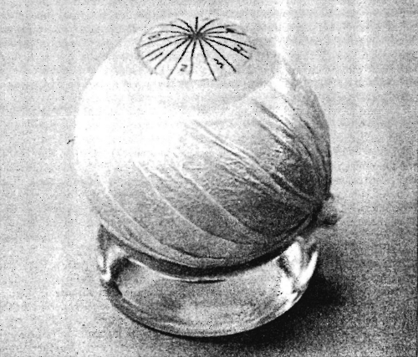
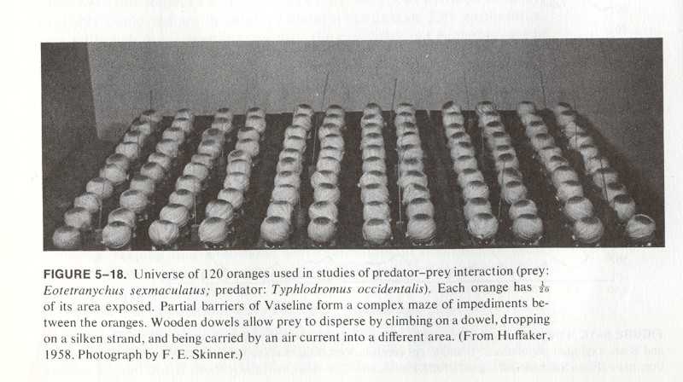
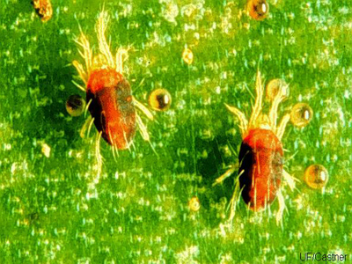
Spatial interactions
Huffaker’s mites

Slide 12
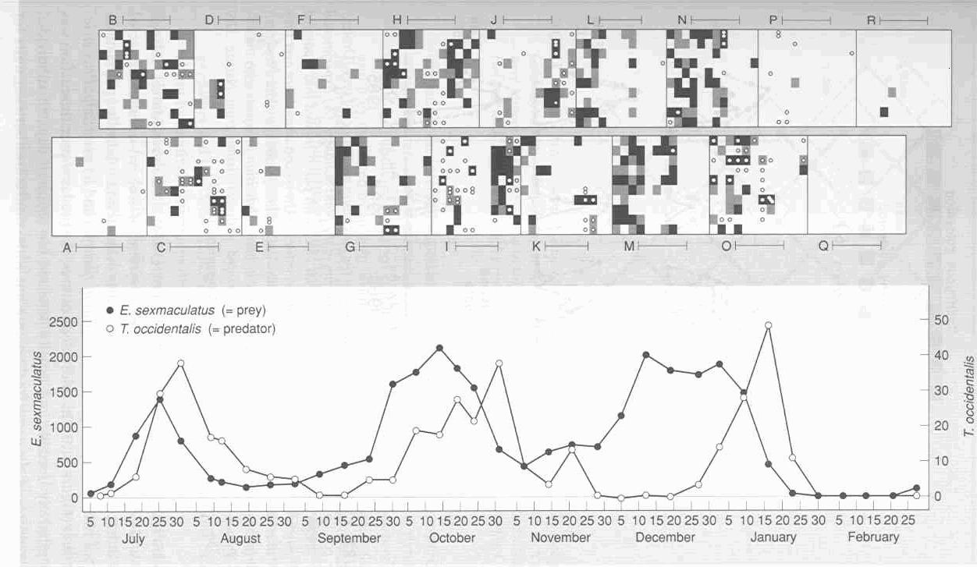
Spatial interactions
Huffaker’s mites

Slide 13



Spatial interactions
Hassell, Comins and May (1991) made a model in which they assumed that the local interactions were given by the Nicholson-Bailey model, but hosts and parasitoids could disperse to neighbouring sites

Slide 14
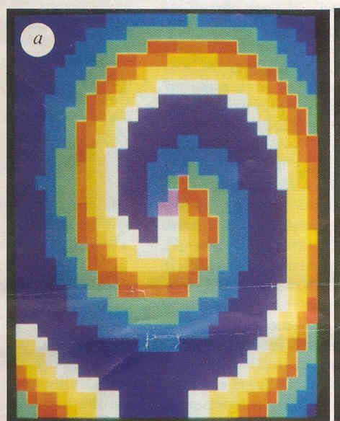
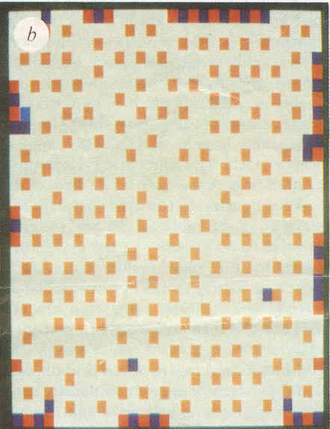
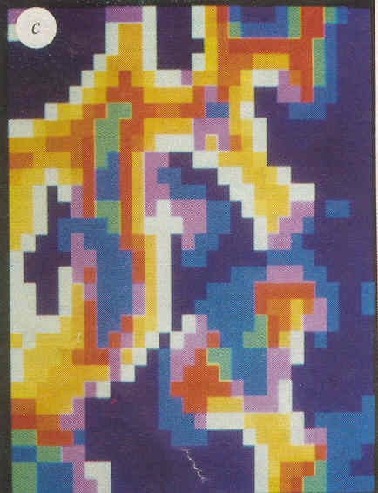
Spatial interactions
Hassell, Comins and May’s simulation results. Different colours represent different densities

Slide 15

Spatial interactions
A similar pattern can occur in coupled predator-prey models
The model equations are very much like two coupled pendulums
dispersal
Space 1
Space 2

Slide 16
Spatial interactions
A similar pattern can occur in coupled predator-prey models
The model equations are very much like two coupled pendulums
dispersal
Space 1
Space 2

Slide 17

Video 2 coupled pendulums here

Slide 18
Do Practical 3: (4-3) The effect of space on the dynamics of a predator-prey model

Slide 19
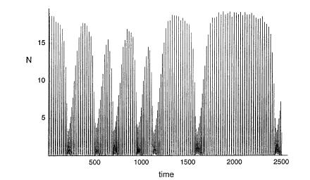
Spatial interactions

Slide 20
Spatial interactions
This offers a solution to the paradox of enrichment
One patch
ln(v₁+v₂)
k
Two patches
ln(v₁+v₂)
k

Slide 21
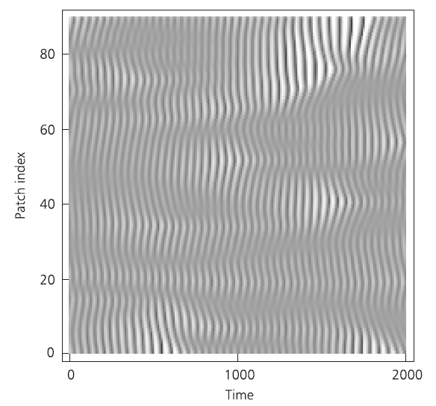
With many patches:

Slide 22
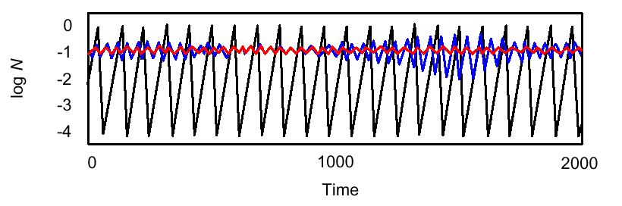
Predators and prey in space
The isolated, coupled and mean dynamics:
In a spatial system predator and prey populations do not oscillate as much and are less likely to become extinct

Slide 23
Spatial interactions
This suggests that spatial interactions can make the host parasitoid (predator-prey) system to persist
But does it really work?

Slide 24
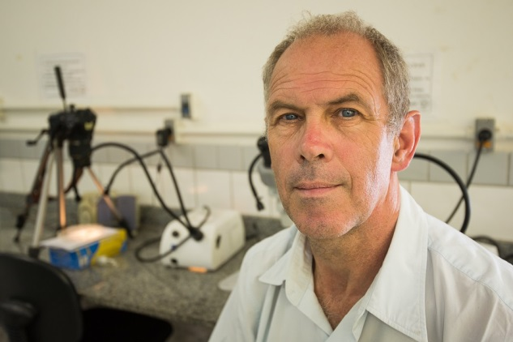
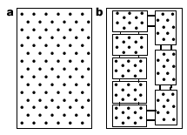
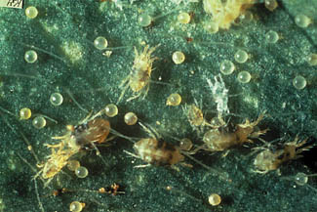
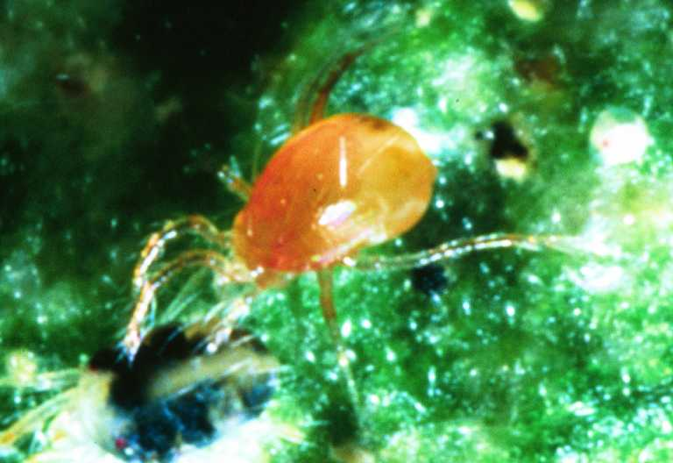
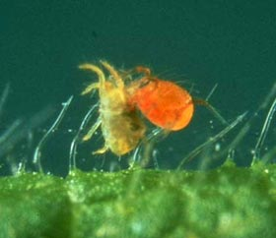
Spatial interactions
Description of Janssen’s experiment
Notes:
Tetranychus urticae and Phytoseiulus persimilis

Slide 25
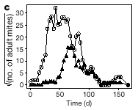
Spatial interactions
Result in the single island system

Slide 26
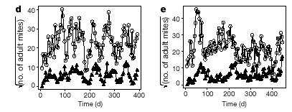
Spatial interactions
Result in the coupled islands system

Slide 27

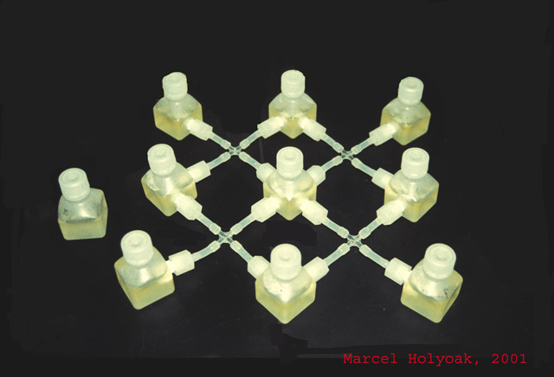
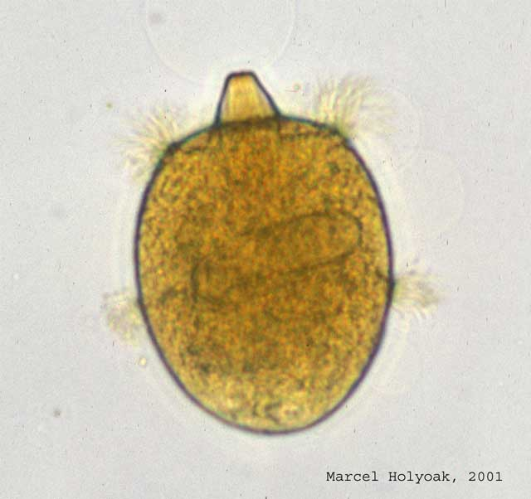
Spatial interactions
Another example:
In the array predator and prey populations persist for much longer than in a single jar (Holyoak and Lawler)
Prey: Colpidium
striatum
Predator: Didinium nastutum

Slide 28
Learning outcomes
Understand the logic underlying the Lotka-Volterra predator model and its limitations
Appreciate the effects of prey density dependence, functional responses, time delays and spatial structure

