Slide 1

AWS DATA ENGINEERING VIRTUAL INTERNSHIP
By
MULAGADA VAMSI- (323103383041)
MUTCHERLA PURANDISH (323103383043)
NALLI SRUTHI- (323103383045)
PALANCHU KUNALSRI- (323103383046)
BATCH NO:11
(CSD)
3rd Year
2025-2026
Name of the Course Co-Ordinator
Dr. CH SITA KUMARI
(Associate Professor)
Name of the Project Mentor
Mr. D. Arun Kumar
(Assistant Professor)

Slide 2
ABSTRACT
Data engineering involves building and managing pipelines that collect, store, transform, and prepare raw data into structured, query-ready formats. In this internship, we studied cloud computing, which delivers resources like compute, storage, and databases on demand through AWS’s global infrastructure. Using these concepts, we designed an automated ETL pipeline to process nested JSON customer order data into Parquet format. The solution used Amazon S3 for storage, AWS Lambda for serverless transformation, AWS Glue for cataloging, and Amazon Athena for querying. This automation eliminated manual effort, reduced delays, and improved accuracy in reporting. Overall, the project highlighted how AWS services enable timely insights and support data-driven decision-making.

Slide 3
AWS CLOUD FOUNDATION
Introduction to Data Engineering – Overview of core concepts
Data-Driven Organizations – Importance and usage in business
The Elements of Data – Key components of data
Pipeline Design – Principles and best practices
Security & Scaling – Protecting and growing pipelines
Data Ingestion – Collecting and preparing data
Batch & Stream Ingestion – Processing real-time and historical data
Storing & Organizing Data – Efficient data management
Processing Big Data – Handling large datasets
ML Data Preparation – Preparing data for machine learning
Analysis & Visualization – Extracting insights from data
Automation – Streamlining workflows and pipelines

Slide 4
AWS DATA ENGINEERING
Introduction to Data Engineering – Overview of core concepts
Data-Driven Organizations – Importance and usage in business
The Elements of Data – Key components of data
Pipeline Design – Principles and best practices
Security & Scaling – Protecting and growing pipelines
Data Ingestion – Collecting and preparing data
Batch & Stream Ingestion – Processing real-time and historical data
Storing & Organizing Data – Efficient data management
Processing Big Data – Handling large datasets
ML Data Preparation – Preparing data for machine learning
Analysis & Visualization – Extracting insights from data
Automation – Streamlining workflows and pipelines

Slide 5
Case Study: Cloud-Based Food Donation Tracking System using AWS
MINI PROJECT
A real-time food donation management solution using AWS services

Slide 6
Aim & Objectives
Project Aim:
Develop a cloud-based web application for tracking and managing food donations.
User Functionality:
Donors can submit donation details via a web interface.
Data Handling:
Donation records stored in AWS DynamoDB.
Real-Time Updates:
Submissions are shown instantly on a live dashboard.
Cloud Benefits:
Leverages AWS for scalability, accessibility, and real-time performance.
Objectives:
Real-time updates without refresh.
Serverless, scalable backend.
Public web access.
Secure resource access.

Slide 7
System Architecture
Frontend:
Static website hosted on Amazon S3
Backend:
AWS Lambda functions process donations
Data stored in Amazon DynamoDB:
API Gateway connects frontend and backend

Slide 8
Key AWS Services
Amazon S3: Hosts your static frontend website (HTML, CSS, JS) and serves it to users over the internet.
DynamoDB: A fully managed NoSQL database where all the donation records are stored and retrieved in real time.
Lambda: A serverless compute service that runs your backend code (POST for adding donations and GET for retrieving them) without managing servers.
API Gate_way: Provides REST API endpoints that connect your frontend (website) with Lambda functions.
IAM: Provides permissions (policies attached to Lambda’s execution role) so that Lambda functions can securely read/write data in DynamoDB.

Slide 9
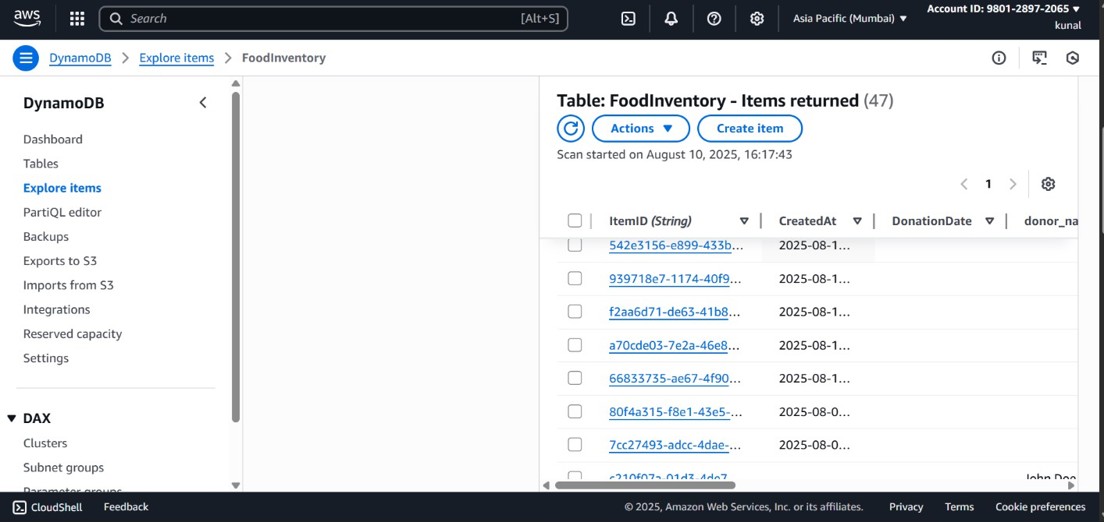
Task-1: Setting up DynamoDB
Creating the DynamoDB Table
Created a table named FoodInventory with ItemID as the primary key.
Configuring Permissions
Created an IAM role for Lambda to read/write to the table
Fig A:DYNAMODB STRUCTURE

Slide 10
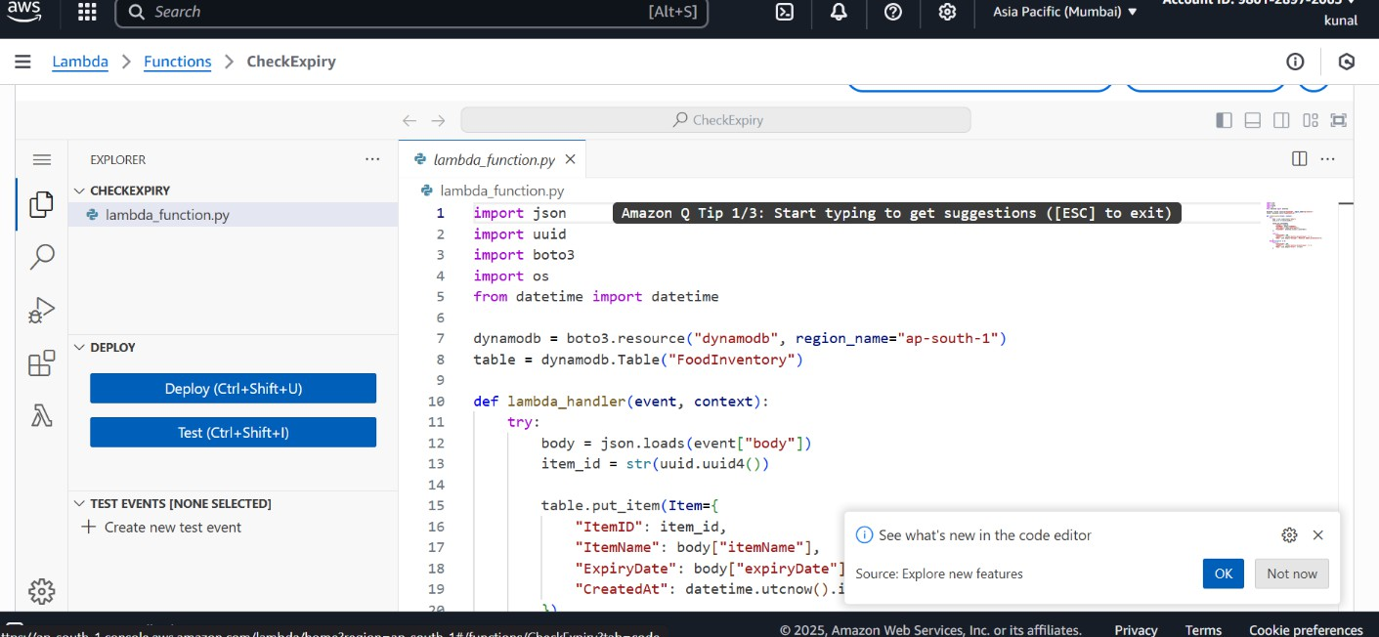
Task-2: Creating the Lambda Functions & API Gateway
Creating the POST Lambda Function
Function accepts donation data from the frontend and stores it in DynamoDB.
Creating the GET Lambda Function
Function fetches donation data and sends it to the frontend.
Connecting via API Gateway
Created /donations POST endpoint and /getDonations GET endpoint.
Enabled CORS for both endpoints.
Fig B: POST CODE LAMBDA FUNCTION

Slide 11
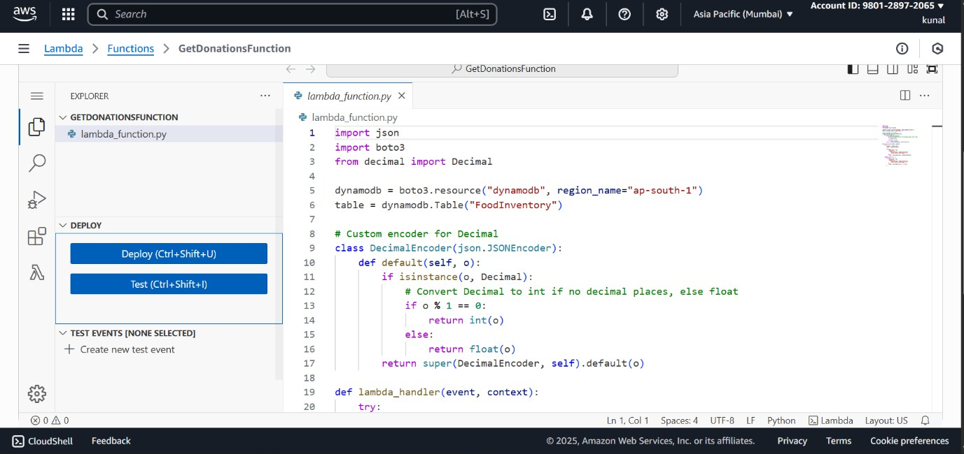
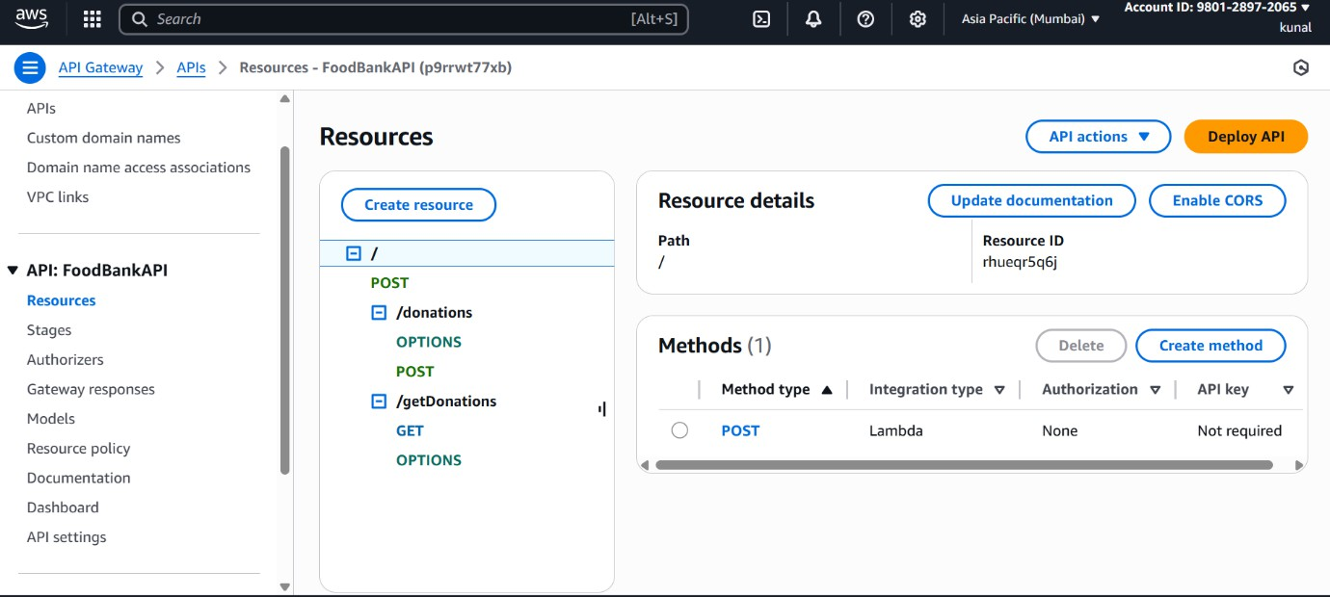
Fig C:GET CODE LAMBDA FUNCTION
Fig D: APIGATE-WAY

Slide 12
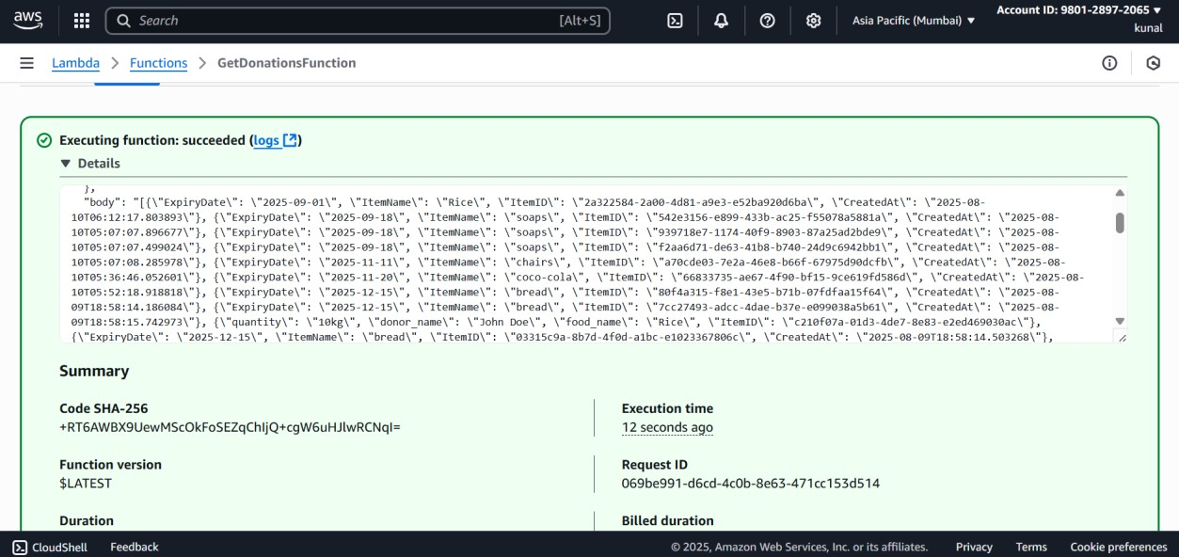
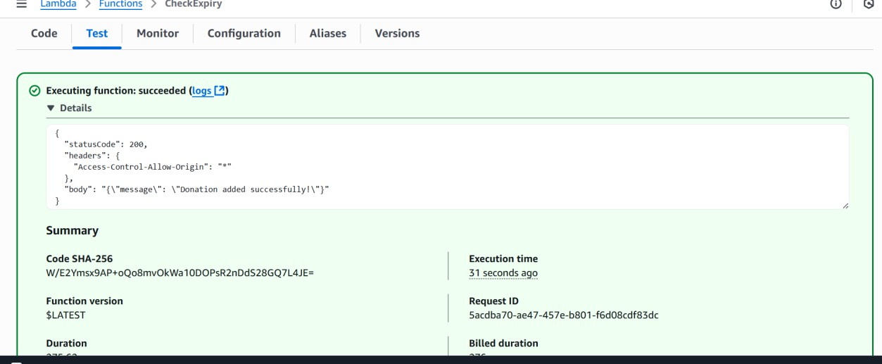
Fig E:OUTPUT FOR POST CODE

Slide 13
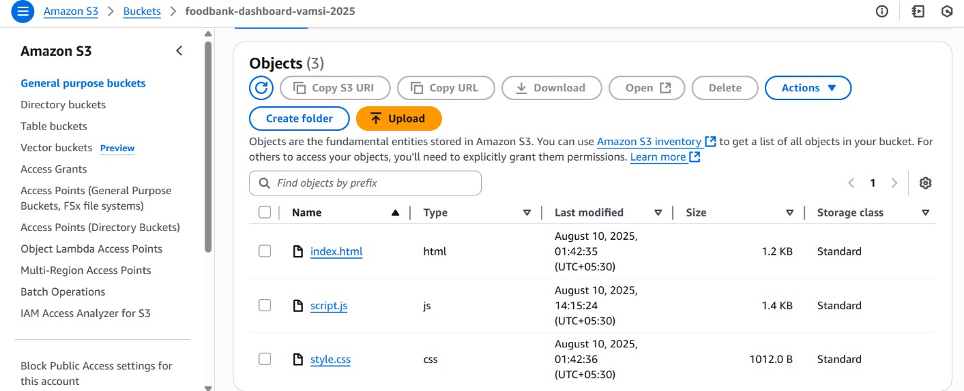
Task-3: Hosting the Website oN Amazon S3
Creating an S3 Bucket:
Created bucket foodbank-project- vamsi and enabled static website hosting.
Uploading Front-End Files:
Uploaded index.html, style.css, and script.js.
Making it Public:
Updated bucket policy to allow public read access.
Fig F:CODES IN S3 BUCKET

Slide 14
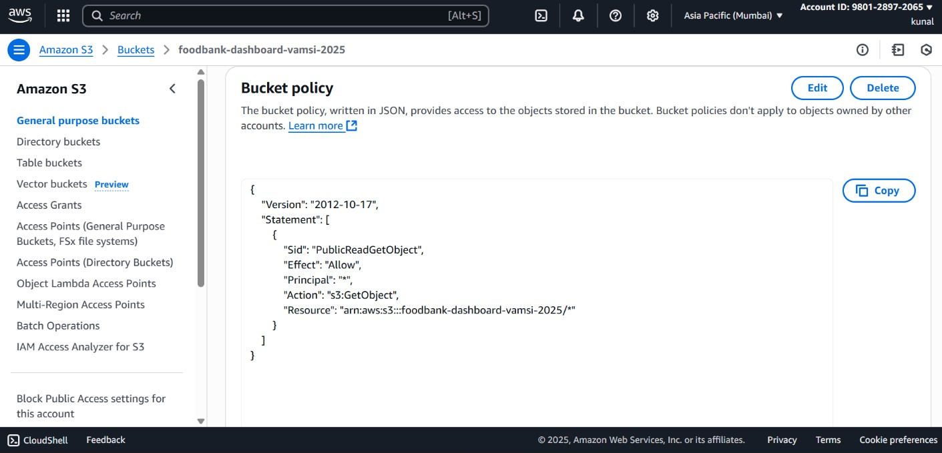
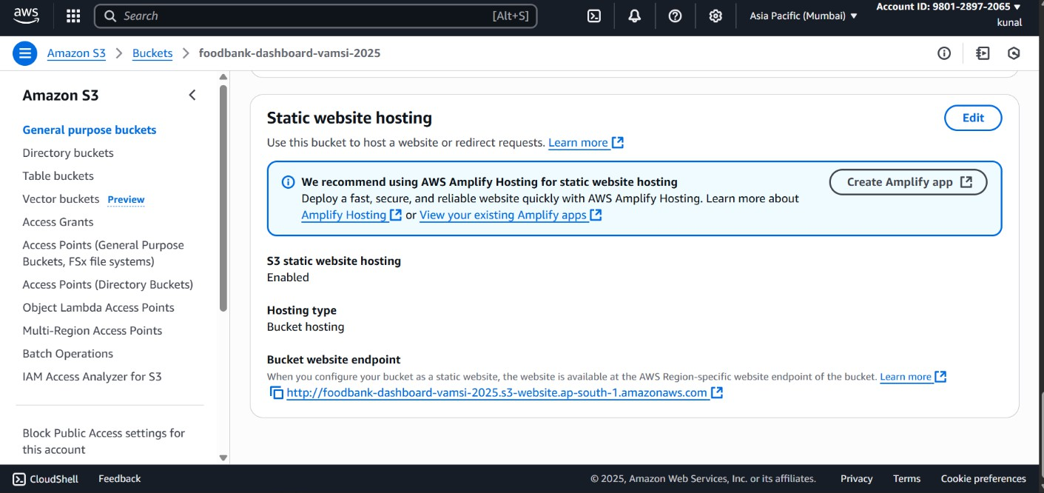
Fig G:BUCKET POLICY
Fig H:STATIC WEBSITE POLICY

Slide 15
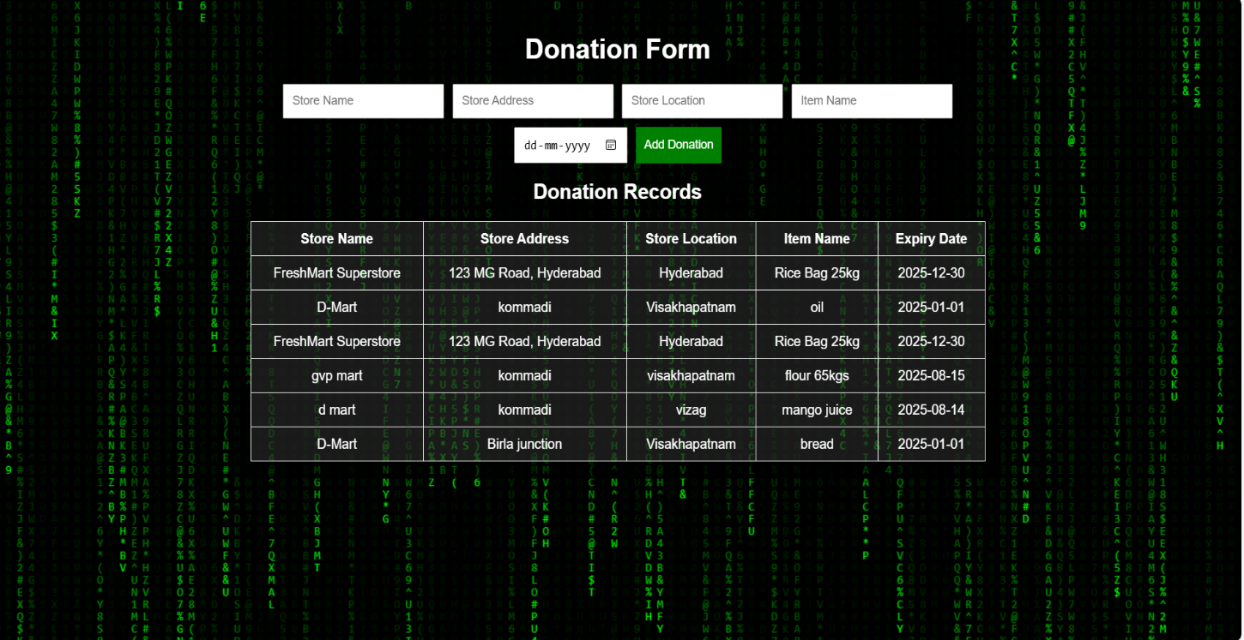
FIG1:WEBSITE

Slide 16
Benefits of AWS
Scalability : The system automatically scales based on incoming traffic or data volume. For example, Lambda scales up instantly when more donation requests come in, and DynamoDB can handle thousands of read/write requests per second without manual intervention.
Cost-effective : You only pay for what you use. With Lambda, charges are based on the number of requests and execution time. DynamoDB and S3 also follow usage-based pricing, which makes this architecture affordable for both small projects and large-scale applications.
Easy deployment : Since services like API Gateway, Lambda, DynamoDB, and S3 are fully managed by AWS, there’s no need to worry about server maintenance, patching, or scaling infrastructure.

Slide 17
Conclusion
- Real-time cloud-based donation tracking achieved
- AWS ensures robust, scalable, cost-efficient solution
- Future scope: user authentication, expiry reminders, analytics dashboards

Slide 18
REFERENCES
AWS Cloud Foundations Course Link: https://awsacademy.instructure.com/courses/81207
AWS Data Engineering Course Link: https://awsacademy.instructure.com/courses/81208
AWS Lambda:
https://docs.aws.amazon.com/lambda/latest/dg/welcome.html
Amazon DynamoDB:
https://docs.aws.amazon.com/amazondynamodb/latest/developerguide/Introduction.html
Amazon S3:
https://docs.aws.amazon.com/AmazonS3/latest/userguide/Welcome.html
Amazon API Gateway:
https://docs.aws.amazon.com/apigateway/latest/developerguide/welcome.html
AWS Identity and Access Management (IAM):
https://docs.aws.amazon.com/IAM/latest/UserGuide/introduction.html

