Slide 1


Slide 2


Ed Lauer
Ed Lauer is currently the CFO for the Lucky Family of service companies that includes Lucky
Services, Inc., Lucky Rental Tool LLC, Lucky Health & Safety LLC, and TRM LLC. Dwayne
Taylor started building the Lucky Family of Excellence in 1986 when he founded Lucky Well
Services here in Hobbs America with one pulling unit. Ed is originally from Nashville, TN and
graduated from Texas Tech University in 1999 with a bachelors degree in Restaurant, Hotel,
and Institutional Management. While at TTU, Ed met and was blessed to marry Heather B.
Taylor. After 12 years in the food and agriculture business, Dwayne convinced Ed and Heather
to join the family business in December of 2011. Ed and Heather have 3 children and reside in
Midland, TX.

Slide 3
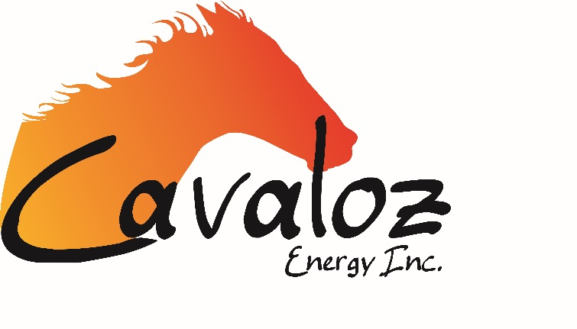
Kristi Goodwin
Kristi Goodwin was born and raised in Hobbs, NM and has been a resident of Lea County all of her life. She became a registered nurse in 1999. Kristi became CEO of Cavaloz Energy, Eunice Well Servicing, ABC Rental Tool and America Supply in 2010 and has been successful in her leadership of the companies. Her people skills have become an obvious asset during the transition. She also earned her Bachelor’s of Science in Nursing from Eastern New Mexico University that same year. Kristi followed this accomplishment by obtaining her MBA in 2013.
Kristi has also participated in a number of philanthropic endeavors, including MyPower (a mentoring program for empowering and educating girls), Hobbs Schools Eagle Trust Foundation and University of the Southwest Foundation Board of Directors as well as the Lea County Toy Tea (an annual Christmas toy drive for children in foster care). . She is a current member of Rotary International as well as the Association of Energy Service Companies. Kristi is known to help others in any way she can while maintaining a balance with work and her personal life.

Slide 4

Zachary D Parker
Co-Founder, General Partner and CEO/President of Blitz Energy Services LLC. and several other related entities. Started Blitz Energy Services in Nov 2013 and grew the Gross Annual Revenue to $67,000,000 in our first year. Built a business model able to Cash Flow our operations through this down market and leverage ourselves for a market rebound with projected gross annual revenues near $200,000,000.
Owned and Operated Zach Parker Ranches in Byers TX. Primarily a Cow Calf operation in North Texas that managed a 1500 – 2200 Hd herd from Northeast Oklahoma to West Texas on roughly 70,000 acres. Farmed 3000 acres of winter wheat to graze over 7000 Hd of stockers throughout the winter months. Annual revenues grossed from $375k - $500k. Managed $1 Million RLOC to fund daily operations and bought and sold over $200 million worth of livestock over the last 13 yrs.
Sat on IsNetworld panel that developed a Safety Program within the Oil and Gas Industry that insures all employees return home to their families after work.
Own and Manage “The River Bluff Lodge”, a year round corporate hunting and fishing retreat in Byers TX on my family’s ranch and lease properties topping out at over 12,000 acres of impeccable hunting land.
Offensive Full Back for Texas Tech University 1998-2001

Slide 5
New Mexico Opportunities & Challenges for Oilfield Service Companies
Industry Trends
Demand for oilfield services is primarily driven by the level of drilling, completion and production activity by E&P companies.
Crude oil prices have increased from their lows of $26.21 per barrel ("Bbl") in early 2016 to $48.32 per Bbl at the end of May 2017
Drilling and completion activity by E&P companies has increased along with increased commodity prices.
Increasing complexity of well completion operations, including longer laterals and a greater number of frac stages per well;
Increasing percentage of rigs that are drilling horizontal wells
Increasing percentage of total production attributable to older horizontal wells

Slide 6
New Mexico Opportunities & Challenges for Oilfield Service Companies
Industry Trends
Shift towards liquids-rich development that is reliant on artificial lift technologies and associated well maintenance and workover operations;
Sizable inventory of DUC wells requiring completion
Increasing customer focus on well-capitalized, safe and efficient service providers that can meet or exceed their health, safety and environmental requirements
According to data from the Energy Information Administration and Drillinginfo, the contribution of horizontal wells to total onshore U.S. crude oil production has increased rapidly over the last five years, representing approximately 66% of such production from the lower 48 states in 2016 as compared to approximately 39% in 2012

Slide 7
New Mexico Opportunities & Challenges for Oilfield Service Companies
Industry Trends
A total of approximately 90,000 horizontal wells are expected to be drilled in the United States from 2017 to 2021. Going forward, unconventional horizontal wells are expected to drive the demand for high-spec well service rigs both for completion of new wells and for maintenance and workover operations to sustain production on the increasing population of existing wells.
According to Coras, the vast majority of well service rigs in the United States are poorly suited for unconventional, long-lateral horizontal well applications. Coras classifies well service rigs with capacities of 450 HP or more and mast heights of 102 feet or higher as high-spec well service rigs that are ideally suited to service unconventional horizontal wells. According to Coras, the U.S. oil and natural gas industry is expected to require 1,000 to 1,500 of such ideally suited high-spec well service rigs over the next three years, as compared to an estimated total industry fleet of 770 as of February 28, 2017.

Slide 8
