Slide 1
Maze Data Analysis
Choo Yu Hao Mulder - U2022324D
Gregory Wong - U2022121D
Ta Anh Trung - U2120170D
Notes:
Hello TA, my name is Mulder and with me, I have Gregory and Trung here to present the mini project our group did.

Slide 2
Overview
By Mulder
Problem Statement
Motivation
Dataset Creation
By Trung
Dataset Preparation
Exploratory Data Analysis
By Gregory
Core Analysis
Takeaways from EDA
Machine Learning Insights
Notes:
To give you a quick overview of the whole presentation
I will be talking about the problem statement, motivation and dataset creation.
Trung will be covering the dataset preparation and exploratory Data Analysis
And Gregory will be finishing up with the core analysis and some machine learning insights.

Slide 3
Scope
The Problem (Mulder)
Motivation for the Problem (Mulder)
Creation of our Dataset (Mulder)
Exploratory Data Analysis (EDA) (Trung)
New learning outcomes (Trung)
Core analysis (Gregory)
Takeaways from findings (Gregory)

Slide 4
Problem Statement
For ANY unweighted bi-directional graph with arguments [source, destination]:
What is the most cost efficient pathfinding algorithm?
What is the best performing pathfinding algorithm?
What is the most consistent pathfinding algorithm?
To answer these problems, we used a dataset - MazeData, which was developed entirely on our own, based on external libraries and Lab Exercise 7: MazeRunner Pathfinding Algorithms
Notes:
The problem statement of our project is For any unweighted bi-directional graph with a source and destination node provided, which algorithm (BFS, DFS, UCS, Greedy and A*) is the most cost efficient, best performing and most consistent.
To answer our problem statement, we have developed our own dataset to aid us by using external libraries as well as pathfinding algorithms taught in this course.

Slide 5
Motivation
We noticed that in Lab Exercise 7 : MazeRuner, the conclusion (optimality) did not hold for some cases.
We wanted to find out if this conclusion was true in ALL cases.
Notes:
The main driving force behind this problem statement is that we noticed that Lab Exercise 7, the conclusion was not a true for all cases. We tried several other test cases, but failed to replicate the desired conclusion. This made us wonder whether the dataset provided was biased and motivated us to see if this conclusion was indeed true for ALL cases.

Slide 6

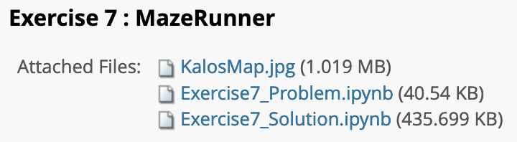
Creation of dataset - Tools used
Lab Exercise 7: Pathfinding Algorithms (BFS, DFS, UCS, Greedy, A*)
MazeLib - Maze Generation Algorithms
Auto Mouse Click by MurGaa
Notes:
These are the tools we used for the creation of our dataset.
As mentioned earlier, we used the different pathfinding algorithms that was taught to us in lab exercise 7 to generate the output for our dataset.
We also use an external library, MazeLib and the external application, Auto Mouse Click.

Slide 7
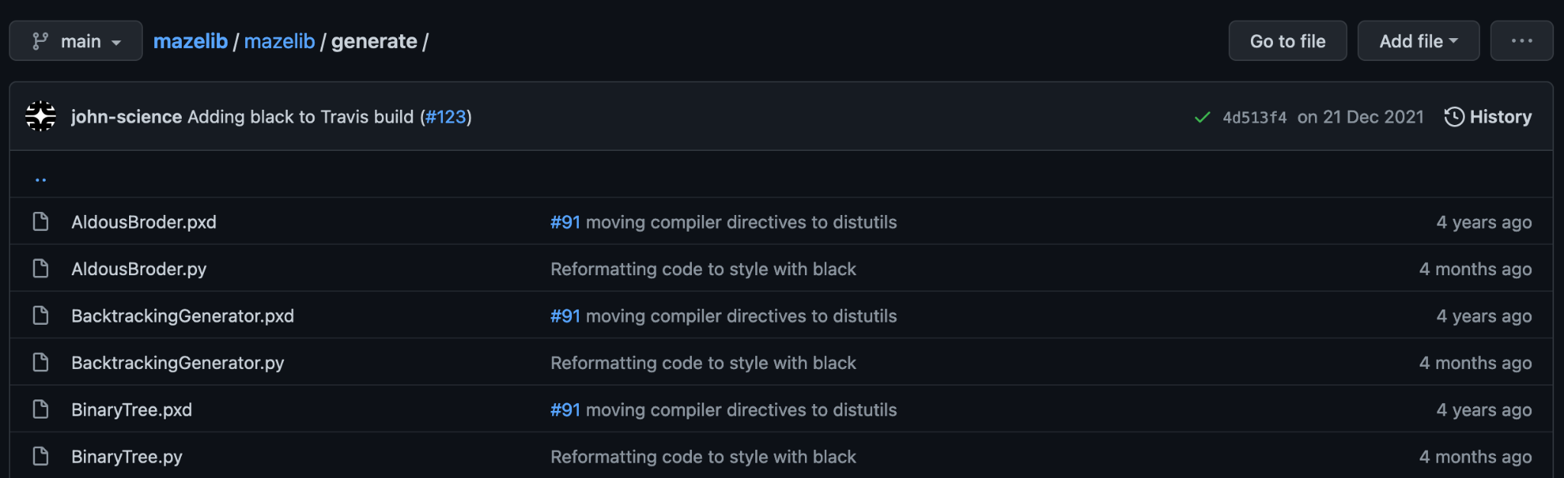
Creation of dataset - Maze Generation
Needed a way to procedurally generate mazes since Lab Exercise 7’s Maze was hard coded and biased.
To solve this issue we use the MazeLib external library
Contains many different maze generation algorithms
Notes:
Moving on to the creation of our dataset,
The first problem we encountered in the creation process was we needed a way to procedurally generate mazes. We realised that manually creating a maze was way too tedious so we found a MazeLib external library to help us. It has many different maze generation algorithms and we used them to generate our all our mazes.

Slide 8

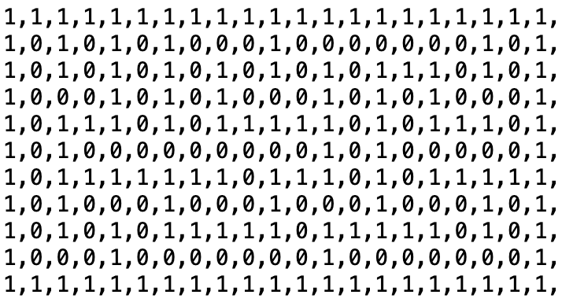

Creation of dataset - Hooking it up
Output of mazelib
Convert to binary 2D Array
Maze Outline
Notes:
The step was to hook it up with our pathfinding script. However, while doing so, we encountered our next problem which was the maze generation output provided to us was not of the correct data type. We solved this by doing simple read/write/replace file operations using inbuilt python libraries, we were able to convert them to the correct data type.

Slide 9
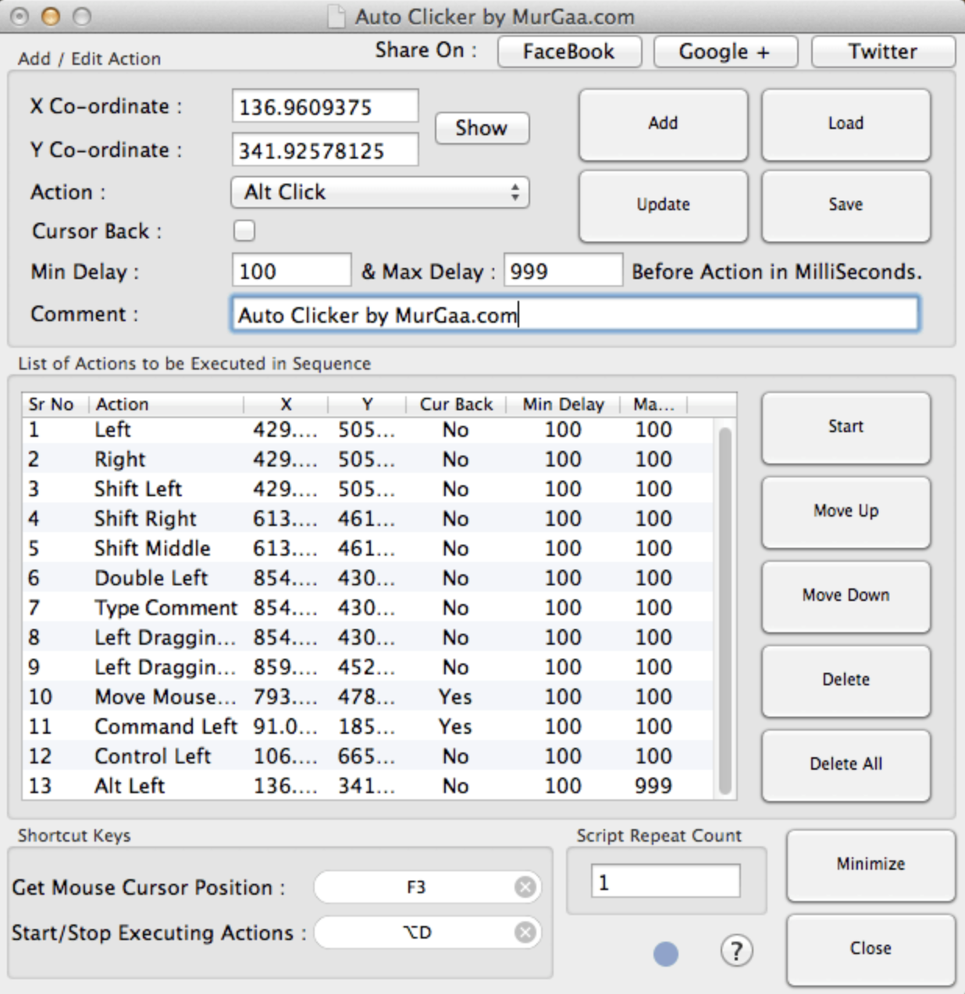

Creation of dataset - Automation
We needed a sizable dataset for fair analysis
Generating it manually will take too much time!
We needed to automate the maze generation process
Notes:
Lastly, we realised that we needed a reasonably sized dataset in order to perform a fair analysis. Manually generating the maze by clicking the “restart kernel” button was time consuming so we needed a way to automate the process. We thus decided to use the an Auto Clicker Application to help us and by simply providing the correct arguments, we were able to generate the whole dataset with a push of a button.

Slide 10
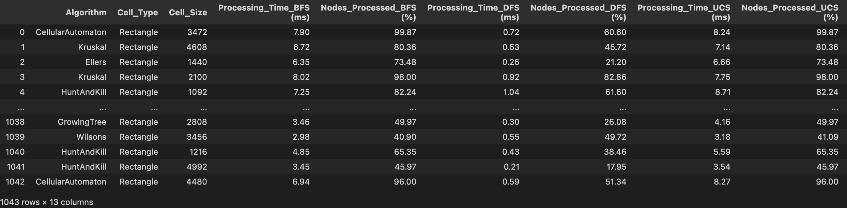
Creation of dataset - Result
A dataset with 1043 procedurally generated results (Could go higher)
Different maze generation algorithms used
Different maze sizes sampled
Notes:
Thus we have obtained the end result of a 1043 sized dataset. All the maze generation algorithms were used and we tested them with varying sizes. Their processing time, percentage of node processed for all 5 pathfinding algorithms were captured in our dataset as well.
I will now pass my time to Trung, to continue with the Exploratory Dataset Analysis of this dataset.

Slide 11
Dataset Preparation
“Visualizing” the efficiency of different algorithms requires….
Pathfinding algorithms (BFS, DFS, UCS, A*, Greedy) versus…
Processing Time + Nodes% Processed
Notes:
Apparently, when we want to check how effective a pathfinding algorithm, we will need to take in consideration 2 main factors when an algorithm “processes” a maze, which is processing time and percentage of nodes processed. These two factors have been recorded during run time like Mulder has just mentioned, which results in the dataset we have used for this time analysis

Slide 12
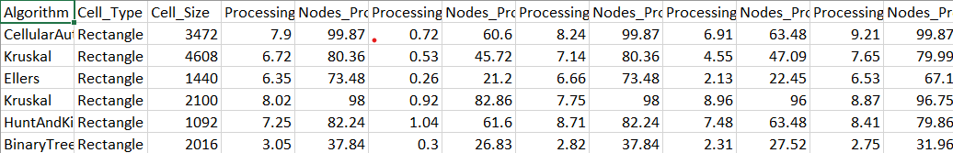
Dataset Preparation
The datasets generated have specific columns for those data
-> quite straightforward, need not much fixings and no addings
Trim error lines only (may happen during data generation process)
Fix blocks with invalid type
Notes:
Obviously we also need to prepare the dataset before any other actions. But actually the data we acquired are straightforward with clear columns of processing time and percentage of nodes processed for each pathfinder algorithm, which saves us a lot of time. The other minor part in preparing the dataset is to find invalid lines of data to fix.

Slide 13
Exploratory Data Analysis (EDA)
Main points:
Clean up datasets (clear outliers)
Plot and find the correlation between Processing Time vs Nodes% Processed
Comparison between learned algorithms (BFS, DFS, UCS, Greedy, A*)
Notes:
Moving on to the Exploratory Data Analysis or EDA
We first clear all the outliers that are still in the dataset
And then we have plotted the processing time versus the percentage of nodes processed using scatterplots and use heatmaps to visualize the correlation between them.

Slide 14
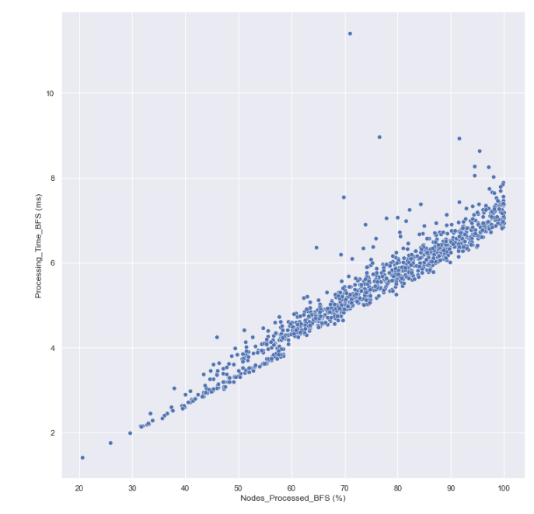
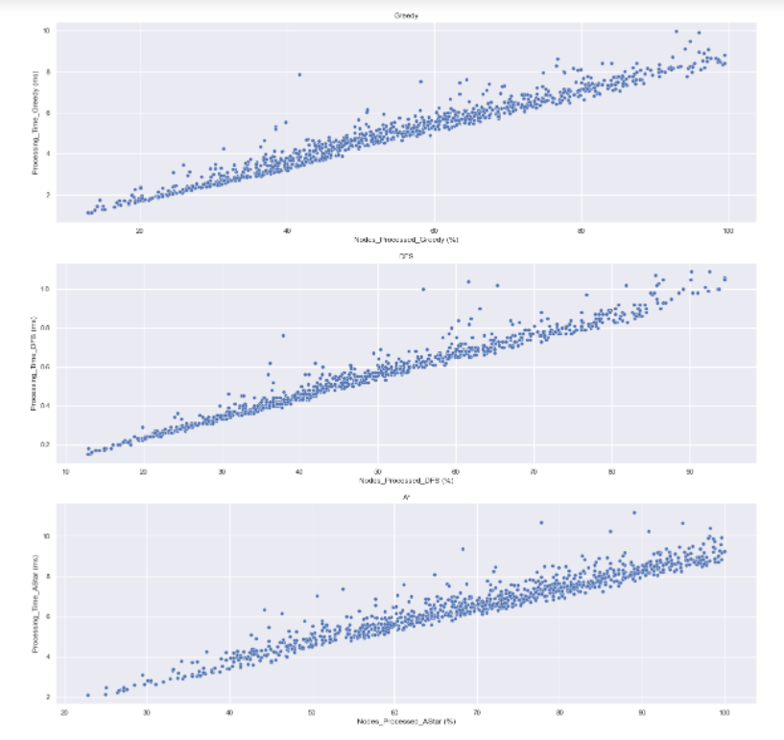
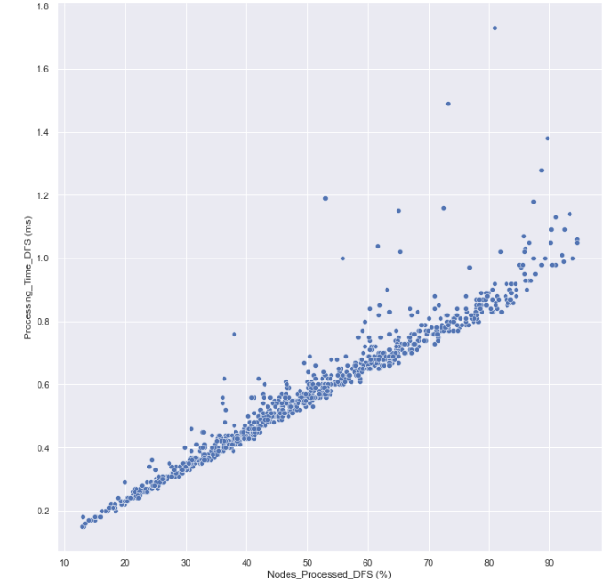
BFS
DFS
Greedy, A* and UCS
Notes:
In these plots, the horizontal represents the percentages of nodes processed, while the vertical one represents the processing time in miliseconds. As you can see here, the plots pretty much form straight lines, which is a sign that these two factors have high correlation

Slide 15
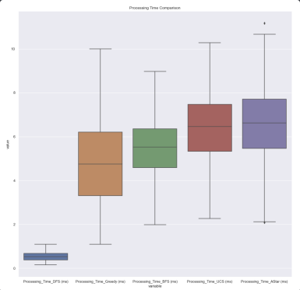
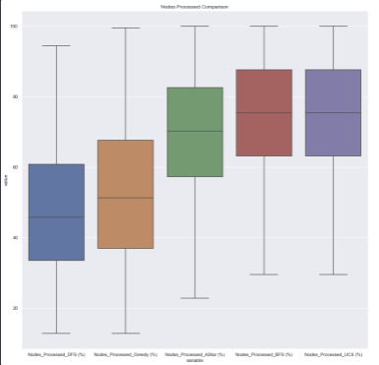
Notes:
We then make a comparison between pathfinder algorithms using box plots.
For processing time, while BFS, UCS , A* and Greedy have relatively similar searching time, DFS completely outshines the other in this aspects.
And for the amount of processed nodes, in average, DFS and BFS cost lower amount of nodes to search the goal.
From this basic plotting, we are now moving on to the core analysis, which will be presented by Gregory

Slide 16
Core Analysis
Takeaways from EDA
Machine Learning (Linear Regression)
Summary
Notes:
I will now delve into the core analysis of the project and talk about what further studies we have done on the dataset the obtain. I will go through some of our takeaways from the EDA, followed by the Machine Learning, Linear Regression algorithm we have applied and lastly a summary of the entire project.

Slide 17
Takeaways from EDA
Relationship exists between the different Searches
Main variables for consideration are:
Processed_Nodes (%)
Processing_Time (ms)
So we will mainly focus on these
Correlation of same type of variables exists among different Search Algorithms.
Shows that problems might arise when we are trying to do some prediction.
Notes:
During our EDA we did many plots and testing within each of the variables to see if any relationship exists between them. We are unsure as to what we might expect as we had no prior understanding of the topic beforehand.
From our testing, we have found that there is a relationship between mainly 2 types of variables in our dataset. The first being processed nodes and the processing time of each search algorithm. These 2 types of variables will be the ones that we will be mostly exploring in the later parts of the presentation.

Slide 18
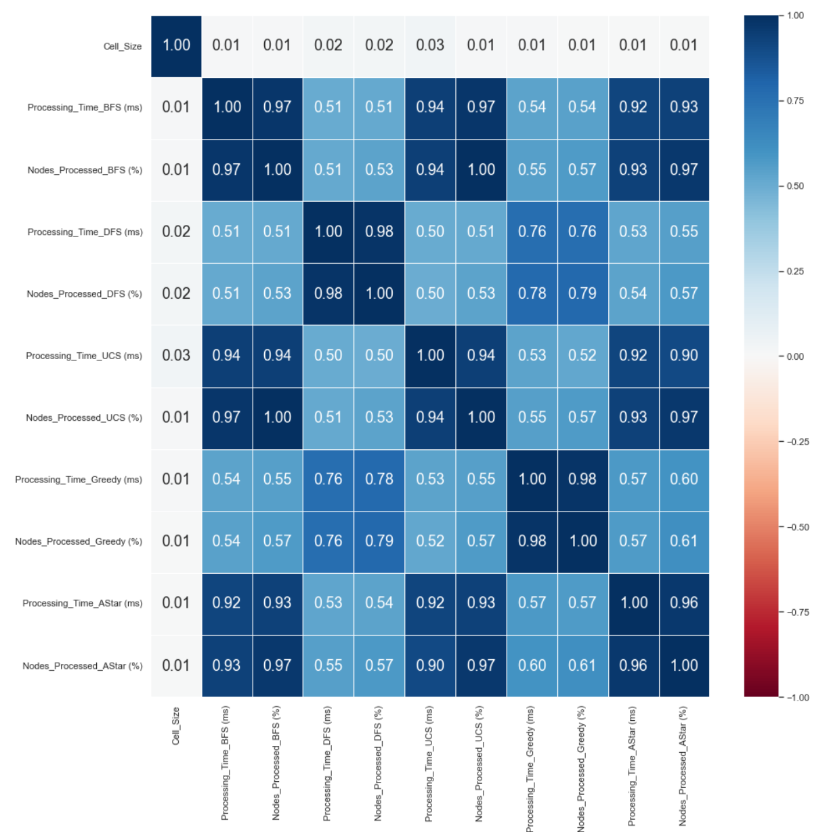
Notes:
From here we plotted a heatmap and the important variables and their corresponding correlations. From here we can see that each Processing Time (on y axis) and their corresponding Processed_Nodes (on x axis) has a strong correlation as highlighted in the red box. This means that there might be some strong relationship between these 2 variables which is explored later.
This is just an overview of each variable and their potential relationship to each other, we will delve into the individual correlations for a clearer picture.

Slide 19
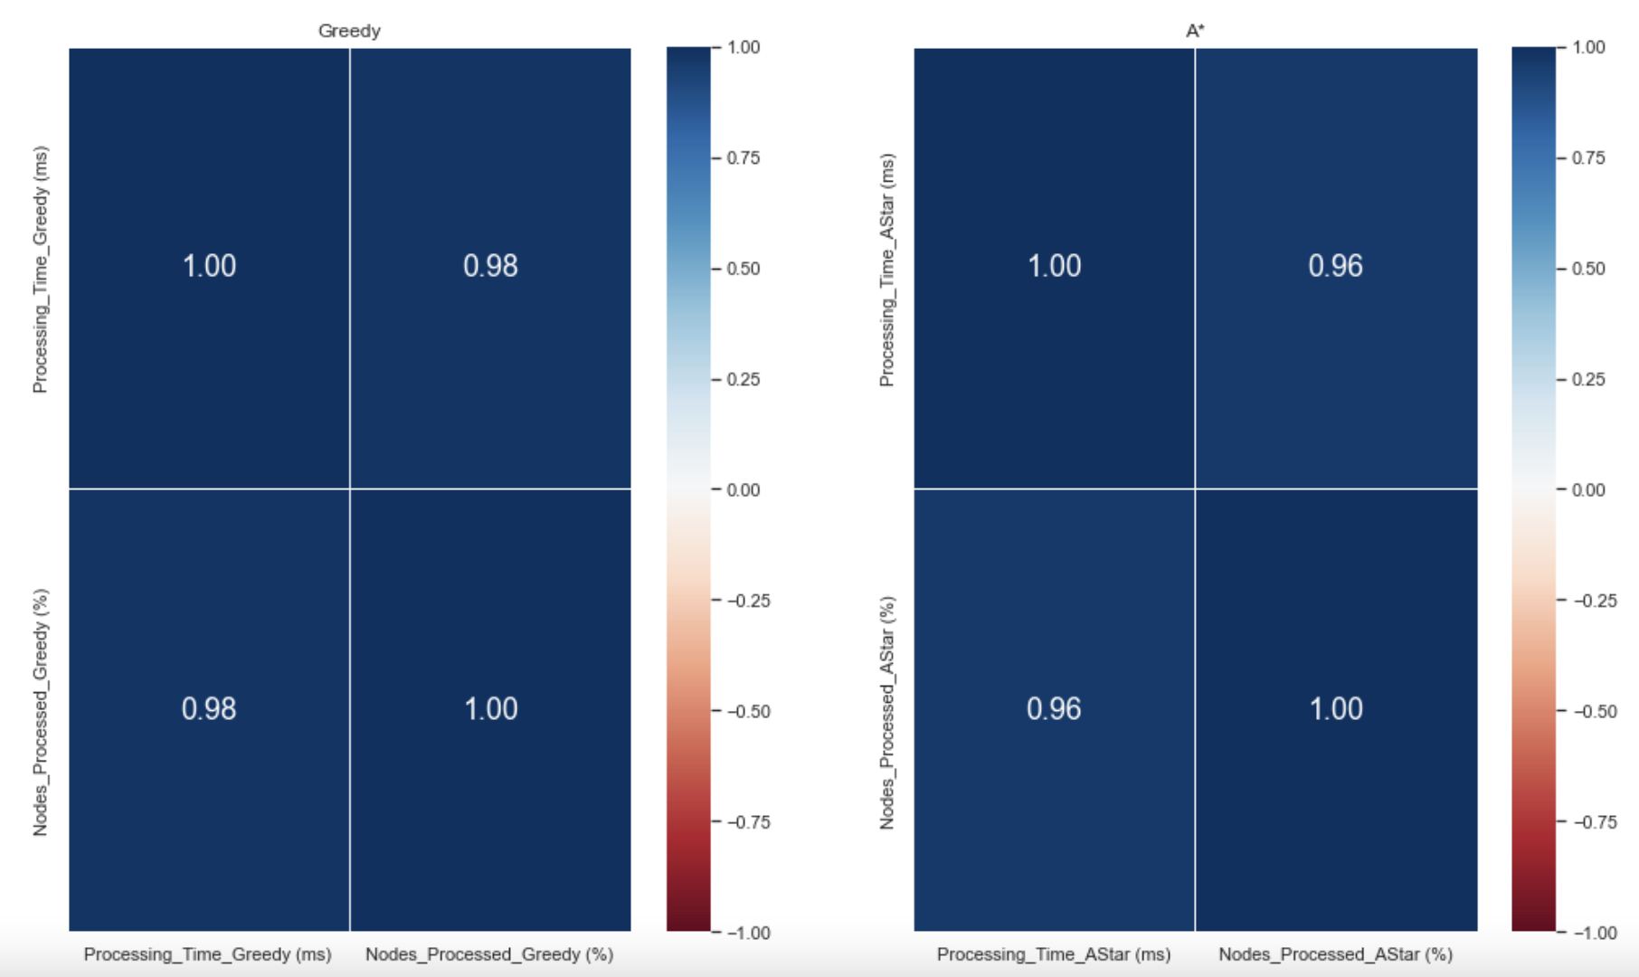
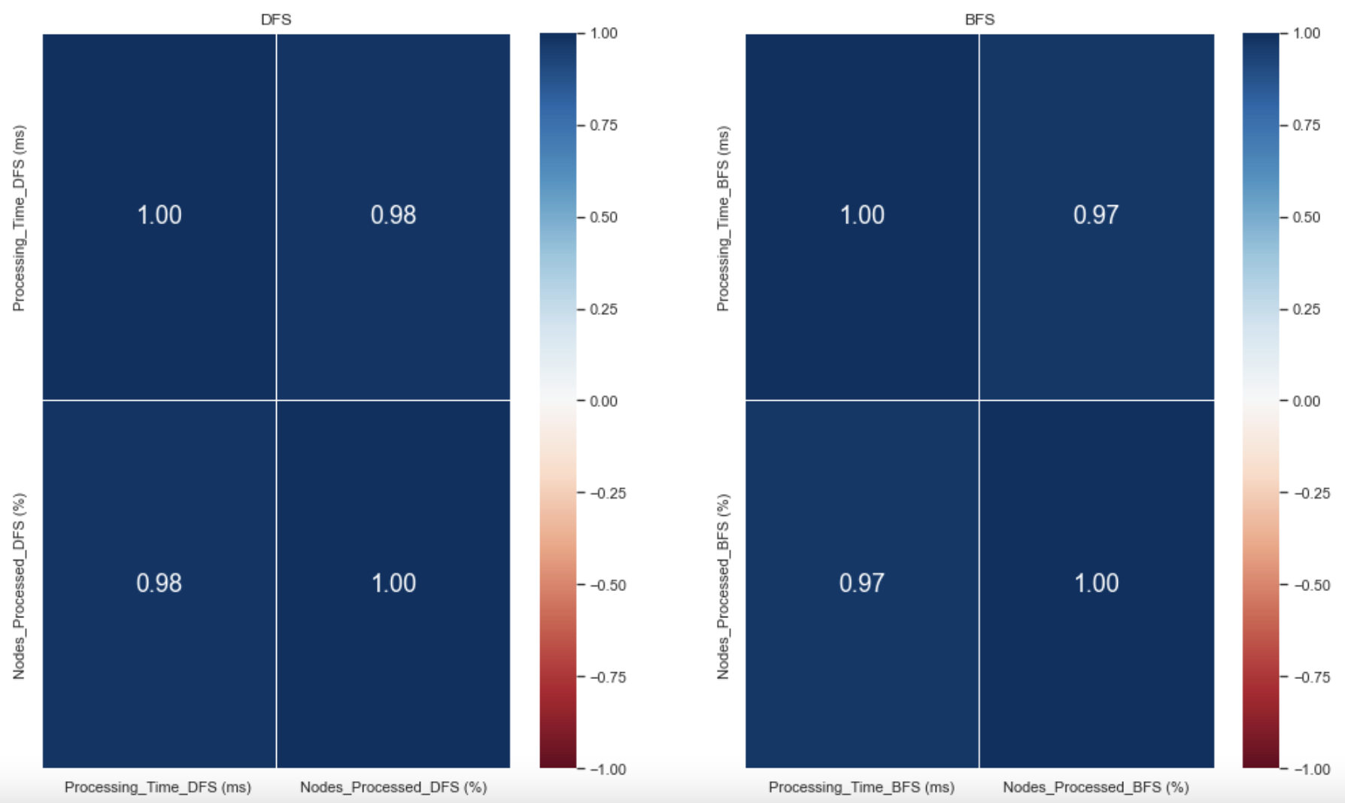
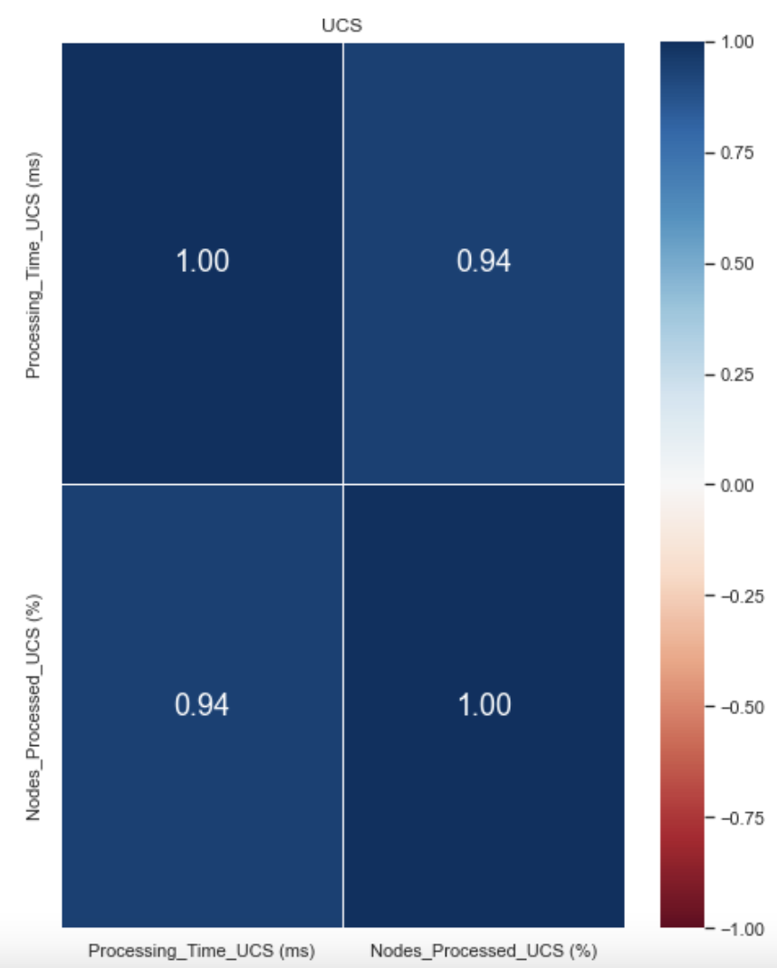
Greedy
A*
DFS
BFS
UCS
Notes:
This shows the individual correlation between the variables and their corresponding correlation. This is mainly for a better view from the previous plot and we can clearly see that each variable possess over 0.9 correlation among their variables.

Slide 20
Plotting of
Linear Regression

Slide 21
Machine Learning [Linear Regression]
Why?
Variables are of continuous format.
Wanting to predict a continuous variable with another continuous.
Why not other models?
Not trying to overcomplicate things
Just need some formal and concrete understanding between the 2 variables.
Notes:
Before we proceed to the Linear Regression, we would like to talk more about why we chose this model over other models. Firstly the data that we have gotten is of the continuous format and we want to predict a continuous variable over another.
Secondly, we are not trying to over complicate things and just need some more concrete understanding of the variables that we have gotten. Decision Tree Classification and K Nearest Neighbors models are unnecessary here as we are not trying to classify the algorithms but rather compare the results we have obtained instead.

Slide 22
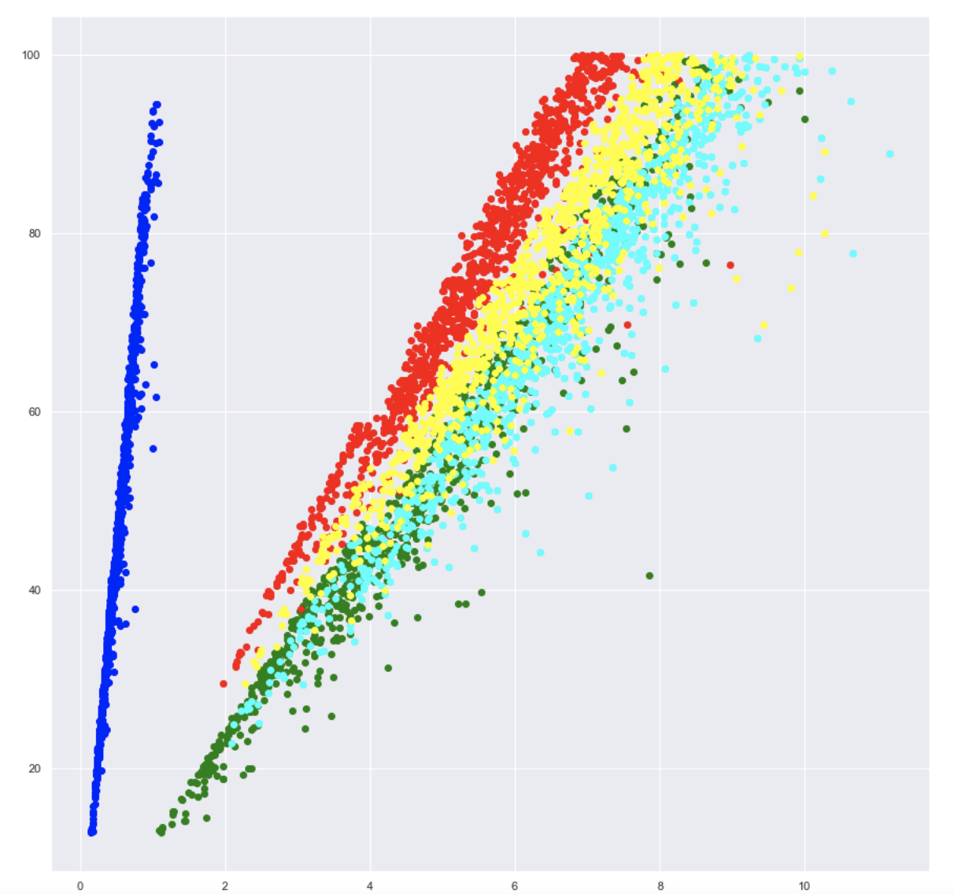
Why classification fails
Notes:
The above plot shows each search algorithm plotted on their processing time (x axis) against their nodes processed (y axis).
Blue - DFS
Red - BFS
Green - Greedy
Yellow - UCS
Cyan - Astar
From the above we can see that there is some segregation between DFS and the rest. It is also arguable that the same could be said for BFS. However, as for the rest, the data is quite mixed together and difficult to classify them into separate classes. Thus, we do not do classification as the data shown overlaps heavily with each other.

Slide 23
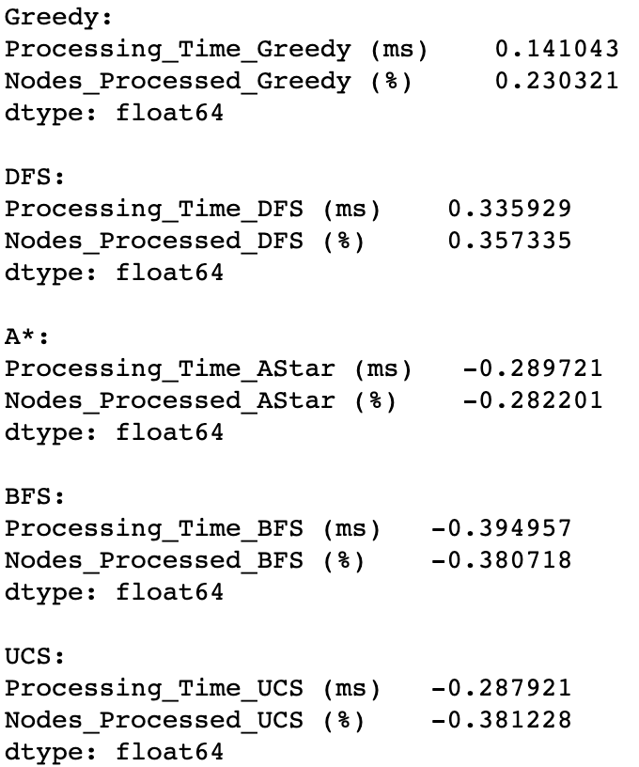
Check Skewness of Variables
Notes:
Before plotting we begin by checking the skewness of the data to see if there is a need for transformation.
As you can see from the skewness of the variables, they are more or less symmetric so any sort of transformation between the variables is unnecessary. We will just use these variables with their outliers removed for linear regression.
- Skewness between -0.5 to 0.5 is considered more or less *symmetric* (no need to transform)
- Skewness between -1.0 to -0.5 or 0.5 to 1.0 is *moderately skewed* (we may try a transform)
- Skewness below -1.0 or above 1.0 is *highly skewed* (we should try transforming the response)
Since all of the data are within acceptable range, no transformation of variable is needed and can go straight to plotting of the linear regression model.

Slide 24
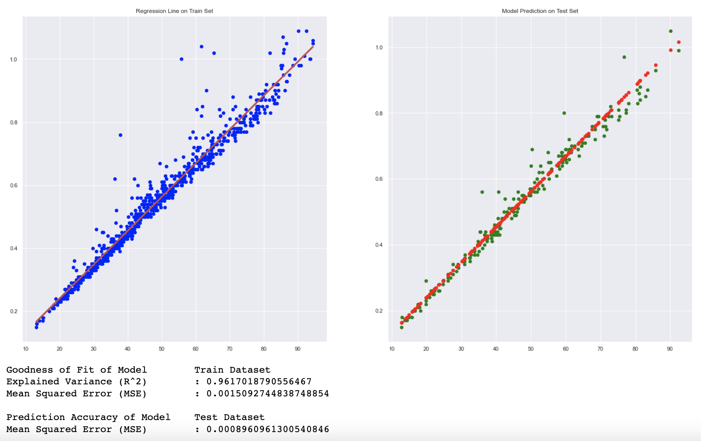
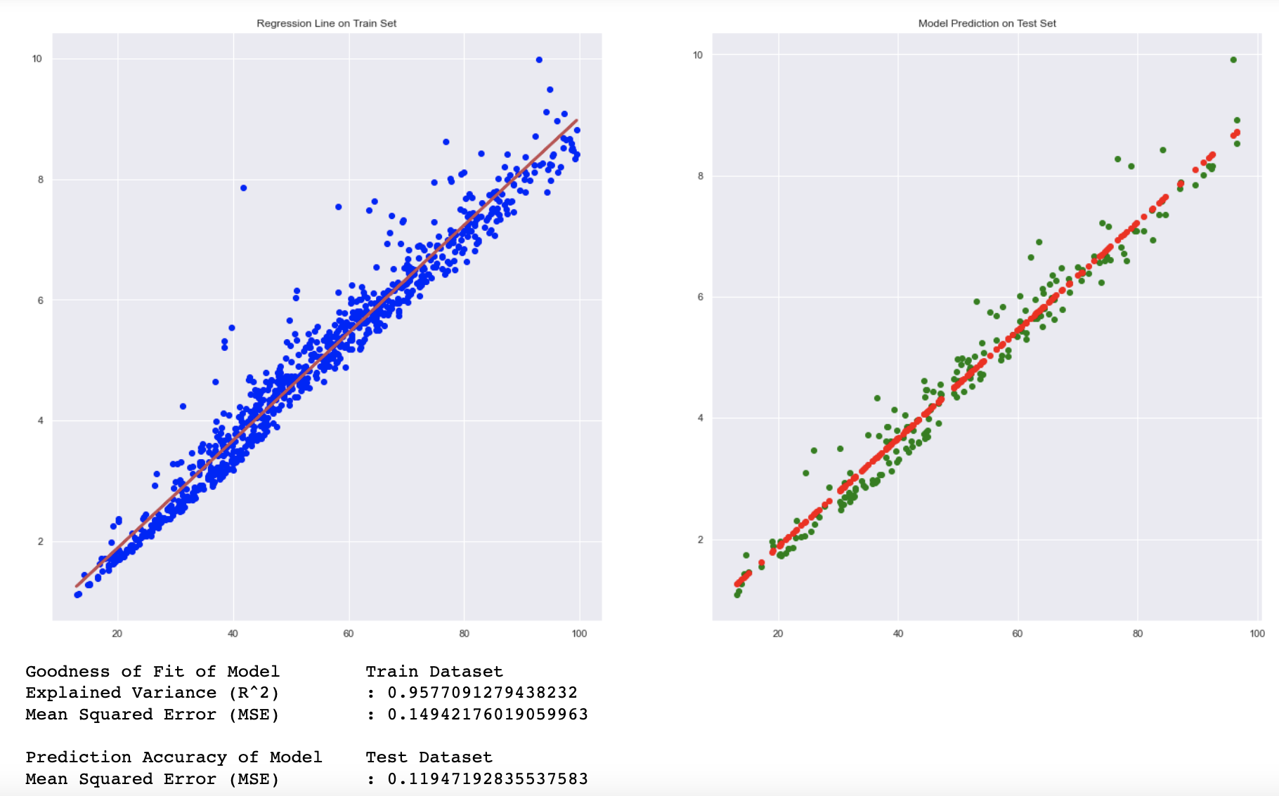
DFS
Greedy
Notes:
Here we can see the linear regression plot between a DFS and Greedy. From the plot, we can compare the MSE to see the accuracy between the algorithms. DFS has fairly low prediction accuracy with the Train MSE = 0.00151 to Test MSE = 0.0009 while Greedy has a 0.149 Train to 0.119 Test. This shows that although DFS might have overall a lower accuracy, it might not be very consistent as the difference between the train and test are quite large while greedy might prove to be more consistent in a unweighted graph.

Slide 25
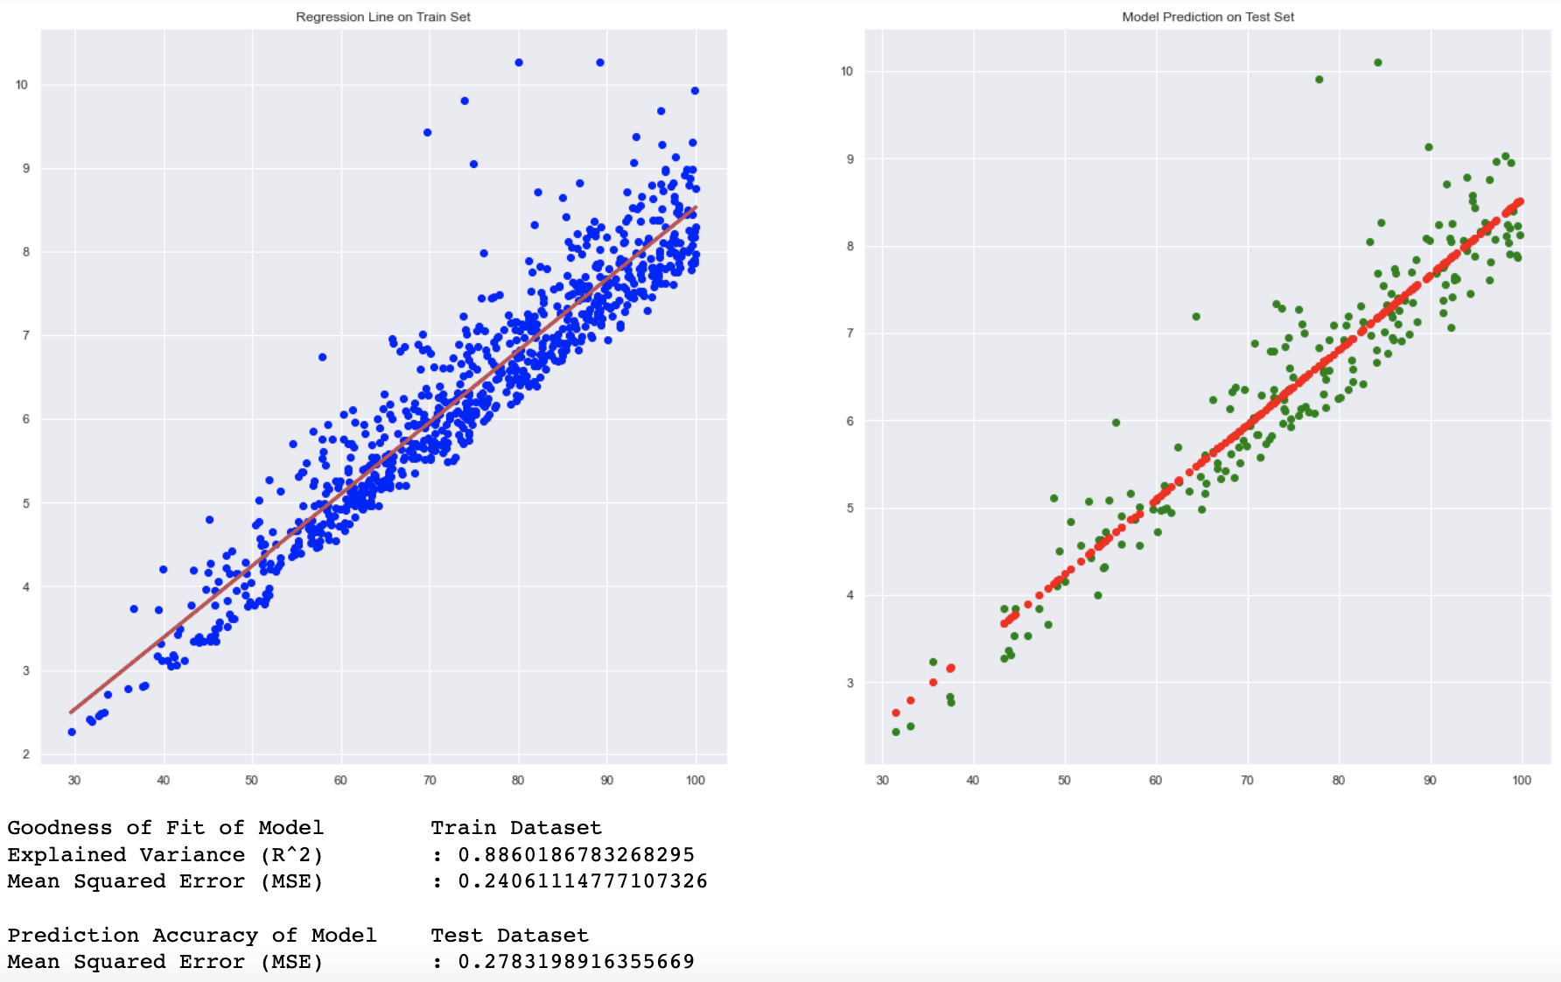
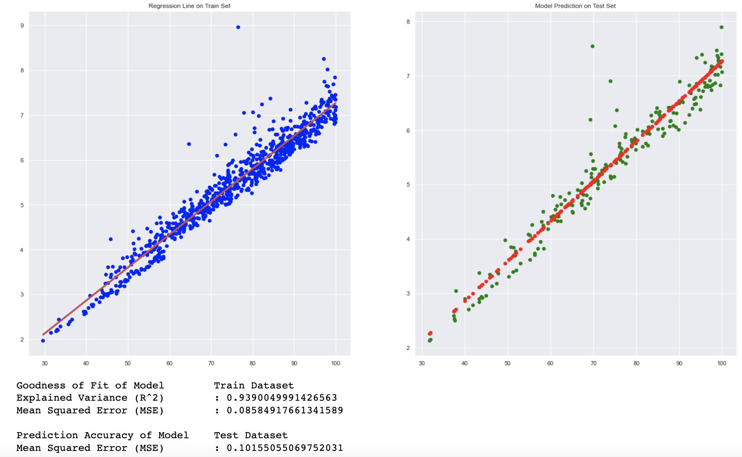
UCS
BFS
Notes:
Here comparing UCS to BFS, we can see that they are fairly similar as both the difference in MSE between the Train and Test are between 0.2 - 0.3. This shows that the behaviour between the 2 might be similar in terms of prediction accuracy. However, the Explained Variance of UCS is 0.5 lower than that of BFS, it might not be that significant but this shows that the variables are more correlated in BFS than in UCS. Meaning we might have overall higher accuracy in predicting a train to a test in BFS than UCS which can be seen in the overall lower MSE in BFS than UCS.

Slide 26
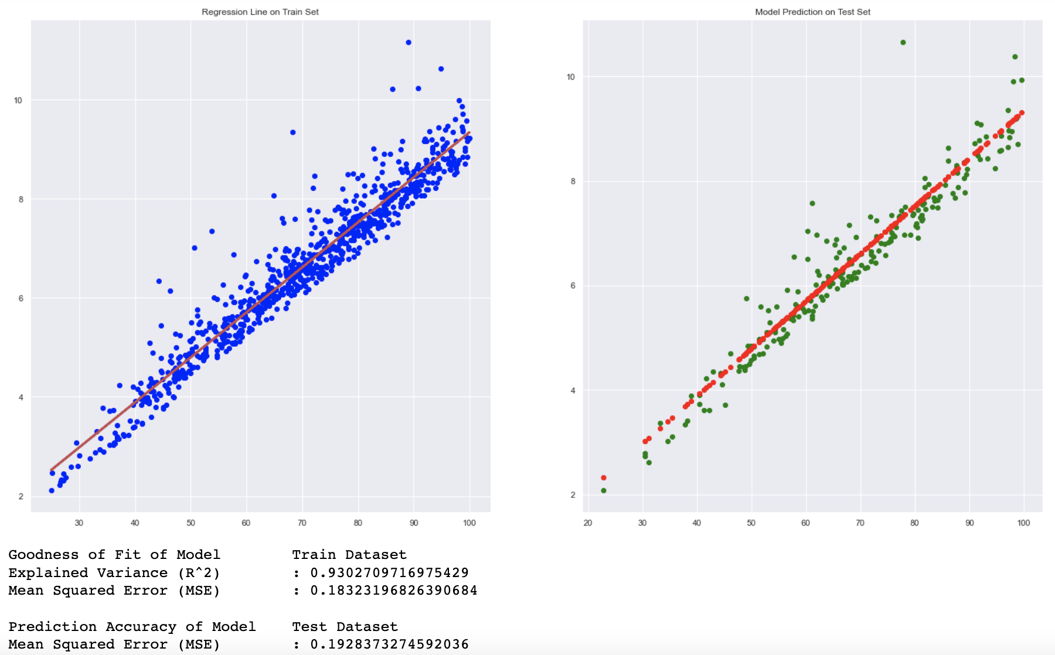
A*
Notes:
Finally we see Astar. From the explained variance we can see if has a high correlation between the 2 variables used. The overall prediction accuracy is higher as MSE of DFS and Greedy is lower but it is still lower than UCS. This is to be expected as AStar uses 2 different aspects (path cost and heuristics) to do pathfinding and thus is highly dependent on these aspects in the graph. For an unweighted graph, the path cost are all the same but the heuristics might differ when it reaches from node to node. This might explain the overall high processing time of the algorithm as it still needs to compute 2 aspects before doing anything else.

Slide 27
Summarization
Notes:
To summarise entirely, we are trying to find the most cost efficient, best performing and consistent search algorithm for an unweighted graph. From our findings, AStar might not be the most cost efficient, best performing and consistent algorithm. Greedy might be a strong contender in the unweighted graph category as there is no need to compute for path cost in an unweighted graph as all the cost are the same. This saves time in the algorithm to just only compute a heuristic for deciding the next best course of action.
Although it has overall higher runtime and nodes processed compared to DFS, but as seen in the linear regression plot, it is overall more consistent in its performance.
In addition, it has the second lowest nodes processed and runtime on average when compared to the other algorithms.
Thus from our dataset, we conclude that Greedy is the overall the best algorithm to run on an unweighted graph among the 4 other algorithms we were tested.

Slide 28
Thank You

