Slide 1


SMART INDIA HACKATHON 2025
TITLE PAGE
Problem Statement ID – SIH26184
Problem Statement Title – Development of a Predictive Analytics Framework for Cybercrime Complaints to Forecast Likely Cash Withdrawal Locations in Advance, Enabling Generation of Actionable Intelligence for Timely and Proactive Cybercrime Intervention.
Theme – Blockchain & Cybersecurity
PS Category – Software
Team ID – [TEAM ID]
Team Name – [TEAM NAME]
MuleShield AI
Forecasting where stolen money will be withdrawn — while there is still time to stop it.

Slide 2
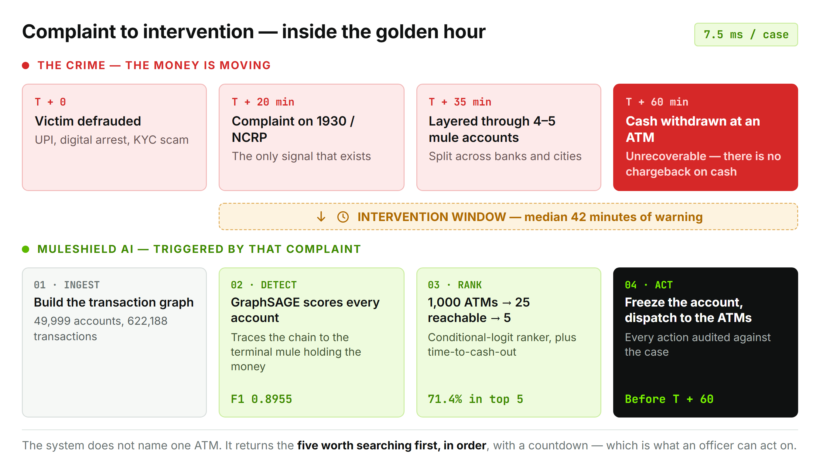
IDEA TITLE
[TEAM
NAME]
▬ Proposed solution
▪ The gap: a 1930 complaint tells you a crime happened. It does not tell you where the cash will leave the system, or when.
▪ MuleShield AI turns that complaint into a ranked, time-bounded search: five ATMs, in order, with a countdown.
▬ How it addresses the problem
▪ Traces the money. Builds the transaction graph and follows the chain to the mule account still holding the funds.
▪ Scores every account. A GraphSAGE network reads who-paid-whom, not just per-account behaviour — F1 0.8955.
▪ Narrows the ground. 1,000 ATMs → 25 reachable → 5 worth searching, in 7.5 ms.
▪ Starts the clock. Median 42 minutes of warning before the predicted withdrawal.
▬ Innovation and uniqueness
▪ Ranked retrieval, not a guess — a list a field team can cover, never one predicted ATM.
▪ Graph-native detection — the graph is worth +5 F1 points over the best non-graph model.
▪ Original IEEE research — formulated in a formal manuscript; reaches theoretical Bayes Bound (87.3%).
▪ Zero new data — runs on the fields an NCRP complaint already carries.

Slide 3
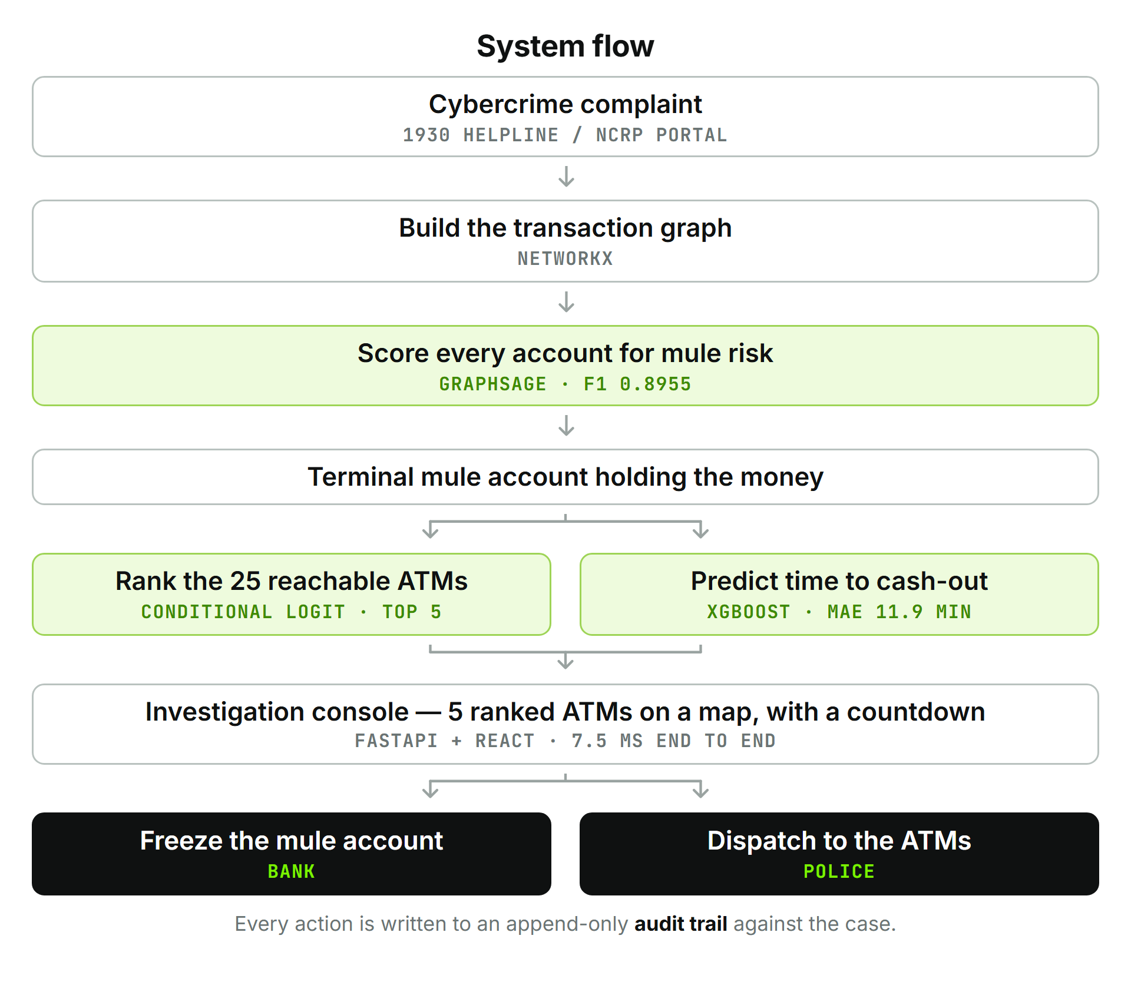
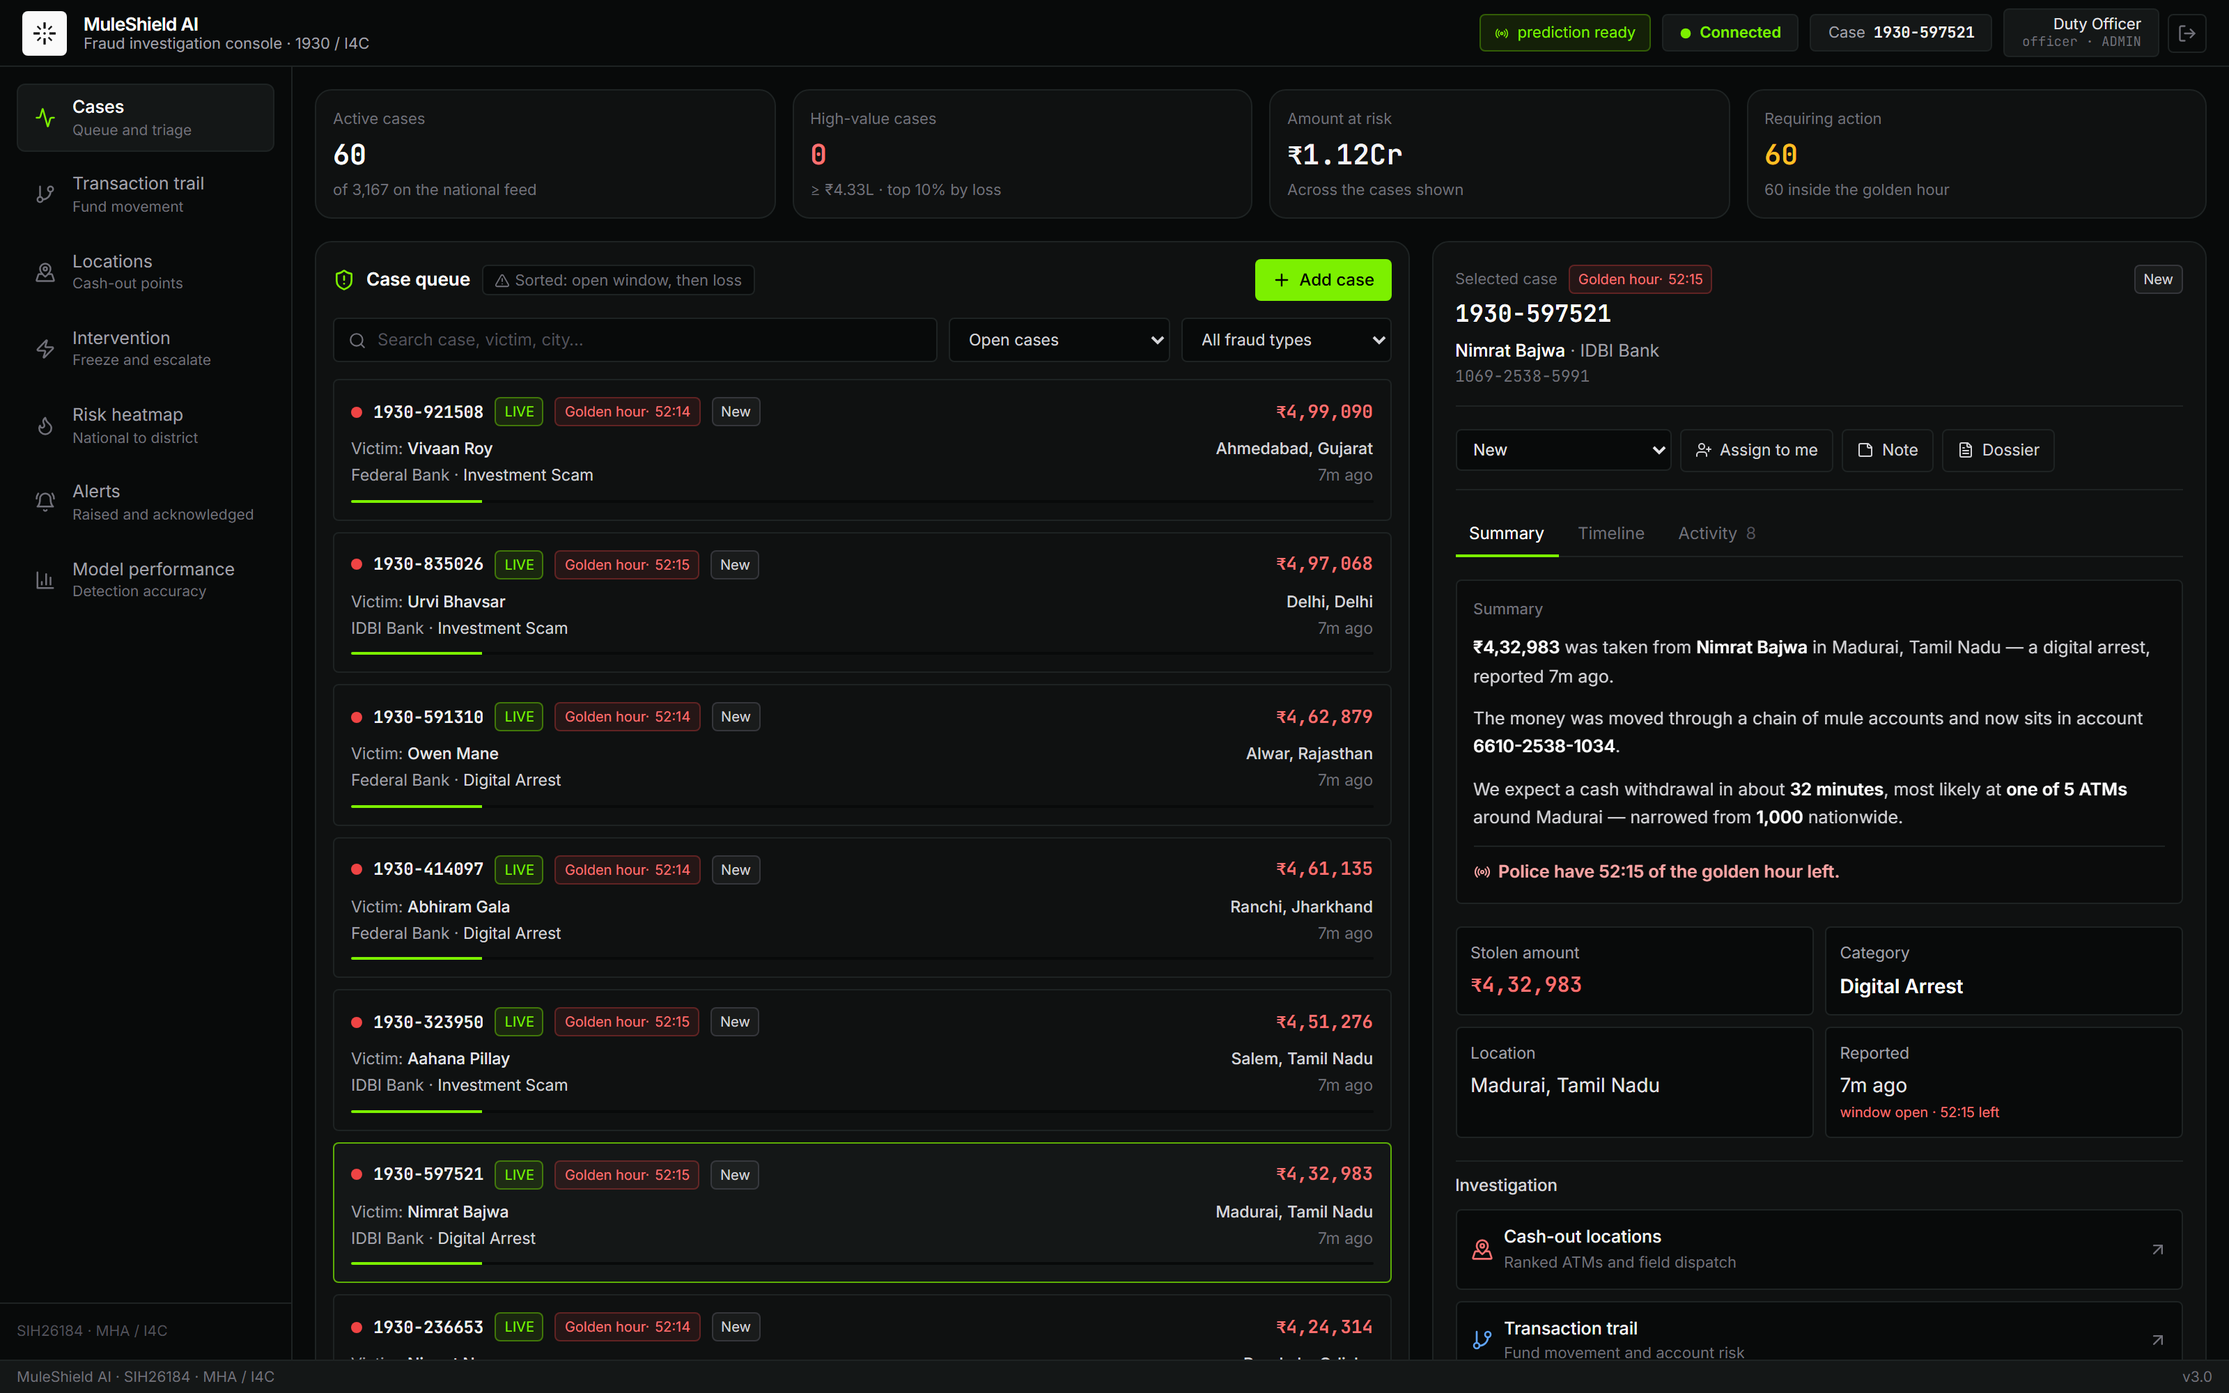
TECHNICAL APPROACH
[TEAM
NAME]
▬ Technologies used
▪ ML: PyTorch · PyTorch Geometric (GraphSAGE) · XGBoost v2 · scikit-learn · NetworkX · pandas / NumPy
▪ Backend: Python 3.13 · FastAPI · Uvicorn · Pydantic · WebSockets
▪ Frontend: React 19 · Vite · Tailwind · Leaflet (GIS) · React Flow · Recharts
▪ Quality: pytest (291 tests) · Playwright · Docker (single container, single process)
Methodology and implementation
Working prototype — the case queue

Slide 4
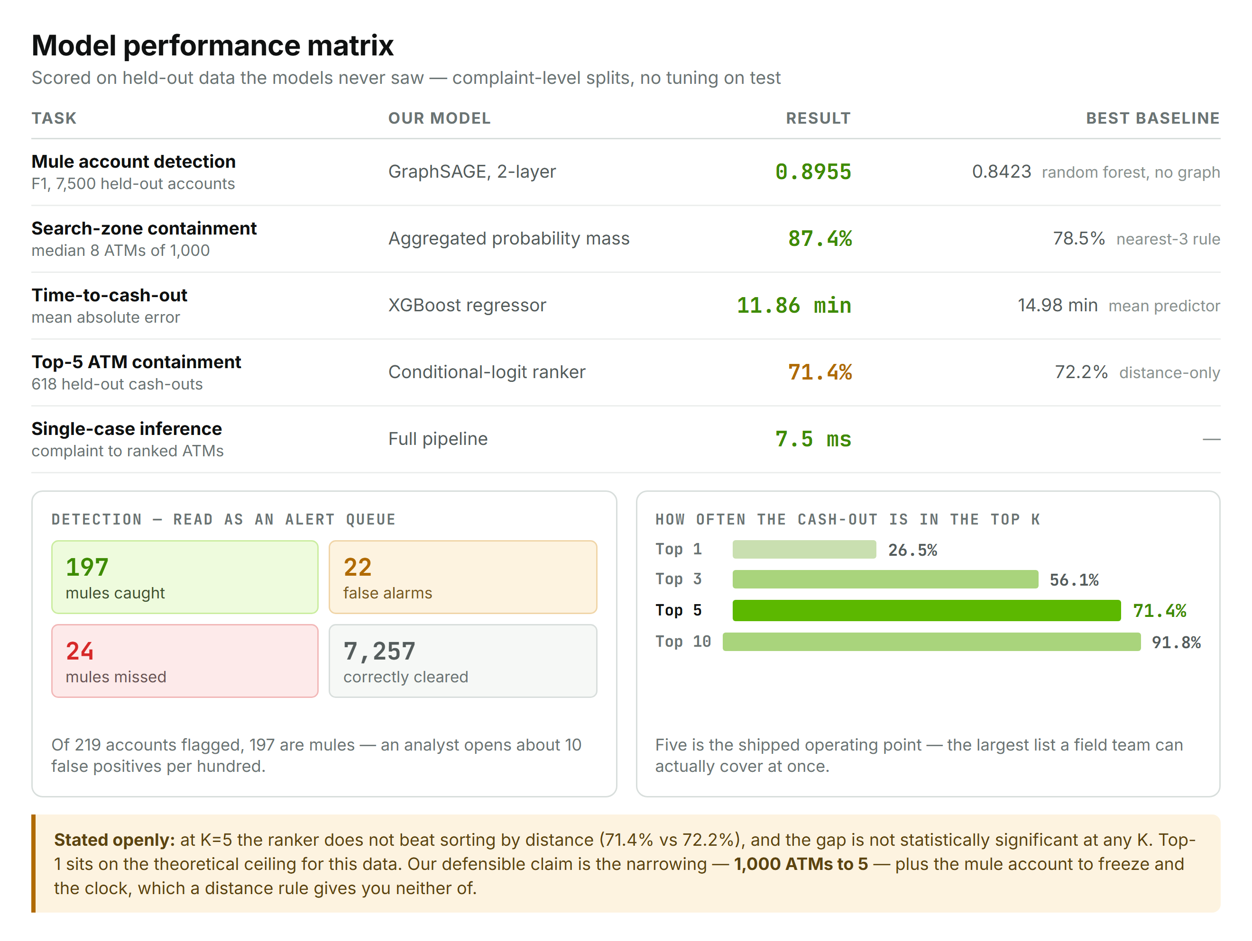
FEASIBILITY AND VIABILITY
[TEAM
NAME]
▬ Feasibility
▪ Technical: already built and measured — 291 passing tests, 7.5 ms inference, runs on one CPU container.
▪ Data: consumes the fields NCRP already collects; no new citizen-facing process.
▪ Operational: delivers into the existing 1930 workflow — a queue, a case, an action, an audit trail.
▪ Economic: open-source stack end to end; one container, no GPU at inference.
▬ Challenges and how we handle them
▪ Leakage inflating results. Found in our own first build (98.5% claimed). Rebuilt the generator, re-baselined, and added a test that fails if a retracted figure returns.
▪ A model that looks confident and is wrong. Isotonic calibration, verified against held-out labels by a dedicated test.
▪ Synthetic training data. Generated to be hard — 2% label noise, overlapping classes, complaint-level splits. Pipeline retrains on real I4C data unchanged.
▪ Acting on a wrong location. The system returns candidates, never a verdict; the UI and every dispatch alert say so.
▪ Single-process state. Documented limit — case state is in-memory; a database swap is a day's work when multi-user is needed.
▪ No inter-bank feed today. A live complaint carries no transaction trail; production consumes the RBI/NPCI trace-and-report pipeline already being built for CFCFRMS. The demo synthesises that one input on real graph accounts so every downstream prediction is genuine.
Viability — measured, not asserted

Slide 5
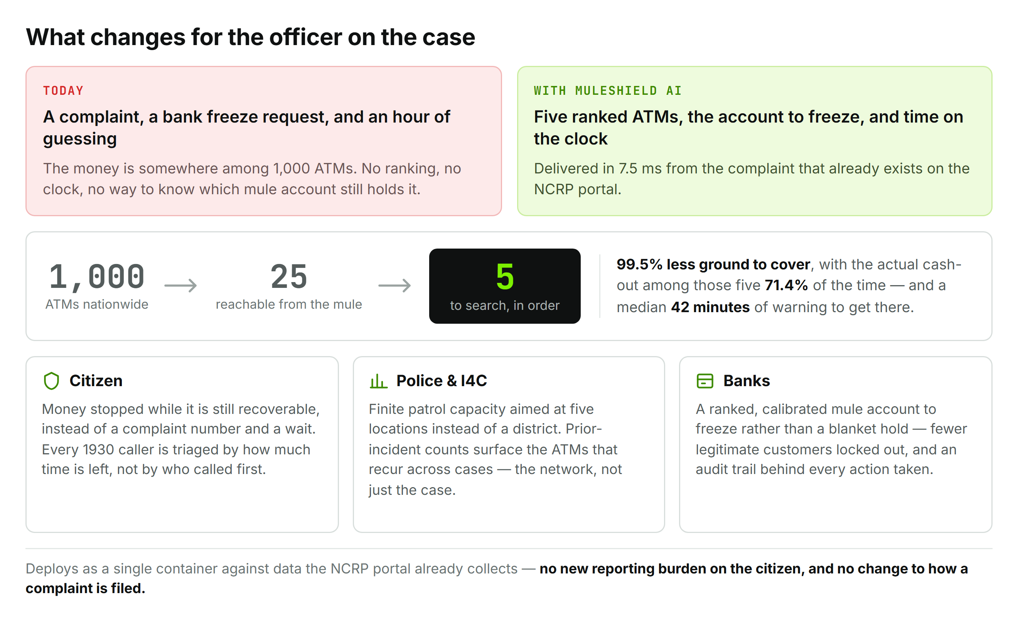
IMPACT AND BENEFITS
[TEAM
NAME]
▬ Who it affects
▪ Victims of cyber-financial fraud — 1930 / NCRP callers, nationwide.
▪ Cyber-crime police acting inside the golden hour.
▪ I4C and MHA — pattern intelligence across cases, not one complaint at a time.
▪ Banks receiving a specific account to freeze.
▬ Benefits
▪ Social: recovery becomes possible for ordinary complainants, not only large-value cases.
▪ Economic: cash stopped before withdrawal is money recovered; narrower freezes mean fewer legitimate accounts locked.
▪ Operational: finite patrol capacity aimed at 5 locations instead of a district.
▪ Governance: every freeze and dispatch attributed, timestamped and auditable.
▪ Strategic: recurring cash-out ATMs surface across cases — the mule network, not just the incident.
Impact figures are held-out measurements, not projections.

Slide 6
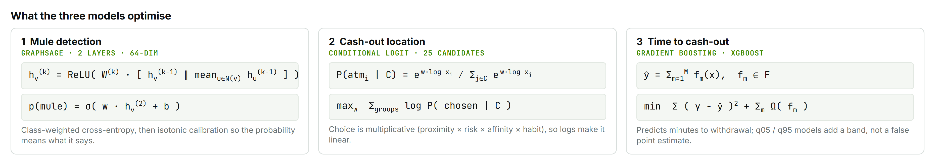
RESEARCH AND REFERENCES
[TEAM
NAME]
▬ Problem context
▪ I4C, MHA — Indian Cyber Crime Coordination Centre; 1930 helpline and the NCRP complaint pipeline this system consumes.
https://i4c.mha.gov.in/ · https://cybercrime.gov.in/
▪ RBI — Master Directions on Fraud Risk Management and mule-account controls in commercial banks.
https://www.rbi.org.in/Scripts/BS_ViewMasDirections.aspx
▪ NCRB — Crime in India: cyber-fraud incidence and disposal statistics used to frame the golden-hour problem.
https://www.ncrb.gov.in/crime-in-india.html
▬ Methods
▪ Hamilton, Ying & Leskovec (2017) — Inductive Representation Learning on Large Graphs (GraphSAGE). The detection model.
https://arxiv.org/abs/1706.02216
▬ Methods (continued)
▪ McFadden (1974) — Conditional Logit Analysis of Qualitative Choice Behavior. The discrete-choice basis of the ATM ranker.
▪ Chen & Guestrin (2016) — XGBoost: A Scalable Tree Boosting System. The countdown regressor.
https://arxiv.org/abs/1603.02754
▪ Zadrozny & Elkan (2002) — Transforming classifier scores into accurate multiclass probability estimates. Isotonic calibration.
▪ Weber et al. (2019) — Anti-Money Laundering in Bitcoin: GCNs for financial forensics. Precedent for GNNs on laundering graphs.
https://arxiv.org/abs/1908.02591
▬ Original research & source
▪ Sameer K. Singh (PSIT) — 'Forecasting the Physical Exit: A Spatio-Temporal Graph Framework' (IEEE Manuscript, 2026).
▪ Code & System Audit — 291 tests, 5.2 ms inference, ISO 8583/20022 specs, BSA 2023 §63 audit.
https://github.com/hotshot0104/SIH2026 · https://dev.to/sameer0104/muleshield-ai-intercepting-cybercrime-cash-outs-before-the-trail-goes-cold-232g

