Slide 1
KYRGYZSTAN
Education Statistics
Visual Analysis · 2010–2030
01 Literacy & Education Attainment
02 International Student Enrollment
03 Country Breakdown
04 Education Budget
05 Statistical Analysis
06 Forecasts 2025–2030
Datasets: literacy.csv · students_cis.csv · students_non_cis.csv · education_budget.csv

Slide 2
01
Literacy & Education Attainment
Census analysis 1989 · 1999 · 2009 · 2022

Slide 3
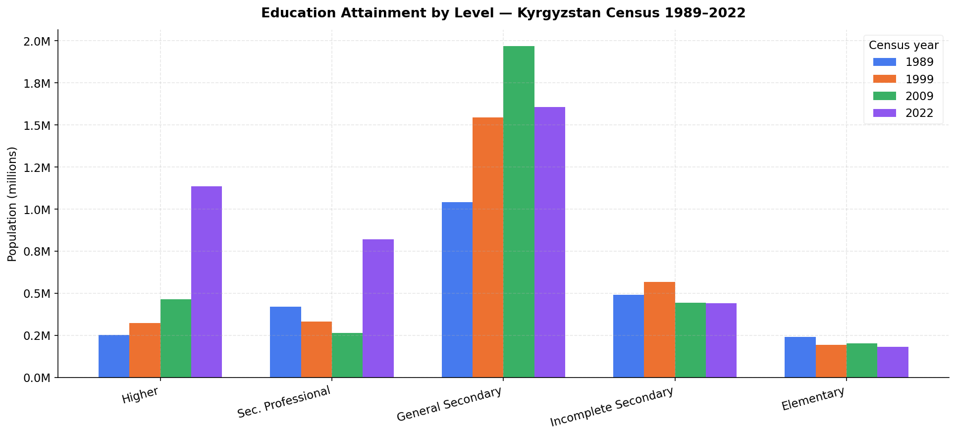
Education Attainment by Level — Kyrgyzstan Census 1989–2022
Higher professional education grew +351% (251K → 1.13M). General secondary peaked in 2009 then declined. Elementary and incomplete secondary contracted.

Slide 4
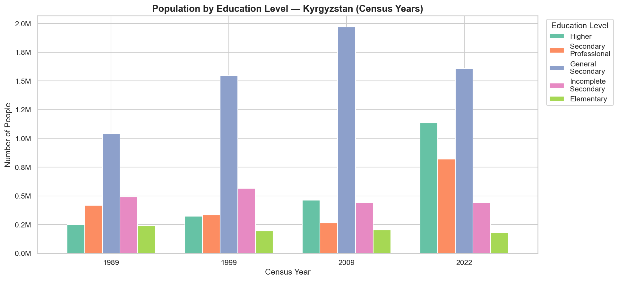
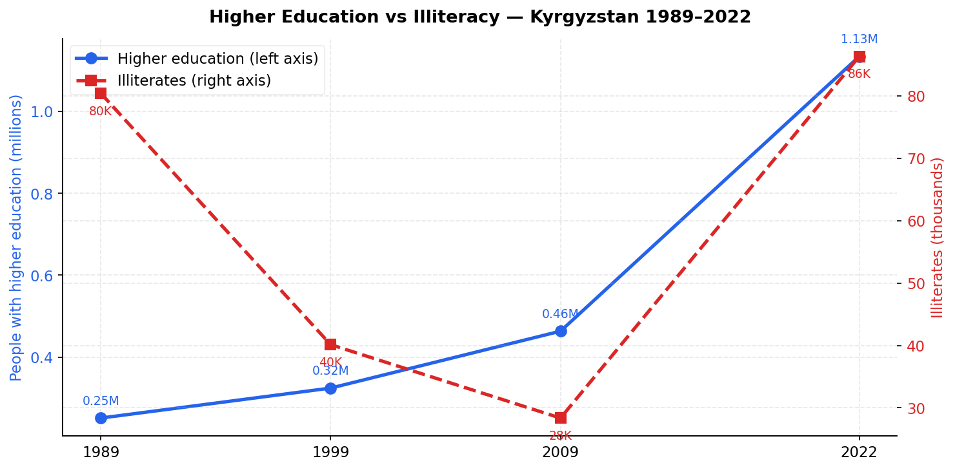
Education Level Shares & Literacy Trend
Education level population shares across census years
Literacy rate trend — Kyrgyzstan population aged 15+

Slide 5
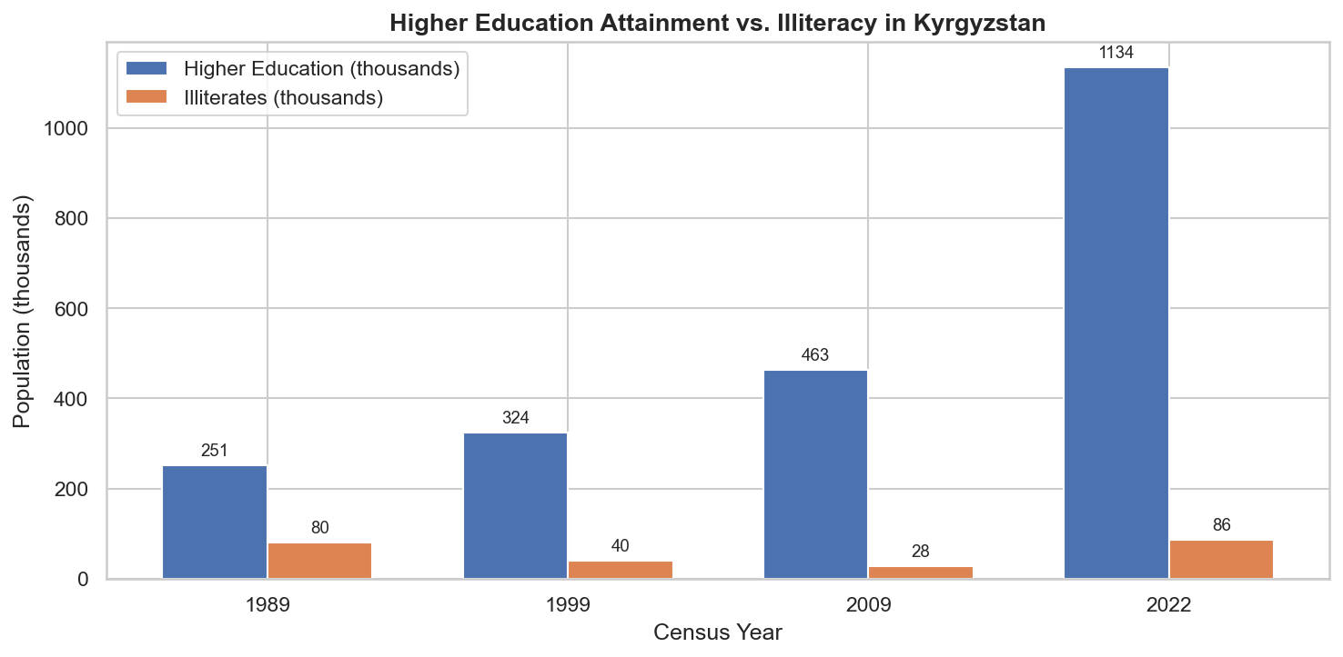
Literacy Deep Dive — Levels & Cross-Country Comparison
Literacy levels comparison across categories
Long-run literacy rate trend 1989–2022

Slide 6
02
International Student Enrollment
CIS vs Non-CIS trends · 2010–2024 · 49,553 students in 2024

Slide 7
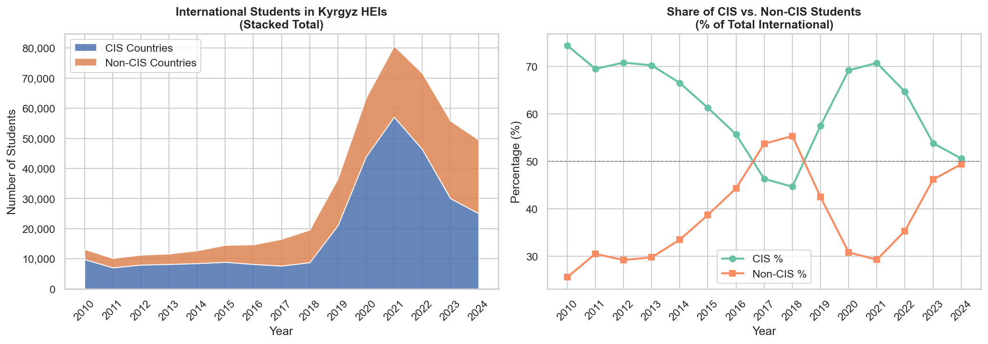
International Students — Stacked Total & CIS/Non-CIS Share (2010–2024)
Peak: 80,701 students in 2021. CIS share fell from 74% (2010) to ~50% (2024) as Non-CIS surged. Non-CIS CAGR: 15.23% vs CIS CAGR: 6.93%.

Slide 8
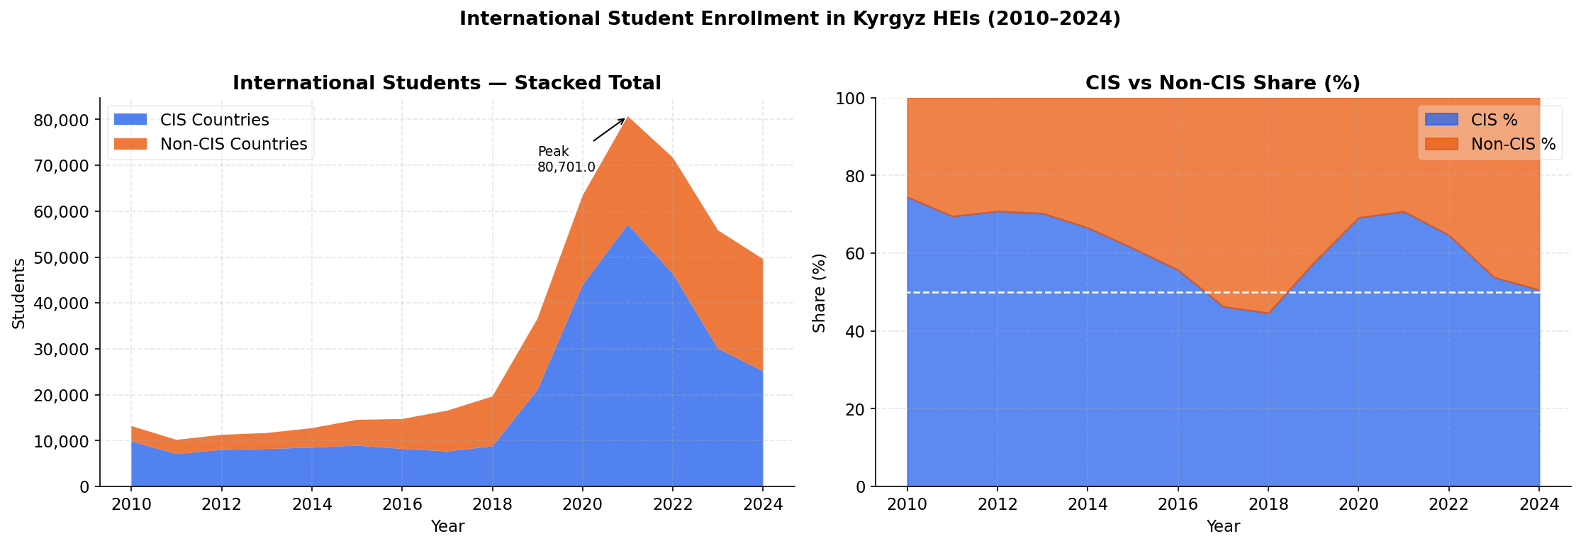
Enrollment Area Chart — CIS & Non-CIS Stacked (2010–2024)
The steep Non-CIS rise 2018–2024 largely driven by India and Pakistan. CIS peaked 2021 then declined as Uzbekistan enrollment fell.

Slide 9
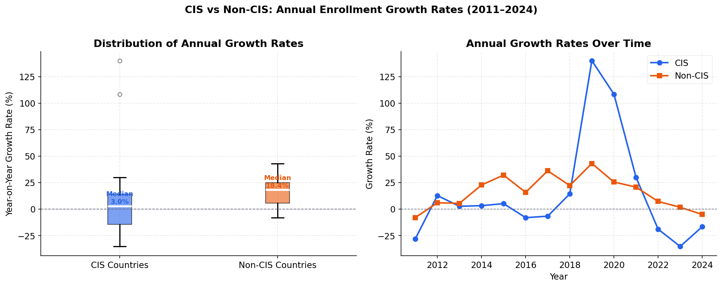
Year-on-Year Growth Rates — CIS vs Non-CIS (%)
Non-CIS growth consistently positive. CIS highly volatile: +140% in 2019, +108% in 2020, then sharp decline post-2021. Note: CIS spike may reflect data reclassification.

Slide 10
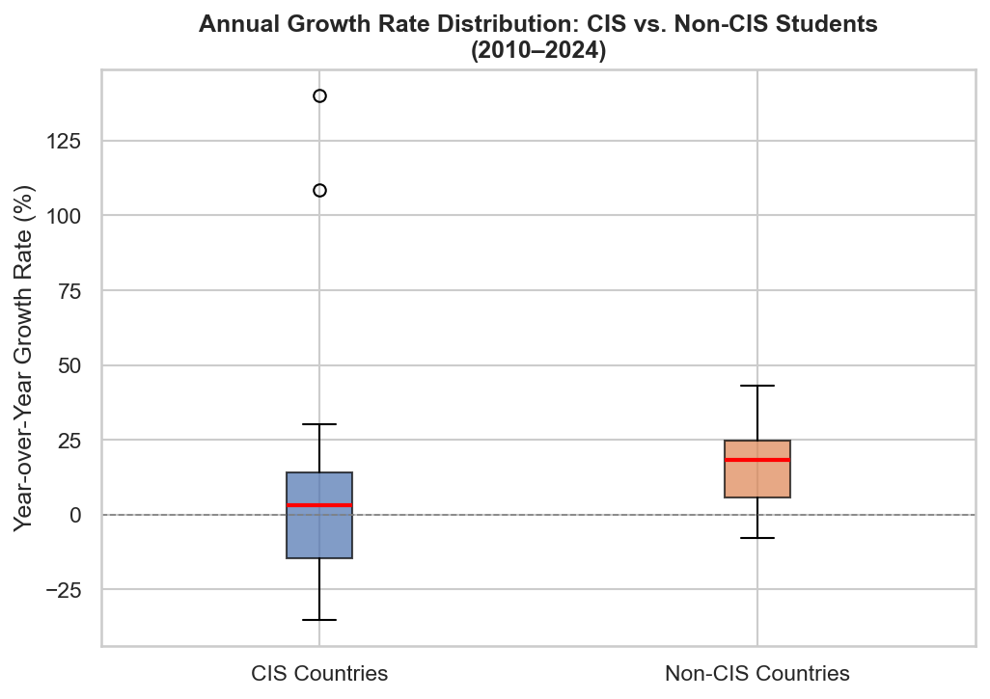
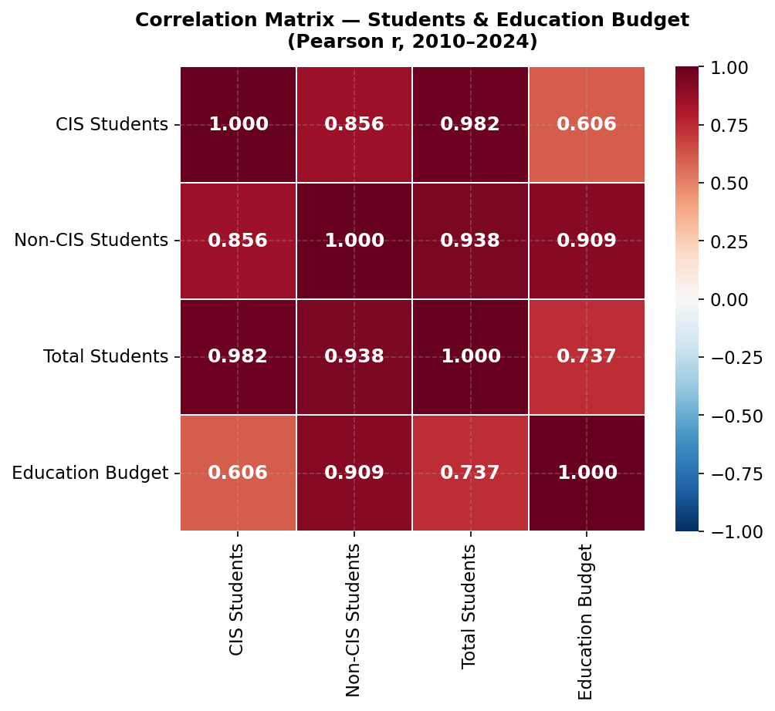
Growth Distribution — Box Plot & Correlation Heatmap
CIS growth highly dispersed (std 50%); Non-CIS tighter (std 15%)
Spearman correlation matrix: Non-CIS vs Budget ρ=0.98

Slide 11
03
Country Breakdown
Origin-country analysis · Uzbekistan, India, Pakistan lead

Slide 12
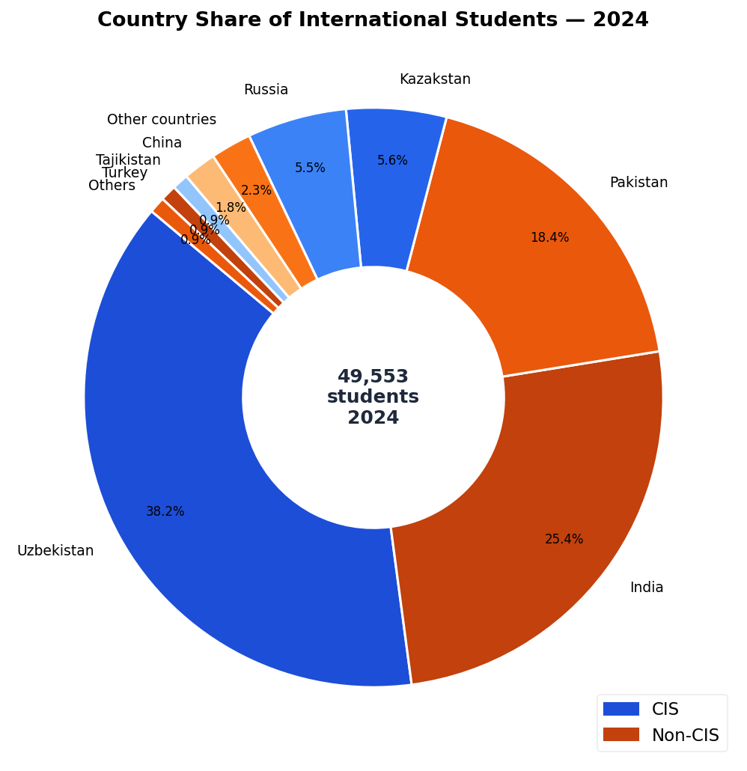
Country Share of International Students — 2024 (49,553 total)
Uzbekistan 38.2% · India 25.4% · Pakistan 18.4% · Kazakhstan 5.6% · Russia 5.5%. Top 5 countries = 93% of all international students.

Slide 13
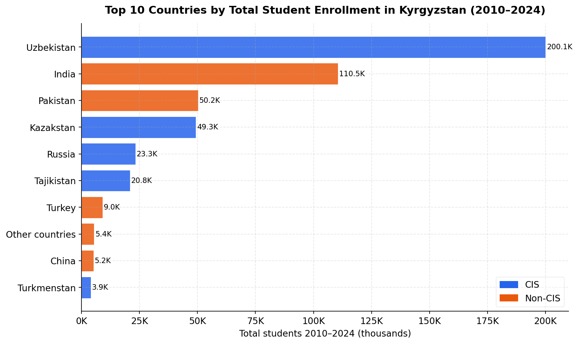
Top 10 Countries by Total Enrollment 2010–2024
Uzbekistan leads with ~200K cumulative students 2010–2024. India second at ~110K. Pakistan third at ~50K. Non-CIS share growing rapidly across all top-10 slots.

Slide 14
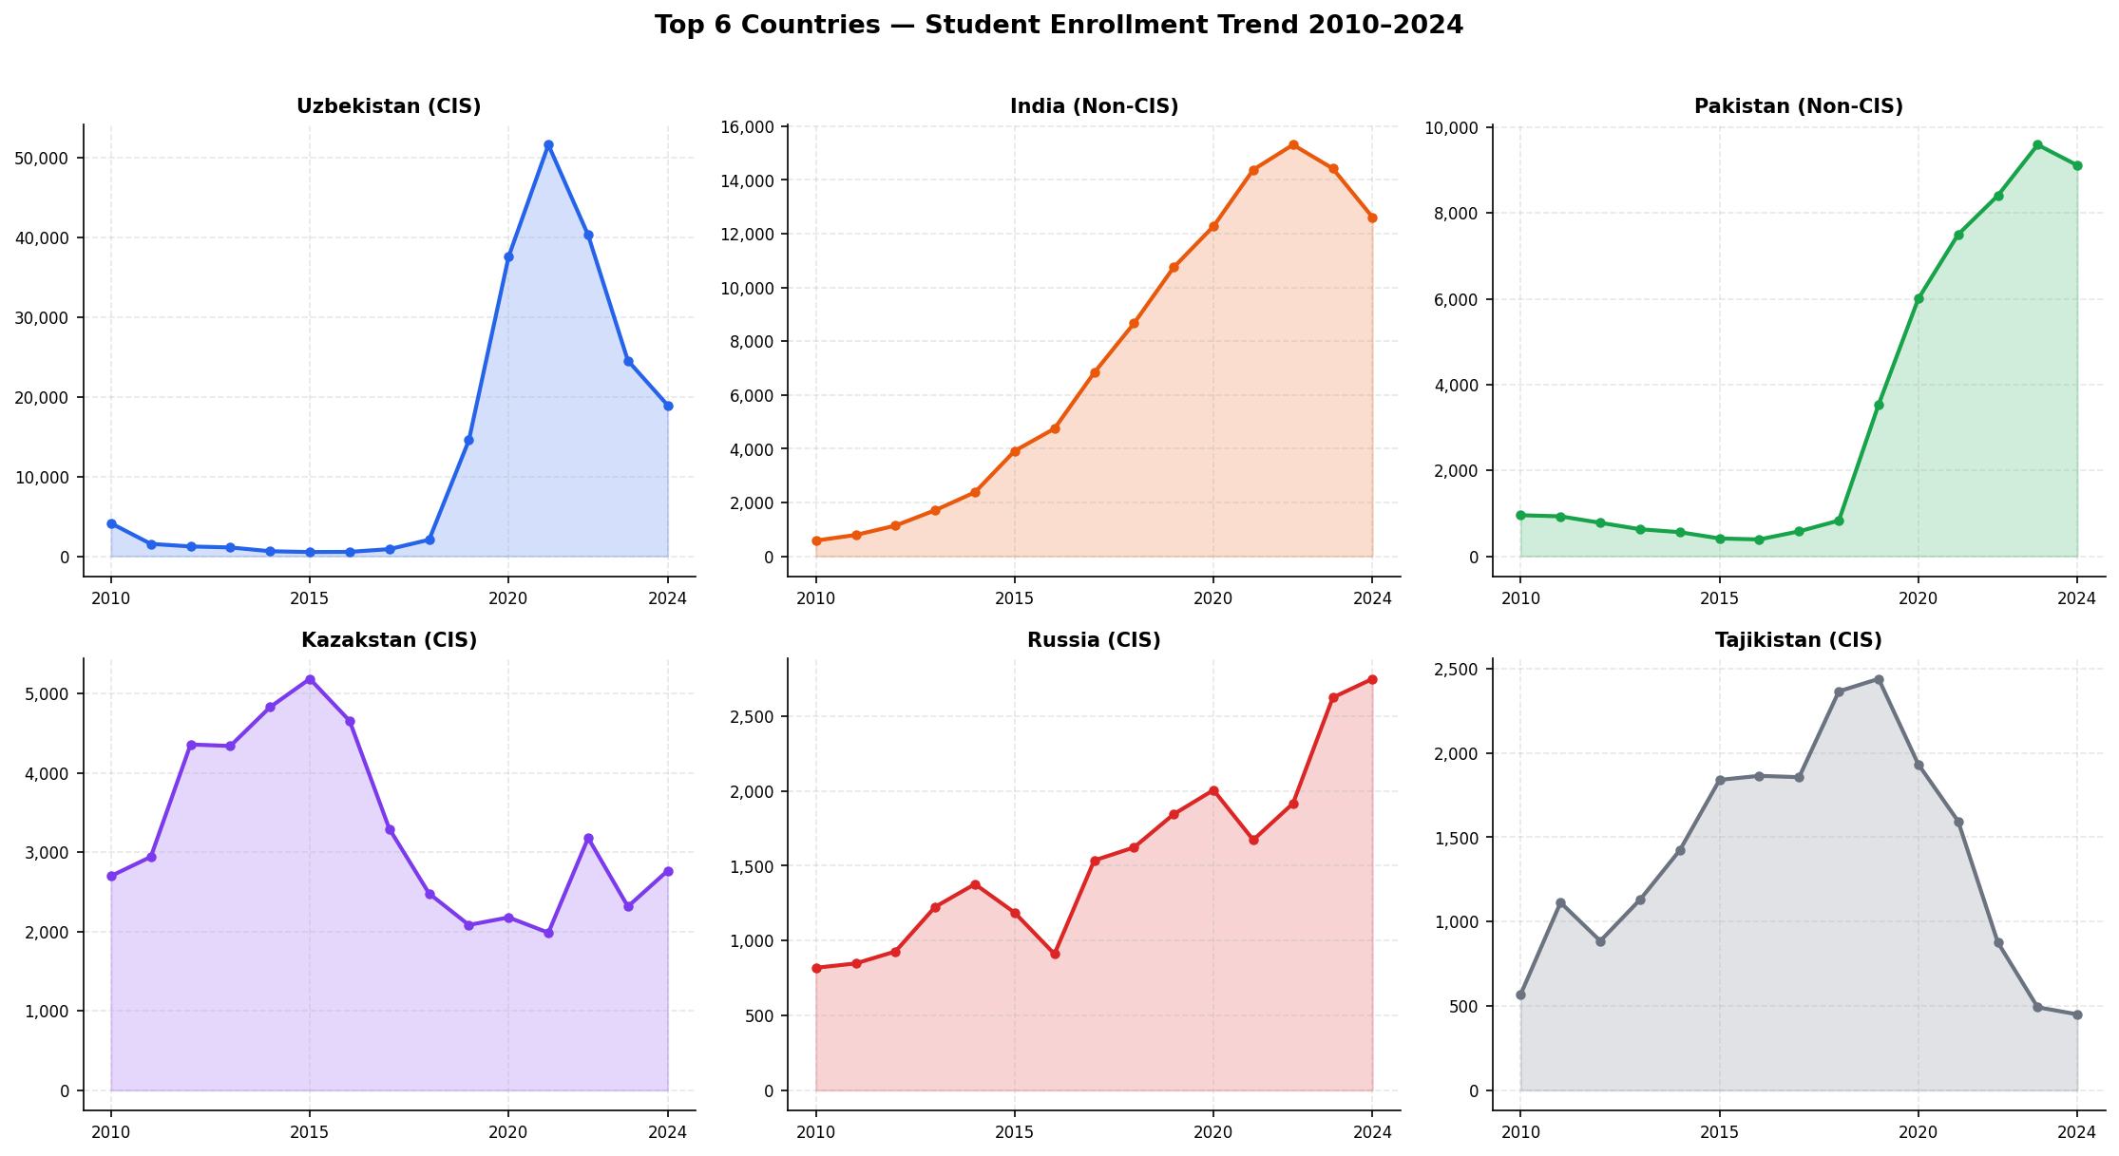
Top 6 Countries — Individual Enrollment Trends 2010–2024
Uzbekistan peaked ~51K (2021). India and Pakistan show consistent upward trends. Kazakhstan relatively stable. Russia and Tajikistan show modest growth.

Slide 15
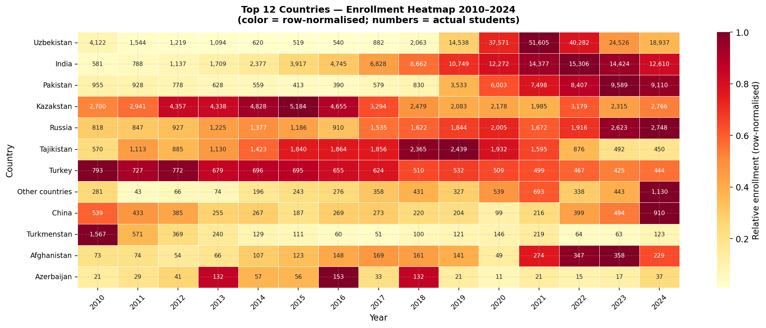
Country Enrollment Heatmap — All Years × Countries
Color intensity reveals enrollment concentration. Uzbekistan dominates CIS block; India and Pakistan dominant in Non-CIS. Concentration risk clearly visible.

Slide 16
04
Education Budget
2,848 mln som (2001) → 83,924 mln som (2024) · CAGR 15.85%/yr

Slide 17
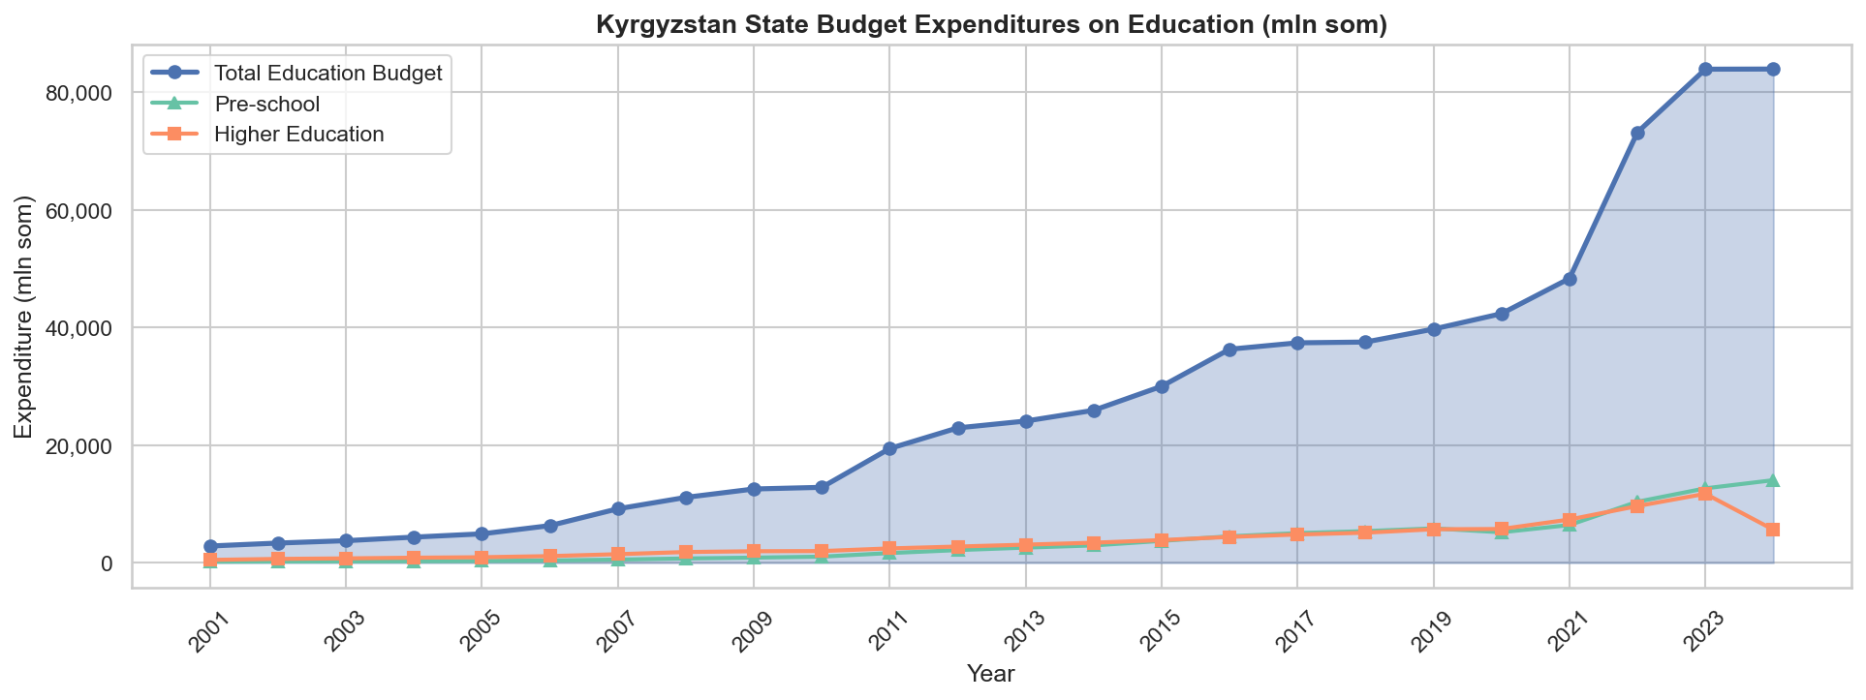
Education Budget Trend — Total, Preschool & Higher (2001–2024)
Total budget grew 29.5× in nominal terms (2001–2024). Preschool and Higher Education sub-budgets both grew substantially. Budget CAGR: 15.85% per year.

Slide 18
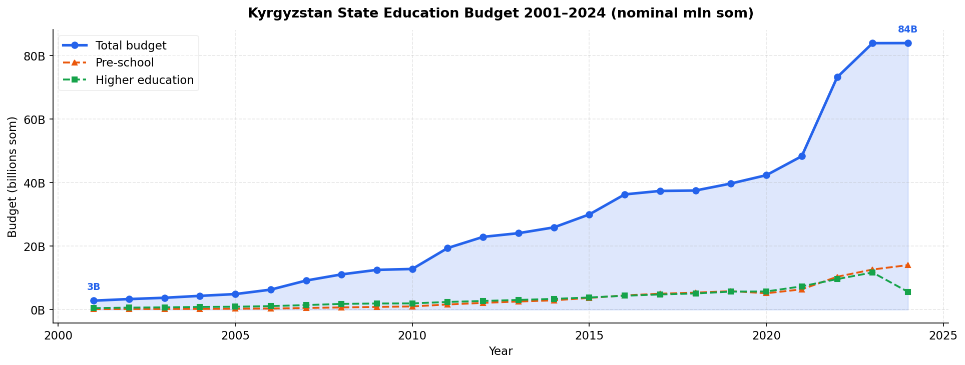
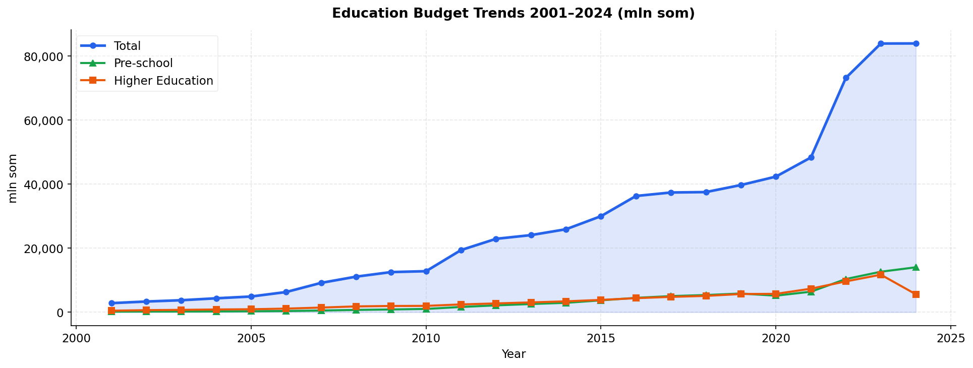
Budget Trend Detail & Regression vs Students
Annual budget growth with sub-category breakdown
Budget trend overlaid with student enrollment trajectory

Slide 19
05
Statistical Analysis
Correlation · Regression · Hypothesis testing

Slide 20
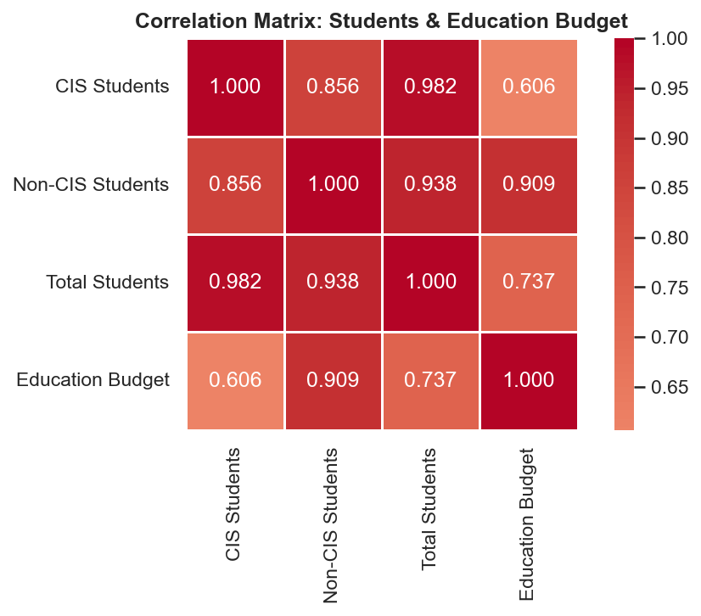
Correlation Heatmap — Students vs Budget (Pearson & Spearman)
Non-CIS vs Budget: Pearson r=0.91, Spearman ρ=0.98. Total vs Budget: r=0.74, ρ=0.90. All correlations statistically significant (p<0.05).

Slide 21
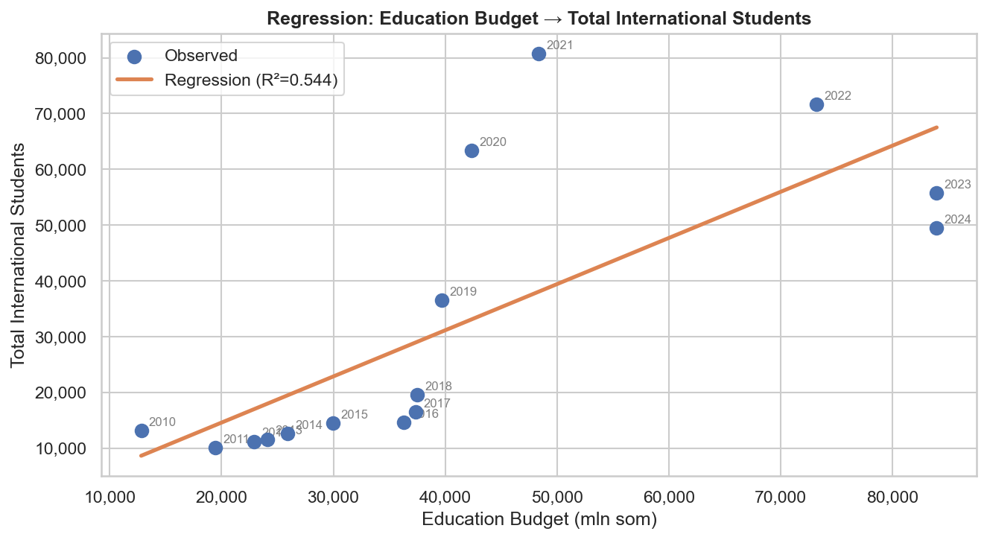
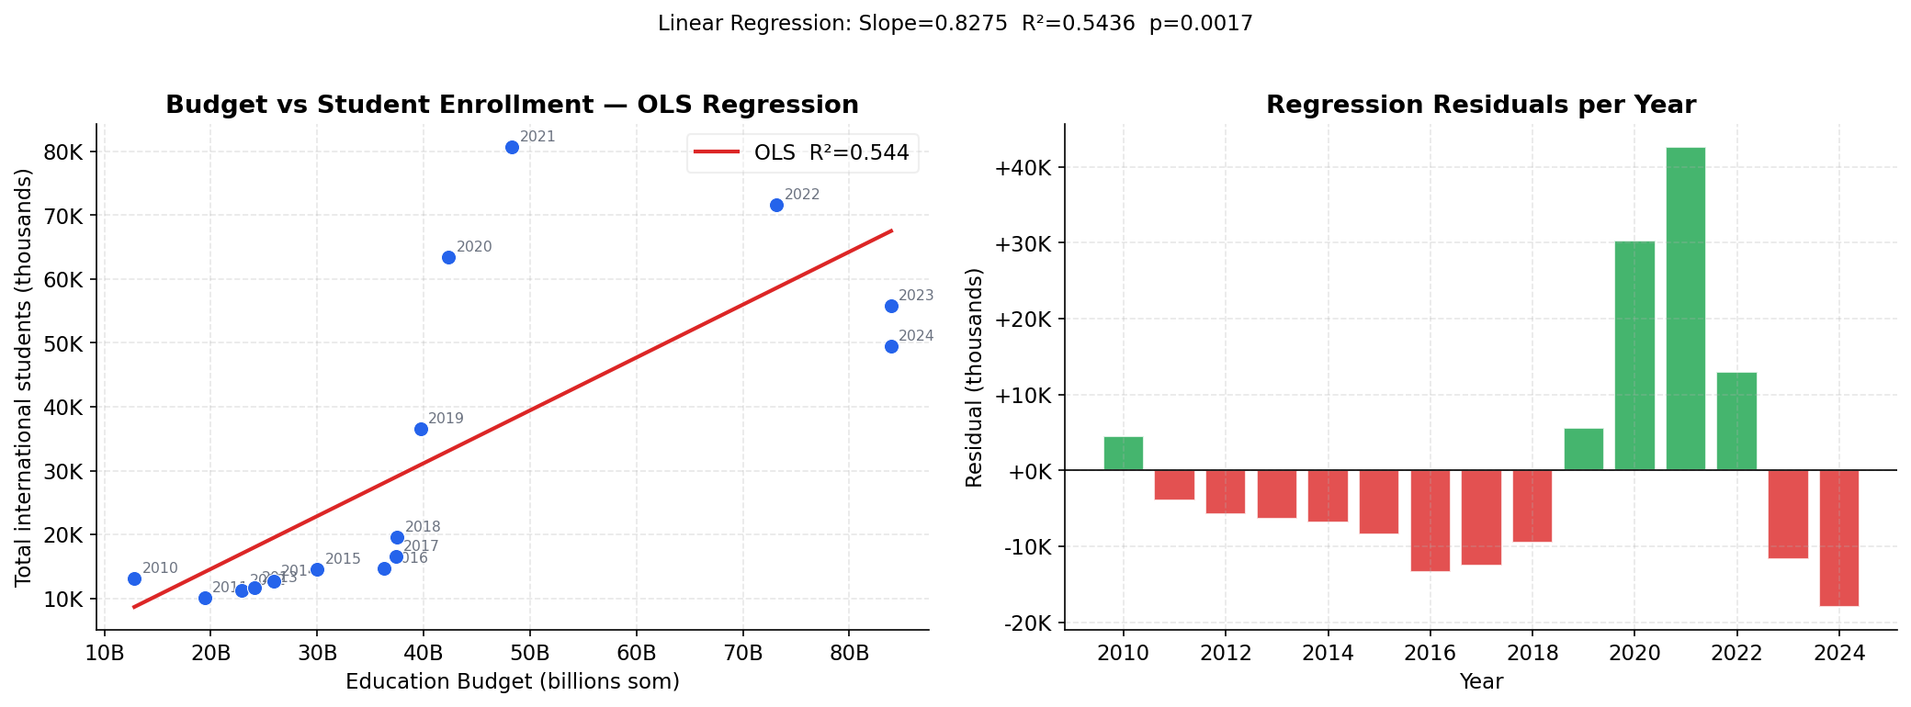
Regression Analysis — Total Students ~ Education Budget
Simple OLS: slope=0.83 students/mln som, R²=0.54, p=0.0017
Regression diagnostics: residuals and model fit

Slide 22
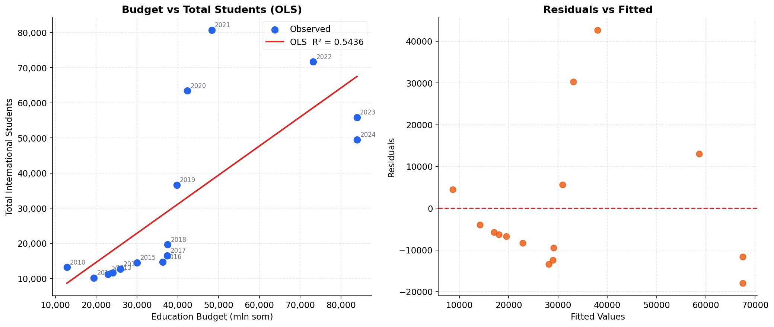
Full Regression Model — Total Students vs Education Budget
Model: Ŷ = 0.82753 × Budget − 1,936 · R²=0.54 · RMSE=16,430 · 95% CI slope: [0.37, 1.28] · p=0.0017

Slide 23
06
Forecasts 2025–2030
Linear · Polynomial · ARIMA models for students and budget

Slide 24
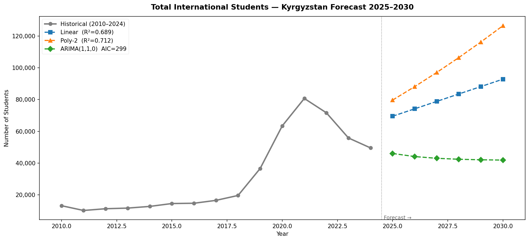
Total International Students — Forecast 2025–2030
Linear (R²=0.69): ~93K by 2030 · Poly-2 (R²=0.71): ~126K by 2030 · ARIMA(1,1,0): stable ~42K. Wide divergence signals structural uncertainty post-2021 peak.

Slide 25
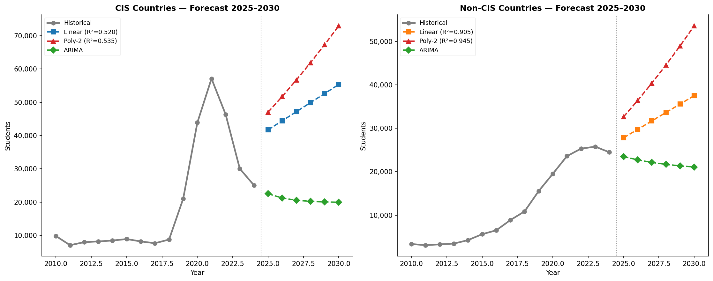
CIS vs Non-CIS Students — Forecast 2025–2030
Non-CIS projected to continue growing. CIS forecast shows mean-reversion. Scenarios diverge significantly depending on model assumptions.

Slide 26
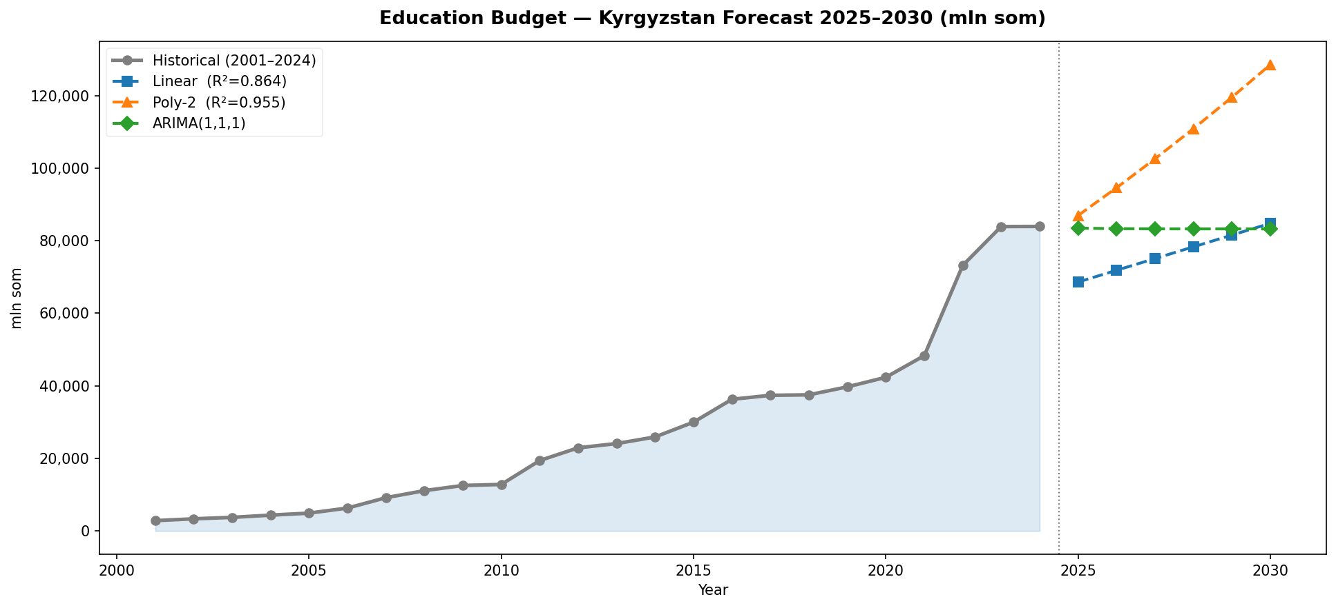
Education Budget — Forecast 2025–2030
Budget forecasts show continued growth based on 15.85% CAGR trend. Polynomial model projects accelerating nominal growth. Inflation-adjusted growth likely more modest.

Slide 27
Key Takeaways
📈 Enrollment
Peak 80,701 (2021); declined to 49,553 (2024). Non-CIS CAGR 15.23% vs CIS 6.93%.
🌍 Origin shift
Non-CIS share rose from 26% (2010) to 49% (2024). India & Pakistan now dominant.
💰 Budget
83,924 mln som in 2024 — a 29.5× increase since 2001. CAGR 15.85%/yr.
📊 Correlation
Non-CIS vs Budget strongest: Spearman ρ=0.98. Budget drives Non-CIS growth.
🎓 Literacy
Higher education +351% (1989→2022). Near-universal literacy achieved.
🔮 Forecast
Wide model divergence by 2030: 42K–126K students depending on assumptions.
Kyrgyzstan Education Statistics — Visual Analysis · 2025

