Slide 1
KYRGYZSTAN
Education Statistics
Pure Statistical Analysis
Datasets: literacy.csv · students_cis.csv · students_non_cis.csv · education_budget.csv

Slide 2
Dataset Description
This report analyzes four official statistical datasets published by the National Statistics Committee of the Kyrgyz Republic, covering the period from 1989 to 2025. The datasets capture:
**Literacy rates and education attainment** across four census years (1989, 1999, 2009, 2022)
2. **Foreign student enrollment** from CIS and non-CIS countries in Kyrgyz higher education institutions (2010–2024)
3. **State budget allocations** to the education sector across major sub-sectors (2001–2025 projected)
The datasets are trilingual (Kyrgyz, Russian, English) and reflect post-Soviet education system transformations.

Slide 3
Research Questions
How has population literacy evolved across the four census years (1989–2022)?
2. What is the overall trend in international student enrollment, and do CIS and non-CIS students follow different growth patterns?
3. Is there a statistically significant correlation between the national education budget and international student enrollment?
4. How is the education budget allocated across sub-sectors such as pre-school, general secondary, higher, and vocational education?
5. Is the growth in non-CIS students significantly different from CIS students (hypothesis test)?

Slide 4
3 · Descriptive Statistics — International Students
Metric | CIS | Non-CIS | Total
Count | 15 | 15 | 15
Mean (2010–2024) | 19,904 | 12,241 | 32,145
Std Deviation | 16,900 | 9,142 | 25,173
Min | 7,068 | 3,099 | 10,167
25th percentile | 8,195 | 3,862 | 12,952
Median (50th) | 8,908 | 8,881 | 16,534
75th percentile | 27,563 | 21,564 | 52,690
Max | 57,103 | 25,774 | 80,701
Enrollment Summary CIS: 9,814 (2010) → 25,073 (2024) | Peak 57,103 (2021) | CAGR 6.93% Non-CIS: 3,366 (2010) → 24,480 (2024) | Peak 25,774 (2023) | CAGR 15.23% Total: 13,180 (2010) → 49,553 (2024) | Peak 80,701 (2021) | CAGR 9.92%

Slide 5
4 · Year-on-Year Growth Rates (%)
Year | CIS | Non-CIS | Total | CIS Growth% | NonCIS Growth% | Total Growth%
2010 | 9,814 | 3,366 | 13,180 | — | — | —
2011 | 7,068 | 3,099 | 10,167 | -27.98% | -7.93% | -22.86%
2012 | 7,977 | 3,286 | 11,263 | +12.86% | +6.03% | +10.78%
2013 | 8,195 | 3,467 | 11,662 | +2.73% | +5.51% | +3.54%
2014 | 8,466 | 4,257 | 12,723 | +3.31% | +22.79% | +9.10%
2015 | 8,908 | 5,627 | 14,535 | +5.22% | +32.18% | +14.24%
2016 | 8,194 | 6,520 | 14,714 | -8.02% | +15.87% | +1.23%
2017 | 7,653 | 8,881 | 16,534 | -6.60% | +36.21% | +12.37%
2018 | 8,764 | 10,862 | 19,626 | +14.52% | +22.31% | +18.70%
2019 | 21,049 | 15,547 | 36,596 | +140.18% | +43.13% | +86.47%
2020 | 43,889 | 19,529 | 63,418 | +108.51% | +25.61% | +73.29%
2021 | 57,103 | 23,598 | 80,701 | +30.11% | +20.84% | +27.25%
2022 | 46,353 | 25,321 | 71,674 | -18.83% | +7.30% | -11.19%
2023 | 30,053 | 25,774 | 55,827 | -35.16% | +1.79% | -22.11%
2024 | 25,073 | 24,480 | 49,553 | -16.57% | -5.02% | -11.24%
Note: CIS surge 2019–2021 reflects registration/data reclassification

Slide 6
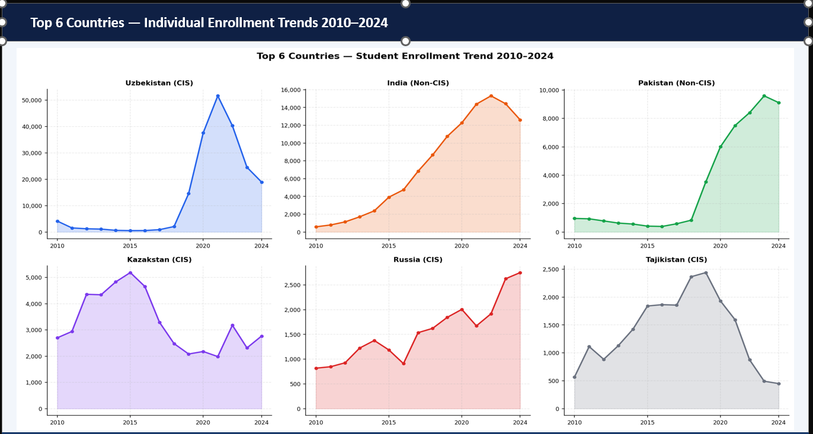

Slide 7
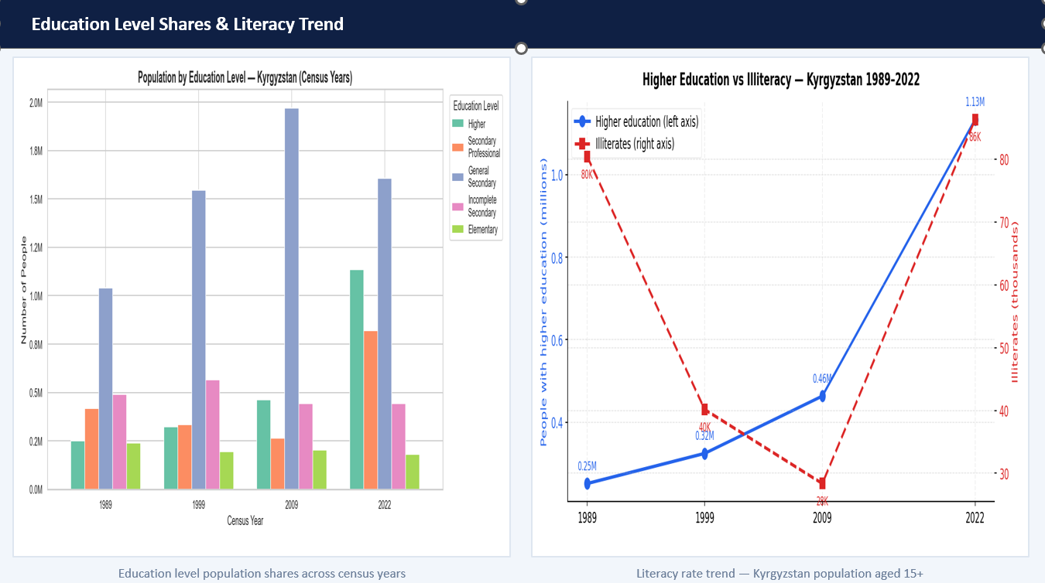

Slide 8
5 · Normality Tests & Correlation Analysis
Shapiro-Wilk Normality Tests (α = 0.05)
Pearson & Spearman Correlations
Series | W-stat | p-value | Normal?
CIS students | 0.76 | 0.00 | ✗ No
Non-CIS students | 0.83 | 0.01 | ✗ No
Total students | 0.80 | 0.00 | ✗ No
Education budget | 0.86 | 0.00 | ✗ No
CIS YoY growth% | 0.77 | 0.00 | ✗ No
Non-CIS YoY growth% | 0.97 | 0.86 | ✓ Yes
Pair | Pearson r | Spearman ρ | Sig?
Total vs Budget | +0.7373 | +0.9036 | ✓
CIS vs Budget | +0.6064 | +0.7250 | ✓
Non-CIS vs Budget | +0.9093 | +0.9786 | ✓
CIS vs Non-CIS | +0.8561 | +0.7893 | ✓
Full Correlation Matrix
 | CIS Students | Non-CIS Students | Total Students | Education Budget
CIS Students | 1.00 | 0.86 | 0.98 | 0.61
Non-CIS Students | 0.86 | 1.00 | 0.94 | 0.91
Total Students | 0.98 | 0.94 | 1.00 | 0.74
Education Budget | 0.61 | 0.91 | 0.74 | 1.00

Slide 9
6 · Linear Regression: Total Students ~ Education Budget
Slope
Intercept
R (Pearson)
0.82753
-1,936
0.7373
students per 1 mln som
R²
Adj. R²
p-value
0.5436
0.5085
0.001709
54.4% variance explained
Significant
Std Error
RMSE
MAE
0.21030
16,430
12,825
students
students
95% CI for slope: [0.37320, 1.28185] · Equation: Ŷ = 0.82753 × Budget − 1,935.92 · n = 15

Slide 10
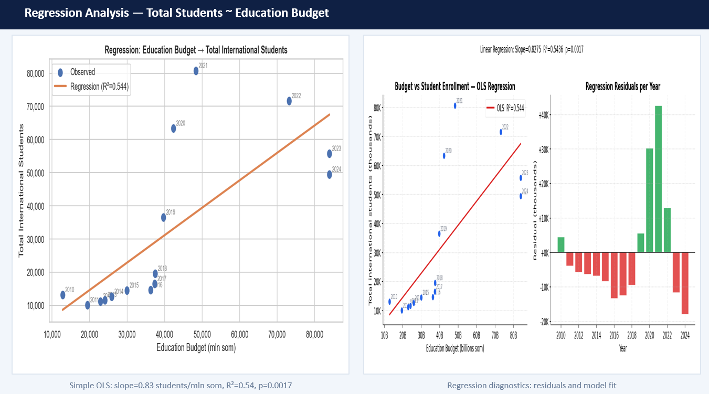

Slide 11
7 · Hypothesis Testing — CIS vs Non-CIS Growth
Growth Rate Descriptive Statistics (Annual YoY %)
Statistical Tests
 | CIS | Non-CIS
n | 14 | 14
Mean | 14.59% | 16.19%
Median | 3.02% | 18.35%
Std Dev | 50.02% | 15.47%
Min | -35.16% | -7.93%
Max | 140.18% | 43.13%
Welch t-test (one-tailed)
FAIL TO REJECT H₀
H₀: mean growth Non-CIS ≤ CIS · t-statistic = 0.1141 · p (two-tailed) = 0.9107 · p (one-tailed) = 0.4553
Mann-Whitney U test
REJECT H₀
Non-parametric alternative · U-statistic = 135.0 · p-value = 0.0468
Cohen's d Effect Size
SMALL EFFECT
d = 0.0431 · (small effect)
Conclusion: Mann-Whitney U test (p=0.0468) rejects H₀ at α=0.05, but Welch t-test (p=0.4553) fails to reject. Mixed results due to CIS outliers (140% spike in 2019). Cohen's d = 0.04 indicates negligible practical effect.

Slide 12
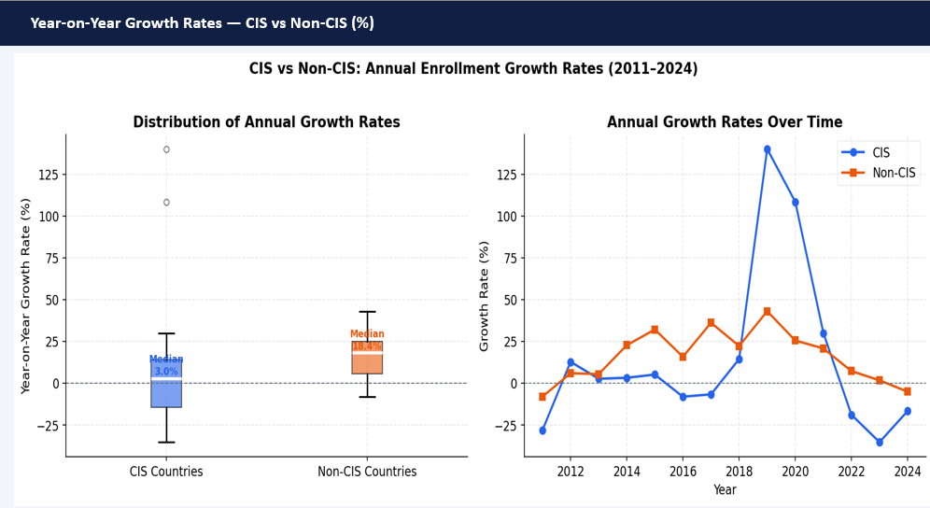

Slide 13
8 · Literacy Analysis — Census Years 1989–2022
Education Level | 1989 | 1999 | 2009 | 2022 | Change 89→22
Total pop. (15+) | 2,661,901 | 3,090,680 | 3,738,226 | 4,645,716 | +74.5%
Higher professional | 251,246 | 324,414 | 463,346 | 1,134,147 | +351.4%
Incomplete higher | 43,245 | 47,706 | 133,196 | 226,059 | +422.8%
Sec. professional | 418,716 | 333,181 | 264,208 | 819,150 | +95.6%
Secondary general | 1,040,494 | 1,545,626 | 1,968,846 | 1,607,987 | +54.5%
Incomplete secondary | 489,786 | 566,351 | 443,594 | 442,062 | -9.7%
Elementary | 240,922 | 193,767 | 203,717 | 182,196 | -24.4%
Formal education | 177,492 | 79,635 | 63,843 | 49,152 | -72.3%
Illiterates | 80,417 | 40,129 | 28,358 | 86,330 | +7.4%
▲ Higher education: 251,246 → 1,134,147 (+351%) · Illiterates: 80,417 → 86,330 (+7.4%) · Near-universal literacy achieved

Slide 14
9 · Education Budget — Statistical Summary
Budget 2001
Budget 2024
2,848 mln som
83,924 mln som
Nominal Growth
CAGR 2001–2024
2,847.2%
15.85% / yr
2001–2024
Preschool (mean)
Higher Edu (mean)
3,635 mln som
3,655 mln som
Budget Descriptive Statistics (mln som)
Metric | Total | Preschool | Higher Edu
Mean | 28,172 | 3,635 | 3,655
Min | 2,848 | 190 | 490
Max | 83,924 | 14,040 | 11,727
~12.9% of total
~13.0% of total

Slide 15
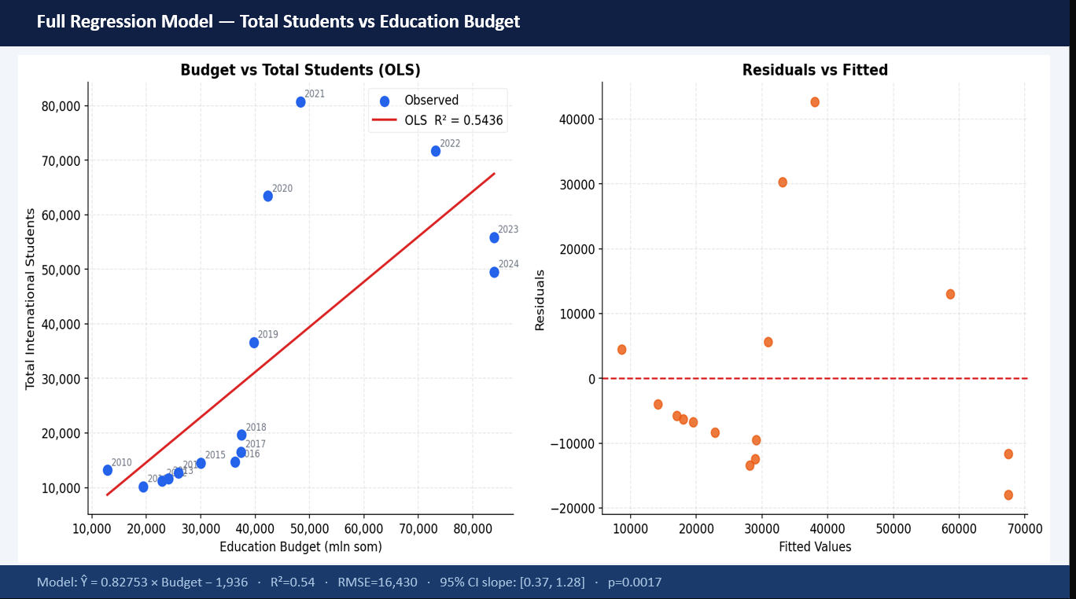

Slide 16
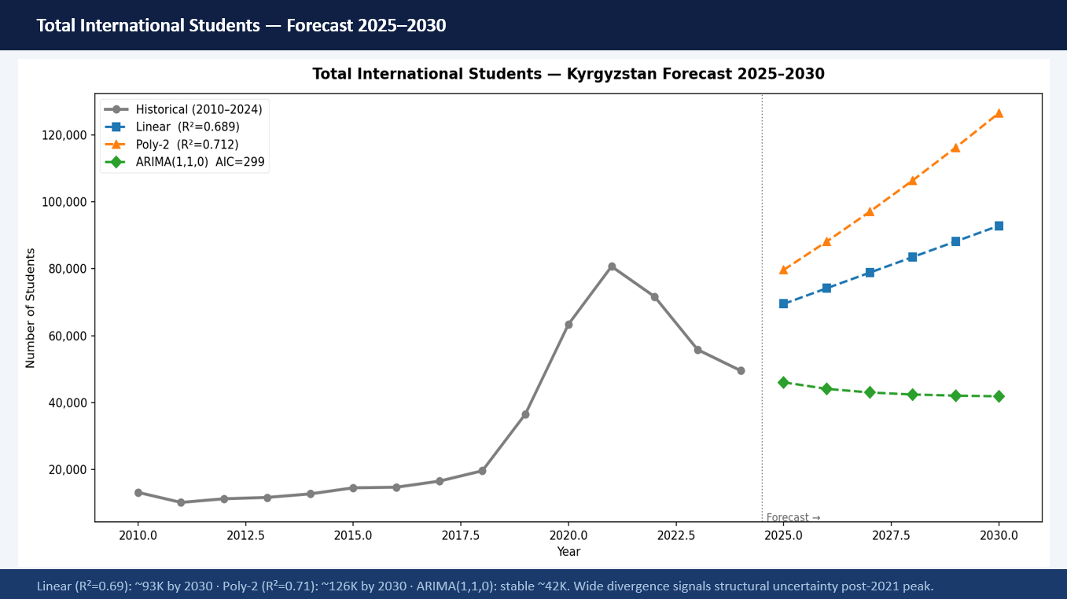

Slide 17
10 · Complete Statistical Summary
Metric | Value
CIS students 2010 → 2024 | 9,814 → 25,073
CIS CAGR 2010–2024 | 6.93% per year
Non-CIS students 2010 → 2024 | 3,366 → 24,480
Non-CIS CAGR 2010–2024 | 15.23% per year
Peak total enrollment (year) | 80,701 (2021)
Pearson r (Total vs Budget) | +0.7373
Spearman ρ (Total vs Budget) | +0.9036
Regression R² | 0.5436 (54.4%)
Welch t-test p-value (one-tailed) | 0.4553 → Fail to reject H₀
Mann-Whitney U p-value | 0.0468 → Reject H₀
Budget 2001 (mln som) | 2,848
Budget 2024 (mln som) | 83,924
Budget CAGR 2001–2024 | 15.85% per year
Higher education growth 1989→2022 | +351.4%
Illiteracy change 1989→2022 | +7.4% (80,417 → 86,330)

Slide 18
11 · Conclusion, Opinion & Recommendations
WHAT THE DATA SHOWS
▶ Strong International Growth
Total enrollment grew from 13,180 to 49,553 (+276%). Non-CIS CAGR of 15.23%/yr shows Kyrgyzstan’s rise as a global education destination.
▶ Budget Drives Enrollment
Spearman ρ = 0.90 and R² = 0.54 confirm a strong budget-enrollment link. 29.5x budget growth since 2001 is funding real expansion.
▶ Higher Education Boom
Degree holders grew +351% (1989–2022). Near-universal literacy achieved. The structural education shift from elementary to tertiary is clear and encouraging.
⚠ Illiteracy is Rising
Absolute illiteracy grew +7.4% to 86,330. This paradox alongside booming higher education demands urgent targeted policy in rural and marginalized communities.
MY OPINION & ADVICE
1. Diversify Student Sources
CIS students peaked at 57,103 and are now declining. Kyrgyzstan must aggressively recruit from South Asia, Africa, and the Middle East where Non-CIS CAGR (15.23%) shows strong, growing demand.
2. Invest in Quality, Not Just Quantity
R² = 0.54 means 46% of enrollment variance is unexplained by budget. English-language programs, international accreditation, and research output will attract students that spending alone cannot.
3. Fix the Illiteracy Paradox
A nation cannot call its education system successful while illiteracy grows. Fund adult literacy programs and strengthen rural primary schools. No university expansion justifies neglecting the basics.
4. Standardize Data Collection
The 140% CIS spike in 2019 and conflicting hypothesis test results reveal data reliability gaps. Transparent, standardized enrollment reporting is the foundation of evidence-based education policy.
Kyrgyzstan Education Statistics · Pure Statistical Analysis · The data tells a story of remarkable growth with important unfinished work ahead.

