Slide 1
ECE 18-649
Final Project Report Starting Point
December 4, 2013
Group # 9
Wenhui Hu
Yichao Xue
Yujia Wang
Wenhui Hu

Slide 2
Overview
Content
  Project statistics (Wenhui Hu)
  Design of Dispatcher
    Sequence Diagram (Wenhui Hu)
    Requirements (Yujia Wang)
    Statecharts (Yujia Wang)
    Code (Yujia Wang)
    Testing (Yichao Xue)
  Lessons learned (Yichao Xue)
  Open issues (Yichao Xue)
  Suggestion (Yichao Xue)
Wenhui Hu

Slide 3
Project Statistics
COMPARE mid-semester and now (use a table)
20 Scenarios & Sequence diagrams
  133 sequence diagram arcs
78 lines of requirements
7 State-charts for 7 controllers
  Total number of states: 35
  Total number of arcs: 78
Number of lines of non-comment code
Test files written: 7+20+1
35 revisions (change log entries)
107 peer reviews; defects found via review; peer review defects fixed
Number of defects found via test & other; number fixed
Wenhui Hu

Slide 4
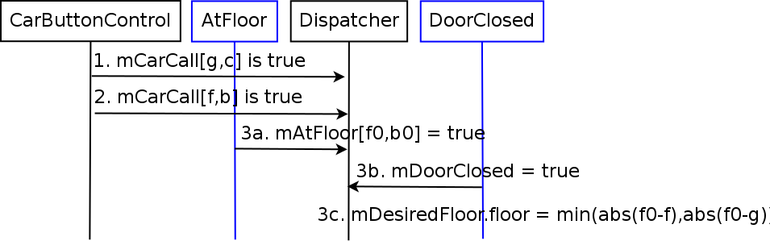
Design of Dispatcher
Scenario 7C
  Elevator determines desired floor when there are 2 car calls for different floors. Both calls have the same desired direction as current direction.
Sequence Diagram_x001a__x001a__x001a__x001a__x001a__x001a__x001a__x001a__x001a__x001a__x001a__x001a__x001a__x001a__x001a__x001a__x001a__x001a__x001a__x001a__x001a__x001a_
Wenhui Hu

Slide 5
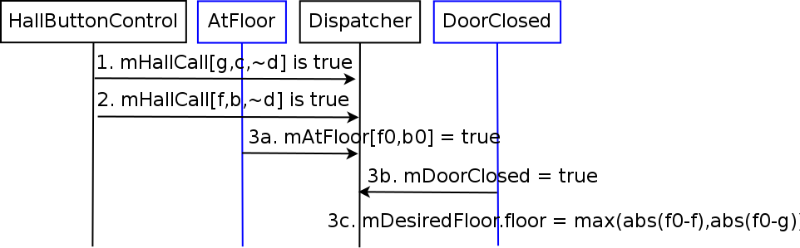
Design of Dispatcher
Scenario 7D
  Elevator determines desired floor when there are 2 hall calls for different floors. Both calls have the opposite desired direction as current direction.
Sequence Diagram
Wenhui Hu

Slide 6
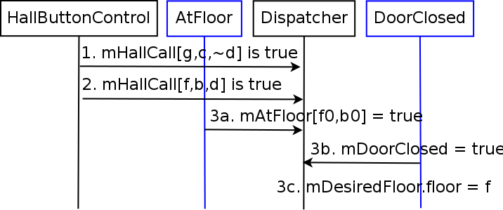
Design of Dispatcher
Scenario 7E
  Elevator determines desired floor when there are 2 hall calls for different floors. One has the same desired direction as current direction, the other has the opposite.
Sequence Diagram
Wenhui Hu

Slide 7
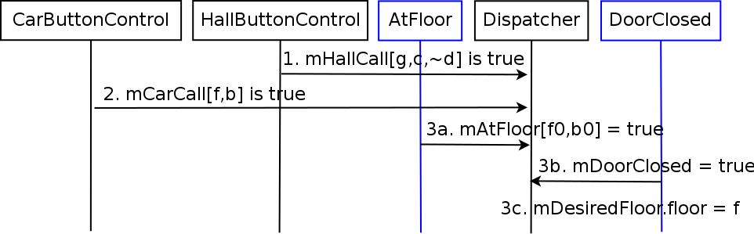
Design of Dispatcher
Scenario 7F
  Elevator determines desired floor when there are 1 car call and 1 hall call from different floors. Car call has the same desired direction as current direction, hall call has opposite desired direction as current direction.
Sequence Diagram
Wenhui Hu

Slide 8
Lessons Learned
Problems that you have already solved
  How they came up
  What did you do to solve them
Which strategies (team, technical, etc.) have worked well, and which have not?
In retrospect, which aspects of testing, peer reviews, other worked best?
Make these slides advice for next year students!
SPEAKER NAME GOES HERE

Slide 9
Common Presentation Errors #1
Bullet items more than one line long
Fonts smaller than 16 point
  Diagrams with fonts too small to read
    This font is pretty tiny and should only be used for details (16 pt)
    This font is too small and shouldn’t be used (14 pt)
  Powerpoint auto-shrinks things, so be careful!
Poor personal presence
  Wearing outdoor coats, hats, torn clothing
  Chewing gum
  Talking to front row instead of back row
SPEAKER NAME GOES HERE

Slide 10
Common Presentation Errors #2
Poor time management
  Each team member must speak for 2+ minutes
  We’ll give you 5 & 2 minute warnings for talk
Statecharts with illegible arcs
  Almost always, this means putting transition conditions under diagram, not in diagram
  It’s OK to be creative so long as you are legible
Forgetting to put speaker name on each slide
  (Helps the TAs know who they are grading)
SPEAKER NAME GOES HERE

Slide 11
Logistics
Sun December 1st
  5 PM hand in slides
    Send them via E-mail to ece649 staff e-mail list
  No changes after that permitted unless required by staff
  (e.g., “make fonts on slide 7 bigger”)
  but, points deducted if we must do that
    Embed fonts so they render properly!
    Use Acrobat or Powerpoint with proper file name(!)
See course web page for time slots
  We are not going to manage time swaps
    If you want to swap, you must arrange it yourself
    Document time swaps in advance via e-mail to course staff
  Try to leave a little time for Q&A at end of talk
SPEAKER NAME GOES HERE

