Slide 1
ECE 18-649
Mid-Term Project
Presentation
Oct 30, 2013
Group #9
Priya Mahajan
Wenhui Hu
Yichao Xue
Yujia Wang
File Name MUST BE: GP_mid_pres.ppt
(e.g., 05_mid_pres.ppt)
SPEAKER NAME GOES HERE

Slide 2
Overview
Format
Grading criteria
Content
  Project statistics(A)
  Complete design of one control object(Yujia)
  Lessons learned(B)
  Open issues(C)
  Predictions(C)
  Suggestions(C)
SPEAKER NAME GOES HERE

Slide 3
Format
Stay on time!
  Whole presentation: about 10 minutes
    You will be cut off at 11 minutes
  Each group member: at least 2 minutes
Cover all of the content!
  Title slide w/ group # & member names
  Outline slide
  Content slides (8-10 total)
    Project statistics
    Complete design of one control object
    Lessons learned
    Open issues
    Slide template is flexible, but must be legible
      Use slide numbers!
      Don’t bring printed handouts to class
SPEAKER NAME GOES HERE

Slide 4
Grading Criteria (20 pts)
(15pts) GROUP PERFORMANCE
(5pts) Quality of the technical content
  Do you provide the information we asked for?
  Does the technical material make sense?
(5pts) Materials
  Are the slides well prepared?
  Was the file in format: 00_mid_pres.ppt
  Are the fonts readable, including pictures?
  Does every slide have a slide number AND presenter name?
  Does every arc have a human-understandable label?
(5pts) Time budgeting
  Was time budgeted effectively given the time limit?
  Were all team members given at least 2 minutes to speak?
(5pts) INDIVIDUAL PERFORMANCE
(5pts) Presentation
  Loud enough to be heard? eye contact? familiarity with material?
SPEAKER NAME GOES HERE

Slide 5
Project Statistics
Number of scenarios/sequence diagrams
  Number of sequence diagram arcs
Number of lines of requirements
Number of Statecharts
  Total number of states
  Total number of arcs
Number of lines of non-comment code
Number of test files written
Number of revisions (change log entries)
  This does not mean simply change control check-outs!
Number of peer reviews; defects found via review; peer review defects fixed
Number of defects found via test & other; number fixed
SPEAKER NAME GOES HERE

Slide 6
Design of One Control Object
DoorControl, DriveControl, or Dispatcher
  DoorControl – Groups: 1,4,7,10,13,16,19,22
  DriveControl – Groups: 2,5,8,11,14,17,20,23
  Dispatcher – Groups: 3,6,9, 12,15,18,21,24
Walk-through complete design
  Scenarios
  Sequence diagrams
  Requirements
  Statecharts (include transition conditions!)
  Code
  Testing
  (IF design too complex, talk about representative portions for each of above design phases)
SPEAKER NAME GOES HERE

Slide 7
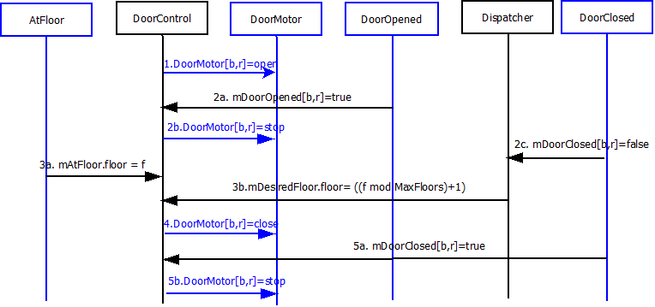
Design of Dispatcher
Scenarios
  Moving to another floor
  Cycle doors, set target when door opens
Sequence Diagram
Requirements
Yujia Wang

Slide 8
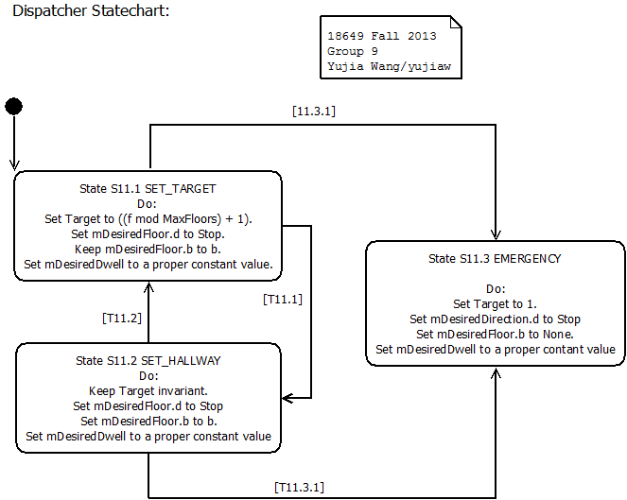
Design of Dispatcher
Statecharts
  S1 SET_TARGET
  S2 SET_HALL_CALL
  S3 EMERGENCY
Code
Testing
Transition | Guard conditions
T11.1 | All mDoorClosed ← true
T11.2 | Any mDoorClosed ← false AND any mAtFloor ← true
T11.3.* | Any mDoorClosed ← false AND all mAtFloor ← false
Yujia Wang

Slide 9
Lessons Learned
Problems that you have already solved
  How they came up
  What did you do to solve them
Which strategies (team, technical, etc.) have worked well, and which have not?
SPEAKER NAME GOES HERE

Slide 10
Optional: Open Issues
Problems that you have not yet solved
  How they came up
  What you have tried to fix them
  What your plan will be for tackling them
  OR why they will remain open issues
What do you anticipate will be the biggest challenge going forward?
Include this slide if you think you have time. If you omit this slide that’s OK
SPEAKER NAME GOES HERE

Slide 11
Common Presentation Errors #1
Bullet items more than one line long
Fonts smaller than 16 point
  Diagrams with fonts too small to read
    This font is pretty tiny and should only be used for details (16 pt)
    This font is too small and shouldn’t be used (14 pt)
  Powerpoint auto-shrinks things, so be careful!
Poor personal presence
  Wearing outdoor coats, hats, torn clothing
  Chewing gum
  Talking to front row instead of back row
SPEAKER NAME GOES HERE

Slide 12
Common Presentation Errors #2
Poor time management
  Each team member must speak for 2+ minutes
  We’ll give you 5 & 2 minute warnings for talk
Statecharts with illegible arcs
  Almost always, this means putting transition conditions under diagram, not in diagram
Forgetting to put speaker name on each slide
  (Helps the TAs know who they are grading)
Using the wrong file name
  Creates problems when managing the files
SPEAKER NAME GOES HERE

Slide 13
Logistics
Fri before presentations
  5 PM hand in slides
    Send via E-mail to ece649-staff@ece.cmu.edu
  No changes after that permitted
    Embed fonts so they render properly!
    Use Acrobat or Powerpoint (Powerpoint 2003 .ppt!)
    Don’t embed movies or do anything fancy
    Use the file naming convention!
See course web page for time slots
  We are not going to manage time swaps
    If you want to swap, you must arrange
    Document time swaps by Friday noon before presentations via e-mail to course staff
SPEAKER NAME GOES HERE

