Slide 1


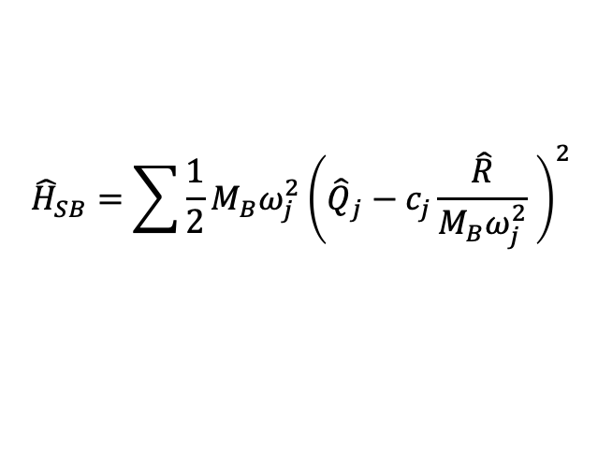
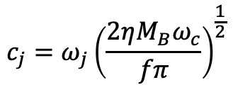

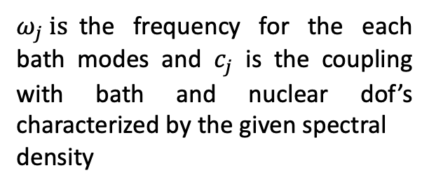
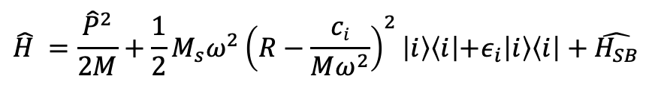

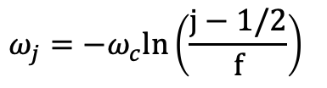







DDA System with Bath :
$$\hat{H} =\frac{{\hat{P}}^{2}}{2M}+\frac{1}{2}M_{s}ω^{2}{\left(R−\frac{ci}{Mω^{2}}\right)}^{2}\left|i\right\rangle \left\langle i\left|+ε_{i}\right|i\right\rangle \left\langle i\right|+\hat{H_{SB}}$$
$${\hat{H}}_{SB}=\sum{\frac{1}{2}M_{B}ω_{j}^{2}{\left({\hat{Q}}_{j}−c_{j}\frac{\hat{R}}{M_{B}ω_{j}^{2}} \right)}^{2}}$$
Spectral density of the bath is ohmic :
$$J\left(ω\right)=ηωe^{−\frac{ω}{ω_{c}}}$$
Bath Discretization :
R $=N$uclear DOF.
$M_{s}=$ Mass of the nuclear DOF.
$$ω_{j}=−ω_{c}ln\left(\frac{j−1/2}{f}\right)$$
$ω=$ frequency of the nuclear DOF.
$c_{i}=$ Harmonic oscillator shift.
$$c_{j}=ω_{j}{\left(\frac{2ηM_{B}ω_{c}}{fπ}\right)}^{\frac{1}{2}}$$
$ε_{i}=$ energy bias.
$Q=$ Bath modes.
$ω_{j} is$the frequency for the each bath modes and $c_{j}$ is the coupling with bath and nuclear dof’s characterized by the given spectral
density
$f=$ total number of bath modes.
$ω_{c}=$ cutoff frequency for bath modes.
$η=$ Friction strength .
$M_{B}=$ Mass of the bath modes.

Slide 2

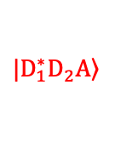


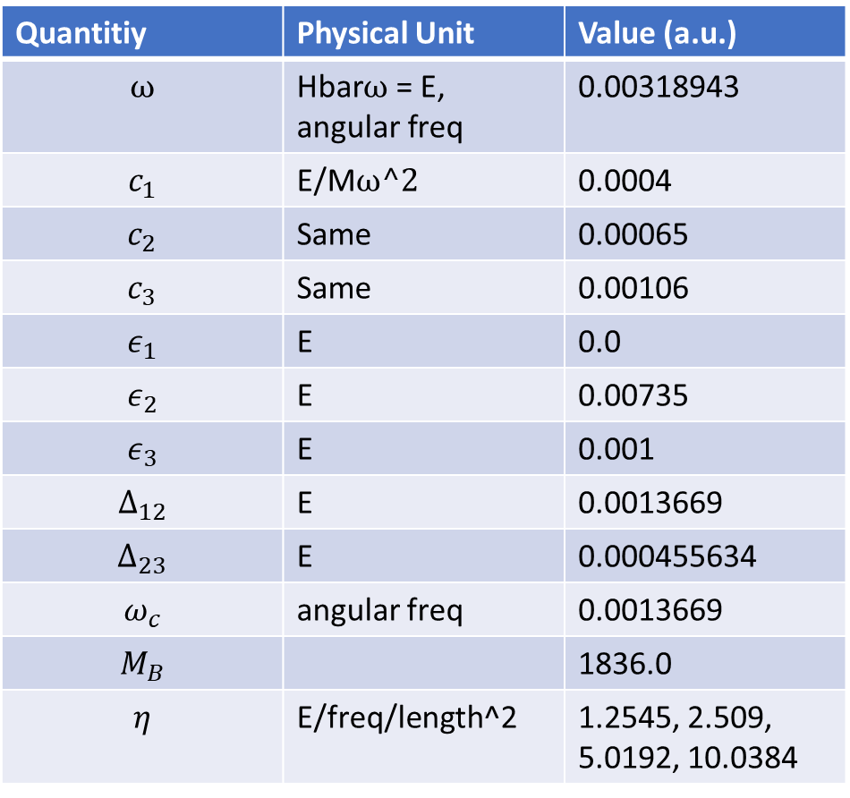
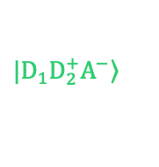

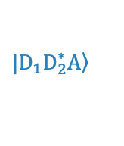
Model Parameters:
Initial photo-excitation at R₀ = 81.0238
(along reaction coordinate)
Details of the system parameters : (in a.u.)
$$\left.|D_{1}^{∗}D_{2}A\right\rangle$$
$$\left.|D_{1}D_{2}^{∗}A\right\rangle$$
$$\left.|D_{1}D_{2}^{+}A^{−}\right\rangle$$
Quantitiy | Physical Unit | Value (a.u.)
$$ω$$ | Hbar$ω$ = E, angular freq | 0.00318943
$$c_{1}$$ | E/M$ω^2$ | 0.0004
$$c_{2}$$ | Same | 0.00065
$$c_{3}$$ | Same | 0.00106
$$ε_{1}$$ | E | 0.0
$$ε_{2}$$ | E | 0.00735
$$ε_{3}$$ | E | 0.001
$$Δ_{12}$$ | E | 0.0013669
$$Δ_{23}$$ | E | 0.000455634
$$ω_{c}$$ | angular freq | 0.0013669
$$M_{B}$$ |  | 1836.0
$$η$$ | E/freq/length^2 | 1.2545, 2.509, 5.0192, 10.0384
Potential (eV)
R (a.u.)
Details of the bath parameters : (in a.u.)
$$ω_{c}=0.0013669$$
$$M_{B}=1836.0$$
$$f=100$$
$$η=1.2545, 2.509, 5.0192, 10.0384$$
M_{s}= 1 au ; T = 300K

