Slide 1
Spring, Spring MVC and RestAPI

Slide 2
Spring, Spring MVC and RestAPI
1.1 Spring Framework
1.2 Spring MVC
1.3 Rest API

Slide 3
Spring Framework
Install
Install Spring Tool Suite (STS) :
Search STS in Eclipse / Help / Eclipse MarketPlace . Download and install it

Slide 4
Spring MVC
Create project Spring MVC :

Slide 5
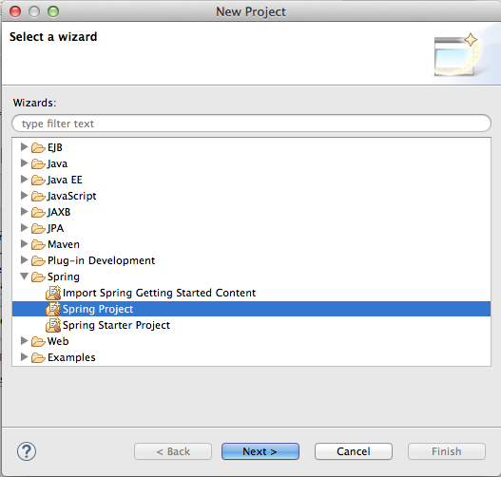
Spring MVC

Slide 6
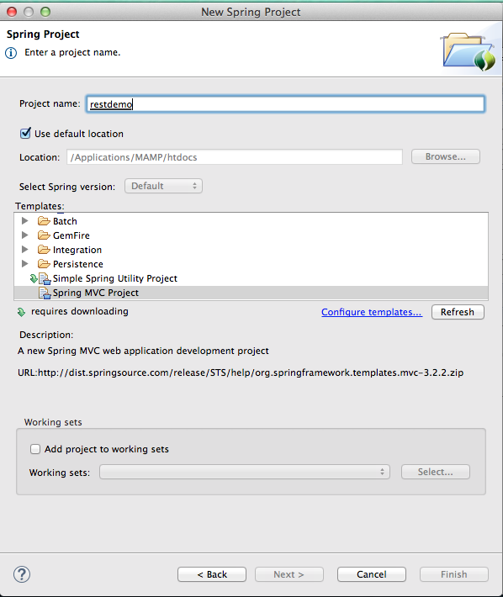
Spring MVC

Slide 7
Spring MVC
Controller :
@RequestMapping(value = "/list", method = RequestMethod.GET)
public String list( Model model) {
//should get all record from DB
List<Device> deviceObjArr = new ArrayList<Device>();
Device deviceObj = new Device();
deviceObj.setIDDevice("IPH_1");
deviceObj.setNameDevice("IPhone 5S");
deviceObj.setNote("White 36GB");
deviceObjArr.add(deviceObj);
// add list result to attribute to send to view
model.addAttribute("deviceList", deviceObjArr );
// return to view
return "list";
}

Slide 8
Spring MVC
View : list.html
<html>
<head>
<title>List Device</title>
</head>
<body>
<h1>
Demo Spring MVC!
</h1>
<table border="1" cellpadding="5" cellspacing="5">
<tr>
<th>Device ID</th>
<th>Name</th>
<th>OS Version</th>
<th>Type </th>
<th>Note</th>
<th colspan=2>Action</th>
</tr>

Slide 9
Spring MVC
<c:forEach var="device" items="${deviceList}">
<tr>
<td>${device.getIDDevice()}</td>
<td>${device.getNameDevice()}</td>
<td>${device.getOSVersion()}</td>
<td>${device.getTypeDevice()}</td>
<td>${device.getNote()}</td>
<td><a href="device_servlet?action=edit&id_device=<c:out value="${device.getIDDevice()}"/>">Update</a></td>
<td><a href="device_servlet?action=delete&id_device=<c:out value="${device.getIDDevice()}"/>">Delete</a></td>
</tr>
</c:forEach>
</table>
</body>
</html>

Slide 10
Spring MVC
Demo

Slide 11
Rest API
A key difference between a traditional MVC controller and the RESTful web service controller above is the way that the HTTP response body is created. Rather than relying on a view technology to perform server-side rendering of the greeting data to HTML, this RESTful web service controller simply populates and returns a Greeting object. The object data will be written directly to the HTTP response as JSON.
The Spring framework supports 2 ways of creating RESTful services:
Using MVC with ModelAndView
Using HTTP message converters

Slide 12
Rest API
Add Jackjon lib
Properties
<properties>
<java-version>1.6</java-version>
<org.springframework-version>4.0.0.RELEASE</org.springframework-version>
<org.aspectj-version>1.7.4</org.aspectj-version>
<org.slf4j-version>1.7.5</org.slf4j-version>
<jackson.databind-version>2.2.3</jackson.databind-version>
</properties>

Slide 13
Rest API
Dependency
<dependency> <groupId>com.fasterxml.jackson.core</groupId>
<artifactId>jackson-databind</artifactId>
<version>${jackson.databind-version}</version>
</dependency>

Slide 14
Rest API
@RequestMapping(value = "/list", method = RequestMethod.GET)
@RequestMapping(value = "/create", method = RequestMethod.POST)
@RequestMapping(value = "/delete/{id}", method = RequestMethod.PUT)

Slide 15
Rest API
Demo

