Slide 1
GIT/GITHUB

Slide 2
1
2
About Git
GitHub

Slide 3
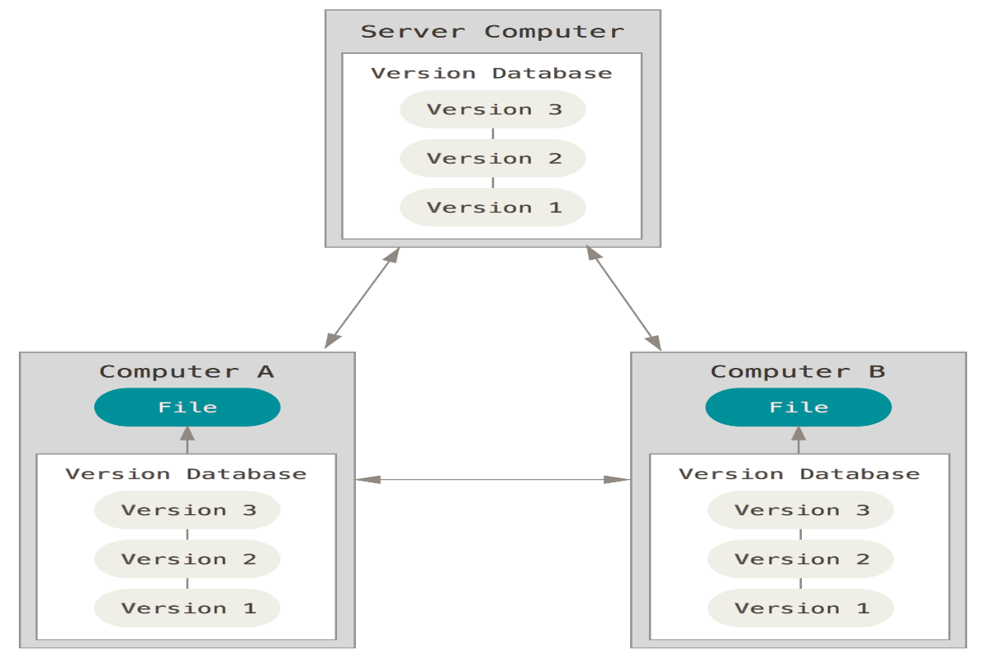
About Git
Git: Distributed Version Control Systems
Every clone is a full backup of all the data
http://git-scm.com/book/en/v2/Getting-Started-About-Version-Control

Slide 4




About Git
Website: http://git-scm.com
Host: bitbucket, github …
Tool: SourceTree, GitHub, Putty, …
Git branching:
- A branch in Git is simply a lightweight movable pointer to one of these commits
- Default branch name: master

Slide 5
About Git
Getting a Git Repository:
Initializing a Repository in an Existing Directory:
- Create new subdirectory name .git that contains all necessary repository:
git init
Cloning an Existing Repository:
- Clone a repository with: git clone [url]

Slide 6
About Git
Basic git commands:
Create a new local repository: git init
Check out a repository : git clone /path/to/repository
Add one or more file: git add <filename> / git add .
Commit: git commit –m “ commit message”
Send changes to the branch: git push origin <branchname>
Create a new branch and switch to it: git checkout <branchname>

Slide 7
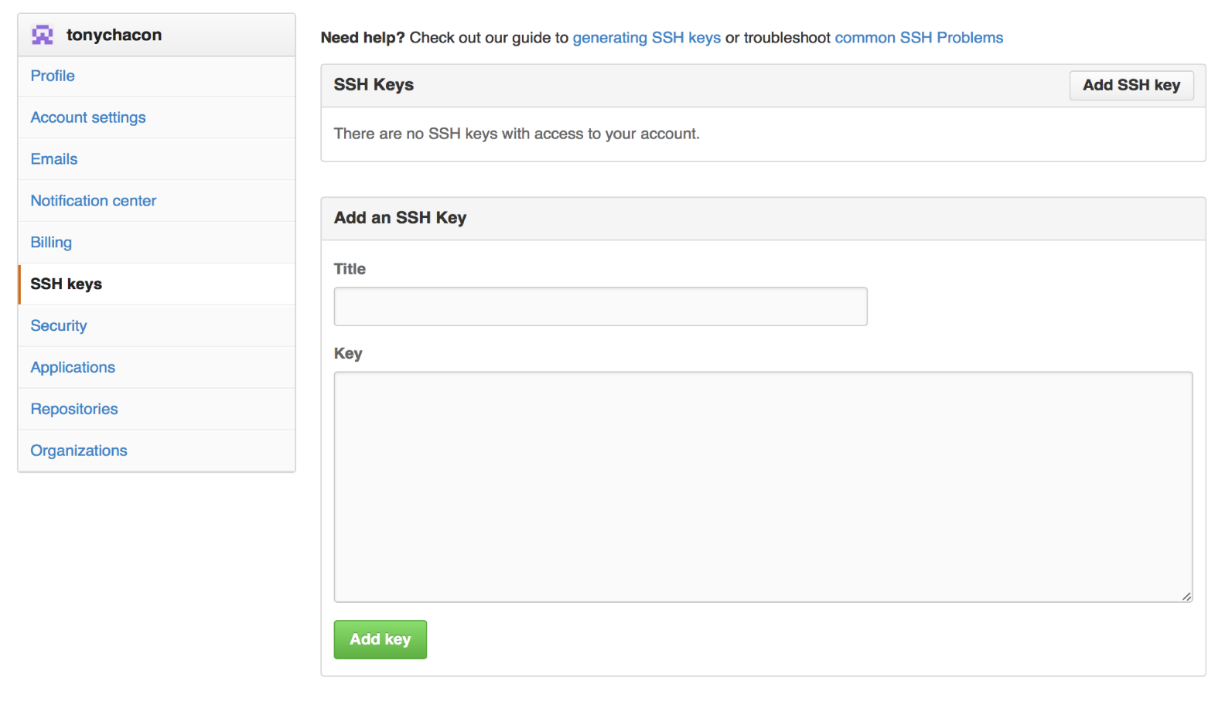
GitHub
Create and setup user account
Add an SSH key: To simply clone public projects

Slide 8
GitHub
Using pull requests:
Pull requests let tell others about changes you've pushed to a repository on GitHub.
Pull requests can be sent from any branch or commit
Navigate to the repository with the changes want someone else to pull and press the Pull Request button.
1, Swithch to branch
2, Compare & review

Slide 9
THANK YOU !

