Slide 1
Mini Blog Wireframe
Create by: Huyen Nguyen
2015/03/25

Slide 2
S-1-1
S-2-1
Homepage
Login
S-3-1
S-3-2
S-3-3
All post
Detail
Create
Comment
S-3-6
S-3-4
Search
Edit
Comment
S-4-1
S-4-2
S-3-5
Update Info
Delete
Comment
My Account
Sitemap:
S-4-3
Change Password
S-4-4
S-4-5
Edit
My Posts
S-4-6
Delete
S-4-8
Logout
S-5-1
S-5-2
Search user
View all User’s Post
S-6-1
Create post
S-7-1
Sign Up
S-8-1
1
Logout

Slide 3
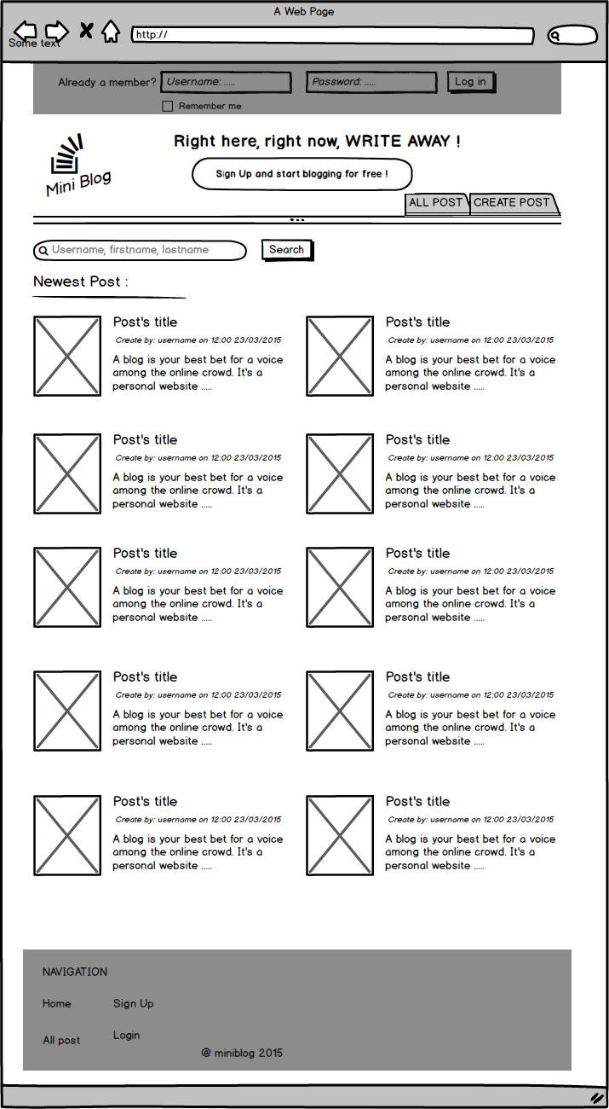
S-1-1: Homepage:
(1)
No. | Content | Detail | Goto
1 | Login | User login
2 | Sign Up | Go to register page | S-7-1
3 | All posts | Show list all posts | S-3-1
4 | Create post | Go to page to create post or show message request user login | S-6-1
5 | Search user | Search user by username, first name, last name. Go to page result search user | S-5-1
6 | Newest post | Show 10 newest post
7 | Title | Title of post
8 | Username and date created | Username of user created post and date created
9 | Short description | Short description of post . Limit 50 word.
(2)
(3)
(4)
(5)
{ show message}
(6)
(7)
(8)
(10)
(9)
2

Slide 4
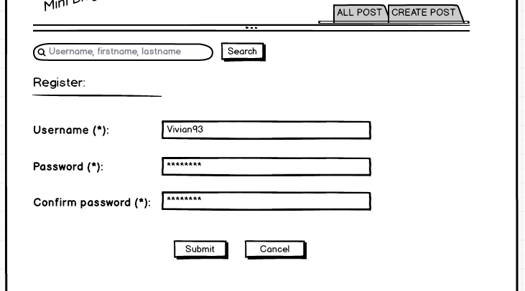
S-7-1: Register page:
No. | Content | Detail | Goto
1 | Username | Input username
2 | Password | Input password
3 | Confirm password | Input confirm password
{ show message: result register }
{ show error message }
(1)
{ show error message }
(2)
{ show error message }
(3)
3

Slide 5
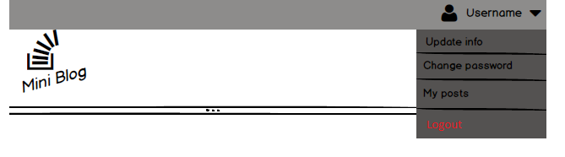
S-8-1: Logout:
(2)
(1)
(3)
No. | Content | Detail | Goto
1 | Avatar | User’s avatar
2 | Username | Display username
3 | Update info | Go to page update user info | S-4-2
4 | Change password | Go to change password page | S-4-3
5 | My posts | Go to page manage post | S-4-4
6 | Logout | User logout
(4)
(5)
(6)
4

Slide 6
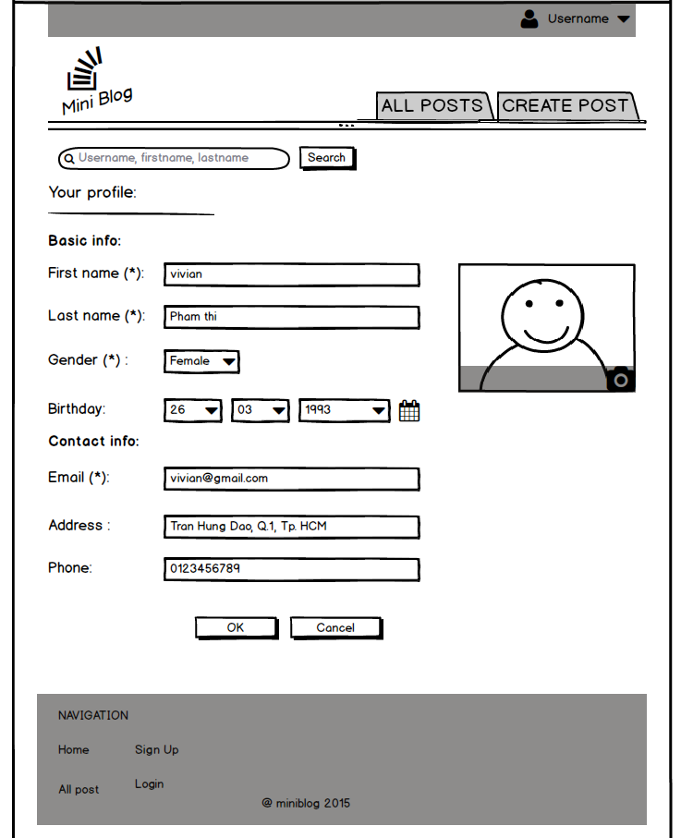
S-4-2: Update info:
No. | Content | Detail | Goto
1 | First name | Input first name
2 | Last name | Input last name
3 | Gender | Input gender
4 | Birthday | Input birthday
5 | Email | Input email
6 | Address | Input email
7 | Phone | Input phone
8 | Change avatar | Change user’s avatar
{ Show message: result update profile}
{ show error message }
(1)
{ show error message }
(2)
(3)
(8)
(4)
{ show error message }
(5)
(6)
(7)
5

Slide 7
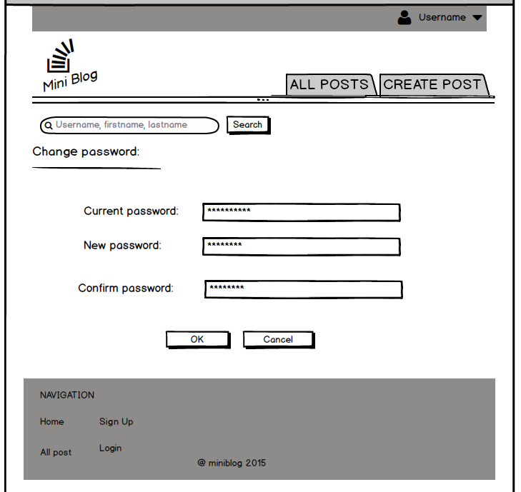
S-4-3: Change password:
No. | Content | Detail | Goto
1 | Current password | Input current password
2 | New password | Input new password
3 | Confirm password | Input confirm password
{ Show message: result change password}
{ show error message }
(1)
{ show error message }
(2)
{ show error message }
(3)
6

Slide 8
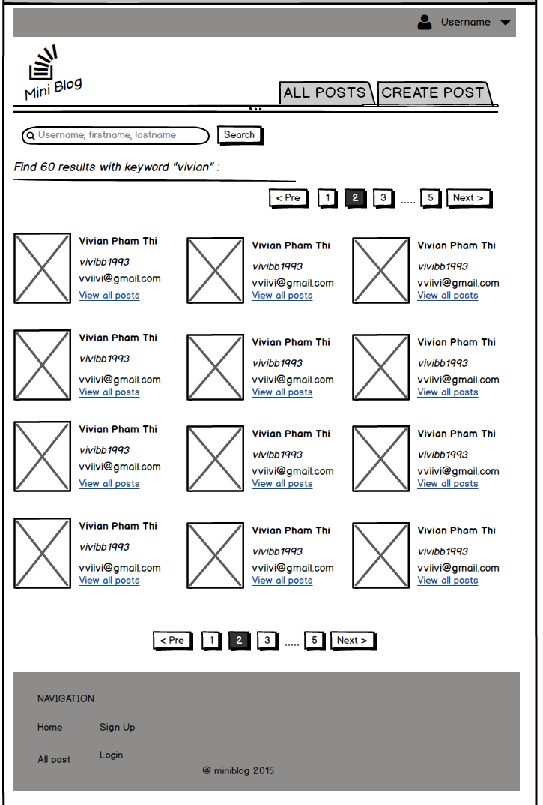
S-5-1: Search user:
(1)
No. | Content | Detail | Goto
2 | Name | First name + Last name
3 | Avatar | User’s avatar
4 | Username | Username
5 | Email | User’s email
6 | View all posts | Show list all user post | S-5-2
(2)
(3)
(4)
(5)
(6)
7

Slide 9
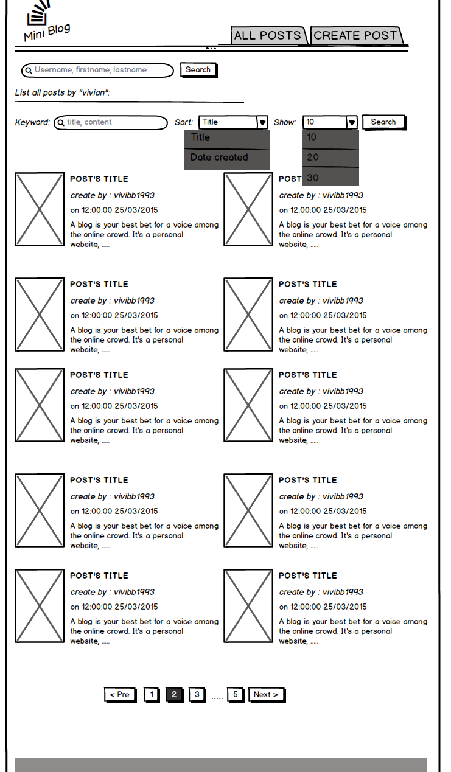
S-5-2: List all user posts:
(1)
No. | Content | Detail | Goto
2 | Search post | Search post by keyword
3 | Sort | Sort by title (A -Z) or date created (newest)
4 | Show | Limit
5 | Title | Post’s title. Go to detail page | S-3-2
6 | Create by | Username
7 | Date created | Date created
8 | Short description | Short description of post . Limit 50 word.
9 | Image | First image of this post. Go to detail page | S-3-2
(2)
(3)
(4)
(5)
(6)
(9)
(7)
(8)
8

Slide 10
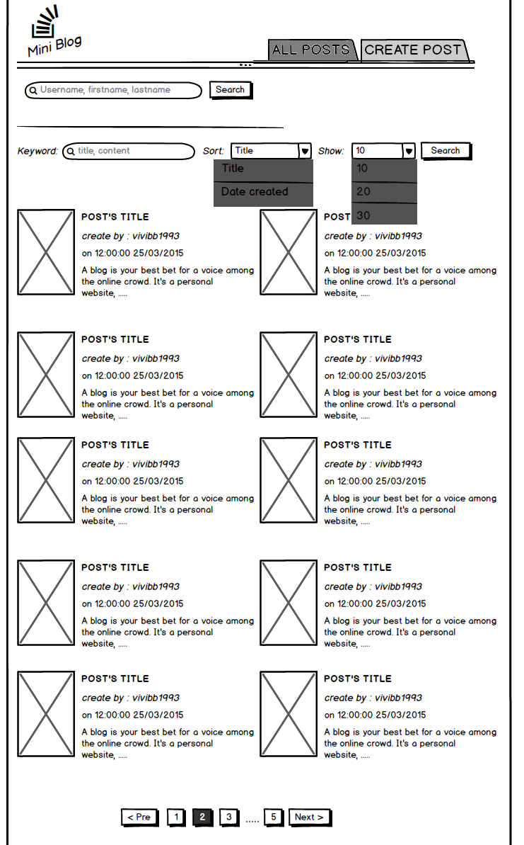
S-3-1: List all posts:
(1)
No. | Content | Detail | Goto
1 | All posts | Show list all posts
9

Slide 11
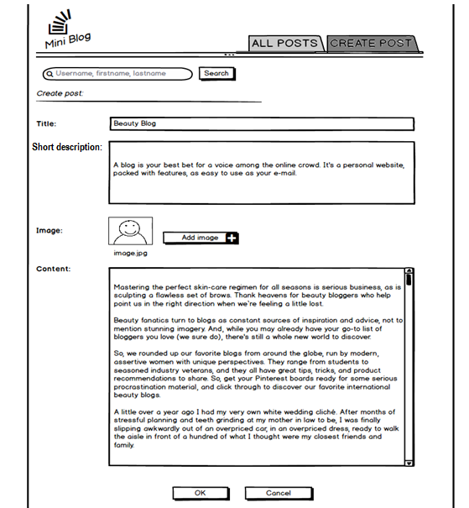
S-7-1: Create post:
(1)
{ Show message: result create post}
No. | Content | Detail | Goto
2 | Title | Input title
3 | Short description | Input short description
4 | Image | Add image
5 | Content | Input content
{ show error message }
(2)
{ show error message }
(3)
(4)
{ show error message }
(5)
10

Slide 12
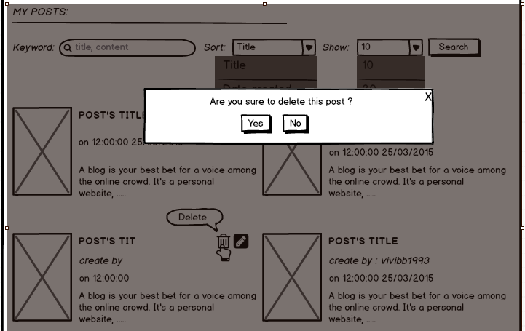
S-4-7: Delete post:
No. | Content | Detail | Goto
1 | Delete post | Show icon delete post when hover
2 | Confirm delete post | Show modal confirm when click at icon delete post
(2)
(1)
11

Slide 13
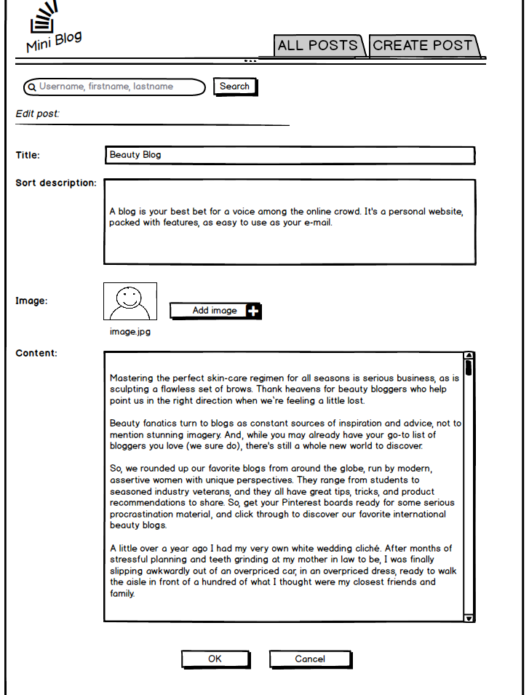
S-4-6: Edit post:
(1)
{ Show message: result create post}
No. | Content | Detail | Goto
2 | Title | Input title
3 | Short description | Input short description
4 | Image | Add image
5 | Content | Input content
{ show error message }
(2)
{ show error message }
(3)
(4)
{ show error message }
(5)
12

Slide 14
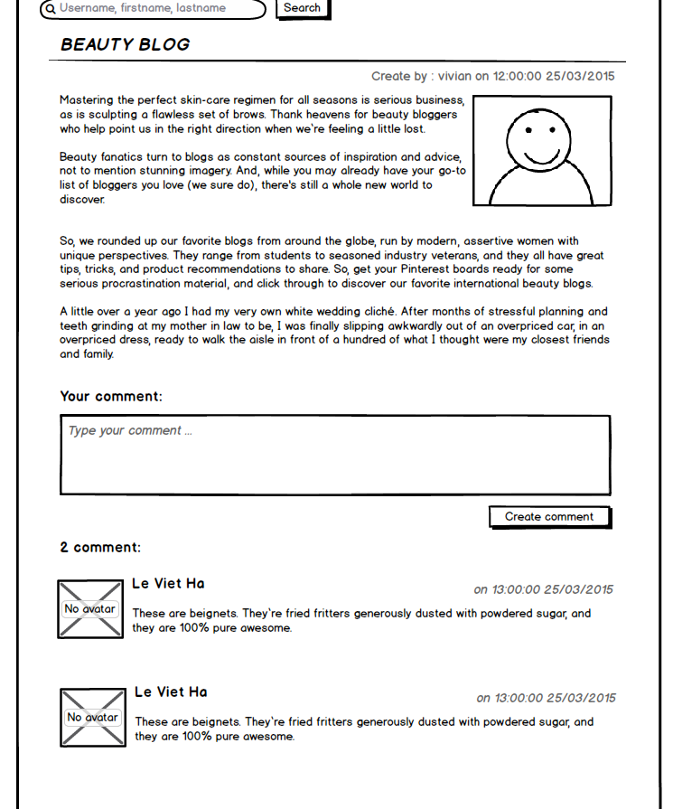
S-3-3: Create comment:
No. | Content | Detail | Goto
1 | Content | Comment’s content
(1)
13

Slide 15
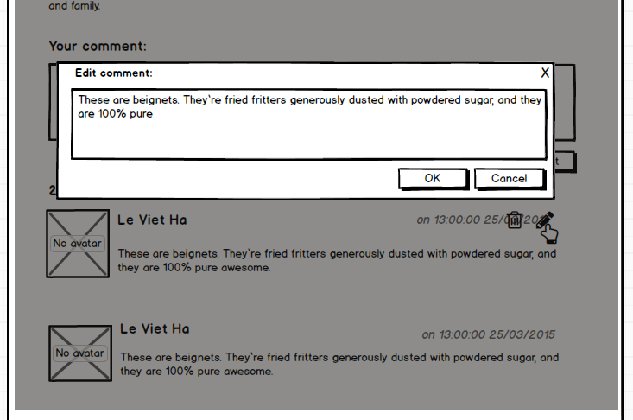
S-3-4: Edit comment:
No. | Content | Detail | Goto
1 | Edit comment | Show icon edit when hover
2 | Modal edit comment | Input comment’s content
(2)
(1)
14

Slide 16
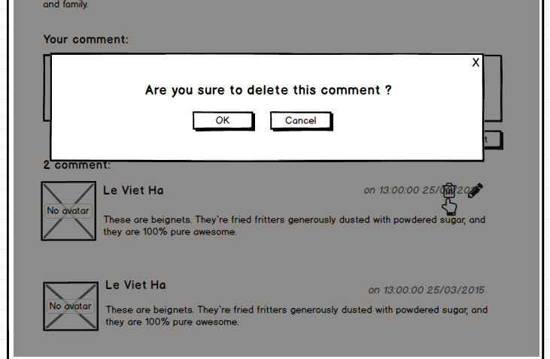
S-3-5 Delete comment:
No. | Content | Detail | Goto
1 | Delete comment | Show icon delete when hover
2 | Confirm delete comment | Show modal confirm when click at icon delete
15

