Slide 1
MVC
and
MVC in RoR

Slide 2
MVC?

Slide 3
MVC/about
Model–view–controller (MVC) is a software architectural pattern for implementing user interfaces. It divides a given software application into three interconnected parts

Slide 4
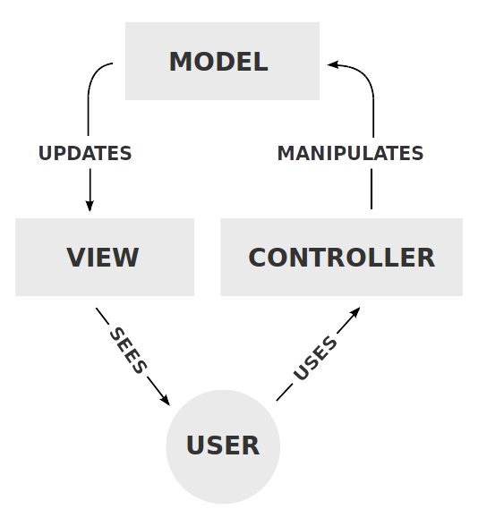
MVC/components
Components

Slide 5
MVC/components
- Model:
Notifies its associated views and controllers when there has been a change in its state
- View:
Requests information from the model that it uses to generate an output representation to the user
Update when model have change in its state
- Controller:
Send commands to the model to update the model's state
Send commands to its associated view to change the view's presentation of the model

Slide 6
MVC/useful
- Clear separation
- Easy maintenance
- Flexibility
- Reusability

Slide 7
MVC/frameworks
- ASP.NET MVC
- AngularJS
- Ruby on Rails

Slide 8
MVC on RoR?

Slide 9
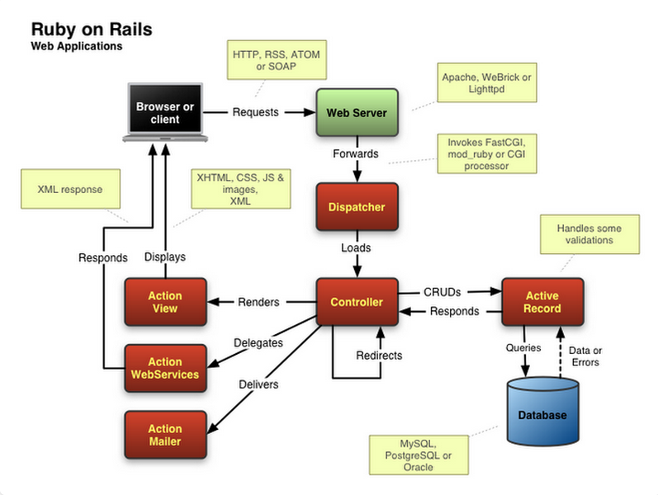
MVC of RoR

Slide 10
MVC of RoR
- Request:
External objects(browsers, devices, RESTclient) send request to web server (apache,nginx)
- Forwards:
Web server process request
It use handler (CGI, FastCGI, mod_ruby) to interact with App
- Loads:
Module Action Dispather of Rails with receive data or request and process (basic) and call Controller to process (pro)

Slide 11
MVC of RoR
- Redirect:
Controller can redirect to other controller if request is difficult
When process request controller can call to Module Active Record (Model)
- CRUD:
Controller interact with data in Model
Model will interact with database and respond to controller
- Query:
Model call DBMS (use query to interact with data in database)
DBMS will respond data or error (data nil)

Slide 12
MVC of RoR
- Renders:
Call ActionView (html, css, js) to dislay for external objects (browsers)
- Delegates:
Controller delegates for Module AWS to process request and response data (XML, JSON,...) for external objects (divice, devices, RESTclient)
- Delivers:
Controller delivers to Module Action Mailer, Action Mailer will process request and send mail for external objects

Slide 13
Document
http://en.wikipedia.org/wiki/Main_Page
http://guides.rubyonrails.org/

Slide 14



