Slide 1

RESEARCH GIT/GITHUB

Slide 2
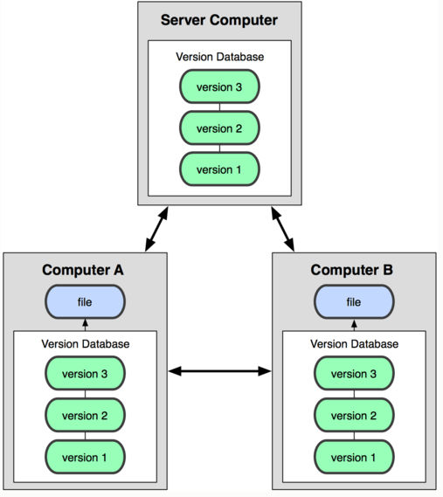
ABOUT GIT
“Git is a distributed revision control and source code management (SCM) system with an emphasis on speed, data integrity, and support for distributed, non-linear workflow. Git was initially designed and developed by Linus Torvalds for Linux kernel development in 2005, and has since become the most widely adopted version control system for software development.”

Slide 3
ABOUT GITHUB
GitHub is a web-based Git repository hosting service, which offers all of the distributed revision control and source code management (SCM) functionality of Git as well as adding its own features. Unlike Git, which is strictly a command-line tool, GitHub provides a web-based graphical interface and desktop as well as mobile integration. It also provides access control and several collaboration features such as wikis, task management, and bug tracking and feature requests for every project.

Slide 4
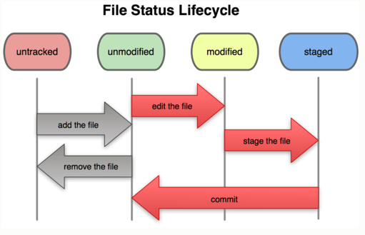
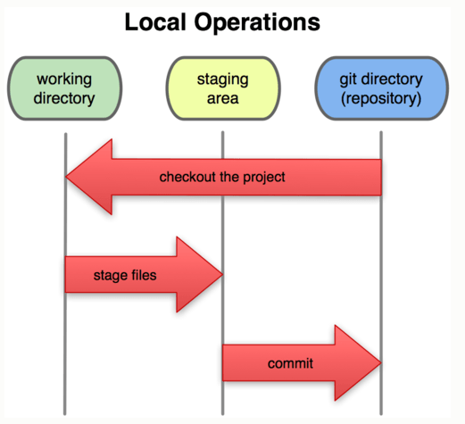
GIT (cont)

Slide 5
SETUP GIT & GITHUB
Git was installed already
Please follow steps in https://help.github.com/articles/set-up-git
  Set Up Git
Git branching:
- A branch in Git is simply a lightweight movable pointer to one of these commits
- Default branch name: master
  Create A Repository
  Fork A Repository
  Be Social with Github

Slide 6
GIT BASIC COMMANDS
 | Example | Description
Config | git config user.name | config name
 | git config user.email | config email
Init | git config init | init a empty repo
Add & remove files to repo | git add [-r] <<file>> | add file(s) to staging area
 | git rm <<file>> | remove a file from repo
 | git mv <<old name>> <<new name>> | change file name in repo
Commit | git commit –m “message” | create a commit with message
 | git commit --amend | change last commit

Slide 7
GIT BASIC COMMANDS (cont)
 | Example | Description
Clone | git clone <<repo>> | “copy” from remote to local
Status | git status | view which files are modified in local
 | git diff [file] | View all the merge conflicts:
Log | git log [file] | View the conflicts against the base file
 | git show [file] | Preview changes, before merging
Branch | git branch [-a] | list up all branch
 | git checkout <<branch name>> | change working area to new branch
 | git checkout –b <<new branch>> | create a new branch
Remote | git fetch [remote-name] | fetch data from remote to local. Default remote-name should be “origin”
 | git push [remote-name] master | push local change to remote

Slide 8
GIT BASIC COMMANDS (cont)
 | Example | Description
Tag | git tag –v <<version>> Ex: git tag –v v1.0 | create a version. “1” is version, “5” is revision. Version is “big” change, revision is “minor” change
Alias | git config --global alias.co checkout | alias “co” as checkout
File | Description
~/.gitconfig | Global config (with option –global)
.gitconfig | Local config (impact to each repo)
.gitignore | Ignored files. The changing of these files will not be shown in “git status” & “git commit”,…

Slide 9
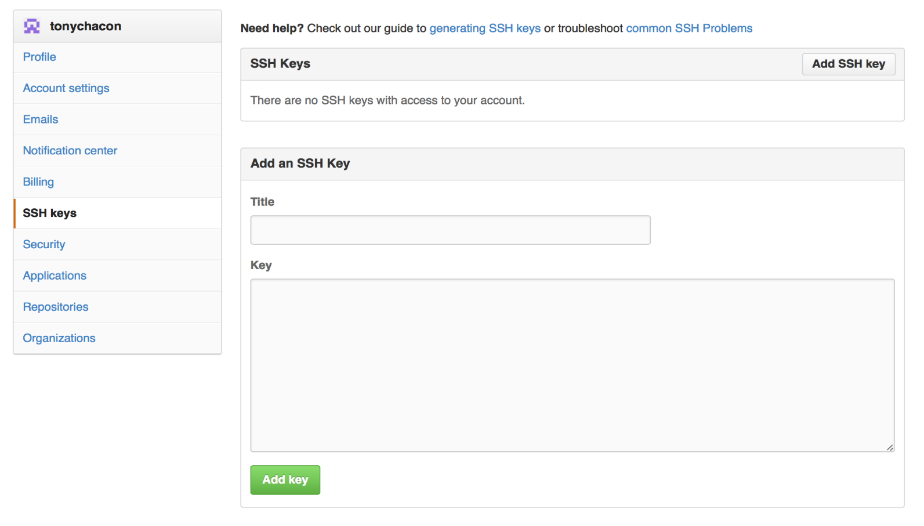
STEP BY STEP USE GITHUB
Create your account on Github
Create your repo
Clone Github’s repo to local
Add an SSH key: To simply clone public projects

Slide 10
GITBUB/PULLREQUES
Using pull requests:
Pull requests let tell others about changes you've pushed to a repository on GitHub.
Pull requests can be sent from any branch or commit
Navigate to the repository with the changes want someone else to pull and press the Pull Request button.
  1, Switch to branch
  2, Compare & review

Slide 11
DOCUMENT
Website:
- http://git-scm.com
- https://help.github.com
- http://yangsu.github.io/pull-request-tutorial
- https://confluence.atlassian.com/display/STASH/Basic+Git+commands

Slide 12

THE END

