Slide 1
Rule Translation and Check for Android App Development
Week2

Slide 2
Three Categories of Rules in Documentation
Dynamic Behavior
Suggestion
Compulsory Rules

Slide 3
Dynamic Behavior Rules

Slide 4
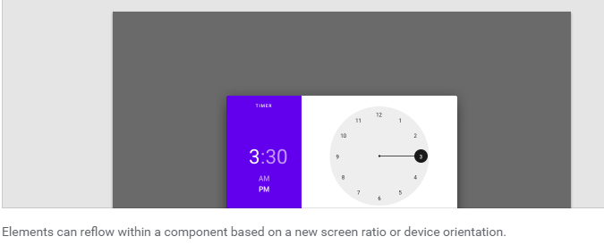
Suggestion Rules
Your design “could” …

