Slide 1
Rule Translation and Check for Android App Development
Week2

Slide 2
Categories of Rules in Documentation
Dynamic Behavior
Suggestion
Rough Rule
Systematical Rule
Quantitative Rule

Slide 3
Categories of Rules in Documentation
Infeasible to Encode
Dynamic Behavior
Suggestion
Rough Rule
Hard to Implement
Systematical Rule
Implementable
Quantitative Rule

Slide 4
Infeasible to Encode
The rules in this category is either impossible to detect by the methods used in this stage
- Dynamic Rule
or just some illustrative description
- Suggestion
or too fuzzy to encode
- Rough Rule

Slide 5
Dynamic Behavior Rules
Those rules are instructive and helpful for design, but hard or even impossible to be programmed into code at current stage.
“

Slide 6
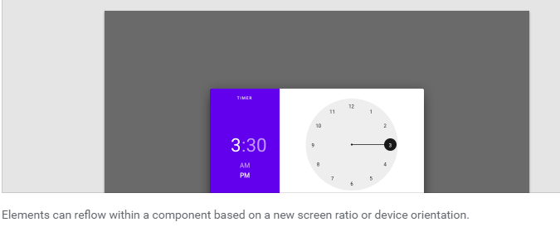
Suggestion Rules
Those rules are illustrative guide but no more operative details.
“Your design ‘could’ …”

Slide 7
Rough Rule
Those rules indicate what should or should not do, the standard, however, is ambiguous and empirical.
“The button should not be ‘too large’, the text in title should be ‘light enough’ …”

