Slide 1
Rule Translation and Check for Android App Development
Week2

Slide 2
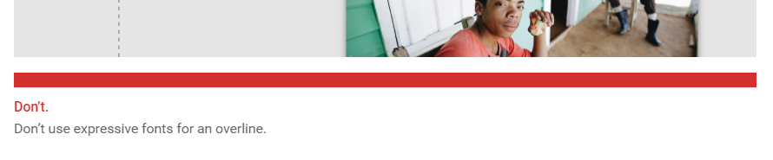
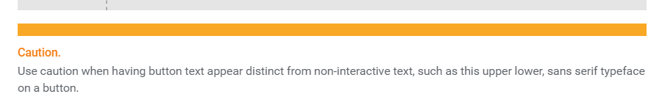
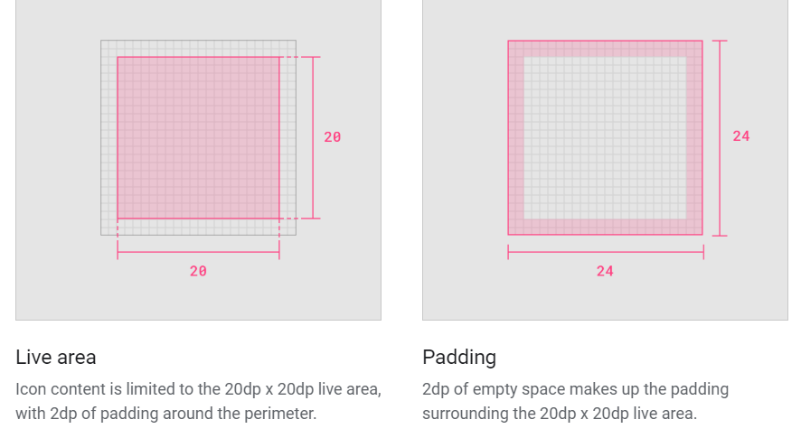
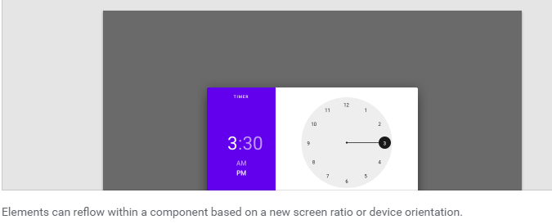
Forms of Rules in Google Documentation
Explicit (Colored)
Implicit (Uncolored)

Slide 3
Categories of Rules in Documentation
Dynamic Behavior
Graphic Design
Description and Suggestion (Most)
Rough Rule
Systematical Rule
Quantitative Rule
Rigid Rule

Slide 4
Categories of Rules in Documentation
Infeasible to Encode
Dynamic Behavior
Graphic Design
Description and Suggestion
Rough Rule
Hard to Implement
Systematical Rule
Implementable
Quantitative Rule
Rigid Rule

Slide 5
Infeasible to Encode
Rules in this category is either impossible to detect by the methods used in this stage
- Dynamic Rule
- Graphic Design
or just some illustrative description
- Description and Suggestion
or too fuzzy to encode
- Rough Rule

Slide 6
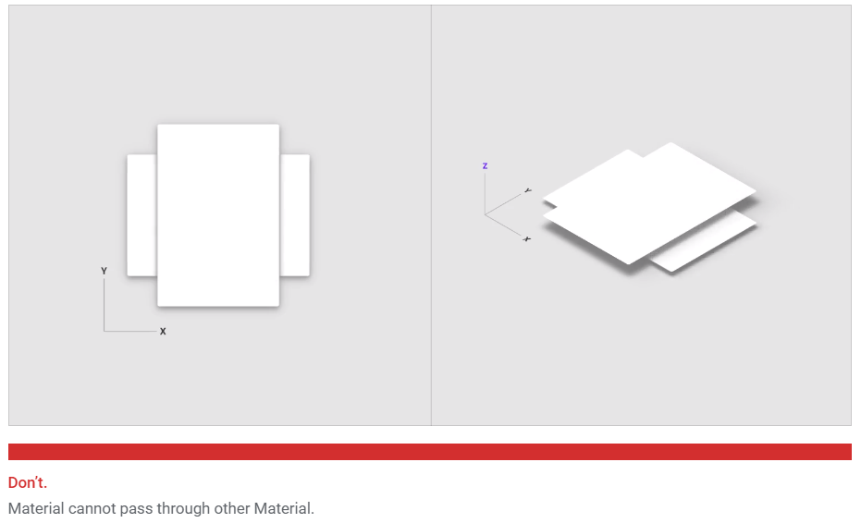

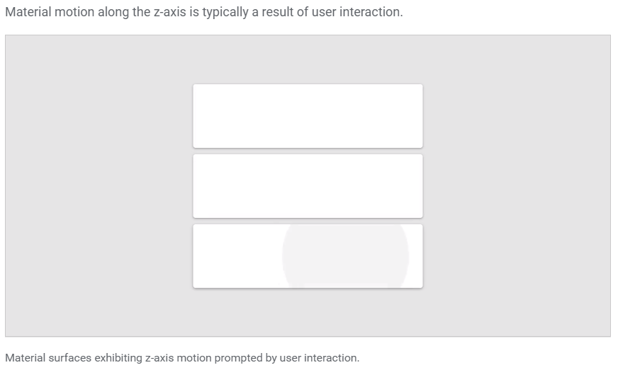
Dynamic Behavior Rules
Those rules are instructive and helpful for design, but hard or even impossible to be programmed into code at current stage.
“Shape behavior should not like liquid or gel either”

Slide 7
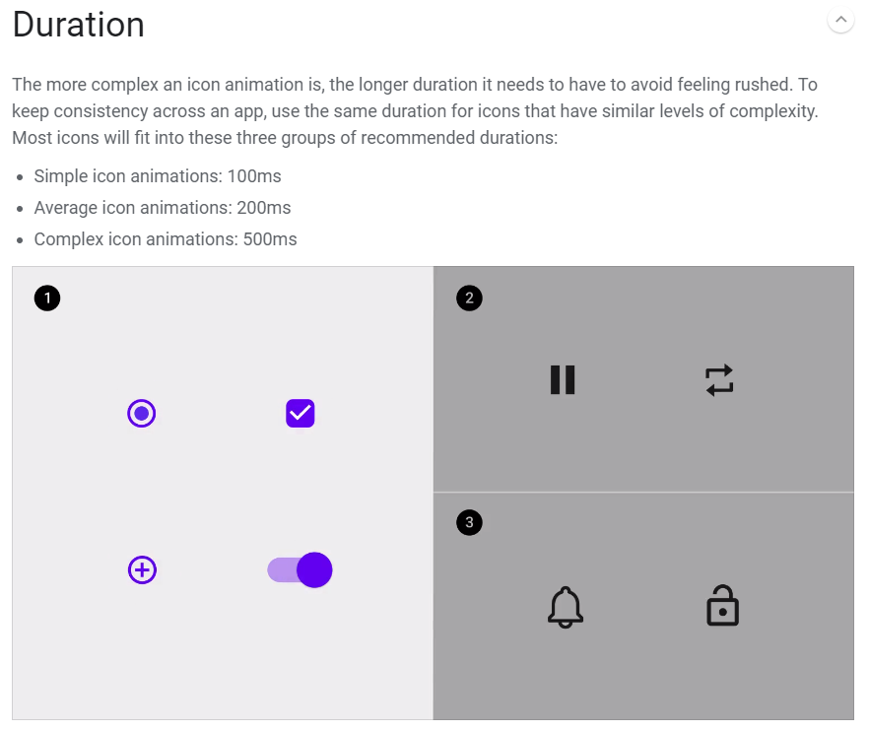
Dynamic Behavior Rules
The dynamic rules are not only about movement, also concern the “time”

Slide 8
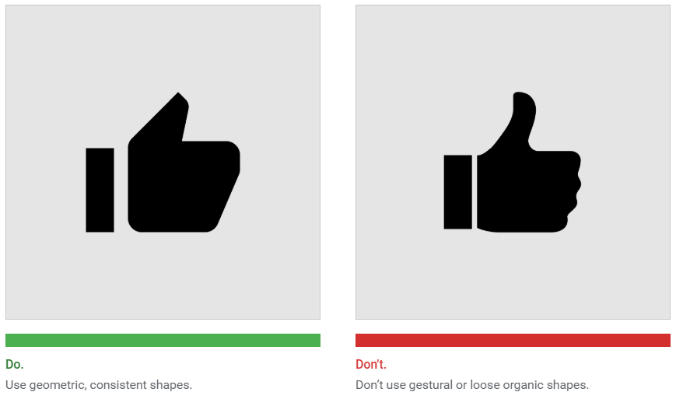
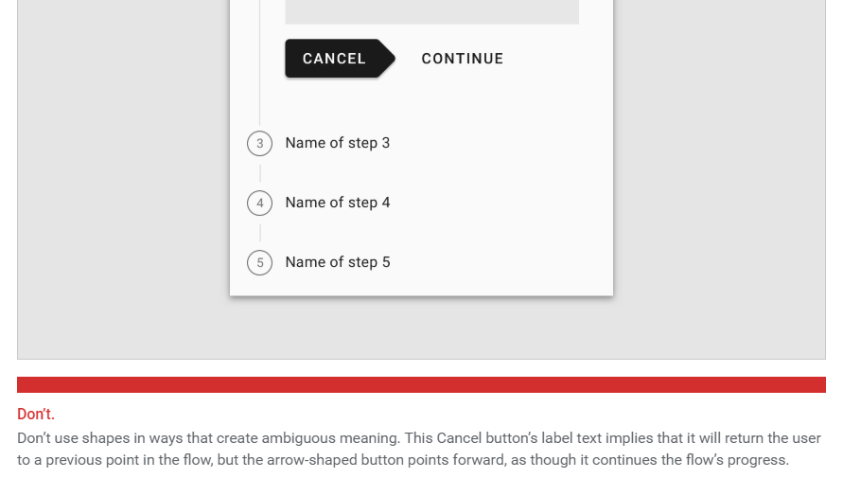
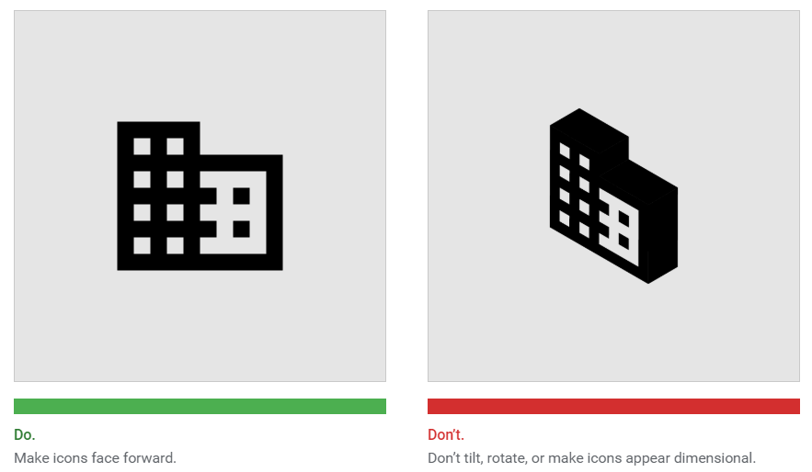
Graphic Design Rules
Some rules is purely about the image and graphic design, which is not detectable without extra image process analysis.

Slide 9
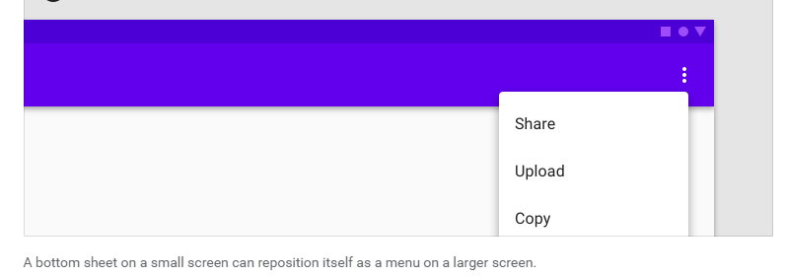
Description and Suggestion Rules
Those rules are illustrative and descriptive guide but no more operative details.
“Your design ‘could’ …”

Slide 10
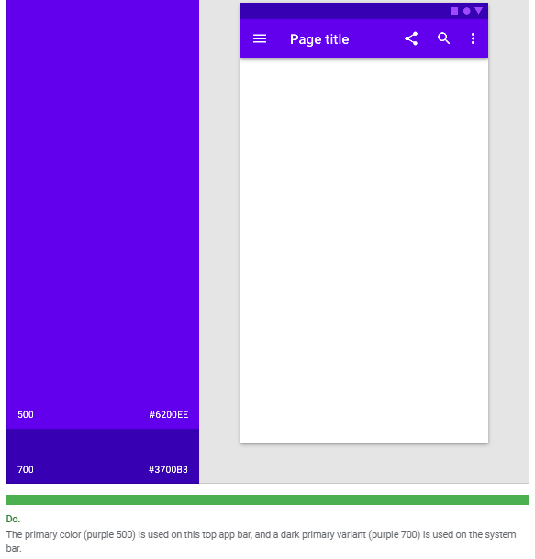
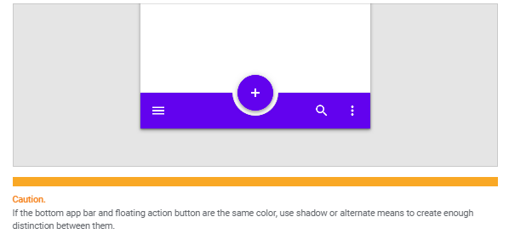
Description and Suggestion Rules
Some rules are only description

Slide 11
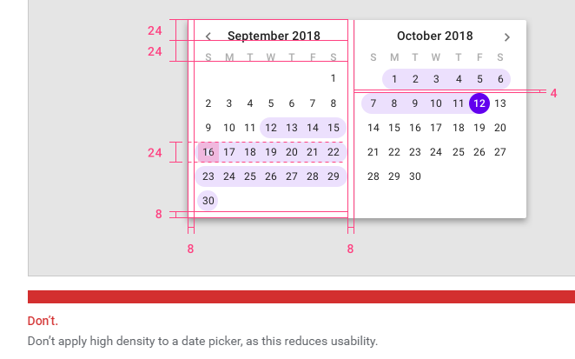
Rough Rule
Those rules indicate what should or should not do, the standard, however, is ambiguous and empirical.
“The button should not be ‘too large’, the text in title should be ‘light enough’ …”

Slide 12
Hard to Implement
Rules here are programmable and feasible to encode, however, because of some complicated properties, they are still hard to implement, such as
- Systematical Rules

Slide 13
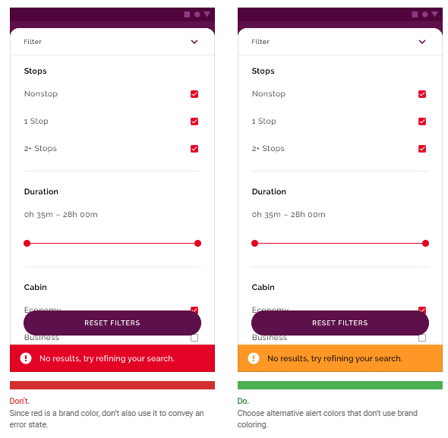
Systematical Rules
The systematical rule stipulate the design of single component based on the entire style or other elements.
“The primary color should be coherent to the color of the logo image”

Slide 14

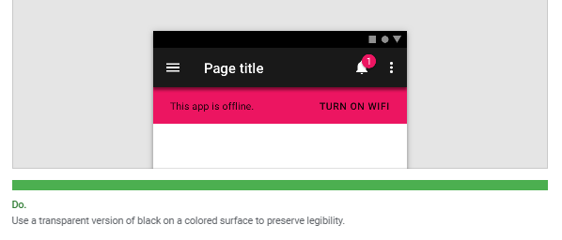
Systematical Rules
This type of rules frequently occur at the color design.
The “primary color” and “secondary color” need to be calculated at first.

Slide 15
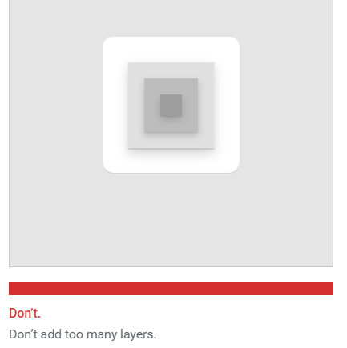
Systematical Rules
Because the Android code does not indicate the image layer directly, the rule like “few more layer” needs more analysis and complicated detection algorithm.

Slide 16
Implementable
As implied by the name, implementable rules are easier to be translated into code for its specific and explicit property. They can be rules that clearly state the value of setting
- Quantitative Rules
or certain setting in terms of shape, size and so on
- Rigid Rules

Slide 17
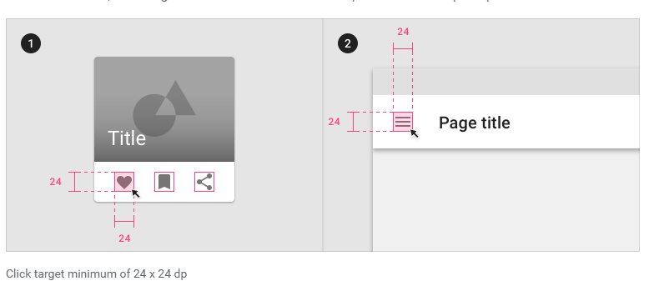
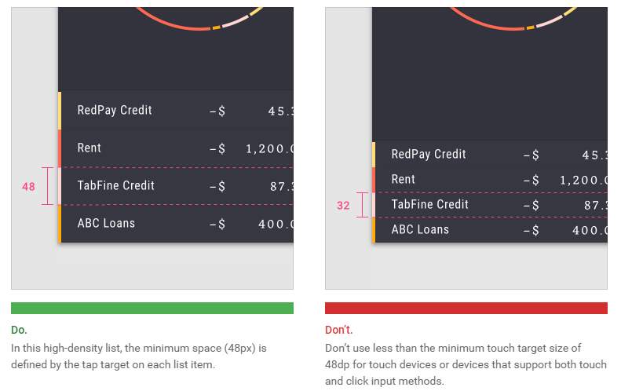
Quantitative Rules
Quantitative rules give the specific value of small range of value to guide the design.
“The minimum width of button is 46dp”

Slide 18
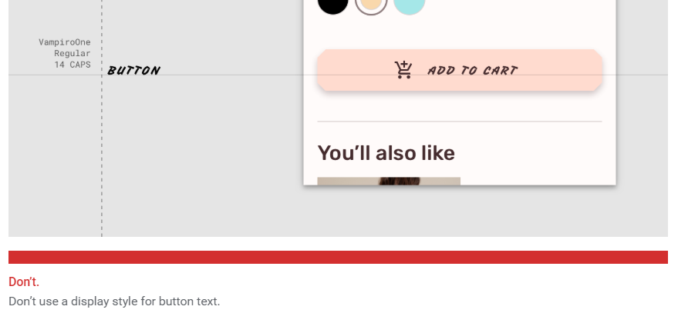
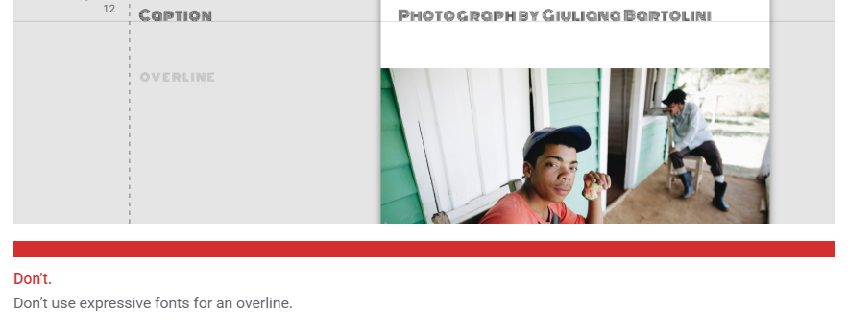
Rigid Rules
Rigid rules stipulate certain behavior for some components in terms of shape, color, font and so on.
“The text in body should not be impressive font”

Slide 19
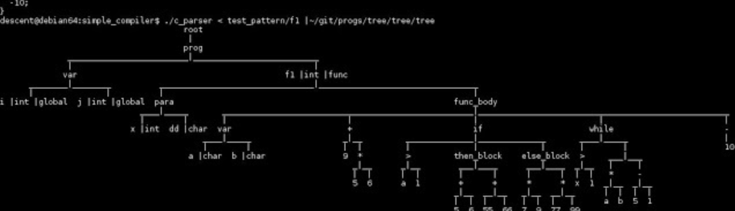
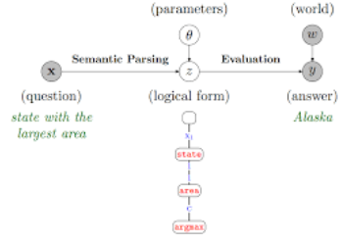
Possible Methods for Rule Detection
Semantic Parsing
State Machine
Reference: http://www.cs.tau.ac.il/~joberant/teaching/Talks/ben.pdf

