Slide 1
Week6
Code Generating

Slide 2
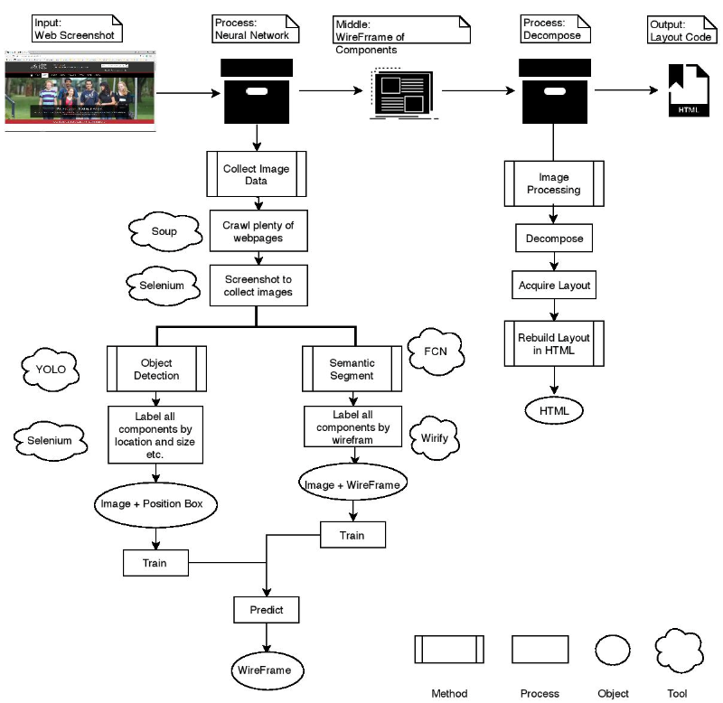
Select by user

Slide 3
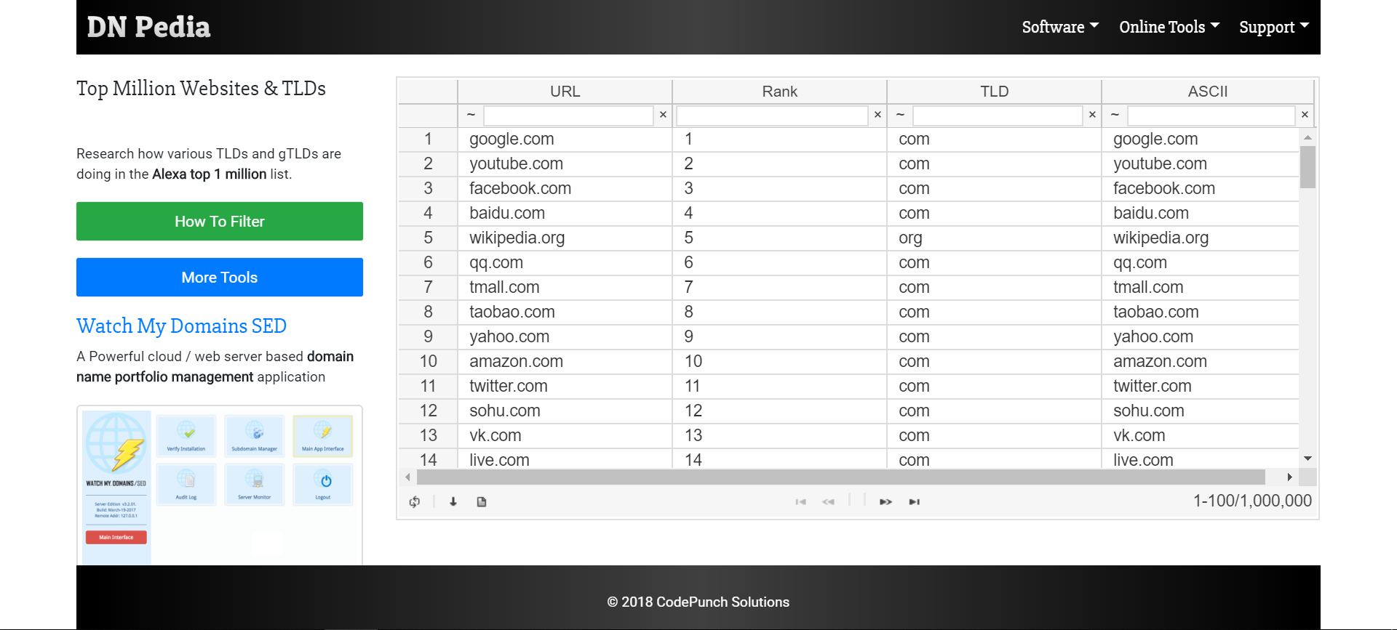
Instead of Analysis the whole page, we focus on selected block

Slide 4
s
Instead of Analysis the whole page, we focus on selected block

Slide 5
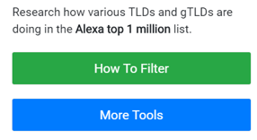
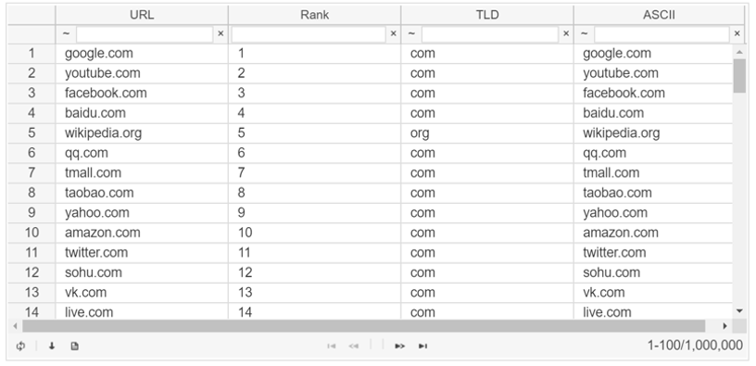

Then joint those components to adjust the layout code

