Slide 1
Week7
Code Generating

Slide 2
Backlog
Preprocessing
Training (Neural Network)
Transform (Image Processing)

Slide 3
Preprocessing
Gather data and building the training data set
Crawl and collect webpage + Info √
Label component on the web page w.r.t the Info gathered √
Clip the components for classification √

Slide 4
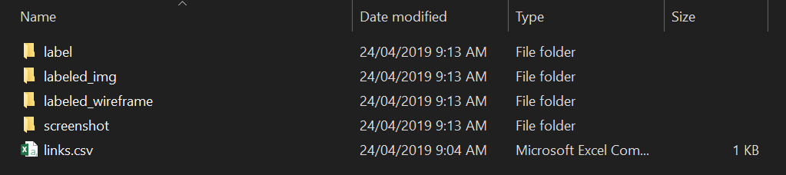
Preprocessing
Crawl and collect webpage + Info & Label data w.r.t the Info
https://github.com/MulongXie/Research-ReverselyGeneratingWebCode/tree/master/code/Crawl%2BScreenshot%2BLabel_v2/data

Slide 5
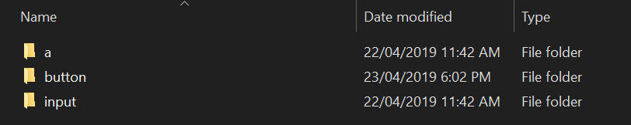
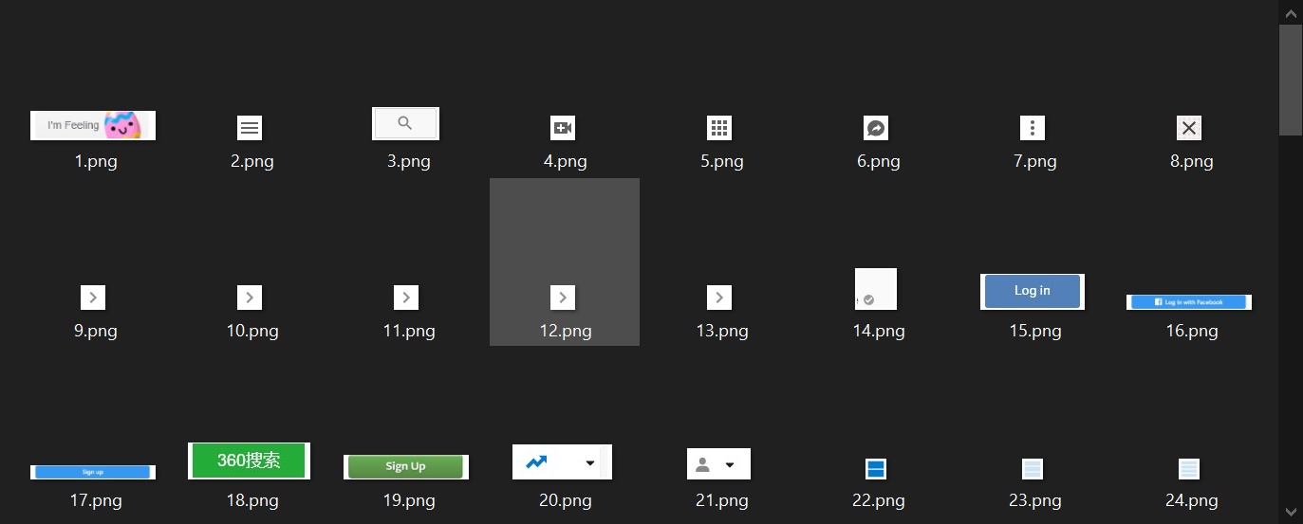
Preprocessing
Clip the components for classification
https://github.com/MulongXie/Research-ReverselyGeneratingWebCode/tree/master/code/component_clip

Slide 6
Transform (Image Processing)
Transform the input component images into HTML code
Calculate the shape and size of components √
Calculate the color theme of components √
Classify the tag of components
Text recognition
Output structure HTML code √

Slide 7
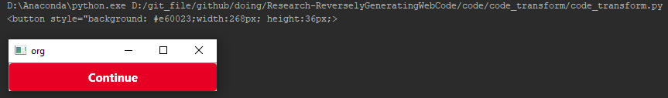
Transform (Image Processing)
Calculate the shape and size of components & Background color theme
https://github.com/MulongXie/Research-ReverselyGeneratingWebCode/tree/master/code/code_transform

Slide 8
Training (Neural Network)
Build model to recognize the tag class
Decide and build an appropriate model
Fine tune

Slide 9
Training (Neural Network)
Decide and build an appropriate model & Fine tune
https://github.com/MulongXie/Research-ReverselyGeneratingWebCode/tree/master/code/NN

Slide 10
Issues
Preprocessing
Occasional malposition
Training (Neural Network)
Model selection
Or restructure?
Transform (Image Processing)
Class of tag (necessitating the NN model)

