Slide 1
Week4
Code Generating

Slide 2
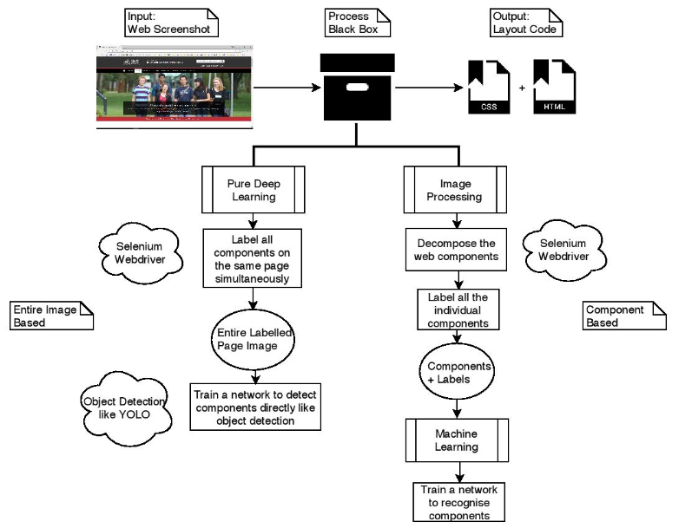
System Structure Version I

Slide 3
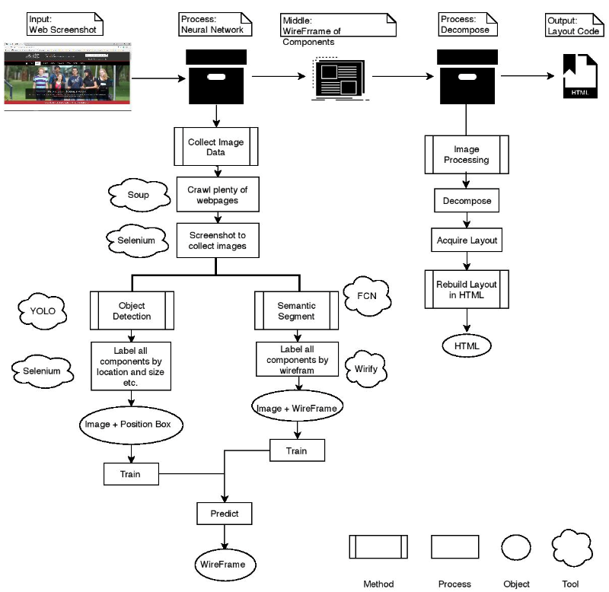
System Structure Version II

Slide 4
System Structure Version II - Revise
Manually Pick by User

Slide 5
System Structure Version II

Slide 6
Data Collection
Object Detection
Semantic Segment
Regard the components as the objects
Label each single component according to their position and size
Build a semantic map according to the component wireframe

Slide 7

Data Collection: OD Way

Slide 8
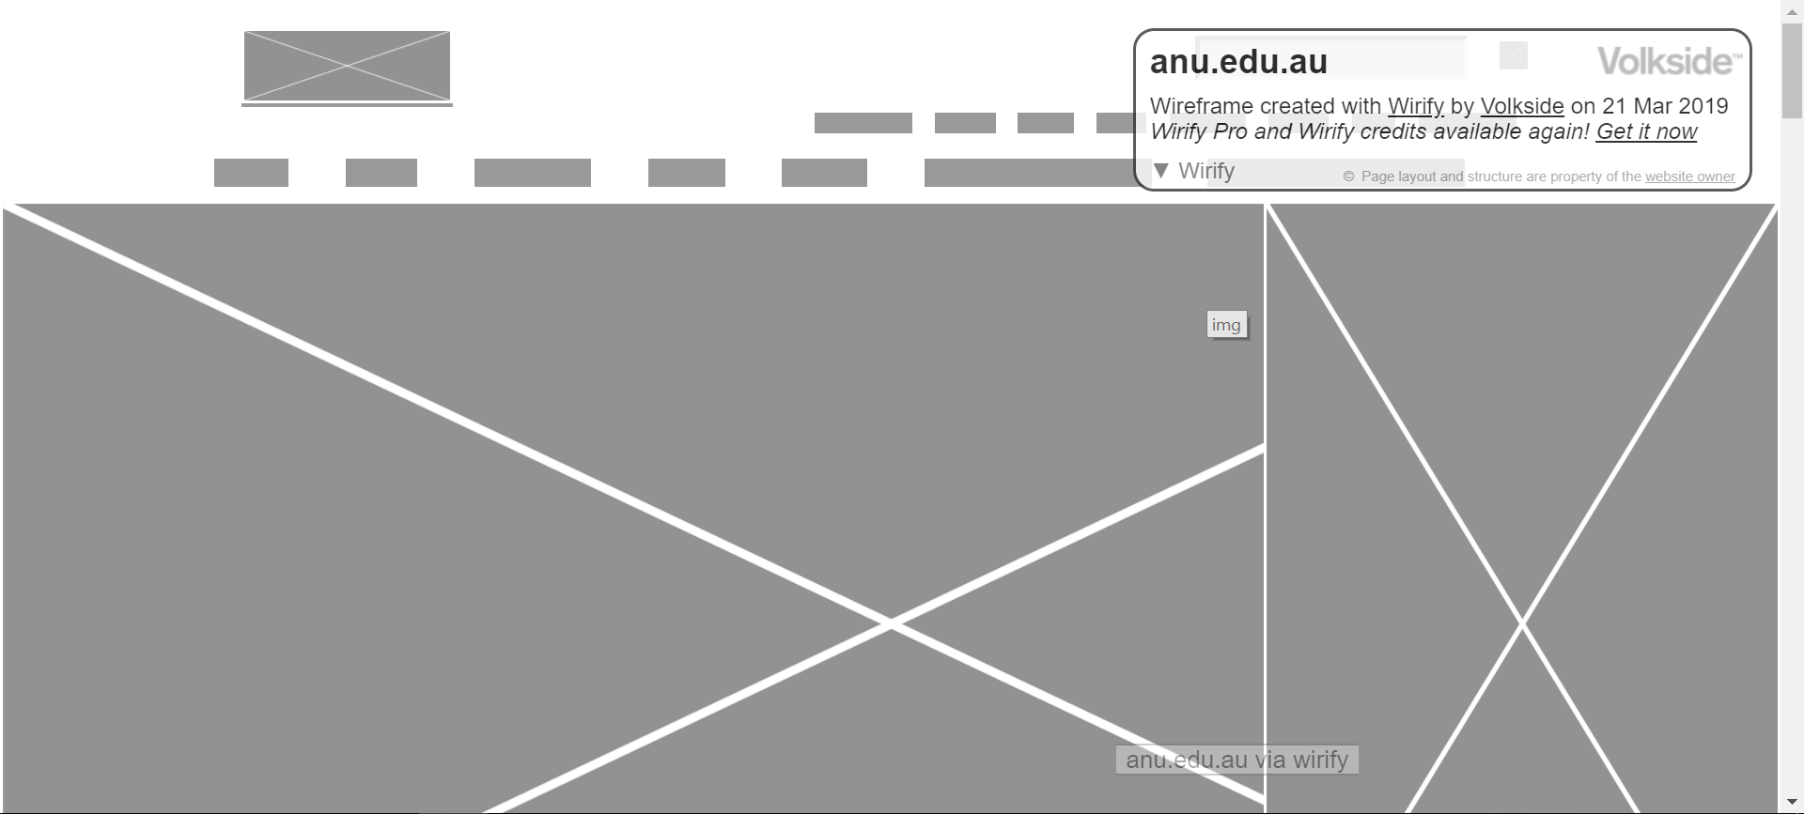

Data Collection: SS Way

Slide 9
Data Collection
Crawl Web Links
Fetch Web Components
Label and Visualization
Screenshot Web Pages
Code: https://github.com/MulongXie/Researech-ReverselyGeneratingWebCode-Selenium

Slide 10
Model Choosing
Object Detection
Semantic Segment
YOLO
RCNN
FCN
PIX2PIX ?

