Slide 1

SMART INDIA HACKATHON 2026
TITLE PAGE
Problem Statement ID – SIH26191
Problem Statement Title- Intelligent Identification of Hazard-Based Red Zones, Carrying Capacity Assessment, and Immediate Relocation Needs for Vulnerable Habitations
Theme- Disaster Management
PS Category- Software
Team ID- Team 16
Team Name - BharatBytes

Slide 2
BharatBytes
ResQGrid: AI-Powered Proactive Relocation Intelligence
Revolutionizing India's Disaster Resilience
CORE INNOVATION
GeoAI Relocation Decision Engine
Risk v Solution
Real-world issue: Flash floods, landslides (Wayanad, Himachal), and unplanned evacuations cause massive casualties, shelter bottlenecks, and severe resource wastage.
Chaotic Relocation
➔
Capacity-Aware Relocation
PRIMARY FUNCTIONS
MULTI-HAZARD RED-ZONING | CAPACITY-CONSTRAINED ROUTING
Shelter Overcrowding
➔
Dynamic Carrying Capacity
Why important: India loses ₹80,000+ crores annually to climate disasters; 30M+ people displaced in a decade. 85% of evacuation failures stem from blind shelter allocation & road cutoffs.
SAFETY & VULNERABILITY COMPLIANCE
SoVI Vulnerability Index
Prioritizes elderly, disabled, infants & kuccha houses
Road Severance AI
Detects submerged roads & landslides, routes convoys safely
Emergency Dispatch
One-click alert broadcast to SDMA, NDRF & Aapda Mitra
Black-Box AI Distrust
➔
Explainable AI (SHAP Metrics)
MONITORING & CAPACITY SUPPORT
Solution: GeoAI system identifies dynamic red zones, models shelter carrying capacity, and optimizes preemptive relocation for vulnerable citizens.
Carrying Capacity
Live tracking of beds, water, food & sanitation limits
What-If Simulation
Simulates dam burst & rainfall escalation scenarios
Explainable AI (XAI)
SHAP transparency for District Magistrate approvals
⚡ EXAMPLE DECISION PIPELINE
• Village A: Critical Risk (1,200 people)
• Shelter B: Capacity 2,500 | Available 1,800
• Action: RELOCATE 1,200 (Priority: IMMEDIATE)
• Route: State Hwy 4 (Clear of Inundation)
Prototype
Video | Website | GitHub
@SIH Idea submission- Template
2

Slide 3
TECHNICAL APPROACH
BharatBytes
METHODOLOGY & PROCESS OF
IMPLEMENTATION
SYSTEM ARCHITECTURE & PIPELINE
🛰️ DATA FEEDS
ISRO Bhuvan • Sentinel-2 • IMD AWS • OpenStreetMap
🤖 GEOAI & VULNERABILITY LAYER
GeoPandas / PostGIS • XGBoost Multi-Hazard • Demographic SoVI
⚡ OPTIMIZATION ENGINE (MILP)
Google OR-Tools • Capacity Constraints • OSMNx Distance Matrix
📊 COMMAND GIS & DISPATCH
FastAPI Cloud Backend • React + Leaflet GIS • Field Mobile App
📐 Linear Optimization Formulation:
Minimize: Sum(x_ij * Dist_ij * Risk_i)
Subject to: Sum_i(x_ij) <= Capacity_j (Zero Overflow)
TECHNOLOGIES USED
FrontEnd
React and TailwindCSS are used for the frontend GIS dashboard.
1. Data Ingestion & Raster Prep
ISRO Bhuvan DEM, Sentinel-2, IMD rainfall & OSM mesh.
2. Dynamic GeoAI Red-Zone
XGBoost models slope instability & flood inundation.
BackEnd
FastAPI, GeoPandas & PostGIS are used for spatial data processing.
3. Vulnerability Score (SoVI)
Demographic layer prioritizes elderly, infants & disabled.
Optimization
Google OR-Tools (MILP) & OSMNx are used for capacity routing.
4. Carrying Capacity Modeling
Live tracking of beds, water, ration & medical staff.
Deployment
Render, Vercel & Cloud PostgreSQL are used for deployment.
5. Capacity-Constrained Opt.
Google OR-Tools MILP calculates zero-overflow routes.
Data Feeds
ISRO Bhuvan, Sentinel-2, IMD AWS API, and OpenStreetMap.
Detailed Report
Report | GitHub
@SIH Idea submission- Template
3

Slide 4
FEASIBILITY AND VIABILITY
BharatBytes
CAN IT BE BUILT, VALIDATED AND DEPLOYED?
FEASIBILITY ANALYSIS
⭐⭐⭐⭐½
Infrastructure Reusability: Leverages existing state GIS portals and open satellite feeds, requiring minimal hardware installation.
Scalable Deployment: Can be implemented in high-risk pilot districts (e.g. Wayanad, Mandi) and expanded nationwide as needed.
Cost-Effectiveness: Setup cost is near-zero compared to building physical infrastructure or post-disaster rebuilding.
Authority Integration: Includes features like SOS alerts, shelter capacity telemetry, and DM manual override for disaster control.
VIABILITY
✔ Proven & Transparent
Proven Concept: Leverages the success of GIS + MILP optimization in emergency logistics, demonstrating clear operational viability.
Builds Public Trust: Explainable AI (SHAP) minimizes human bias, while transparent metrics provide credible proof for all evacuation orders.
Guarantees Accountability: Fosters transparency through detailed logs, shelter manifests, and analytics, ensuring every action is traceable.
Ensures Authority Engagement: Real-time GIS dashboards and one-click dispatch alerts keep disaster management teams actively in control.
BUSINESS POTENTIAL
& GOVERNMENT SAVINGS
Government Cost Savings: Automates evacuation planning to significantly reduce relief logistics overheads and optimize the allocation of NDRF/SDRF personnel.
Resource Efficiency & Zero Wastage: Creates direct cost savings through seamless integration with district relief supply chains, eliminating duplicate food/water convoys and preventing secondary evacuations.
@SIH Idea submission- Template
4

Slide 5
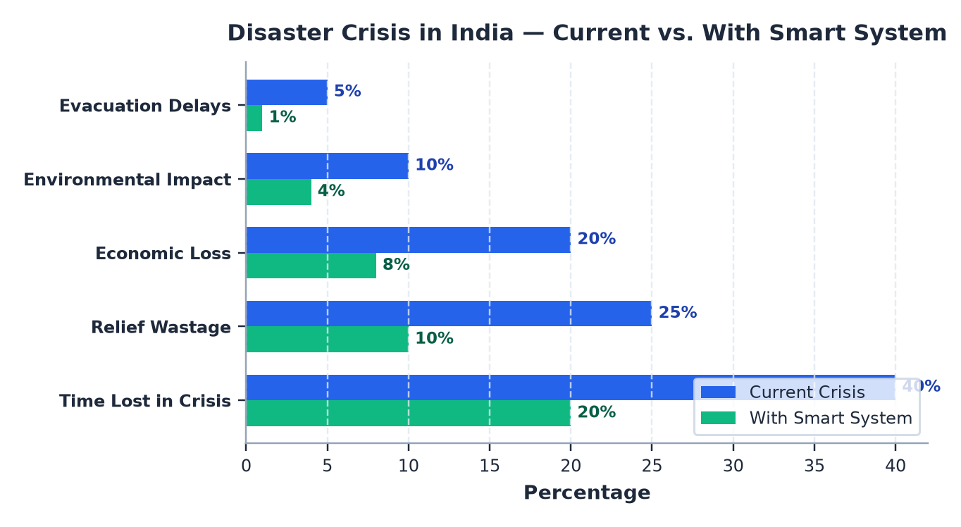

IMPACT AND BENEFITS
BharatBytes
FROM RISK MAP → TO ACTION
Reduced Latency
Reduces evacuation decision time by 95% (72h to <2h), improving response mobility.
1
1
Safety
Quicker emergency response, safer relocation, zero abandoned vulnerable citizens.
Faster Response
Saves crucial emergency time by giving vulnerable habitations priority routing.
2
2
Economic
Time optimization, relief cost savings, improved disaster logistics productivity.
IMPACTS
&
BENEFITS
Lower Relief Waste
Cuts relief material wastage, leading to lower costs and zero shelter stockouts.
3
3
Environmental
Reduced post-disaster contamination, sustainable shelter carrying capacity.
From Chaotic Evacuation ➔ Safe Relocation
Emergency Alerts
Supports SDMA & district administration with real-time alerts for red zones & road cuts.
4
4
Technology
Smart automation, real-time monitoring, AI-driven disaster management.
@SIH Idea submission- Template
5

Slide 6
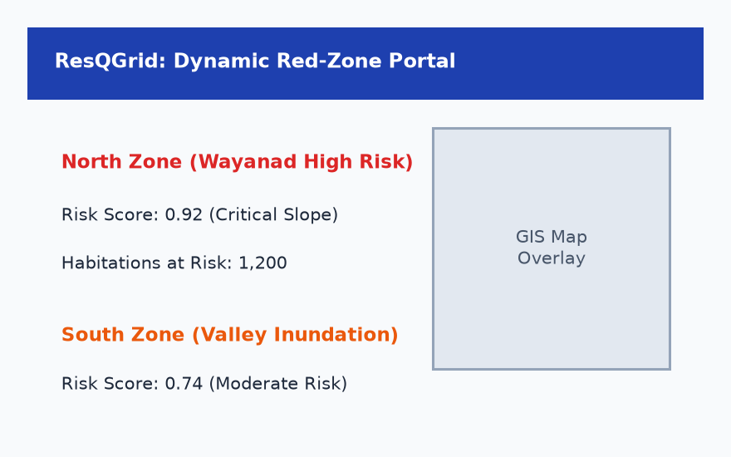
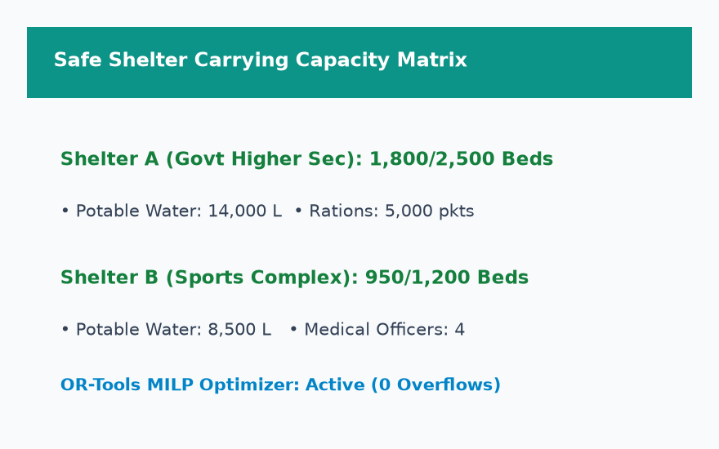
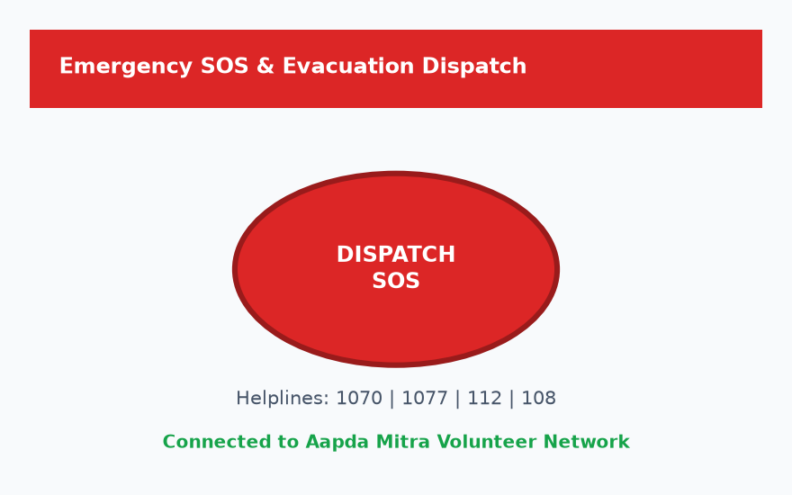
RESEARCH & REFERENCES
BharatBytes
KEY RESEARCH + DATA / TECHNOLOGY REFERENCES
ISRO NDEM
Satellite Multi-Hazard & DEM Data
LINK
NDMA SOPs
National Evacuation & Shelter Standards
LINK
Cutter (SoVI)
Social Vulnerability Index Modeling
LINK
Google OR-Tools
Capacity-Constrained Relocation Optimizer
LINK
ScienceDirect
GIS Multi-Hazard Zonation & MCDM
LINK
Lundberg (SHAP)
Explainable AI in Public Decisions
LINK
OpenStreetMap
Road Inundation & Accessibility
LINK
UI/UX
1. Dynamic Red-Zone Portal (Zone Heatmap & Risk Scores)
2. Safe Shelter Carrying Capacity Matrix (Live Bed & Ration Tracking)
3. Emergency SOS & SDMA Dispatch Console (One-Click Broadcast)
@SIH Idea submission- Template
6

