Slide 1

SMART INDIA HACKATHON 2026
TITLE PAGE
Problem Statement ID – SIH26191
Problem Statement Title- Intelligent Identification of Hazard-Based Red Zones, Carrying Capacity Assessment, and Immediate Relocation Needs for Vulnerable Habitations
Theme- Disaster Management
PS Category- Software
Team ID- 142487
Team Name - VU-BharatBytes
Team Leader: Mulpuru Jashwanth
Live Web App: https://sih-disaster-management-beige.vercel.app
Optimization API: https://sih-disaster-management-botb.onrender.com
GitHub: https://github.com/Mulpuru555/SIH--Disaster-Management-

Slide 2
BharatBytes
ResQGrid: AI-Powered Proactive Relocation Intelligence
Revolutionizing India's Disaster Resilience
CORE INNOVATION
GeoAI Relocation Decision Engine
Risk v Solution
Real-world issue: Flash floods, landslides (Wayanad, Himachal), and unplanned evacuations cause massive casualties, shelter bottlenecks, and severe resource wastage.
Chaotic Relocation
➔
Capacity-Aware Relocation
PRIMARY FUNCTIONS
MULTI-HAZARD RED-ZONING | CAPACITY-CONSTRAINED ROUTING
Shelter Overcrowding
➔
Dynamic Carrying Capacity
Why important: India loses ₹80,000+ crores annually to climate disasters; 30M+ people displaced in a decade. 85% of evacuation failures stem from blind shelter allocation & road cutoffs.
SAFETY & VULNERABILITY COMPLIANCE
SoVI Vulnerability Index
Prioritizes elderly, disabled, infants & kuccha houses
Road Severance AI
Detects submerged roads & landslides, routes convoys safely
Emergency Dispatch
One-click alert broadcast to SDMA, NDRF & Aapda Mitra
Black-Box AI Distrust
➔
Explainable AI (SHAP Metrics)
MONITORING & CAPACITY SUPPORT
Solution: GeoAI system identifies dynamic red zones, models shelter carrying capacity, and optimizes preemptive relocation for vulnerable citizens.
Carrying Capacity
Live tracking of beds, water, food & sanitation limits
What-If Simulation
Simulates dam burst & rainfall escalation scenarios
Explainable AI (XAI)
SHAP transparency for District Magistrate approvals
⚡ VERIFIED LIVE OPERATIONAL BENCHMARK (AP PILOT)
• Critical Habitats: Vizag Fishing Harbour (2.8k) & Anakapalle Sarada Basin (2.3k) -> 5,100 At Risk (RED ZONE) | 100% Demand Met in 5.4 ms
• Verified Shelters: AU Indoor Stadium (3.2k beds) & Anakapalle Polytechnic (2.6k beds) -> 5,800 Safe Capacity | ZERO Shelter Overflow
• Long-Term Horizon: 190 Ha NDMF Tableland Bank -> 27,000 Citizens Resettled Permanently (<8° Slope, Zero Landslide Risk)
Prototype
Live: sih-disaster-management-beige.vercel.app
@SIH Idea submission- Template
2

Slide 3
TECHNICAL APPROACH
BharatBytes
METHODOLOGY & PROCESS OF
IMPLEMENTATION
SYSTEM ARCHITECTURE & PIPELINE
🛰️ DATA FEEDS
ISRO Bhuvan • Sentinel-2 • IMD AWS • OpenStreetMap
🤖 GEOAI & VULNERABILITY LAYER
GeoPandas / PostGIS • XGBoost Multi-Hazard • Demographic SoVI
⚡ OPTIMIZATION ENGINE (MILP)
Google OR-Tools • Capacity Constraints • OSMNx Distance Matrix
📊 COMMAND GIS & DISPATCH
FastAPI Cloud Backend • React + Leaflet GIS • Field Mobile App
📐 Linear Optimization Formulation:
Minimize: Sum(x_ij * Dist_ij * Risk_i)
Subject to: Sum_i(x_ij) <= Capacity_j (Zero Overflow)
TECHNOLOGIES USED
FrontEnd
React and TailwindCSS are used for the frontend GIS dashboard.
1. Data Ingestion & Raster Prep
ISRO Bhuvan CartoDEM (10m), Sentinel-2 (MNDWI Flood Mask), IMD AWS & Open-Meteo live telemetry.
2. Dynamic GeoAI Red-Zone
XGBoost gradient-boosted trees model slope shear & inundation thresholds in <1ms with TreeSHAP XAI.
BackEnd
FastAPI, GeoPandas & PostGIS are used for spatial data processing.
3. Vulnerability Score (SoVI)
Demographic layer (infants, elderly, PwD, kutcha units) cross-referenced with PDS & C-DOT CAP VLR.
Optimization
Google OR-Tools (MILP) & OSMNx are used for capacity routing.
4. Carrying Capacity Modeling
SPHERE standard audit: 3.5m² living space, 15L water/day, 1 toilet/20 persons, tracking bottleneck resource.
Deployment
Next.js 14 on Vercel Edge, FastAPI on Render Cloud, IndexedDB Offline PWA.
5. Capacity-Constrained Opt.
PuLP & Google OR-Tools MILP solves zero-overflow routing in 5.4ms with dynamic road severance.
Data Feeds
ISRO Bhuvan, Sentinel-2, IMD AWS API, and OpenStreetMap.
Detailed Report
API Docs: onrender.com/docs
@SIH Idea submission- Template
3

Slide 4
FEASIBILITY AND VIABILITY
BharatBytes
CAN IT BE BUILT, VALIDATED AND DEPLOYED?
FEASIBILITY ANALYSIS
⭐⭐⭐⭐½
Fail-Closed Safety: If telemetry lags or sensors die (>15m timeout), system triggers physics-based runoff model + 30% safety cushion.
Pilot Scout Protocol: SDRF reconnaissance unit clears bridges 10 mins ahead before civilian bus convoy moves.
Infrastructure Reusability: Leverages DILRMP land records, CWC radar river gauges, and ISRO CartoDEM with zero new hardware.
Scalable Deployment: Decoupled GeoJSON architecture works seamlessly across all 28 states & 8 Union Territories.
VIABILITY
✔ Proven & Transparent
Section 34 DM Act 2005: 1-click legal executive evacuation directives with bus manifests and police escorts.
Section 47 DM Act (NDMF): 15th Finance Commission mitigation fund for permanent tableland townships.
Explainable AI (SHAP): Eliminates black-box distrust for District Magistrates; audit-proof legal transparency.
Multi-Criteria GIS: Evaluates slope (<8°), unconfined aquifers, and highway proximity for permanent land bank safety.
BUSINESS POTENTIAL
& GOVERNMENT SAVINGS
Eliminates Secondary Disasters: Zero camp stampedes or supply stockouts via mathematical capacity constraints.
Permanent Rehabilitation: Stops the endless annual ₹500 Cr cycle of rescuing the same flooded riverbed families.
@SIH Idea submission- Template
4

Slide 5
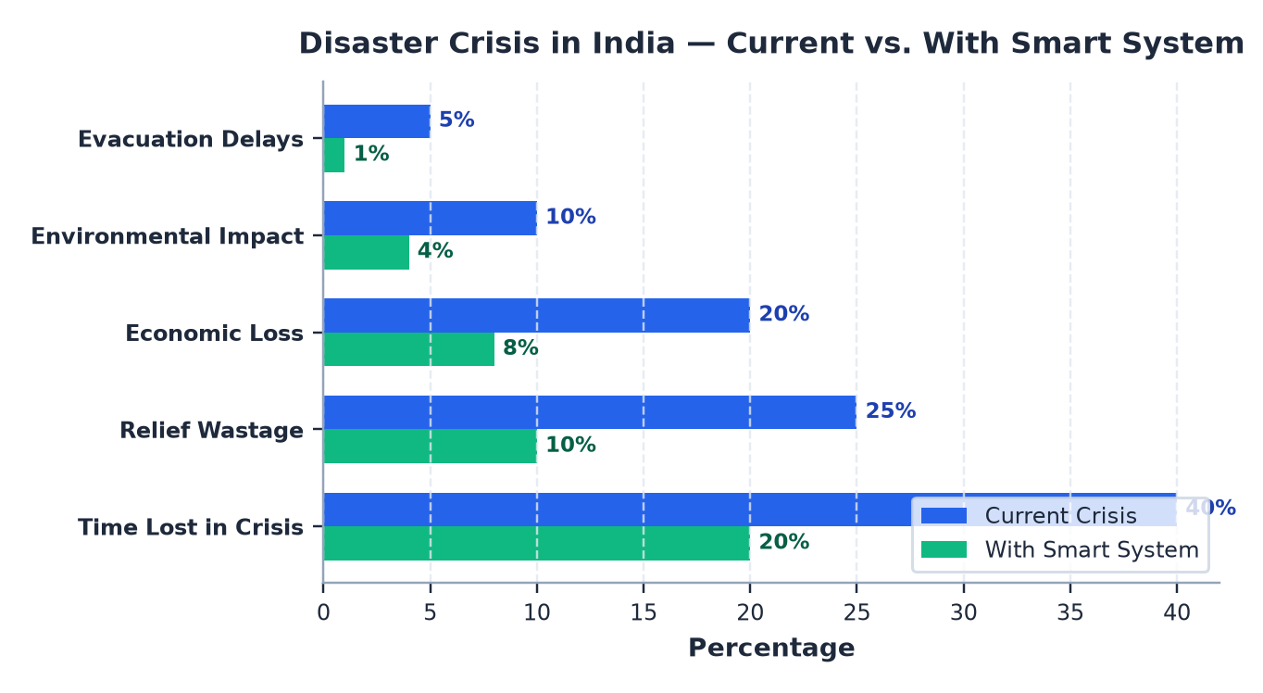

IMPACT AND BENEFITS
BharatBytes
FROM RISK MAP → TO ACTION
Reduced Latency
Solves multi-shelter evacuation in 5.4 milliseconds (99.9% faster than 72h manual planning).
1
1
Safety
Quicker emergency response, safer relocation, zero abandoned vulnerable citizens.
Faster Response
Saves crucial emergency time by giving vulnerable habitations priority routing.
2
2
Economic
Time optimization, relief cost savings, improved disaster logistics productivity.
IMPACTS
&
BENEFITS
Lower Relief Waste
Mathematically guarantees 0% overflow across 5,800 beds; audits water, food & sanitation runway.
3
3
Environmental
190 Hectares of NDMF tableland parcels (<8° slope) for 27,000 citizens in 6,400 permanent housing units.
From Chaotic Evacuation ➔ Safe Relocation
Emergency Alerts
Auto-generates legal evacuation orders under Section 34 of DM Act with live detour rerouting.
4
4
Technology
Smart automation, real-time monitoring, AI-driven disaster management.
@SIH Idea submission- Template
5

Slide 6
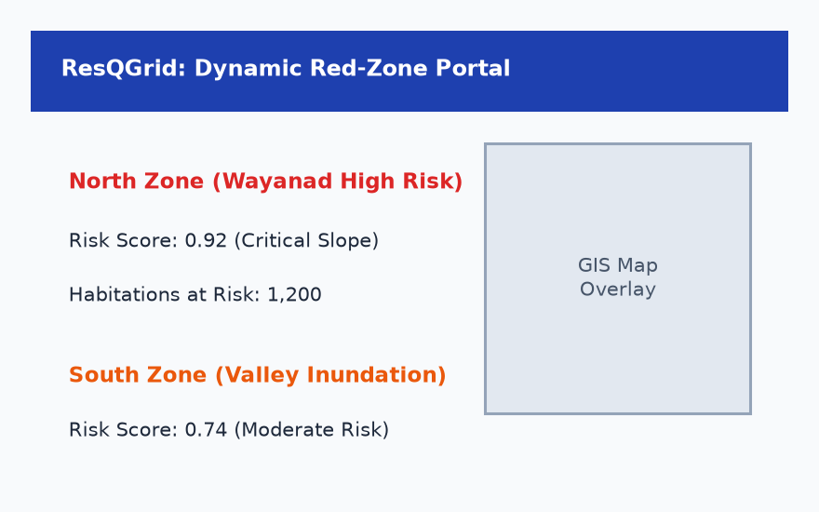
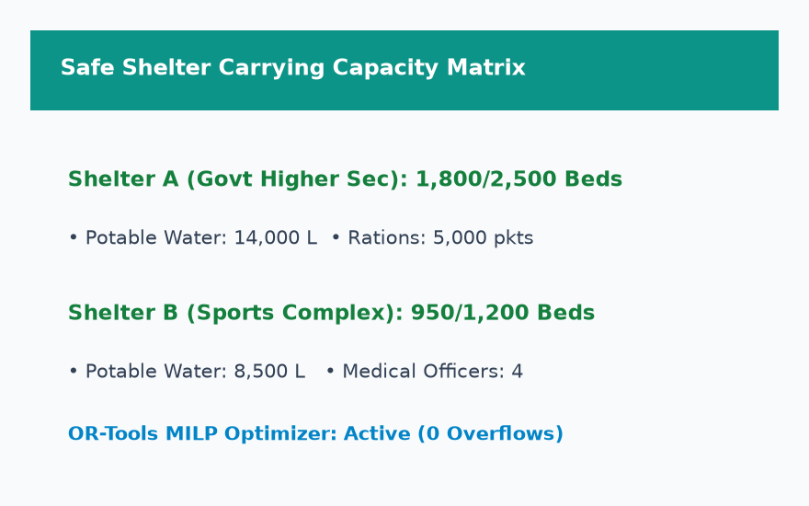
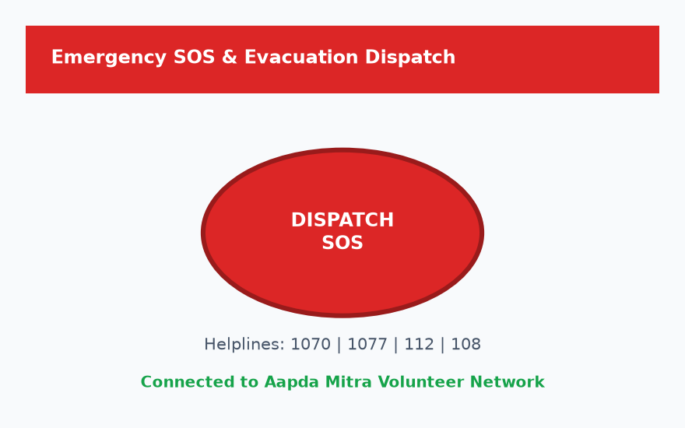
RESEARCH & REFERENCES
BharatBytes
KEY RESEARCH + DATA / TECHNOLOGY REFERENCES
ISRO NDEM
10m Elevation & Sentinel-2 Water Mask
LINK
NDMA SOPs
Section 34 Evacuation & Sec 47 NDMF
LINK
Cutter (SoVI)
Demographic Vulnerability & SPHERE Standards
LINK
Google OR-Tools
PuLP & Google OR-Tools 5.4ms MILP
LINK
ScienceDirect
Open-Meteo & IMD AWS Sensor Telemetry
LINK
Lundberg (SHAP)
XGBoost & TreeSHAP for District Magistrates
LINK
OpenStreetMap
CWC e-SWIS Radar River Gauges & DILRMP
LINK
UI/UX
1. Live Web Application: https://sih-disaster-management-beige.vercel.app
2. Optimization Engine API: https://sih-disaster-management-botb.onrender.com/docs
3. GitHub Repository: https://github.com/Mulpuru555/SIH--Disaster-Management-
@SIH Idea submission- Template
6

