Slide 1
sktime
https://www.sktime.org/en/latest/

Slide 2
General functions
We provide specialized time series algorithms and scikit-learn compatible tools to build, tune and validate time series models for multiple learning problems, including:
      Data structuring
      Feature extraction
      Forecasting
      (https://github.com/alan-turing-institute/sktime/blob/master/examples/01_forecasting.ipynb)
      Time series classification
      (https://github.com/alan-turing-institute/sktime/blob/master/examples/02_classification_univariate.ipynb)

Slide 3
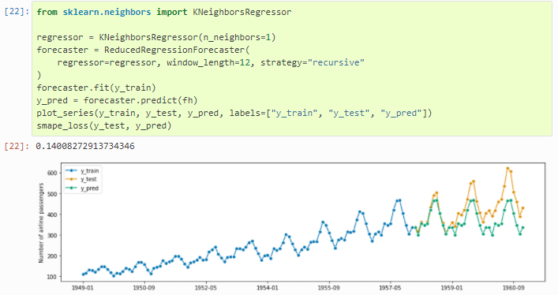
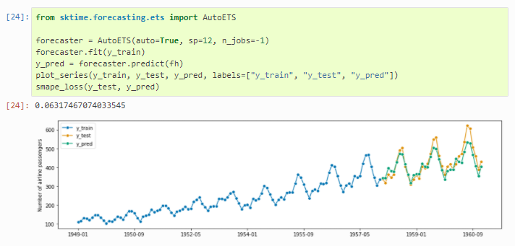
Forecasting
Sktime includes a reduction method that reduces the forecasting task to a tabular regression
Sklearn vs. sktime

Slide 4
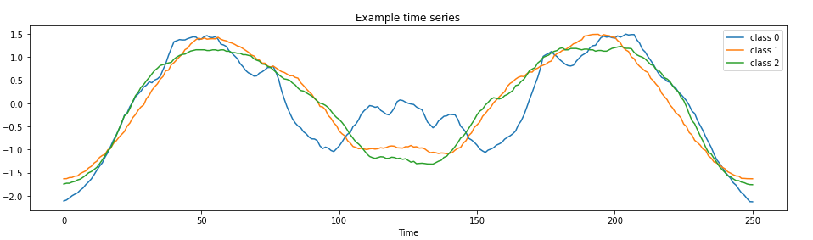
Univariante time series classification
The goal is to learn the relationship between a single time series variable and an associated label to accurately predict the label of new series
18 specialised time series algorithms
Splitting each series in multiple random intervals
Extrating features (mean, std, slope) for each interval
Collecting the feature importance values
3 individual classes

Slide 5
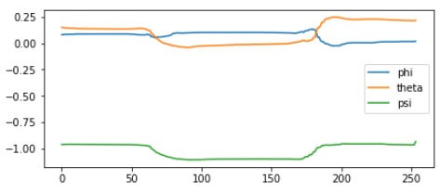
Multivariante time series classification
Learn the relationship between multiple time series variables and a label
3 different methods in sktime:
  Concatenation of time series columns into a single long univariant time series column
  Column-wise ensembling (one classifier for each time series column and their prediction aggregated)
  Classifier specific methods (e.g. finding shapelets in multidimensional space)
3 features, describing the same class

