Slide 1
ROBOTIC INTELLIGENCE — MID-TERM REVIEW
IntelliBot
Autonomous warehouse pick & delivery — perceive, plan, control in a closed loop
Task: pick package P3 (blue) → deliver to Zone B (cyan) · Webots + Python, software-only simulation
14
63
100%
0
Python modules
unit tests passing
P0 code complete
hard-coded routes
ZONE B
P3
Team of 3 · build status & evidence · October 2026
Notes:
Open with the mission one-liner; the four chips frame the talk: everything is built and unit-tested, live simulation runs are the remaining step.

Slide 2
THE TASK
One mission, seven closed-loop capabilities
“Pick package P3 and deliver it to Zone B.”
Every step below is sensed, decided and controlled at runtime — a hard-coded route is explicitly not acceptable.
1 · FIND
2 · PLAN
3 · NAVIGATE
4 · AVOID
5 · PICK
6 · DELIVER
7 · REPORT
camera detects the blue package (HSV)
A* over the inflated occupancy grid
PID waypoint following
LiDAR safety stop, 360° scan
approach & stand off (attach: final)
re-plan and drive to Zone B
time, path length, replans
Why this is “robotic intelligence”
Package position comes from the robot's own camera + LiDAR estimate — not a coordinate we typed in.
The route is planned by A* on an occupancy grid built from the same config that generates the world.
Motion is closed-loop: every 16 ms the controller re-commands (v, ω) from the latest pose and scan.
02
Notes:
Walk the chevron left to right; each step maps to a syllabus topic (vision, planning, control, locomotion, manipulation).

Slide 3
METHODOLOGY
Software architecture — Webots-free core, thin device layer
Sensors
perception.py
decision_maker.py
controller.py
kinematics.py
Motors
LiDAR · camera · GPS/IMU · encoders
device wrappers BGRA→BGR, ray angles
FSM: mission states & goals
WaypointFollower: PID heading
(v, ω) → wheel speeds
left/right + encoders
a_star.py + path_utils
A* on occupancy grid → waypoints
called by the FSM only when a new goal is set
Design rules
Pure-Python core (kinematics, PID, grid, A*, detector, FSM) — unit-tested with pytest, no Webots imports. config.py is the single source of numbers — the world file is GENERATED from it, so simulator and planner can never disagree.
03
Notes:
Orange = the FSM that owns the mission. Emphasize: only perception.py and the entry point import Webots; all logic is pytest-verified.

Slide 4
BUILD STATUS
Everything P0 is coded, modular and unit-tested
A — Simulation & Control
B — Perception
C — Planning & Decisions
generate_world.py → warehouse.wbt
custom diff-drive robot (LiDAR, camera, GPS, IMU, encoders)
kinematics.py · pid.py
controller.py — WaypointFollower
drive_test: sequence / kinematics / odometry
perception.py — device wrappers
detector.py — HSV, red two-range, zone-disjoint
estimation.py — pixel → bearing → range → world
LiDAR sector queries + safety stop
eval_detector.py + frame capture pipeline
mapping.py — grid, circular inflation
a_star.py — octile, no corner cutting + Dijkstra
path_utils.py — LOS simplify, resample
decision_maker.py — full FSM + mission report
intellibot_controller.py — integration loop
3,476
10
7
1
lines of Python
offline + sim tools
architecture docs
generated world file
04
Notes:
Each column is one future owner. Every module has a 'how to explain it' paragraph in docs/architecture.md.

Slide 5
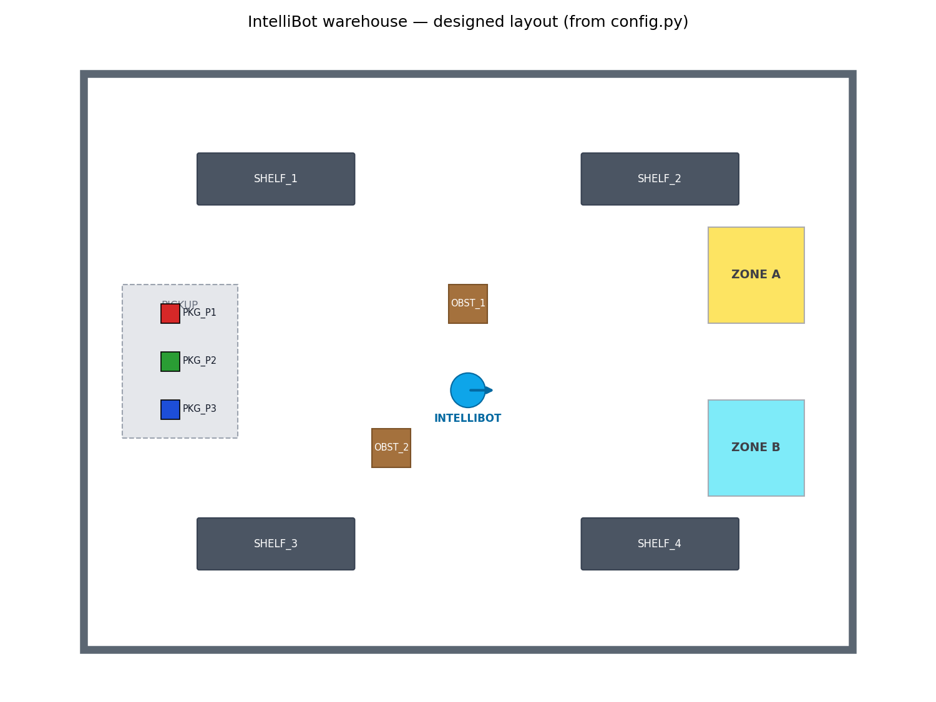
SIMULATION ENVIRONMENT
An 8 × 6 m warehouse, generated — never hand-drawn
worlds/warehouse.wbt is written by tools/generate_world.py from config.py — the map the planner uses IS the world.
4 shelves, 2 crates, pickup station, packages P1–P3 (pure red/green/blue), Zone A (yellow) / Zone B (cyan).
Flat lighting, shadows OFF — keeps HSV detection stable.
Packages are physics solids; floor patches are non-colliding.
Constraint verified by test: every aisle ≥ 1.0 m and TWO distinct routes exist to Zone B (needed for the final re-planning demo).
Layout rendered from config.py (the same numbers that build the .wbt and the occupancy grid).
05
Notes:
Point at the robot start and the two corridors on the right side of the plan: center aisle and outer corridor.

Slide 6
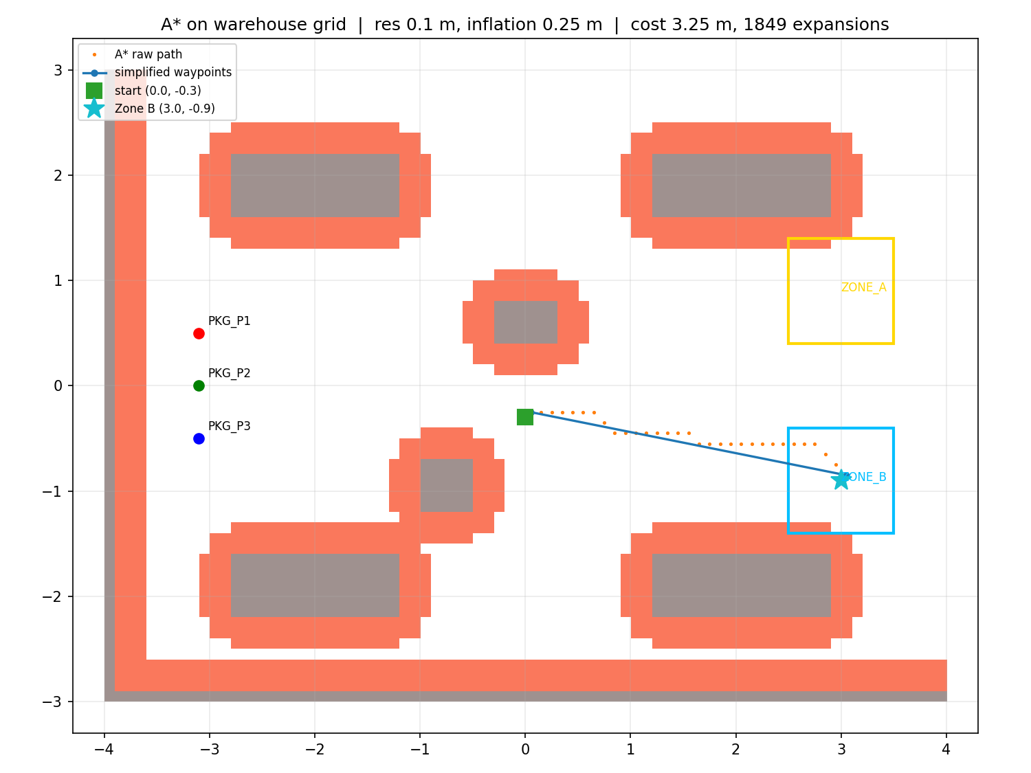
PRELIMINARY RESULTS
A* planning on the real warehouse grid — verified optimal
3.06 m
simplified path, start → Zone B
1,849
A* expansions (~14 ms, pure Python)
== Dijkstra
cost matched on 60 random grids
2 routes
path still found with center aisle blocked
Grid: 80 × 60 cells @ 0.1 m · circular inflation 0.25 m · octile heuristic · corner cutting forbidden.
06
Notes:
The figure is produced by tools/plot_astar.py — regenerated any time config changes. Orange dots = raw A* cells; blue = simplified waypoints.

Slide 7
METHODOLOGY
Perception and control — the closed loop's senses and reflexes
Vision: HSV package detector
Pixel → world position
Per-color masks in HSV (red = two hue ranges); morphology cleans the mask; largest plausible contour wins. Zone hues (yellow ≈ 30°, cyan ≈ 90°) are outside every package window — confusion is test-asserted impossible.
φ = −atan2(u − W/2, fₚₓ) → d = LiDAR min at φ (±3°) → xᵥ = pose + d·(cos(θ+φ), sin(θ+φ)). Pinhole fallback d = fₚₓ·size/bbox when no return.
Waypoint follower (PID)
LiDAR safety reflex
ω = PID(heading error), clamped ±1.5 rad/s; v = Vₘₐₓ·cos(err)·min(1, d/slowdown); rotate in place beyond 0.6 rad; waypoints reached < 0.10 m.
Any ray within ±30° of forward < 0.30 m → v = 0, status BLOCKED. This flag is the exact hook the final-eval dynamic re-planner will consume.
Mission FSM (unit-tested end-to-end with a simulated unicycle):
IDLE
▸
FIND_PACKAGE
▸
NAVIGATE
▸
PICK
▸
PLAN_DELIVERY
▸
DELIVER
▸
DONE
Every transition prints “[t=12.3s] STATE: NAVIGATE → PICK” and lands in the run log.
07
Notes:
If asked about the detector score: it is a documented heuristic (solidity x size), not a statistical confidence.

Slide 8
VALIDATION & CHALLENGES
What is proven today vs. what the live runs must measure
Verified offline — pytest, 63/63 green
Pending live Webots runs (exact commands in README)
Kinematics: round-trip, curvature-preserving clamping, odometry on a known circle
A* cost == Dijkstra on 60 random grids; corner-cutting impossible
Real layout: pickup → Zone B path + two distinct routes
FSM happy path IDLE → … → DONE incl. mission report; ERROR paths
Detector: correct colors/bboxes; zone hues never misfired
Re-plan hooks: blocked route detected → alternate route planned
Kinematics error % — commanded vs GPS/IMU finite differences (drive_test)
Odometry drift vs GPS on line / square / arc
LiDAR ray-order calibration (left-only obstacle) + range accuracy at 0.5/1/2 m
Detector rates on REAL frames + lighting variants
Cross-track error, success rate over ≥10 runs, screen recording
Challenge hit & fixed: the first anti-windup scheme (back-calculation with kᵢ = 0.05) produced ±40 integral jumps and stalled the heading controller; replaced with conditional integration — follower then completed multi-waypoint paths.
No simulation result is claimed without being observed — the build machine has no Webots install, so sim-dependent numbers stay honestly pending.
08
Notes:
Honesty is the point of this slide: green column is proven by tests, orange column lists exactly what the operator runs produce next.

Slide 9
TEAM & ROADMAP
Three owners, one integration — and what comes next
A — Simulation & Control
B — Perception
C — Planning & Decisions
World, robot, kinematics, drive tests, PID + follower tuning
LiDAR calibration, camera pipeline, detector evaluation
Grid, A*, FSM, integration, logging, docs
kinematics · pid · controller · drive_test
perception · detector · estimation · eval tools
mapping · a_star · path_utils · decision_maker
Road to the final evaluation
Now
Run the live validation suite; capture evidence (recordings, metrics)
Next
Tune PID gains on the real robot; ≥10-run success-rate campaign
Final
Dynamic obstacle → BLOCKED → live re-plan (hooks already tested)
Final
Real pickup via connector/supervisor attach; collision counter; dashboard
09
Notes:
Each member presents their column; docs/qa_prep.md has 29 ready answers for the Q&A.

Slide 10
STATUS
Built. Tested. Ready to drive.
Complete P0 codebase: world generator, custom robot, planner, controller, FSM — 63 unit tests green.
Planning proven optimal against Dijkstra; the warehouse provably offers two routes for the re-planning demo.
Remaining work is measurement, not construction: live Webots runs fill the evidence tables, then the final-eval features plug into tested hooks.
RI-Project · worlds/warehouse.wbt · python -m pytest tests/ · docs/demo_script.md
Notes:
Close on: the demo either runs live or we play the pre-recorded run — both show the same FSM console output.

