Slide 1
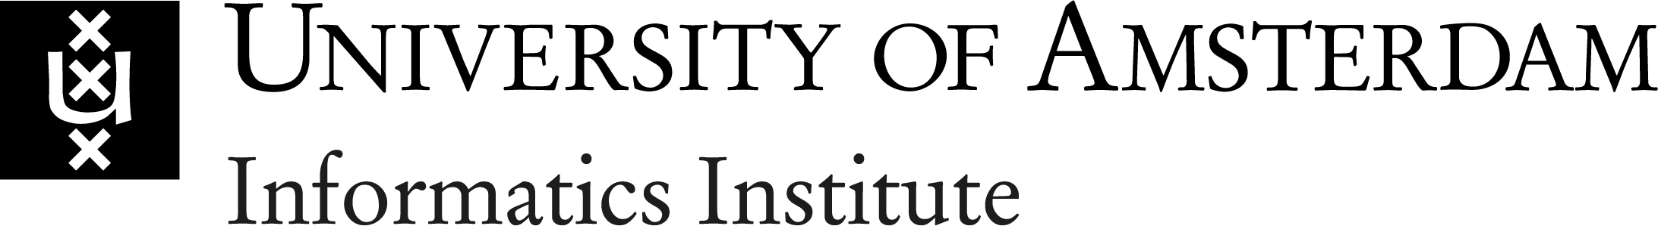
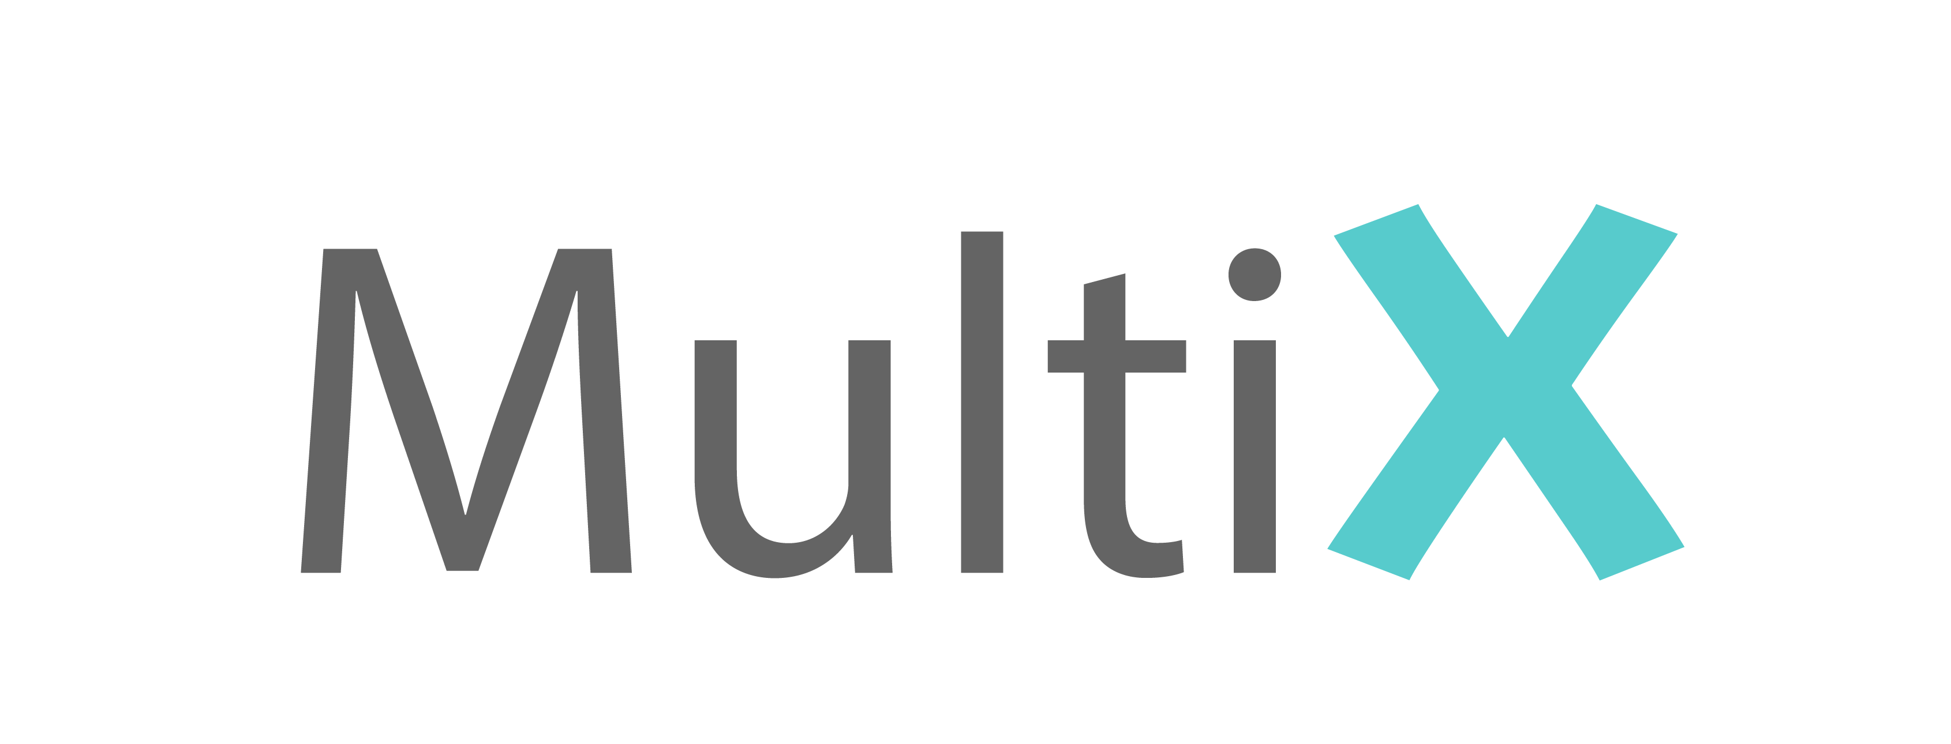
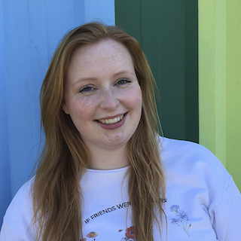
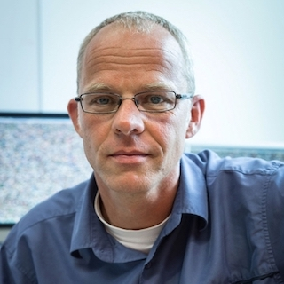






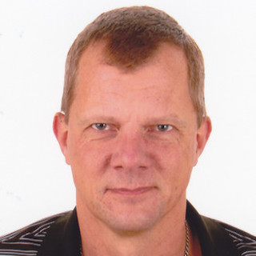

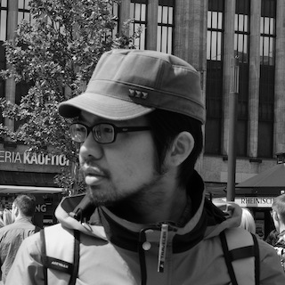





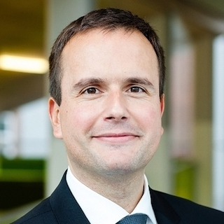





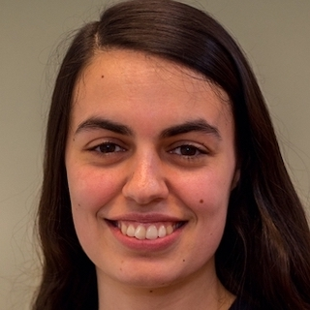






: Multimedia Analytics Lab
Group Leader: Marcel Worring
https://multix.io
We research multimedia analytics by developing AI techniques for getting the richest information possible from the data, visualizations, and interactions surpassing human and machine intelligence. We blend multi-modal data in effective interfaces for applications and social impact in public health, forensics and law enforcement, cultural heritage, and data-driven business.
We develop AI models to jointly analyze multiple types of multimedia data.
Artificial Intelligence
Visualization
We use visualizations as interfaces to show people the data and analysis results to make AI explainable.
We build hybrid intelligence solutions through interactive learning methods.
Interaction
Multimedia Analytics
Multi-modal Data
We collect, analyze, and visualize multi-modal data to enable people to gain insights.
We co-create visualizations, interactions, and AI models with different people (citizens, experts, and other stakeholders).
People
Social Impact
We focus on using multimedia analytics to create social impact in various domains.
Public Health
MIR for Business
Current Labs
CANAL Lab
Cultural Heritage
AIM Lab
Current
Labs
Police Lab AI
Forensics & Law
Enforcement
AI for Forensics
Data-driven Business

