Slide 1

What affects a restaurant’s overall rating on Yelp?
Alex
Lisa
Ma Qitian
Ye Weiting
Group Eleven
December 2018

Slide 2
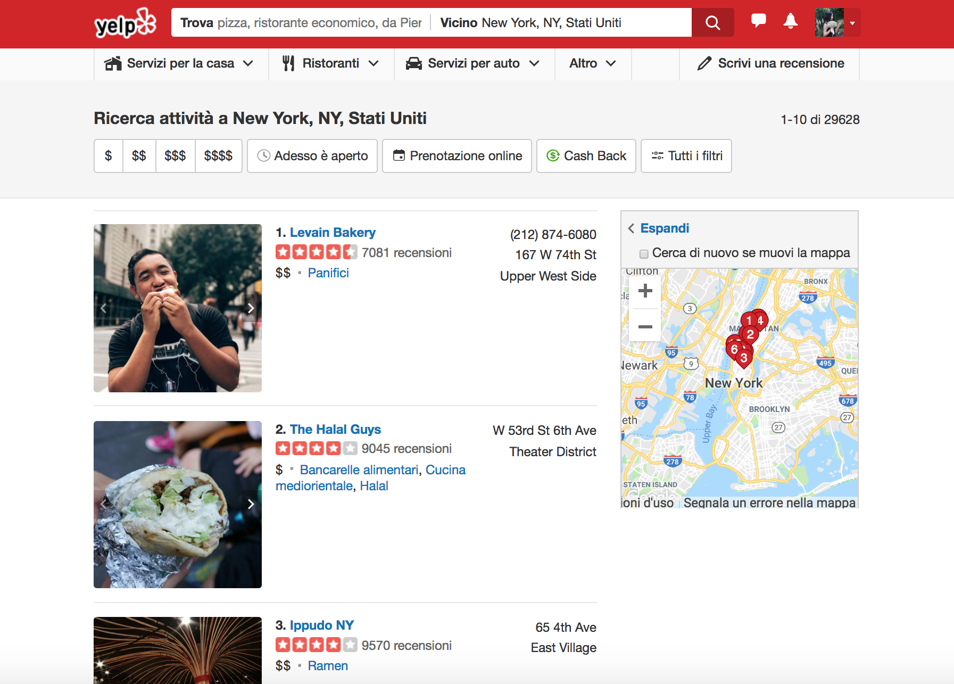

Introduction & hypothesis
Mechanism behind our analysis
Results & interpretations
Conclusion
When rating for a restaurant on a food application like Yelp, users take into consideration many factors, among which we are most interested in other customers’ reviews on its Yelp page.

Slide 3
What we have done so far…
Dataset from New York City Department of Health and Mental Hygiene
Scraping data from yelp.com
Natural Language Processing including:
Data cleaning and debugging
Sentimental analysis on Yelp users’ reviews on restaurants
Cluster analysis --Latent dirichlet allocation model (LDA)
Regression on overall_rating
Introduction & hypothesis
Mechanism behind our analysis
Results & interpretations
Conclusion

Slide 4
Regressors, control variables, dependent variable, …
We choose restaurants with:
row[‘BORO’] == ‘MANHATTAN’
row[‘CUISINE DESCRIPTION’] == ‘American’
Introduction & hypothesis
Methodology
Results & interpretations
Conclusion

Slide 5
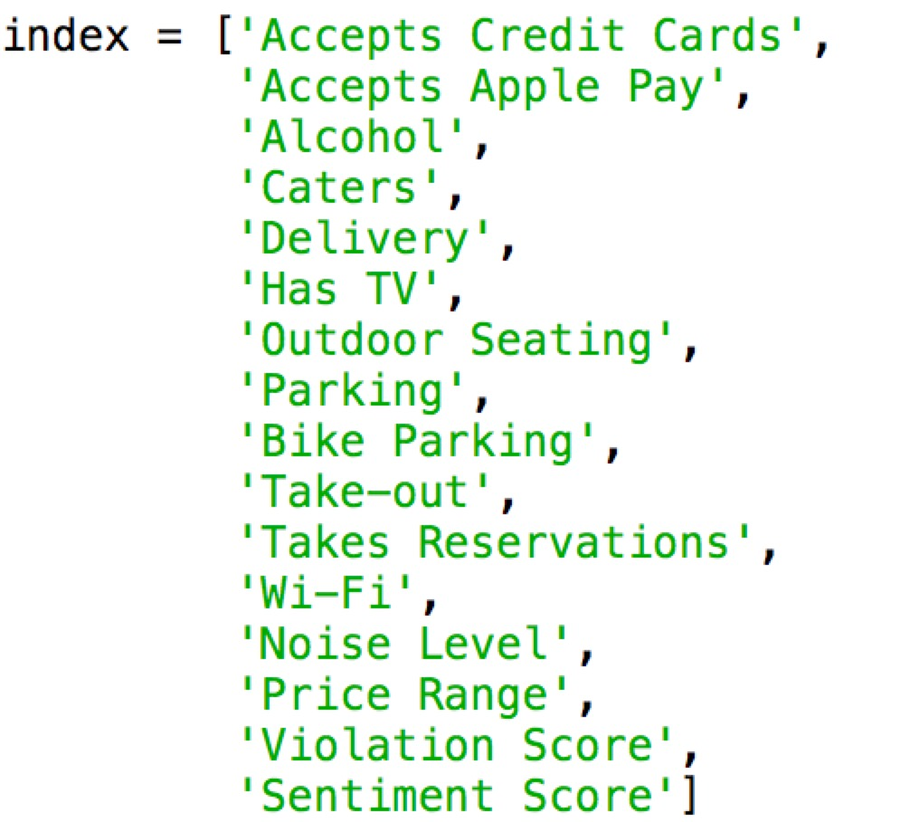
Independent variables
Variable description
Dependent variable
Introduction & hypothesis
Methodology
Results & interpretations
Conclusion
Notes:
<number>

Slide 6
How we get sentiment_score…
Analysis based on term frequency
Regression
Introduction & hypothesis
Methodology
Results & interpretations
Conclusion

Slide 7
VADER: a lexicon based sentiment analyzer
BASELINE:
sid.polarity_scores('good')
{'neg': 0.0, 'neu': 0.0, 'pos': 1.0, 'compound': 0.4404}
VALENCE SHIFT:
sid.polarity_scores('very good')
{'neg': 0.0, 'neu': 0.0, 'pos': 1.0, 'compound': 0.4404}
NEGATION:
sid.polarity_scores('not good')
{'neg': 0.706, 'neu': 0.294, 'pos': 0.0, 'compound': -0.3412}
Introduction & hypothesis
Mechanism behind our analysis
Results & interpretations
Conclusion
Reference:
C.J. Hutto, Eric Gilbert, VADER: A Parsimonious Rule-based Model for Sentiment Analysis of Social Media Text

Slide 8
Latent Dirichlet Allocation
Topic Extraction
and
Word Cluster
Introduction & hypothesis
Mechanism behind our analysis
Results & interpretations
Conclusion
Cluster analysis

Slide 9
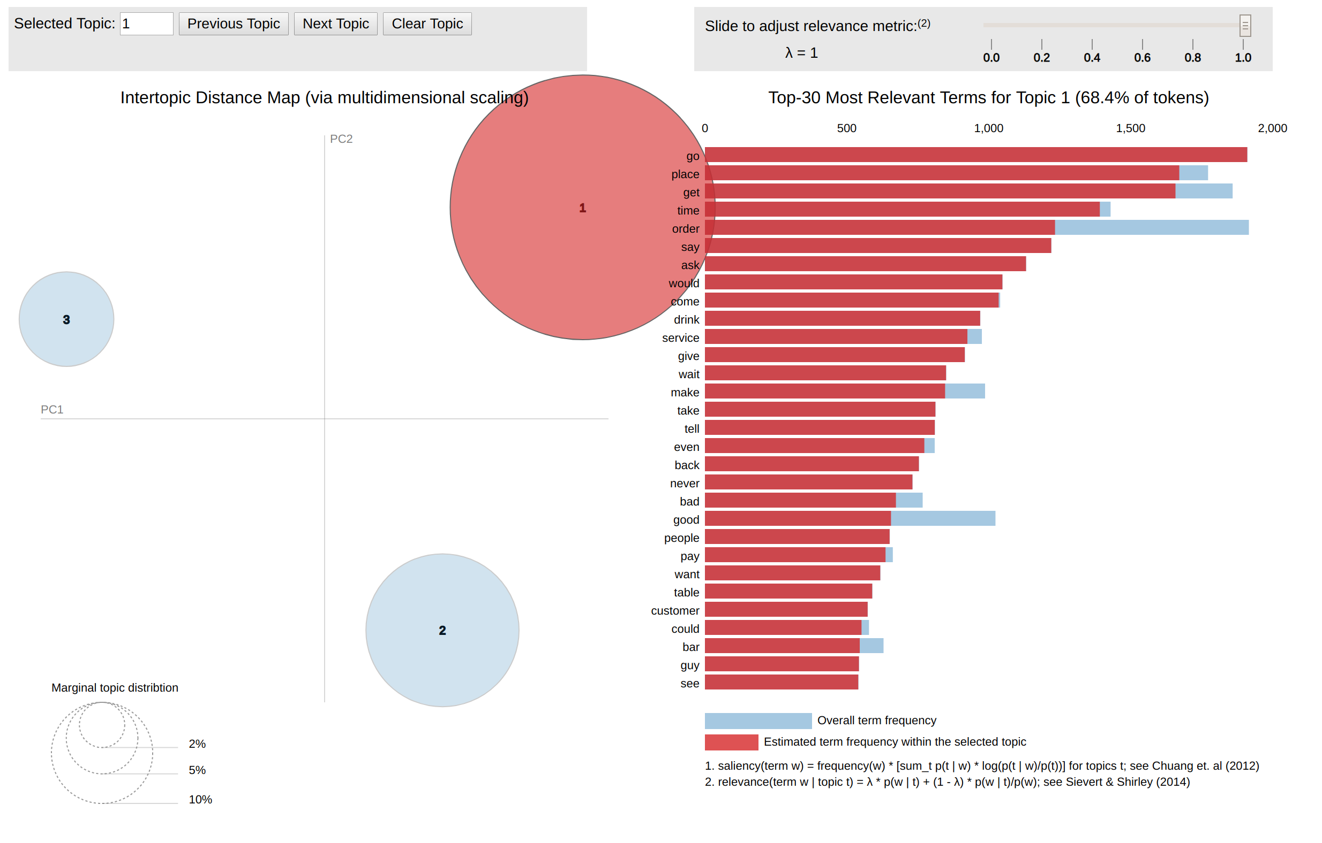
Introduction & hypothesis
Mechanism behind our analysis
Results & interpretations
Conclusion
LDA - Service

Slide 10
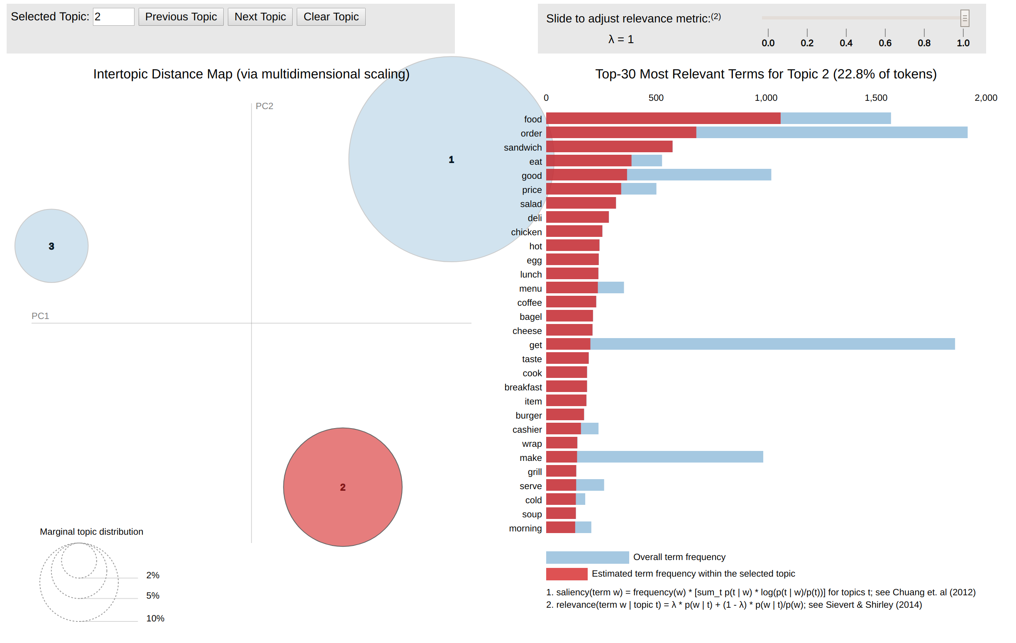
Introduction & hypothesis
Mechanism behind our analysis
Results & interpretations
Conclusion
LDA - Food

Slide 11
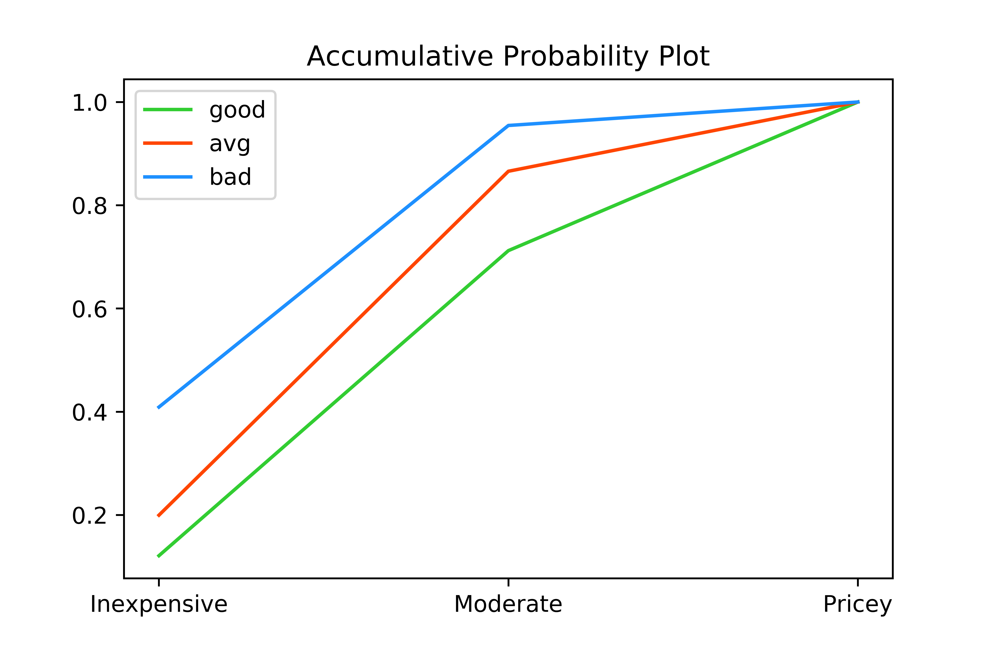
Introduction & hypothesis
Mechanism behind our analysis
Results & interpretations
Conclusion

Slide 12
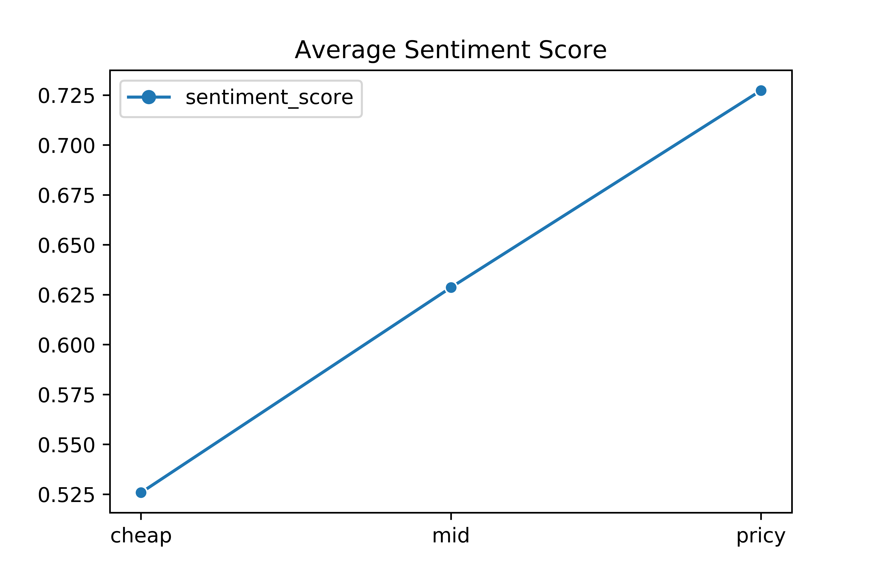
Introduction & hypothesis
Mechanism behind our analysis
Results & interpretations
Conclusion

Slide 13
Regression on overall_rating in Stata:
Econometric interpretations on coefficients:
Introduction & hypothesis
Mechanism behind our analysis
Results & interpretations
Conclusion

Slide 14
Price, sentiment, …
Introduction & hypothesis
Mechanism behind our analysis
Results & interpretations
Conclusion

Slide 15
If we are to open an upper-class restaurant in Manhatten, …
Introduction & hypothesis
Mechanism behind our analysis
Results & interpretations
Conclusion

Slide 16

Introduction & hypothesis
Mechanism behind our analysis
Results & interpretations
Conclusion

Slide 17
Thanks!

