Slide 1

GRUPPO PUMPKINS:
Archetti Enrica 3007697
Bellucci Emanuele 3088387
Colombo Vittorio 3009107
Costanzi Martina 3005687
Qitianma Ma 3068020
Roscioli Dimitri 3001293
Socity

Slide 2
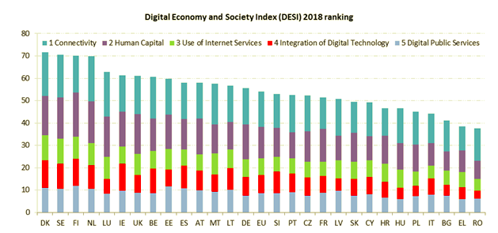
Opportunity identification
WHY IS THERE A MARKET NEED?
IMPORTANT ISSUES
LEGISLATIVE FACTOR:
legge 150/2000→The purpose is to improve communication between citizens and PA via web.
e-Government users: since Italy is at the bottom in the European ranking, digital public services do not add value to the citizens, and struggle to engage them into participating.
The European Commission released every year the DESI (Digital Economy and Society Index) : Italy is 25th out of 28 in Europe overall, 19th for Digital Public Services.
Human capital:
→ Italian citizens are low-skilled with technolgy;
→ Public digital services must be user-friendly.
→ Public Administration relies on external resources (ex. ‘IO’, starting in summer 2019 and developed open-source).
There is much to do to make the communication effective

Slide 3







App Goals
OUR MISSION
App Goals
Publish events promoted by the PA;
Give a more visible CSR option to social responsible enterprises;
Give to the PA the possibility to reach higher consensus by positively impressing the citizens for its efforts.
Improve the communication PA-citizens on both sides;
Help the PA raising funds to solve some problems;
Transform the app into a daily ritual;
Collect user-generated data and provide them to the PA.
PA
Citizens
Enterprises

Slide 4






Competitors overview
Internal
rivalry
Competition on price
Mature sector
Fragmented sector
Volatile market shares
Low switching costs

Slide 5
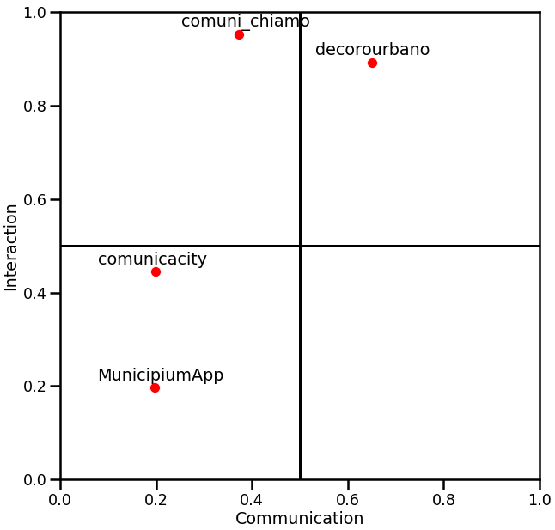




Positioning map
Our Goal
Interaction
Socity's goal is to position itself at the top right, where interaction and communication reach the highest level.
It represents the interaction part of an application. The higher the score, the higher is the perception of users about interactivity.
Conclusion
Comuni-chiamo and Decoro Urbano are our main competitors. There is a free spot in the market that we can exploit, especially in the Communication dimension.
We decided to focus on Comuni-Chiamo because the other competitor is not expanding anymore.
Communication
It represents the communication aspect of an application. The higher the score, the higher is the perception of users about Communication.

Slide 6
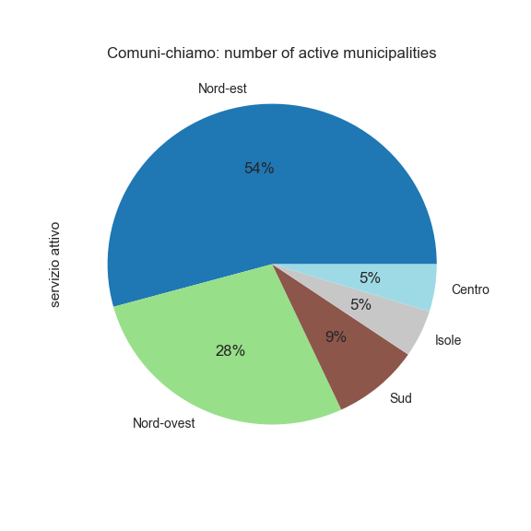
Analysis of Comuni-Chiamo
Performance in competitive dimensions
Active municipalities
Demographics:
number of active municipalities: 105;
biggest cities: Bologna, Trieste, Parma;
focus is on small towns.
Strengths
+10K download on Google Play Store;
392 K people between 25 and 44 years interested in politics (our target);
target conversion rate of 7.65% (our benchmark);
relationships with the Public Administration: collaboration.
Z
Geographical analysis:
82% of municipalities they serve is in the North;
50 municipalities in Emilia Romagna;
20 municipalities in Lombardia.
Weaknesses
Low utility in small towns (their majority): few problems to report;
only 11% of municipalities have the “communication” feature available;
not designed as a social networks.
Opportunity: exploit Comuni-chiamo’ s weaknesses.

Slide 7
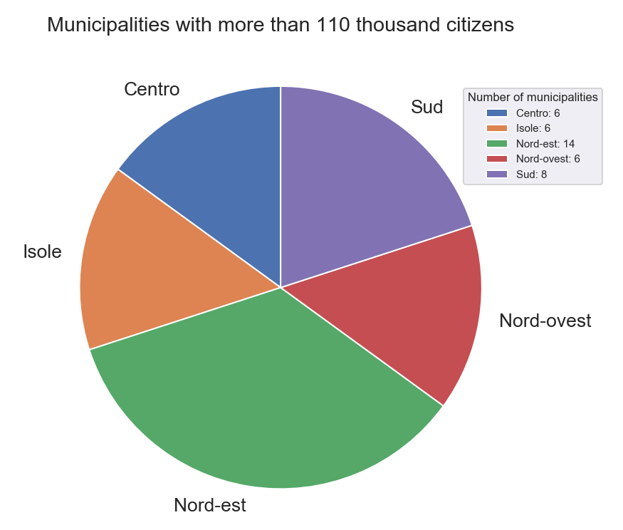
Strategy
Our strategy (1)
Focus on big town → top down approach, starting from big cities (especially in the North).
Why?
easier to reach network effects;
greater interest of their citizens in public affairs, thanks to a higher level of education;
big cities have more problems → more expected activity on the application.
How do we define a city “big”?
Focus on cities in the top 0.5% percentile → more than 110 K citizens.
Where are these cities located?
→ mainly in North Italy: 50%

Slide 8
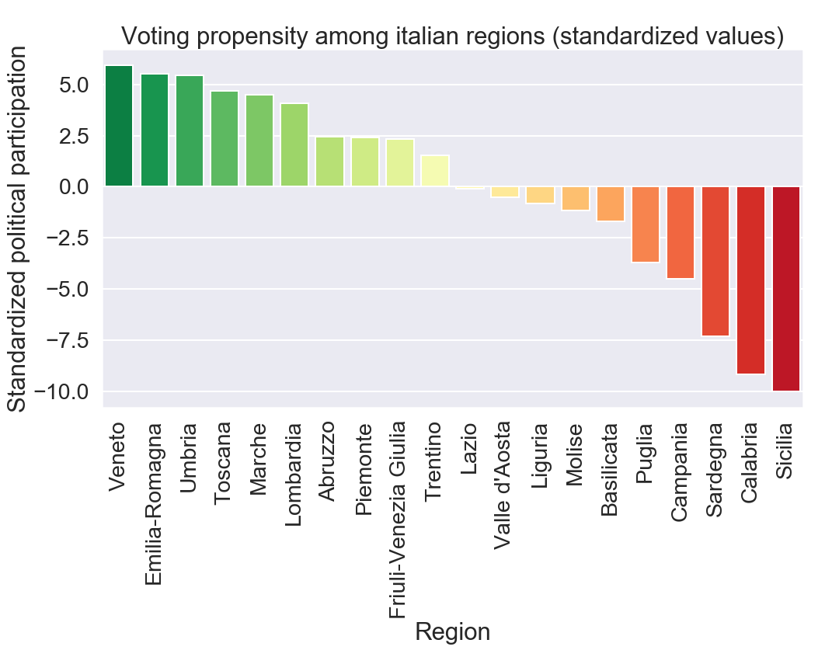
Strategy
Our strategy (2)
Focus on regions where the participation in the last political elections was higher;
→ we assume that, more voting people in a region means higher interest toward politics and social topics.
Which are these regions?
→ Again, mainly Northern Italy regions.
Conclusion: Our target municipalities are in regions with high political participation and more than 110K citizens.
We start from North Italy.

Slide 9

Potential market
Facebook
Istat
Who follows the Comune di Milano Fb page?
Our target:
Age: 25-44 years old;
Interest: Politics and social topics;
Education: College degree or higher;
Professional areas: entertainment, sports and media communications, sales, management.
Estimate the number of people between 25 and 44 in Italian municipalities;
Estimate the interest toward politics using data about voting participation in last Parliament election.
Conclusions:
TAM: It represents the total demand existing in a market→11 Million people;
SAM: It is the part of total available market that can actually be reached. Since we focus on big cities in Northern Italy →1.2 Million;
SOM: It is the share of the market that we can realistically get. Using Comuni-chiamo target conversion rate →92K downloads.
The size identified through Facebook business insights is not sufficiently reliable. We therefore used Facebook to identify the target, and the public dataset provided by ISTAT to have more accurate measurements on its size.

Slide 10


Differentiating Factors
DIFFERENTIATING FACTORS
GAMIFICATION SYSTEM: we aim to incentivize interaction of citizens (likes, comments, posts) with a system of levels they can achieve. The more advanced the level, the higher the benefits they can get.
CSR: possibility for the enterprises to back a project and get visibility and reputation to the eyes of the citizens.
SOCIAL NETWORK: the app is structured as a social network in which people can interact, and share thoughts, feelings and impressions about social issues of their city.
USER GENERATED DATA: we aim to store, process, and intepret aggregated data to provide local administration and political parties with crucial insights and advanced analytics.

Slide 11
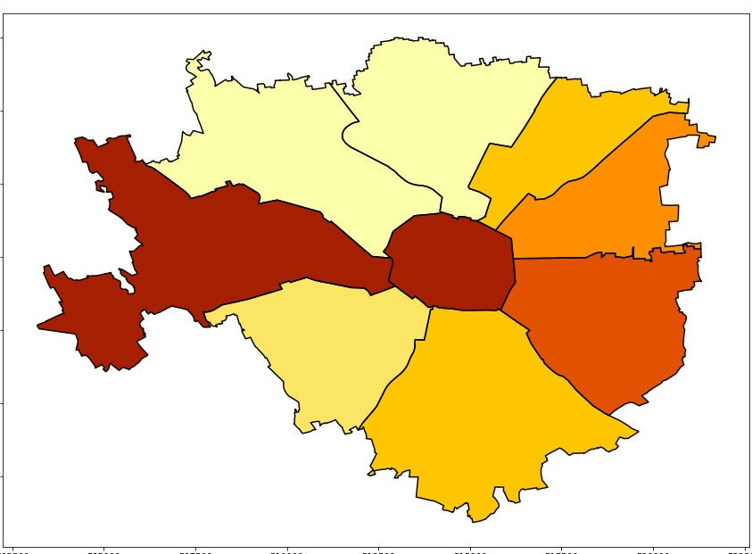
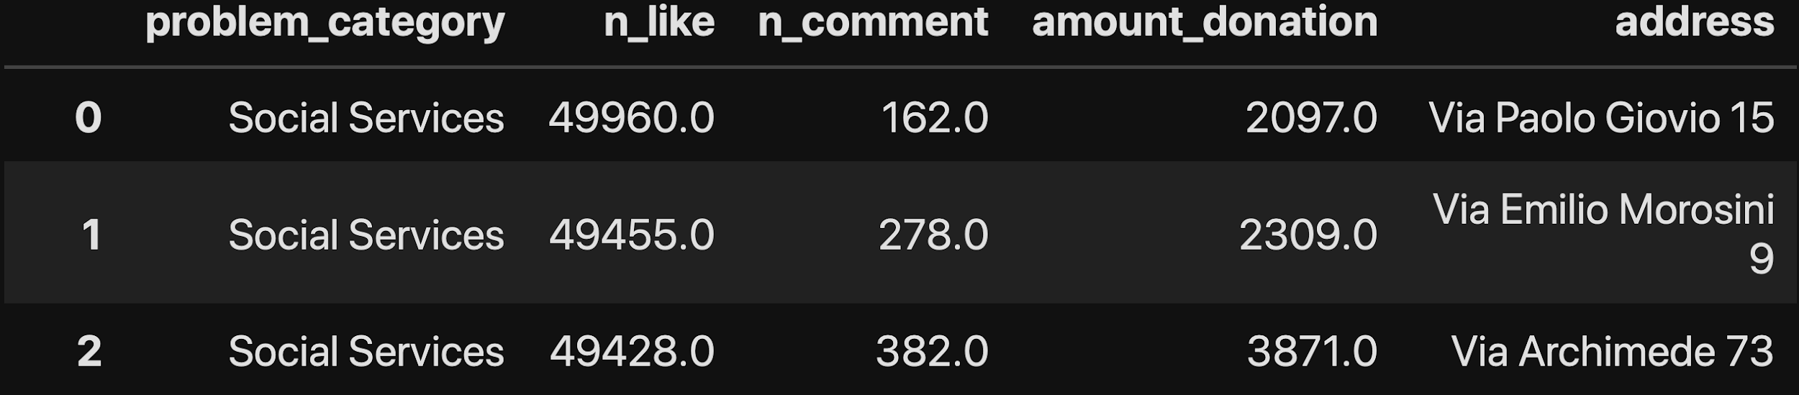
Data Analytics
POLITICAL PARTIES
PUBLIC ADMINISTRATION
We aim to sell aggregated data about the most shared problem categories across different areas of the city and age range. This information will enable parties to implement targeted political campaigns for different parts of the city.
We will measure the importance of the problem combining number of posts per category, likes and comments per post and so on.
We will provide the PA with the same data given to political parties. Moreover, we will share with them information about donations by citizens and enterprises.
The local administration will monitor in real-time the amount pledged for each problem. Combining this with information about the biggest problems in a city, the PA will be able to allocate public resources more efficiently, reaching a higher consensus among the citizens.
PA
Citizens
Example: Made-up data about quality of social services in different parts of Milan.
Enterprises

Slide 12
Revenue analysis
CSR
Data
Enterprises:
Italy is 5° in EU for Enterprises’ donations;
1 Billion donations in 2018;
Companies which do philantropic donations are medium/large sized;
45% of donations come from Italian companies; 55% from italian branches of international groups;
The median value of the contribution was 240k €.
We aim to apply a 3% fee to Corporate contributions in exchange for image returns.
If we are able to gather 5 Ml euros of donations (0.5% of market share), we will get a revenue stream of 150k €.
Individuals:
Individual donations will boost their level in the app;
5% fee on donation smaller than 10 €;
3% fee for higher donations.
→Impossibility to estimate individual donations.
Facebook gets an average revenue per user of 2,5 $ in Europe. We assume that our individual data may be worth 1 €.
Considering an initial expansion in Milan, we can be able to achieve 50k downloads.
→50.000 € of total data value.
Public Administration:
In exchange for the insights we provide the PA, we want a symbolic contribution depending on the municipality’s size (ex. Milan 50.000 €).
Political Parties:
We will give parties targeted strategies for different parts of the city to achieve better results in the election. For each transaction the charge will depend on the quantity of aggregated data sold (ex. one transaction with full data on Milan: 50.000 €).

Slide 13
Revenues-costs analysis for Milan
Costs
Revenues | 250.000
Fixed amount from PA | 50.000
Data sold to Political Parties | 50.000
Donation fees | 150.000
Costs | 152.000
Marketing | 110.000
Maintenance | 20.000
EBITDA | 120.000
Goodwill depreciation | 22.000
EBIT | 98.000
Revenues
Goodwill:
App development: 100k
Logo: 1k
Website: 1k
Patents: 5k
(depreciable in 5 years)
Marketing:
Incentives: 110k
Direct costs:
Maintenance: 20k
PA:
Fixed amount: 50k
Political parties:
Data: 50k
Donation fees:
Individuals: ?
Enterprises: 150k

Slide 14
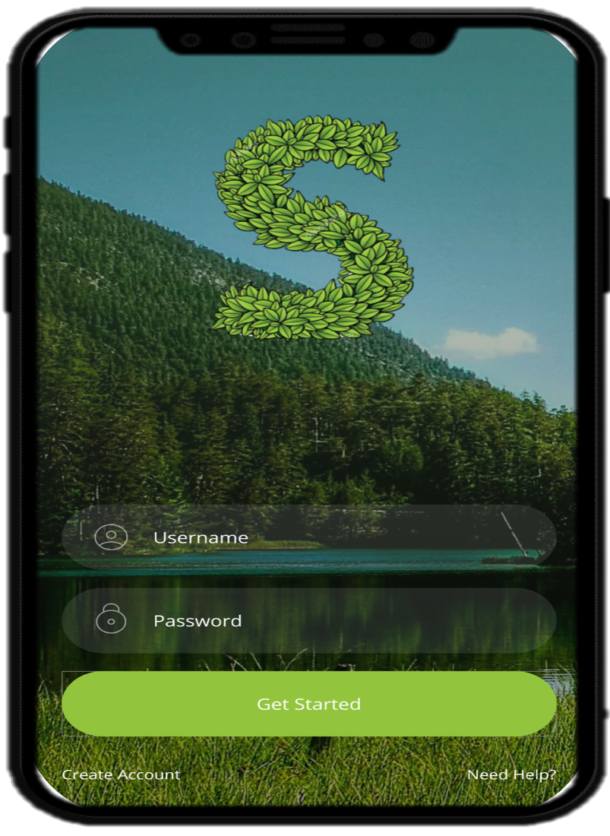
Prototype
https://sites.google.com/view/socityapp/home

Slide 15

Thanks for the attention!
Q&A?

