Slide 1

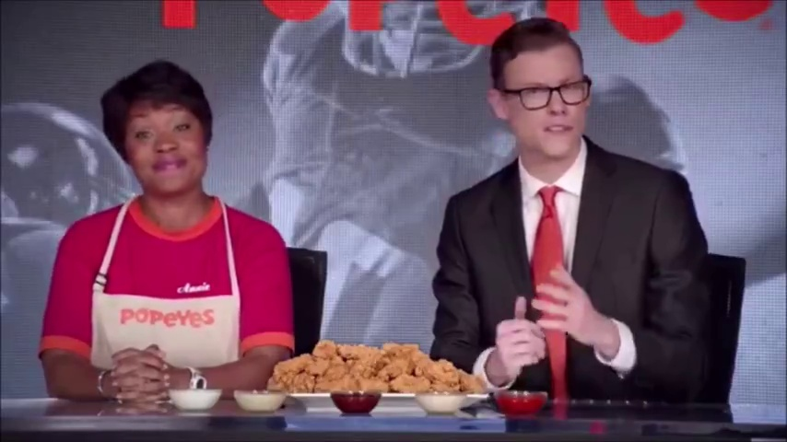
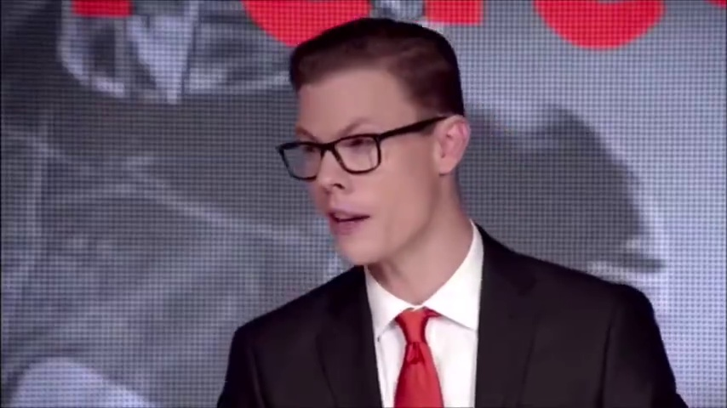
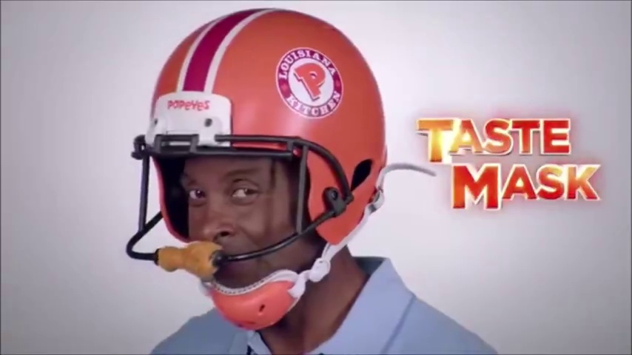
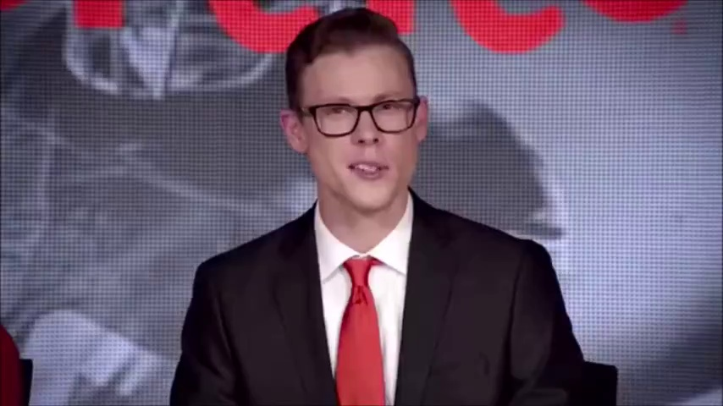


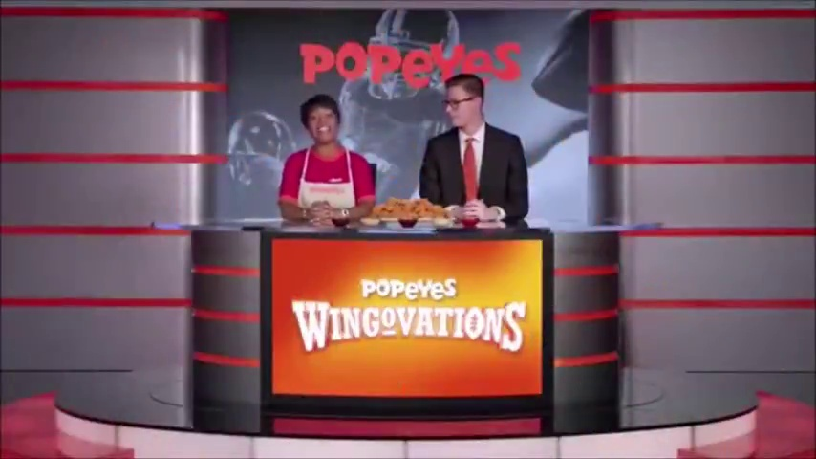
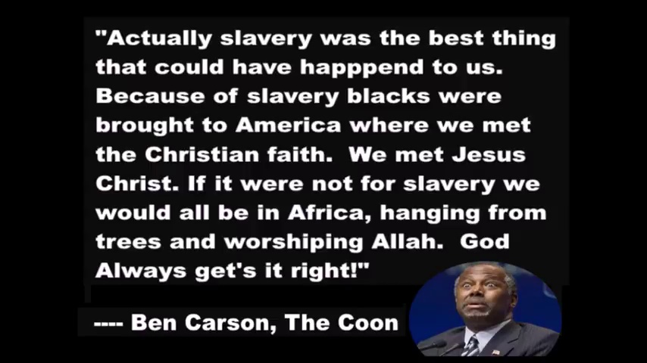

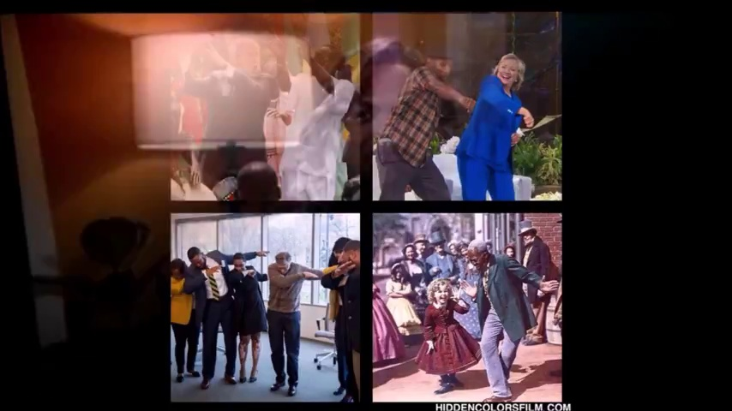

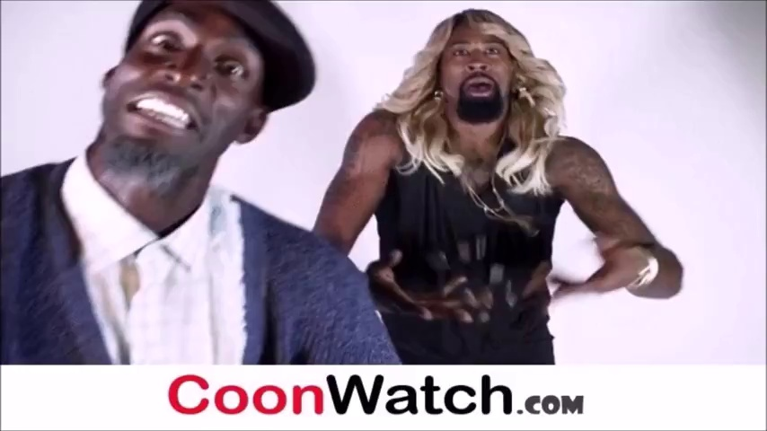
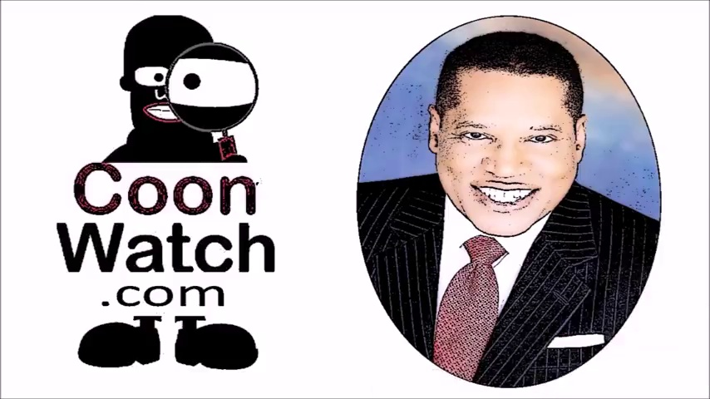




















1
2
3
4
5
6
7
8
9
10
11
12
13
14
15
16
$$I$$
$$A$$
Uniform Sampling of Video Frames
Audio-to-text Transcription
Multi-Stage Adversarial Reasoning
$$P^{obj}$$
Stage 1: Objective Description
Frames + Transcript : Describe what you observe in the video frames and transcript. Be comprehensive and detailed; NO analysis, interpretations, or value judgments.
Response1: The video sequence consists of multiple frames showcasing various scenes and elements, primarily centered around discussions, promotional content, and controversial statements related to race. Here's a detailed breakdown of each frame:...
$$D^{obj}$$
Stage 2: Hate Content Hypothesis Inference
Frames + Transcript : Analyze the video and transcript content under the ASSUMPTION that it contains hateful or offensive content. Identify evidence supporting hateful (offensive) interpretation: Evidence:…; Reasoning:…; and Confidence:… .
$$P^{hate}$$
Response2: The text in the video contains derogatory terms such as 'Coon' and 'Coon Shaming,' which are racial slurs used to demean Black people.", Reasoning: "The use of 'Coon' is a historically offensive term aimed at Black individuals, perpetuating racism by reducing them to stereotypes and derogatory caricatures.“ Confidence: 1
$$D^{hate}$$
Stage 3: Non-Hate Content Hypothesis Inference
Frames + Transcript : Analyze the video and transcript content under the ASSUMPTION that it dose NOT contains hateful or offensive content. Identify evidence supporting non-hateful (non-offensive) interpretation: Evidence:…; Reasoning:…; and Confidence:… .
$$P^{non}$$
Response3: "The phrase 'CoonWatch' suggests an intent to expose or critique rather than perpetuate harmful stereotypes. Reasoning: "The content seems to operate within a framework of satire or commentary, potentially critiquing behaviors or statements rather than targeting individuals based on identity. The use of 'CoonWatch' implies a focus on exposing problematic behavior rather than engaging in hate speech. Confidence: 0.4
$$D^{non}$$
$$P^{meta}$$
Stage 4: Meta-Analytical Synthesis
Frames + Transcript + Response1 + Response2 + Response3: Conduct critical analysis and make final determination: Label (0/1), Factors:…; Reasoning:…; and Confidence:…
Response4: Label: 1, Confidence: 0.95, Key factors: Use of derogatory racial slurs such as 'Coon' and 'Coon Shaming', which are historically offensive and demeaning“,”Implied racial hierarchy where acceptance and well-being are dependent on approval from white people, supporting white supremacy. Reasoning: "The explicit use of racial slurs and the promotion of discriminatory attitudes towards Black individuals outweigh any potential satirical intent."
$$D^{meta}$$
$R^{non\backslash hate\backslash final}$
Evidence: Describe specific evidence supporting the hateful/non-hateful nature of the content. Reasoning: Explain why it is hateful/non-hateful content or your decision.
Confidence: Your confidence in this interpretation or this decision [0-1]. Factors: The decisive elements that determined your judgment.
$E^{non\backslash hate}$
${conf}^{non\backslash hate\backslash final}$
$K^{factors}$

Slide 2
1
2
3
4
5
6
7
8
9
10
11
12
13
14
15
16
Response4：Label: 1；Confidence: 0.95;
Factors: Use of derogatory racial slurs such as 'Coon' and 'Coon Shaming', which are historically offensive and demeaning.", "Implied racial hierarchy where acceptance and well-being are dependent on approval from white people, supporting white supremacy”.
Reasoning: The explicit use of racial slurs and the promotion of discriminatory attitudes towards Black individuals outweigh any potential satirical intent. These elements directly contribute to racial harm and perpetuate stereotypes, making the content hateful in nature;

Slide 3
Stage 1: Objective Description
Frames + Transcript : Describe what you observe in the video frames and transcript. Be comprehensive and detailed; NO analysis, interpretations, or value judgments.
Stage 2: Hate Content Hypothesis Inference
Frames + Transcript : Analyze the video and transcript content under the ASSUMPTION that it contains hateful or offensive content. Identify evidence supporting hateful (offensive) interpretation: Evidence:…; Reasoning:….
Stage 3: Non-Hate Content Hypothesis Inference
Frames + Transcript : Analyze the video and transcript content under the ASSUMPTION that it dose NOT contains hateful or offensive content. Identify evidence supporting non-hateful (non-offensive) interpretation: Evidence:…; Reasoning:….

Slide 4
Stage 2: Hate Content Hypothesis Inference
Frames + Transcript : Analyze the video and transcript content under the ASSUMPTION that it contains hateful or offensive content. Identify evidence supporting hateful (offensive) interpretation: Evidence:…; Reasoning:….

Slide 5
Stage 3: Non-Hate Content Hypothesis Inference
Frames + Transcript : Analyze the video and transcript content under the ASSUMPTION that it dose NOT contains hateful or offensive content. Identify evidence supporting non-hateful (non-offensive) interpretation: Evidence:…; Reasoning:….

